Slide 1


IFW Frame Grabber Toolkit - FGF
J. Knudstrup, M. Kiekebusch, C. Moins

Slide 2
Purpose, Scope & Motivation
Camera interfacing often a bit ‘tricky’.
Not desirable to have
  proprietary SDKs,
  specific hardware solutions,
on the instrument WS.
Represents a problem for updating the IWS’.
Not interested in too many special hardware solutions for mapping the control and image transfer via the control networks.
Advantageous to decouple the specific camera interfacing (HW/SW) from the IWS main deployment.

Slide 3
Purpose, Scope & Motivation – cont’d
A solution: A software frame grabber, deployed on a dedicated ‘frame grabber box’ (=Linux machine).
Based on a small SDK provided by IFW to integrate SW Frame Grabber solutions:
IFW - Frame Grabber Framework – FGF
Can be deployed on a small Linux box (industrial grade, normally passively cooled).
Located near camera => no need for long cabling.
Control and image transfer via standard control network infrastructure.
Lightweight and ‘simple’ to reduce overheads and latency to obtain good performance.
Assumption: After commissioning the FGF Box has been tested enough and can be left as a ‘black-box’ and shall never be updated.
  --- some considerations should be made regarding the inclusion of hot spares…
GitLab: https://gitlab.eso.org/ifw/ifw-fgf

Slide 4
The ENVision Interface
For the interfacing to the FGF, ELT standard protocols chosen:
  OPC UA for the control.
  RTMS for the image transfer.
This protocol named: “ESO Network Vision Protocol” – “ENVision”.
OPC UA interface inspired by the interface used by the PLC Controllers.
No standalone specification, but specification contained in the FGF user manual.
Makes it possible to use
  off-the-shelf OPC UA clients for controlling an FGF instance,
  existing RTMS receiver (applications) for receiving the data.
ENVision Communication Adapter provided for CCF.

Slide 5
The ENVision Interface – OPC UA Interface
Relatively few standard nodes.
Four categories of nodes:
  Standard control nodes (10)
  Standard Status (14)
  Standard Methods (4)
  Application specific nodes.
Node | Type | Description
ctrl.lrExpoTime | Double | Set the exposure time, applied during the frame acquisition. Given in seconds. Valid range: 1E-6..oo.
ctrl.lrFrameRate | Double | Set the desirable frame rate in Hz. The frame rate may be constraint by the exposure time. The node “stat.lrFrameRate” indicates the actual frame rate obtained/applied.
ctrl.nBinX | Integer | Set binning in X to apply during the acquisition. Valid range => 1; the upper limit is defined by the ROI width (“ctrl.win.nWidth”).
. . . | . . . | . . .
Node | Type | Description
stat.lrFrameRate | Float | Frame rate in frames per second (Hz) currently obtained.
stat.nFrameCounter | Integer | Indicates the number of frames acquired since the last “RpcStart”.
stat.nWidth | Integer | The width of the window read out. Given in pixels. Valid range: 1..<chip width>.
stat.nHeight | Integer | The height of the window read out. Given in pixels. Valid range: 1..<chip height>.
. . . | . . . | . . .
Node | Type | Description
rpc.Reset | Input: None Output: Return value (Int16) | Reset the frame grabber, triggering it to carry out a transition to “NotReady”. It may either remain in this state, until “rpc.Init” is submitted or it may auto-transition to “Initialising”, if the Auto-Init-Feature is enabled.
rpc.Start | Input: <start time <ISO8601> | “”. Output: Return value (Int16) | Start the frame acquisition. If no ISO8601 time stamp is given (= empty string), this means that the acquisition shall start immediately.
rpc.Stop | Input: None Output: Return value (Int16) | Stop the frame acquisition.

Slide 6
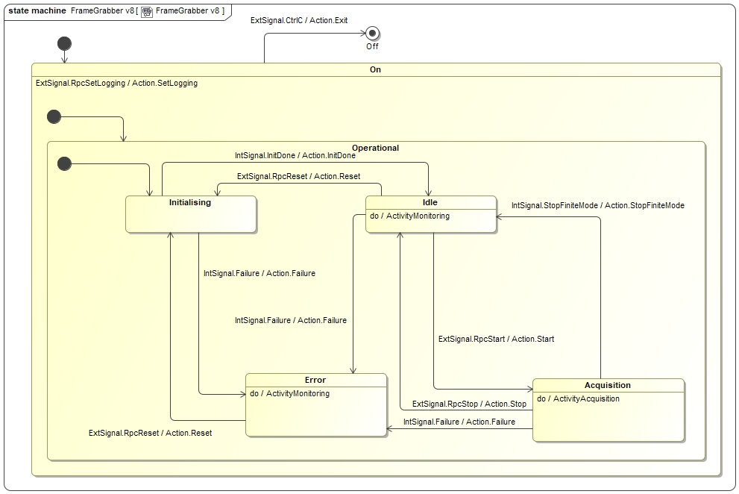
The ENVision Interface – State Machine

Slide 7
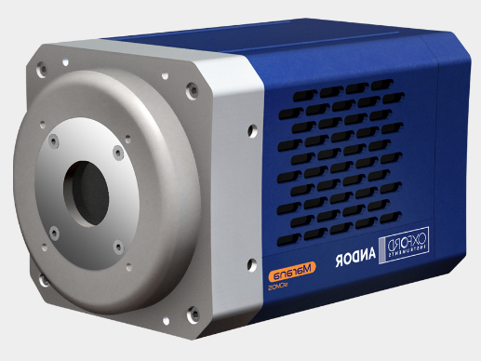
Architecture
No dependency on CII.
Compiled with WAF.
Multiple RTMS sender threads.
RTC
RTMS Packaging Threads
Acquisition Thread
RTMS Packaging Threads
CCF Envision
FGF Com Adapter
RTMS Publisher Thread
CameraLink Interface (PCIe)
Camera SDK
OPC UA Server
UAExpert
FGF Box
FGF Andor

Slide 8
Integration with IFW CCF
CCF Communication Adapter provided for ENVision.
Using the ifw-core OPC UA client (based on open62541).
Using ‘old’ ELT MUDPI/RTMS libraries.
In the process of moving to new MUDPI/RTMS implementation: “llnetio”.
Used for
    controlling the camera,
    displaying in DDT,
    storing in FITS files.
  For high performance applications a separate RTMS receiver may be used (RTC).
  Acceptable performance obtained: Andor Marana – 2560 x 2160 x 2 bytes - @50 Hz – MTU 9000 bytes.

Slide 9
Deliverables
OPC UA Namespace Generator:
  OPC UA nodes defined in a ‘proprietary’ YAML file (easy to edit by hand).
  Python based tool to invoke on the YAML definition to generate the OPC UA node creation code (C++): “fgfGenerator”.
Common Library:
  Library with ‘components’ to build an FGF application. Contains the basic communication adapter, to provide for specific cameras.
Simulator:
  Implements subclass of base com. adapter, which plays back a FITS image cube.
Specific Implementations:
  For the moment Andor cameras supported. Com. adapter based on Andor SDK.
Andor Simulator:
  Implements a simulator, via a subsclass of the FGF base com. adapter, based on the Andor SDK simulator.

Slide 10
OPC UA Namespace Generator
FGF Node Definition (YAML):
Cameras:
Sim:
stat:
lrExpoTime:
type: Double
val: 0.
perm: Read
var_comm_adapter_label: fgf::common::STAT_EXPO_TIME_STR
lrFrameRate:
type: Double
val: 0.
perm: Read
var_comm_adapter_label: fgf::common::STAT_FRAME_RATE_STR
…
ctrl:
lrExpoTime:
type: Double
val: 0
perm: Write
var_comm_adapter_label: fgf::common::CTRL_EXPO_TIME_STR
lrFrameRate:
type: Double
val: 0
perm: Write
var_comm_adapter_label: fgf::common::CTRL_FRAME_RATE_STR
…
$ fgfGenerator -i sim/server/resource/config/fgf/sim/fgNodeSet.yaml -t tmp -c fgf::sim::CommAdapter -s ifw/fgf/sim/commAdapter.hpp -o ifw/fgf/sim
Source files are ('nodeset.hpp', 'nodeset.cpp', 'callbacks.hpp', 'callbacks.cpp’)
$ less tmp/nodeset.cpp
#include <ifw/fgf/sim/nodeset.hpp>
#include <ifw/fgf/sim/callbacks.hpp>
/* Cameras - ns=1;i=5001 */
static UA_StatusCode function_nodeset_0_begin(UA_Server *server, UA_UInt16* ns) {
UA_StatusCode retVal = UA_STATUSCODE_GOOD;
UA_ObjectAttributes attr = UA_ObjectAttributes_default;
char empty[]="";
attr.displayName = UA_LOCALIZEDTEXT_ALLOC(empty, "Cameras");
UA_QualifiedName qualifiedName = UA_QUALIFIEDNAME_ALLOC(ns[1], "Cameras");
retVal |= UA_Server_addNode_begin(server, UA_NODECLASS_OBJECT,
UA_NODEID_NUMERIC(ns[1], 5001),
UA_NODEID_NUMERIC(ns[0], 85LU),
UA_NODEID_NUMERIC(ns[0], UA_NS0ID_ORGANIZES),
qualifiedName,
UA_NODEID_NUMERIC(ns[0], UA_NS0ID_FOLDERTYPE),
…

Slide 11
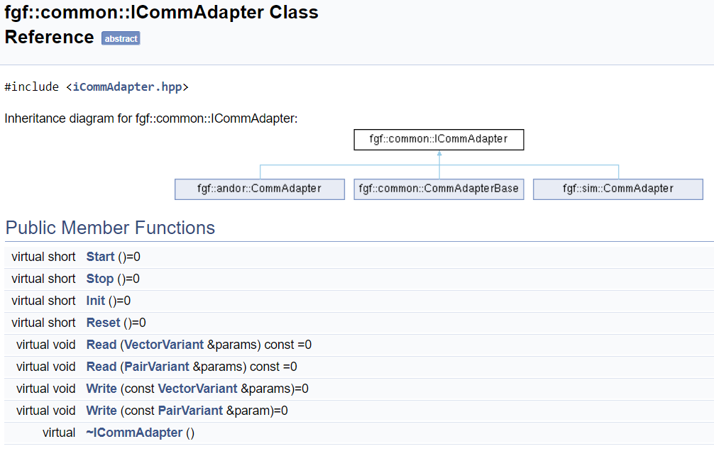
Common Part – Base Communication Adapter

Slide 12
FGF Simulator
Application implementing the ENVision interface, based on the FGF Common Library.
Can be used to play back FITS cubes.
Provides the same functionality as a ‘real’ FGF server (OPC UA interface, data publishing via RTMS).
Supports basic features: Windowing, exposure time/frame rate.
$ fgfSim -h
Options:
-h [ --help ] Print help messages
-a [ --address ] arg (=127.0.0.1) RTMS source IP address
-p [ --port ] arg (=59000) network port
-n [ --netif ] arg network interface to be used
-s [ --fits-file ] arg FITS filename to be used for the simulation
-f [ --log-prop-file ] arg Log property filename
-l [ --log-level ] arg (=ERROR) Log level: ERROR, INFO, DEBUG, TRACE
--list-loggers List defined loggers and exit
$ fgfSim -a 127.0.0.1 -p 59000 -n 127.0.0.1 -s /scratch/jknudstr/INTROOT/resource/image/ccf/control/testCubeUint16_512x512.fits -l INFO
INFO - Starting application...
INFO - Cube number of planes: 10
INFO - Image BPP: 2
INFO - Image width: 512
INFO - Image height: 512
INFO - Acquisition Thread started
INFO - Acquisition waiting...
. . .

Slide 13
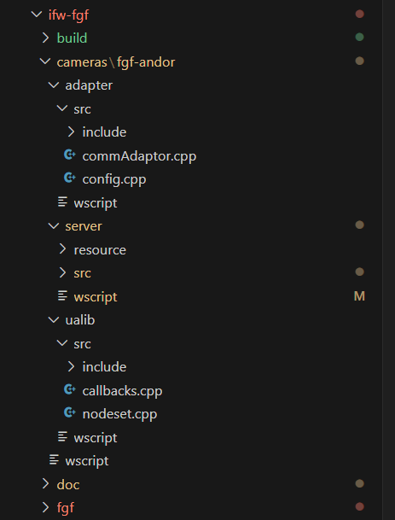
Deployment Module
FGF Communication Adapter
FGF Executable
OPC UA Namespace management
(generated code)

Slide 14
Use Cases so far…
Deployments for the following implemented so far:
  Andor Marana, Andor Balor (Andor SDK).
    In use for the PDS.
  Andor Simulator (Andor SDK).
  FGF Simulator – internal simulation in communication adapter.
  Possible relevant use case: Convert GigE Vision data stream to RTMS.

Slide 15
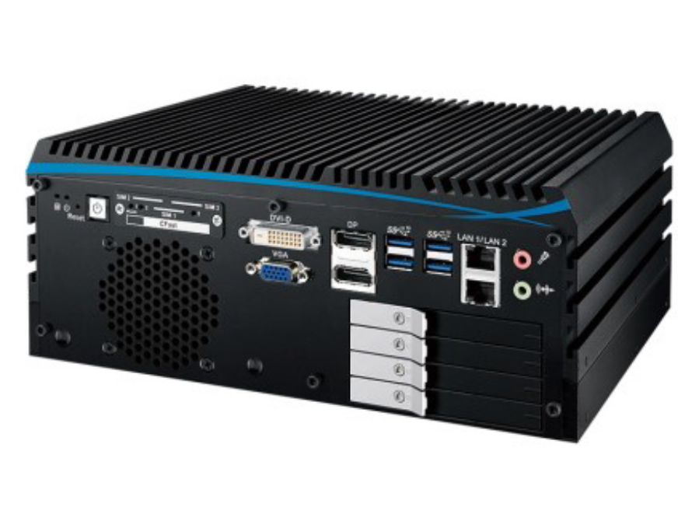
Hardware Setup (PDS) – Example!
Specifications:
Model ECX-1320A from vendor Vecow (Plug-in Electronic GmbH).
Fanless, ‘industrial’ PC.
Intel Xeon I5-9500TE CPU, 6 x 2.2 GHz
PCIe card 10Gb SFP -2 channels (FE-1071)
PCIe card CoaXPress 4 Lane CXP-6 (BitFlow)
8 GB RAM
500 GB SSD.

Slide 16
Performance
  16x16 pixel, 2 BPP:
    Latency sending first packet: 490 micros
    Latency sending a frame: 690 micros
  256x256, 2 BPP:
    Latency sending first packet: 530 micros
    Latency sending a frame: 1650 micros
  512x512, 2 BPP:
    Latency sending first packet: 710 micros
    Latency sending a frame: 4700 micros
  Executed on an eltdev VM using FGF Simulator + CCF ENVision, loopback interface.
  Latency could be reduced by increasing level of concurrency or using e.g. FPGA technology to package and send RTMS packets – may be investigated further…

Slide 17
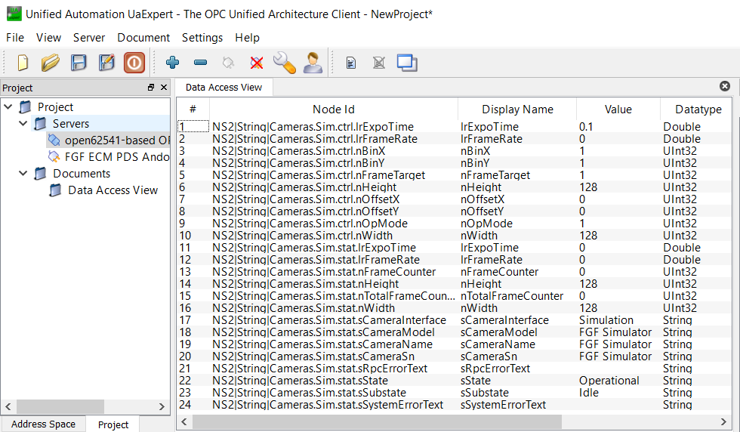
Usage – Example – Controlling via UAExpert
$ fgfSim -a 127.0.0.1 -p 59000 -n 127.0.0.1 -s /scratch/jknudstr/INTROOT/resource/image/ccf/control/testCubeUint16_512x512.fits -l WARN

Slide 18
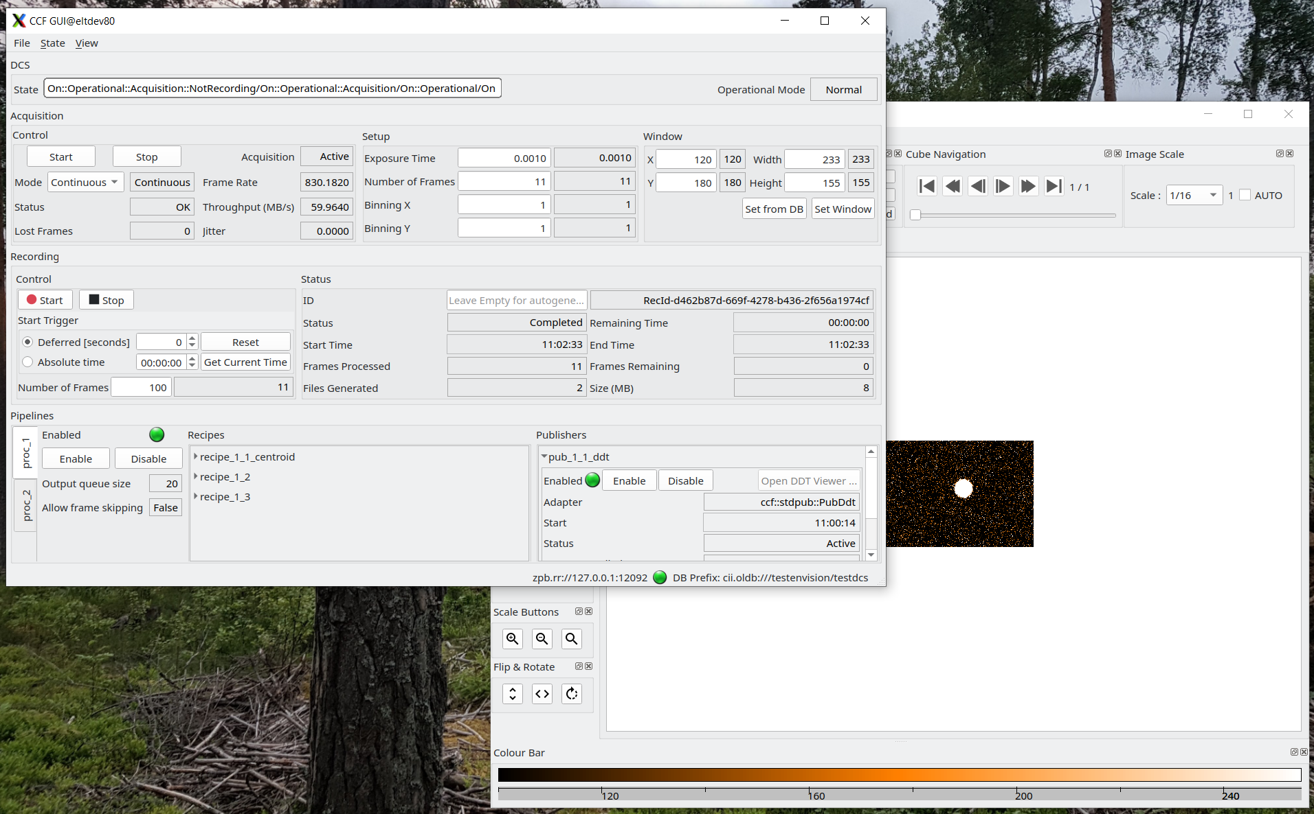
Usage – Example – Using with CCF ENVision (fgfSim)

Slide 19
J. Knudstrup – jknudstr@eso.org
M. Kiekebusch – mkiekebu@eso.org
Christophe Moins – cmoins@eso.org
@ESOAstronomy
@esoastronomy
@ESO
european-southern-observatory
@ESOobservatory

