Slide 1
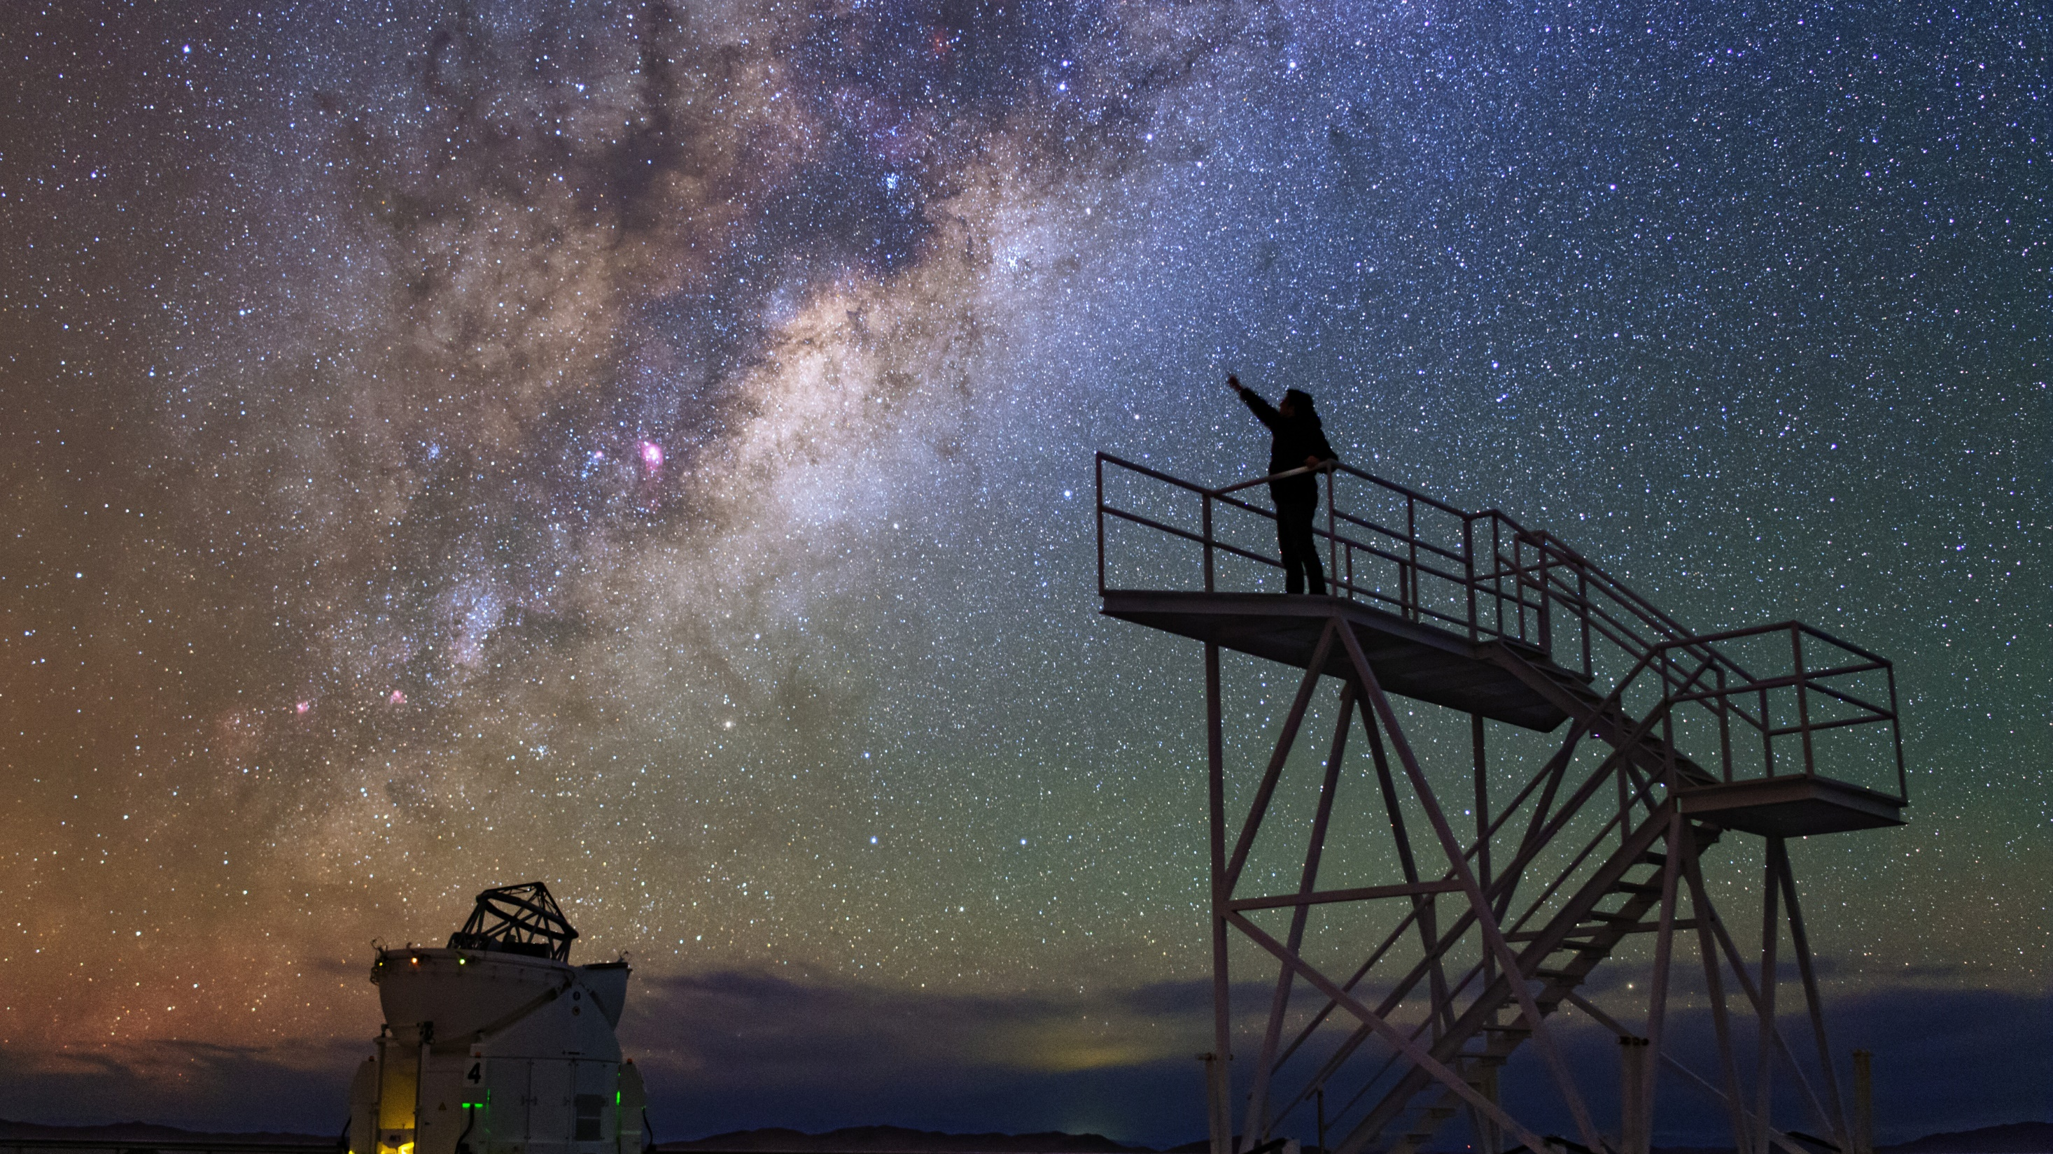


The European Southern Observatory
Add your name,
date and occasion
here or remove
Credit: ESO/B. Tafreshi (twanight.org)

Slide 2

This is ESO
Your Name, Date, Occasion

Slide 3
Introduction Questions and answers

Slide 4
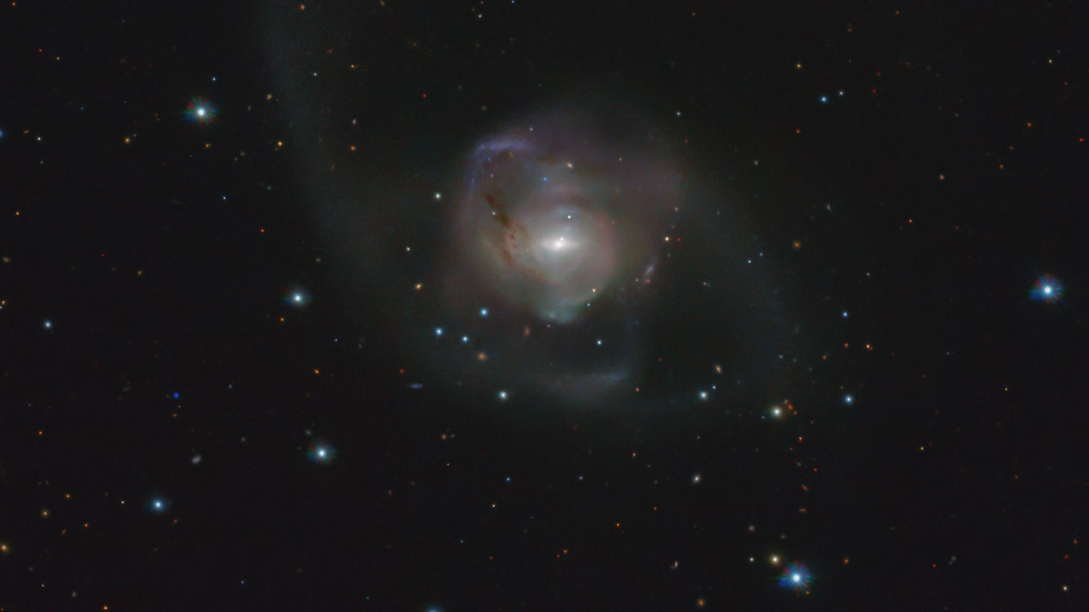
Credit: ESO/VST ATLAS team. Acknowledgement: Durham University/CASU/WFAU
How do we know
the expansion of the Universe is accelerating?

Slide 5
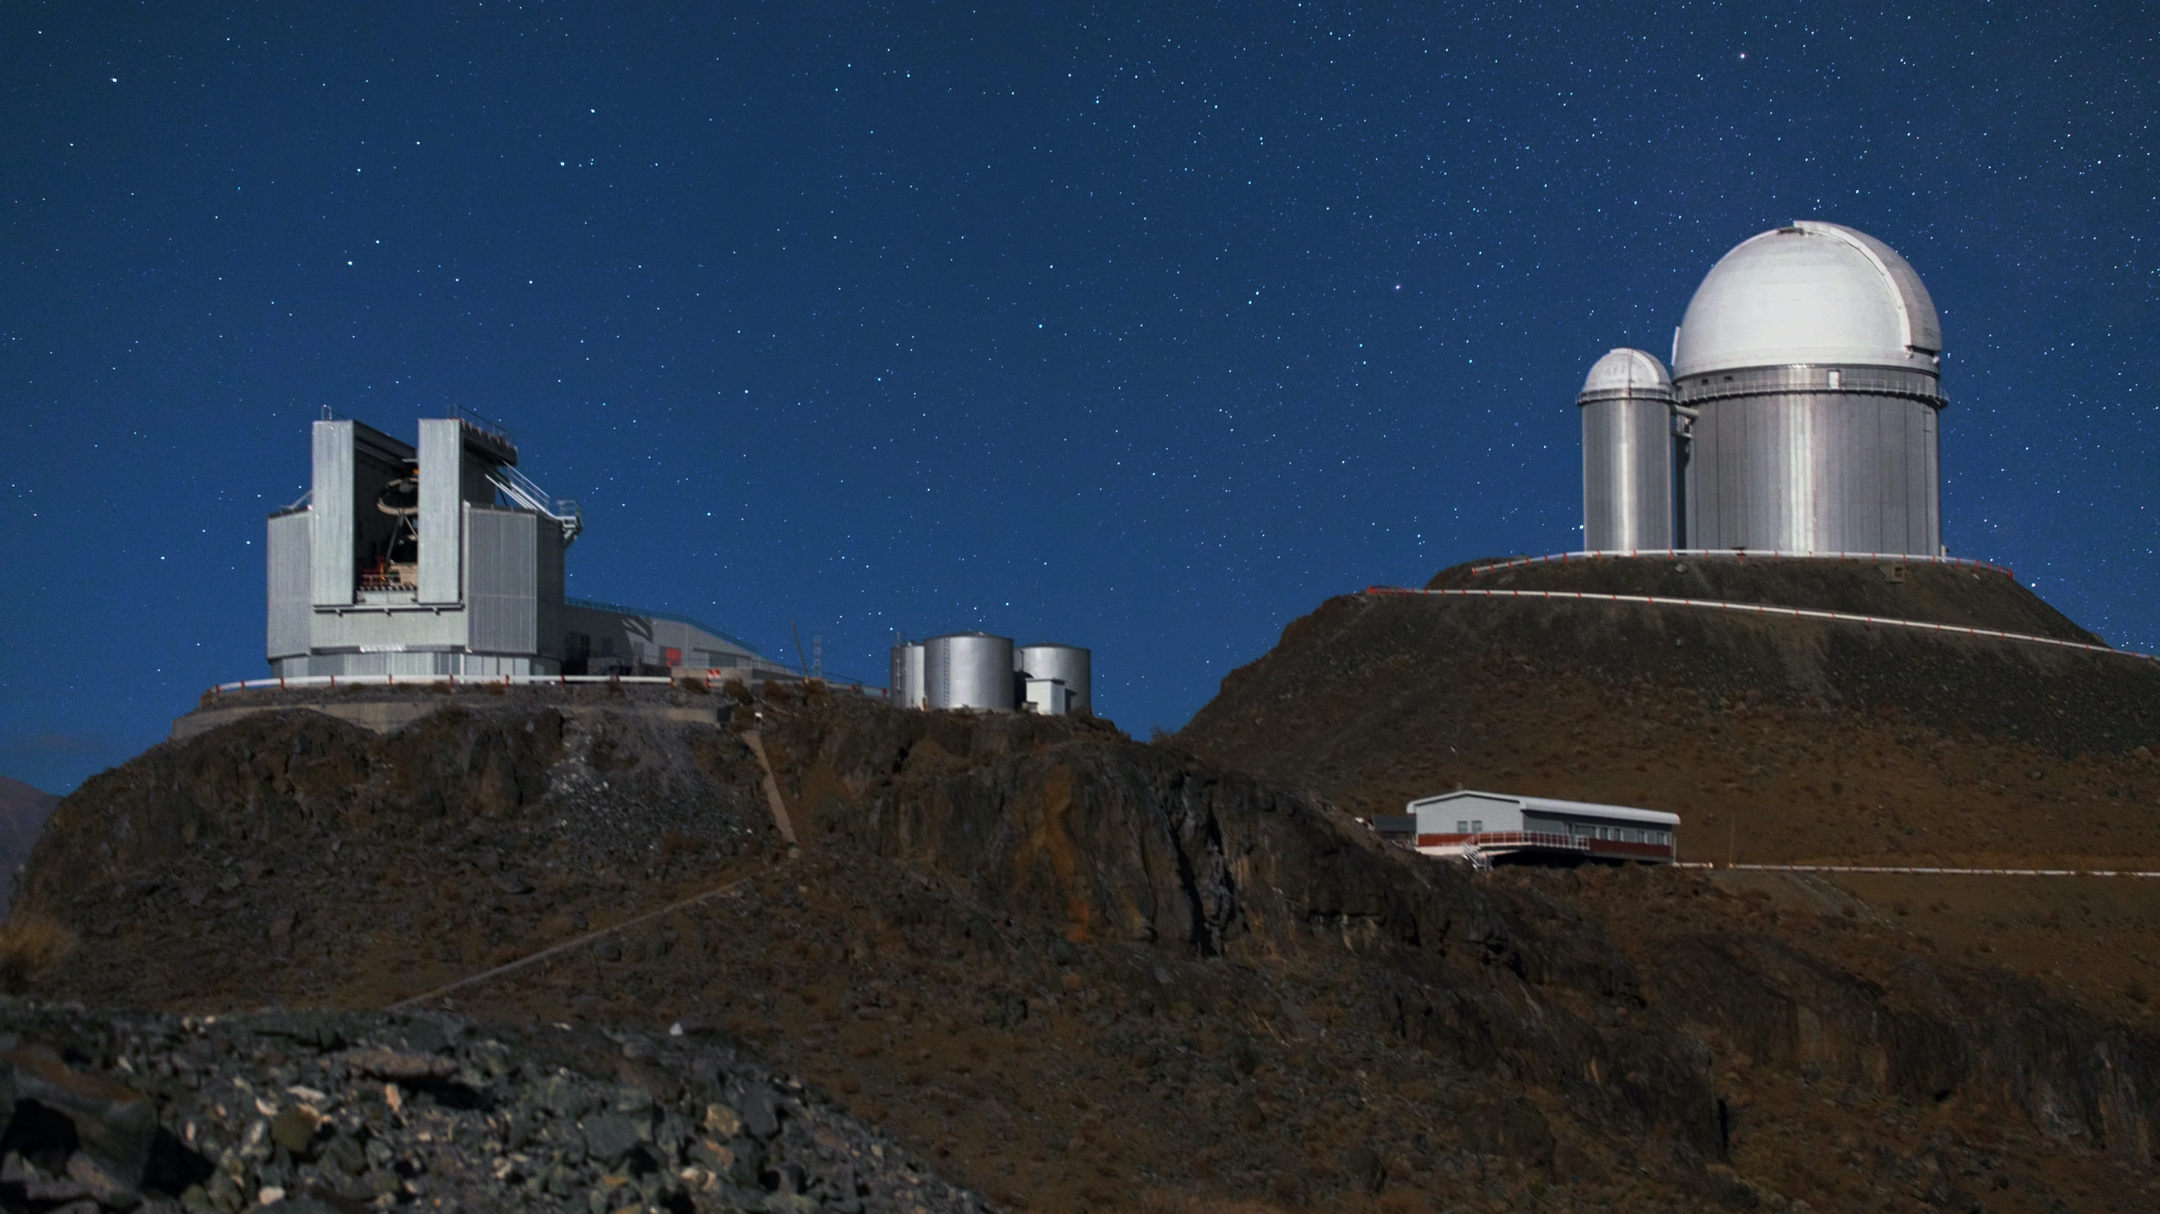
Credit: Y. Beletsky (LCO)/ESO
ESO’s NTT helped to discover the accelerating expansion of the Universe by making observations of distant supernovae
Nobel Prize in Physics 2011

Slide 6
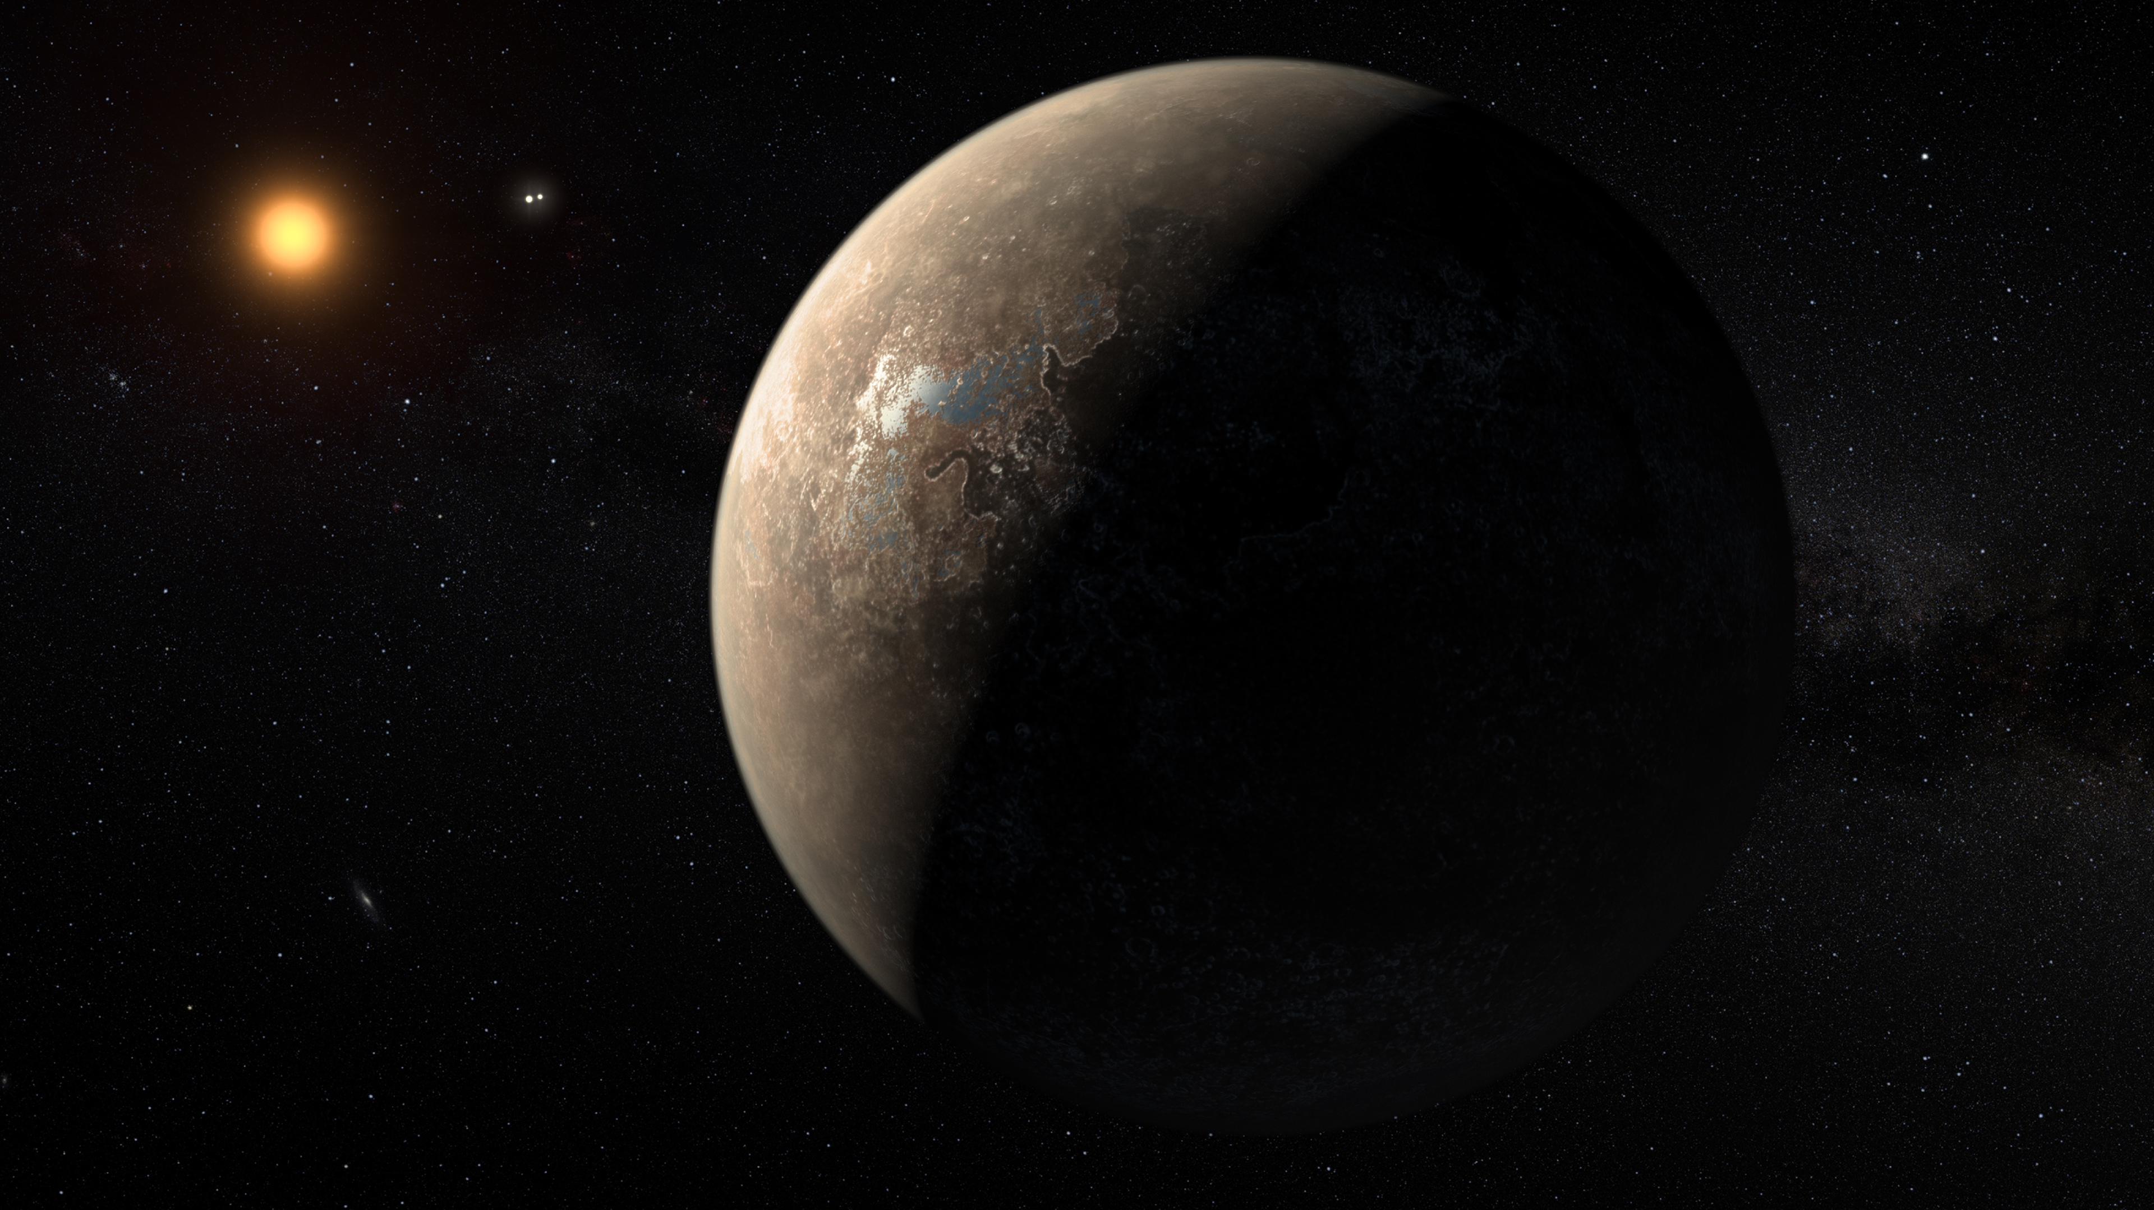
What planets are out there?
Credit: ESO/M. Kornmesser

Slide 7
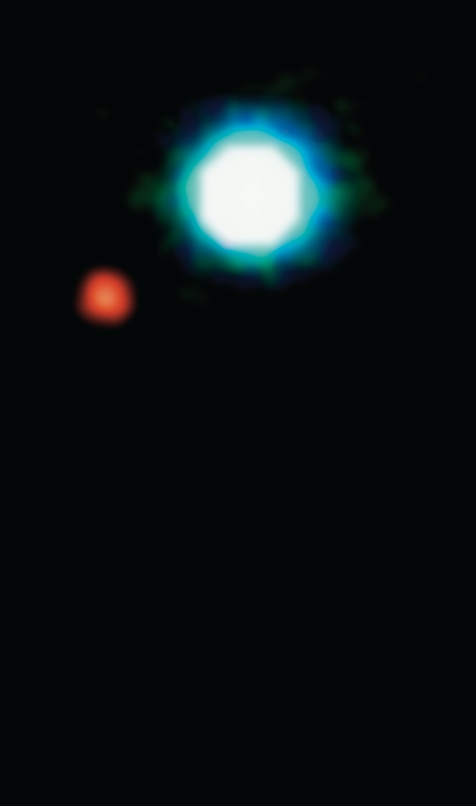
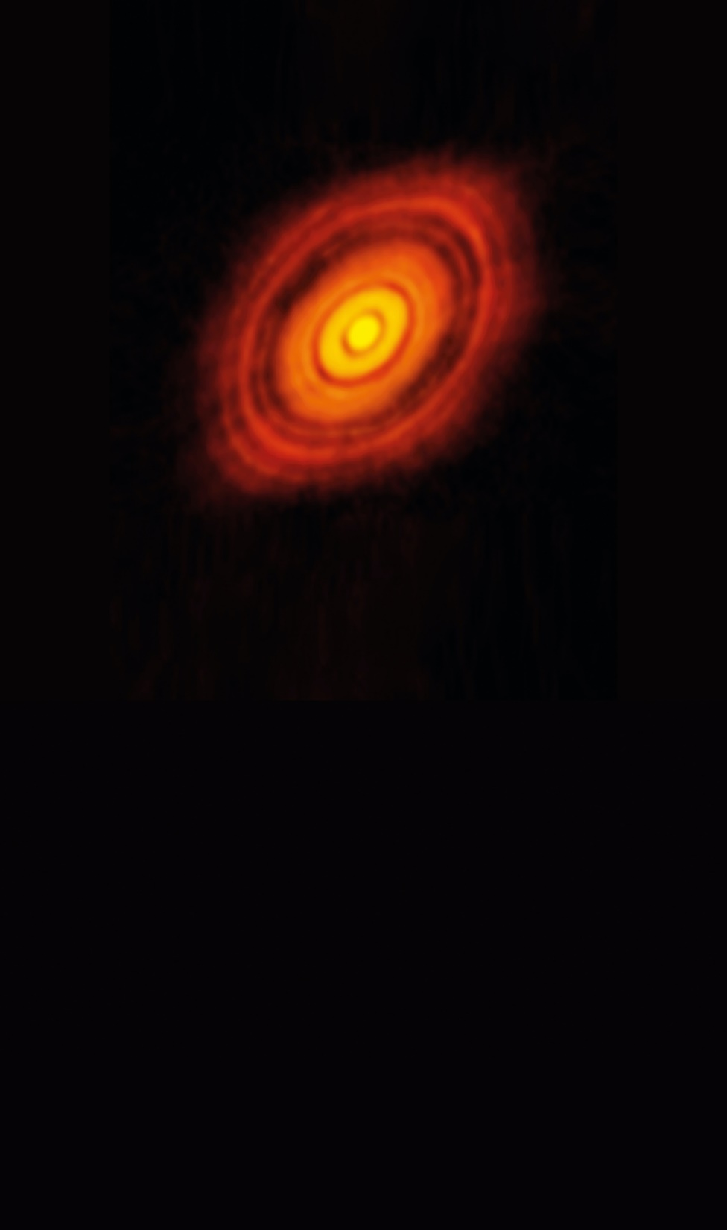
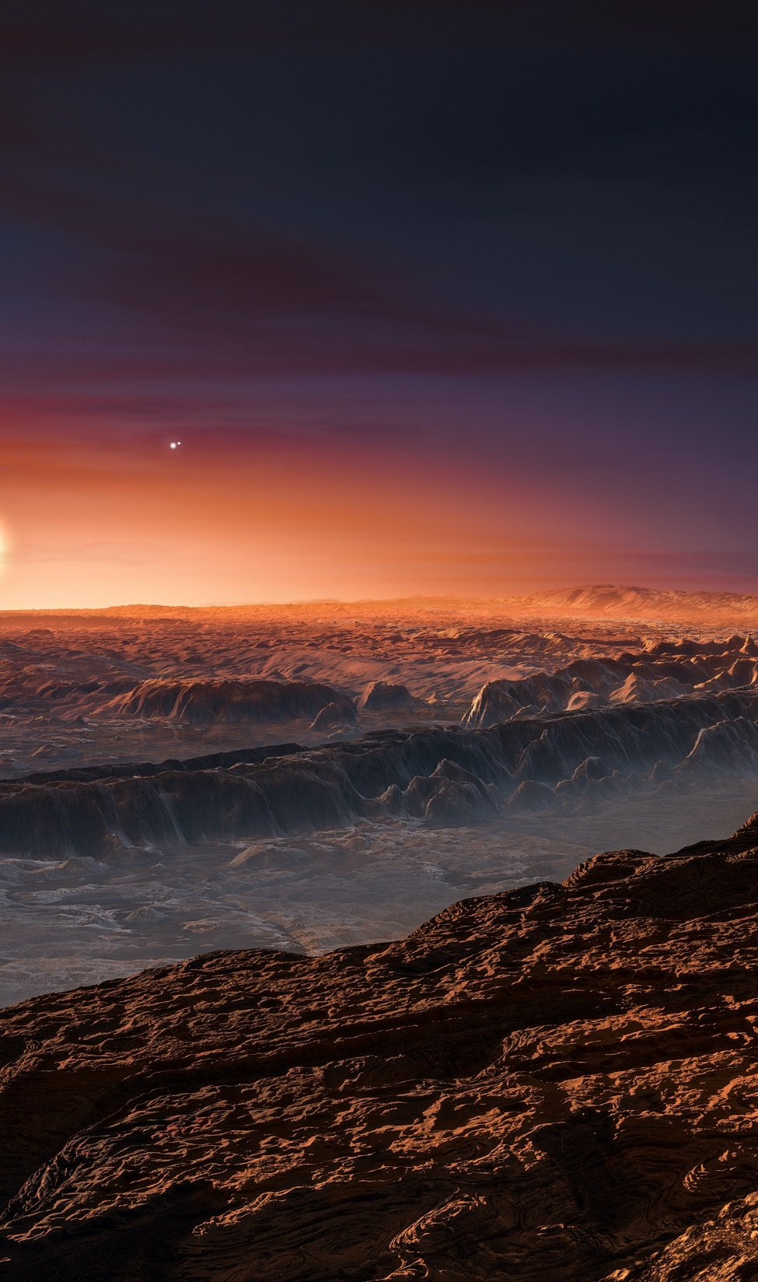
Credit: ALMA (ESO/NAOJ/NRAO)
Credit: ESO/M. Kornmesser
2004
ESOs VLT took the first direct image of a planet outside our Solar System
2014
ALMA imaged the birth of planets
2016
ESO’s 3.6-m telescope revealed that Proxima Centauri hosts a planet in its habitable zone

Slide 8
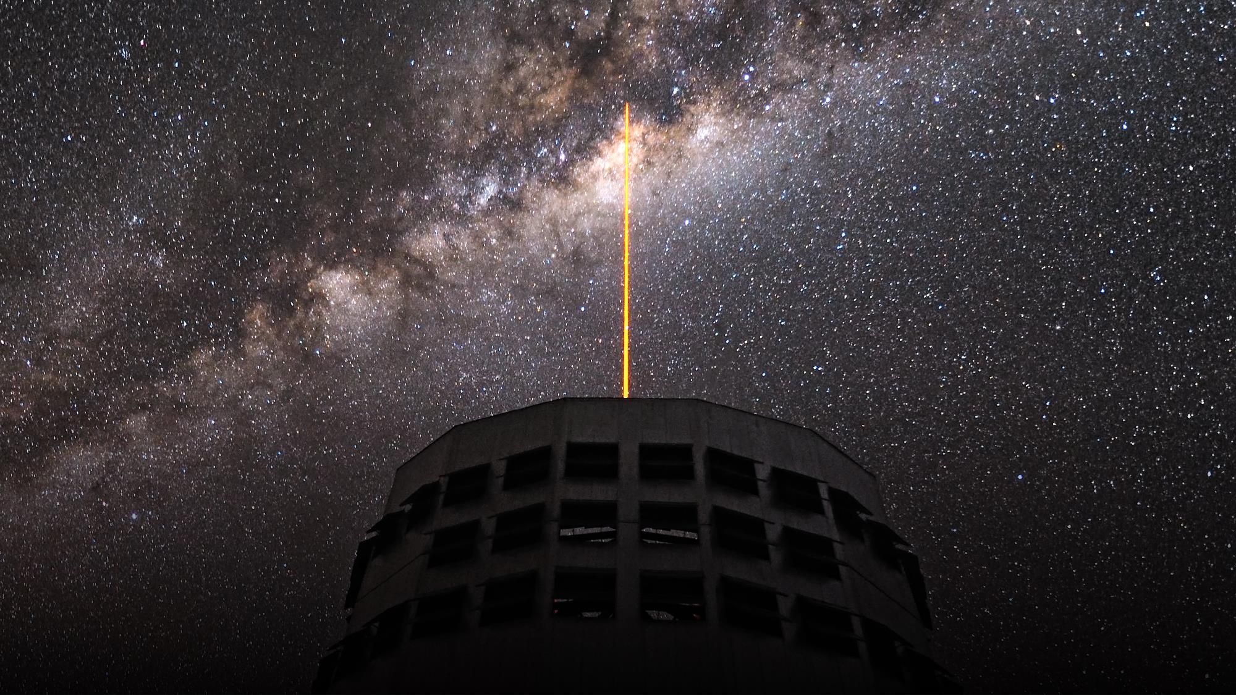
Credit: G. Hüdepohl (atacamaphoto.com)/ESO
How do we know
there is a black hole at the centre of our galaxy?

Slide 9
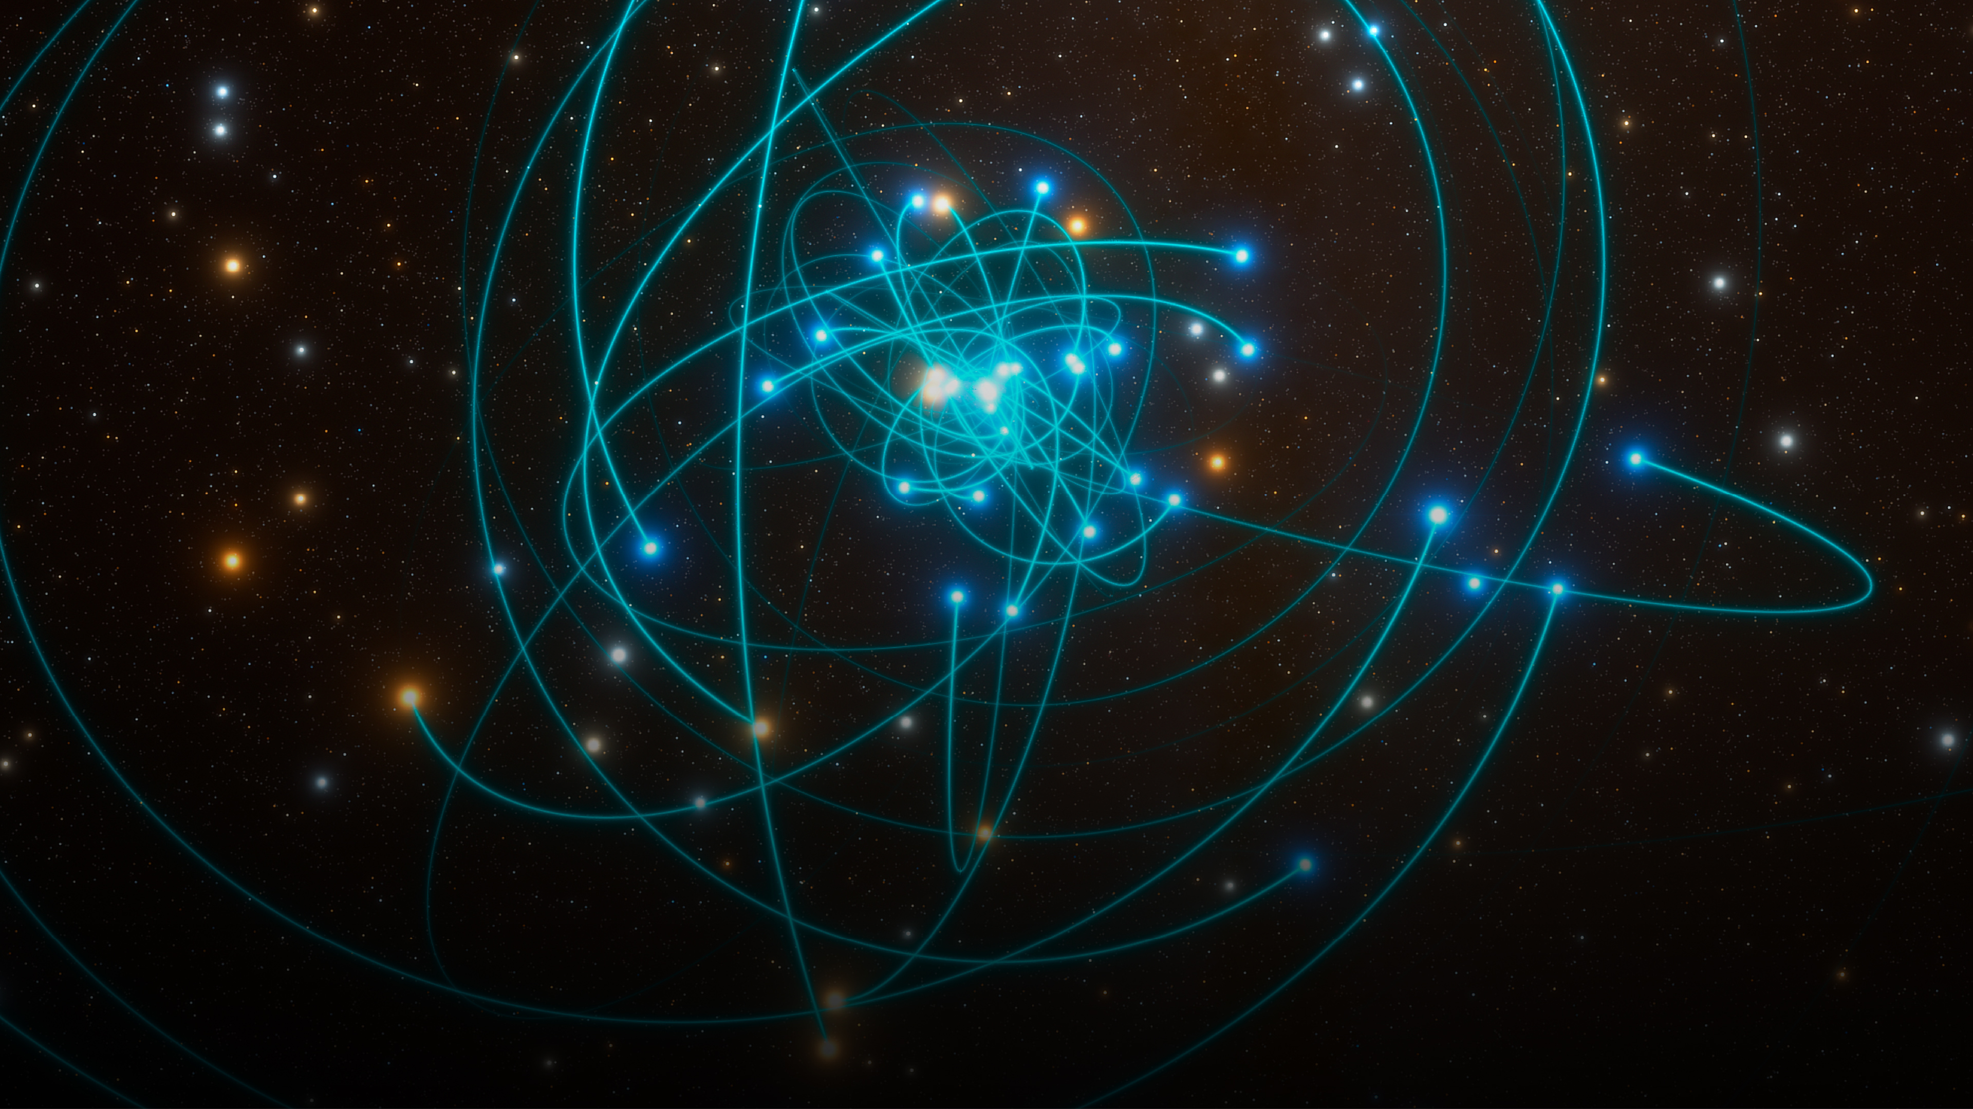
Credit: ESO/L. Calçada/spaceengine.org
30 years of observations with various ESO telescopes
led to the discovery of a supermassive compact object
at the centre of our galaxy
Nobel Prize in Physics 2020

Slide 10
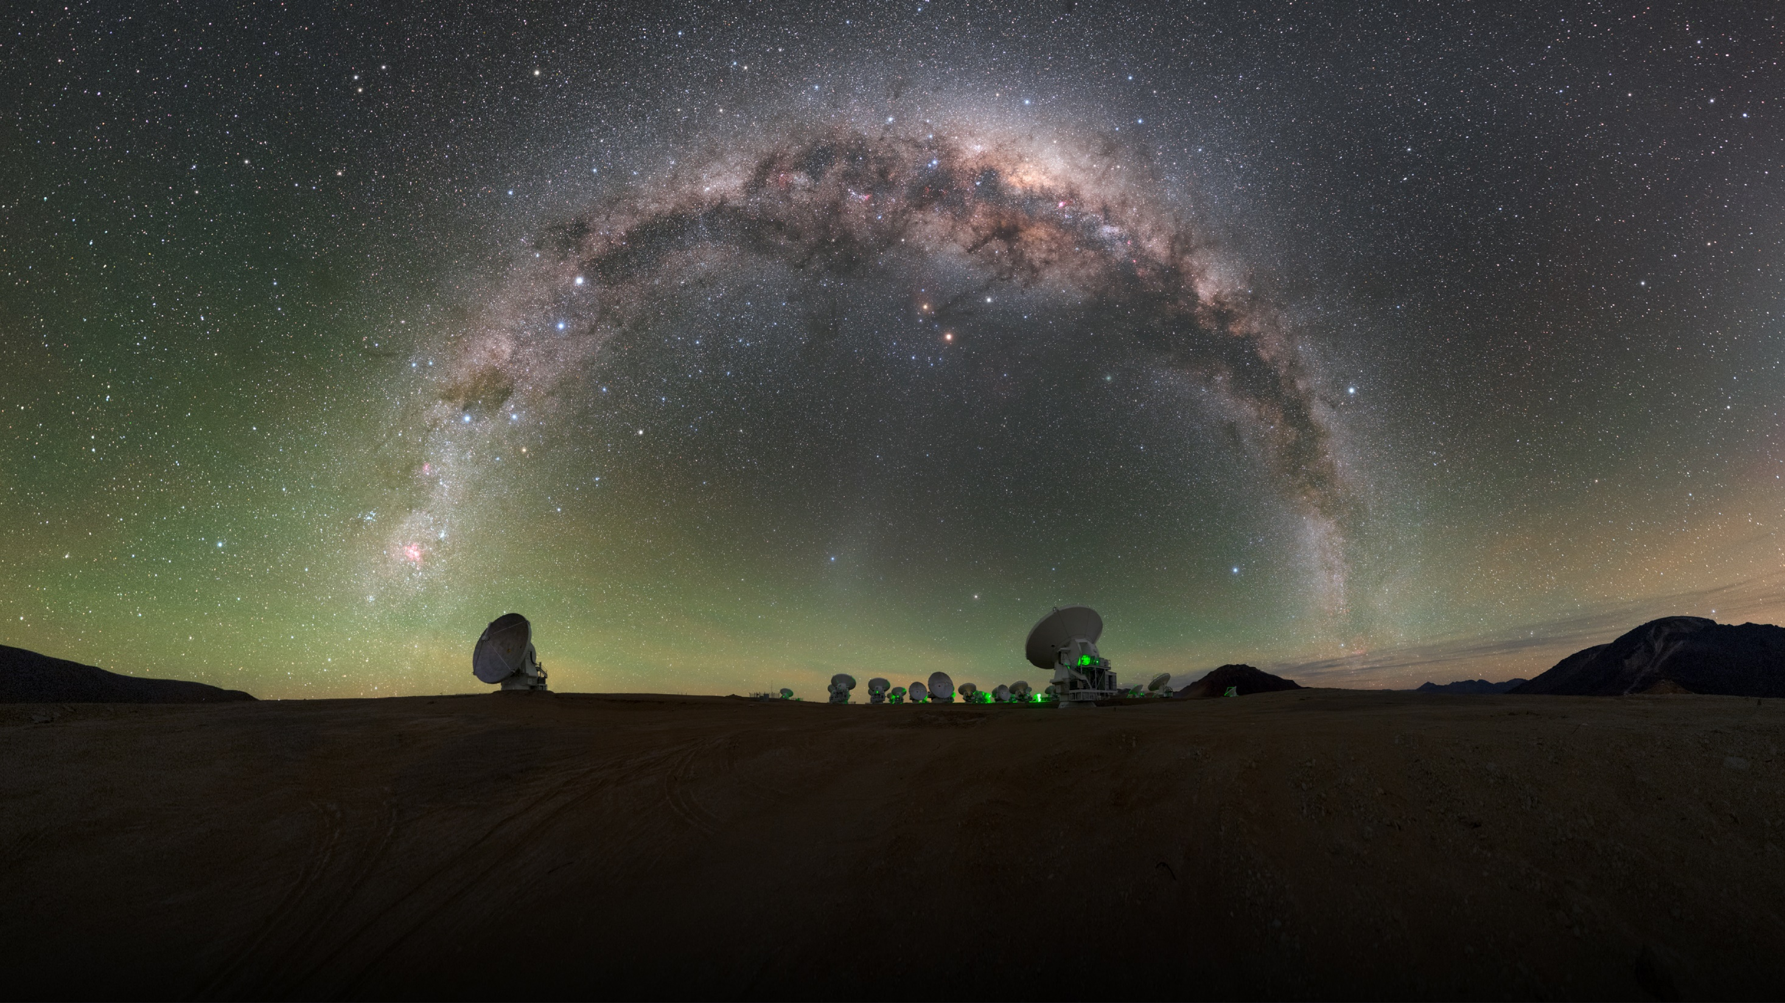
Credit: P. Horálek/ESO
And what does it look like?

Slide 11
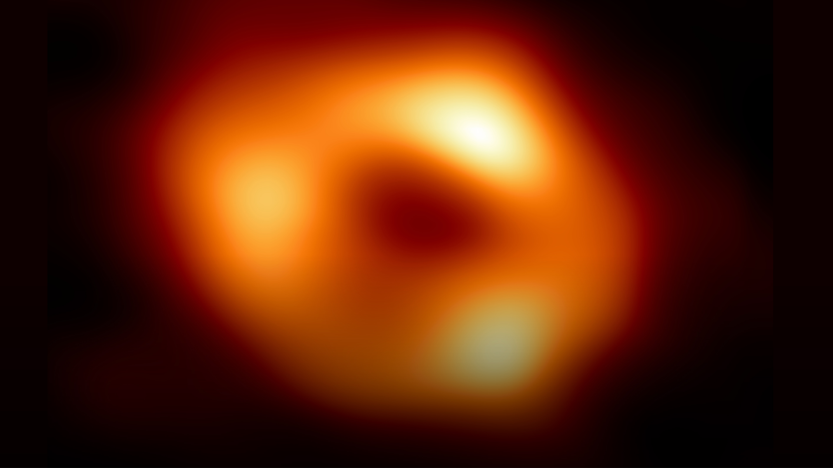
Credit: EHT Collaboration
2022
First image of Sagittarius A*
the black hole at the centre of the Milky Way

Slide 12
Astronomy Life, the Universe and everything

Slide 13
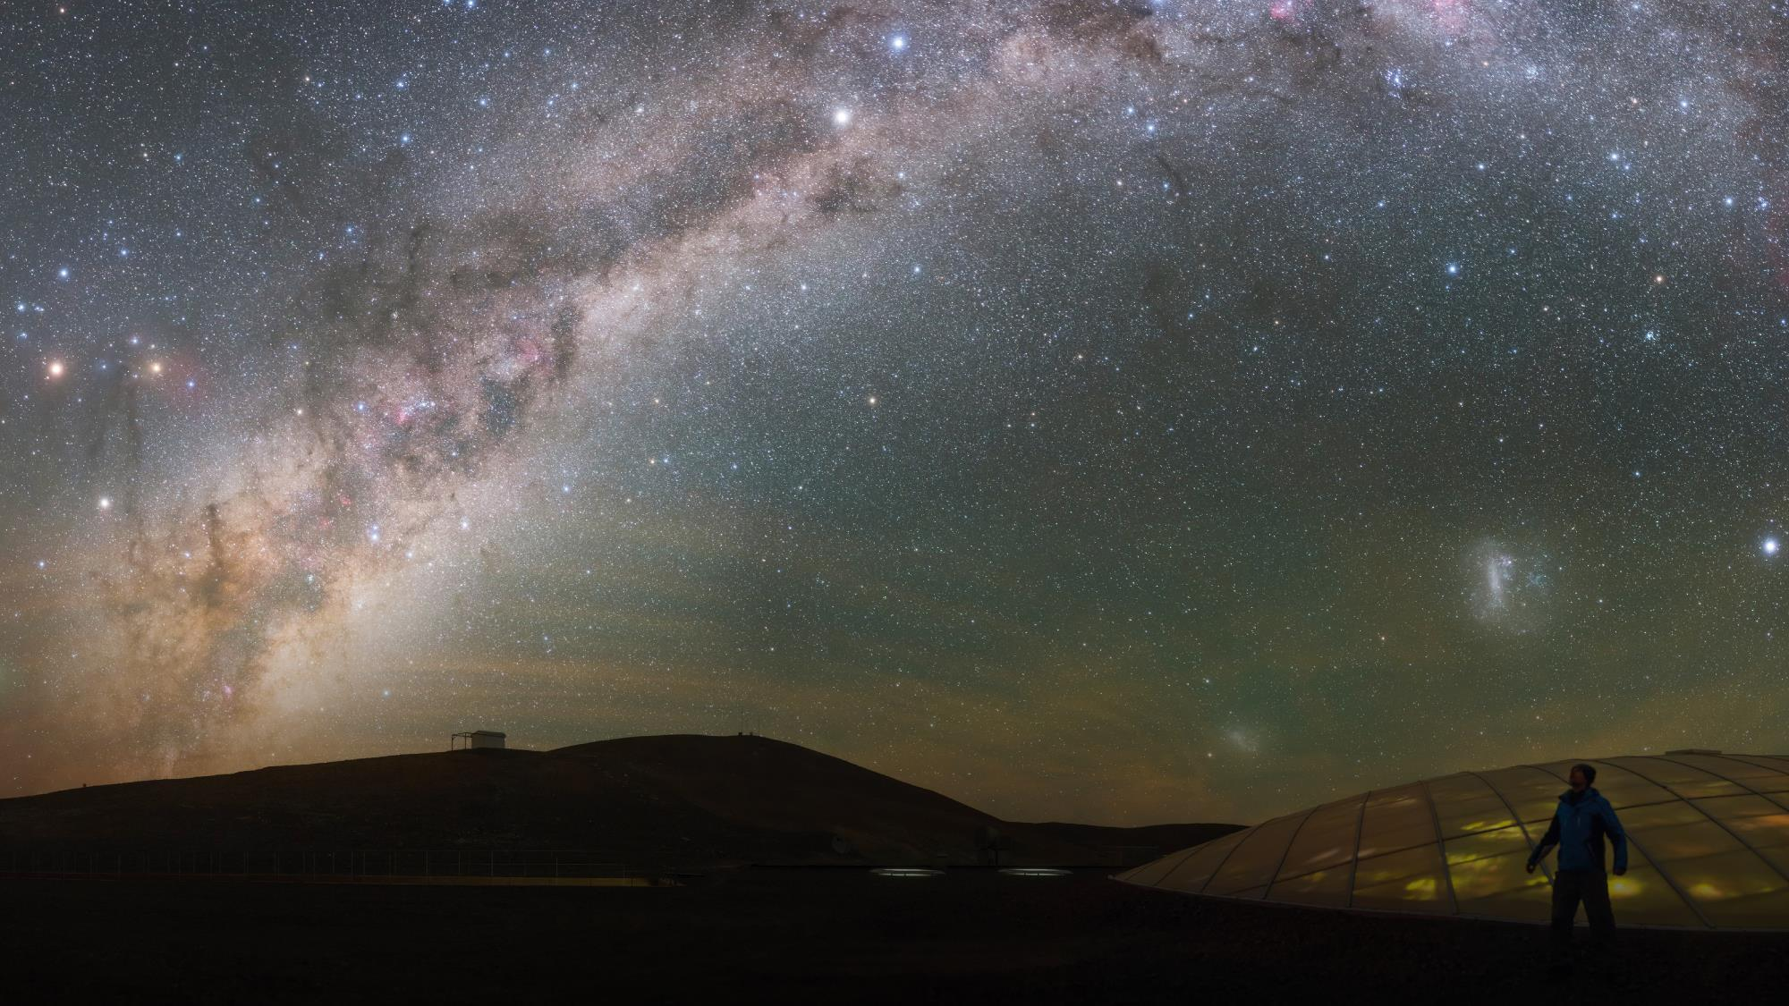
“Man must rise above Earth, to the top of the atmosphere and beyond, for only then will he fully understand the world in which he lives.”
Credit: ESO/P. Horálek
Socrates

Slide 14
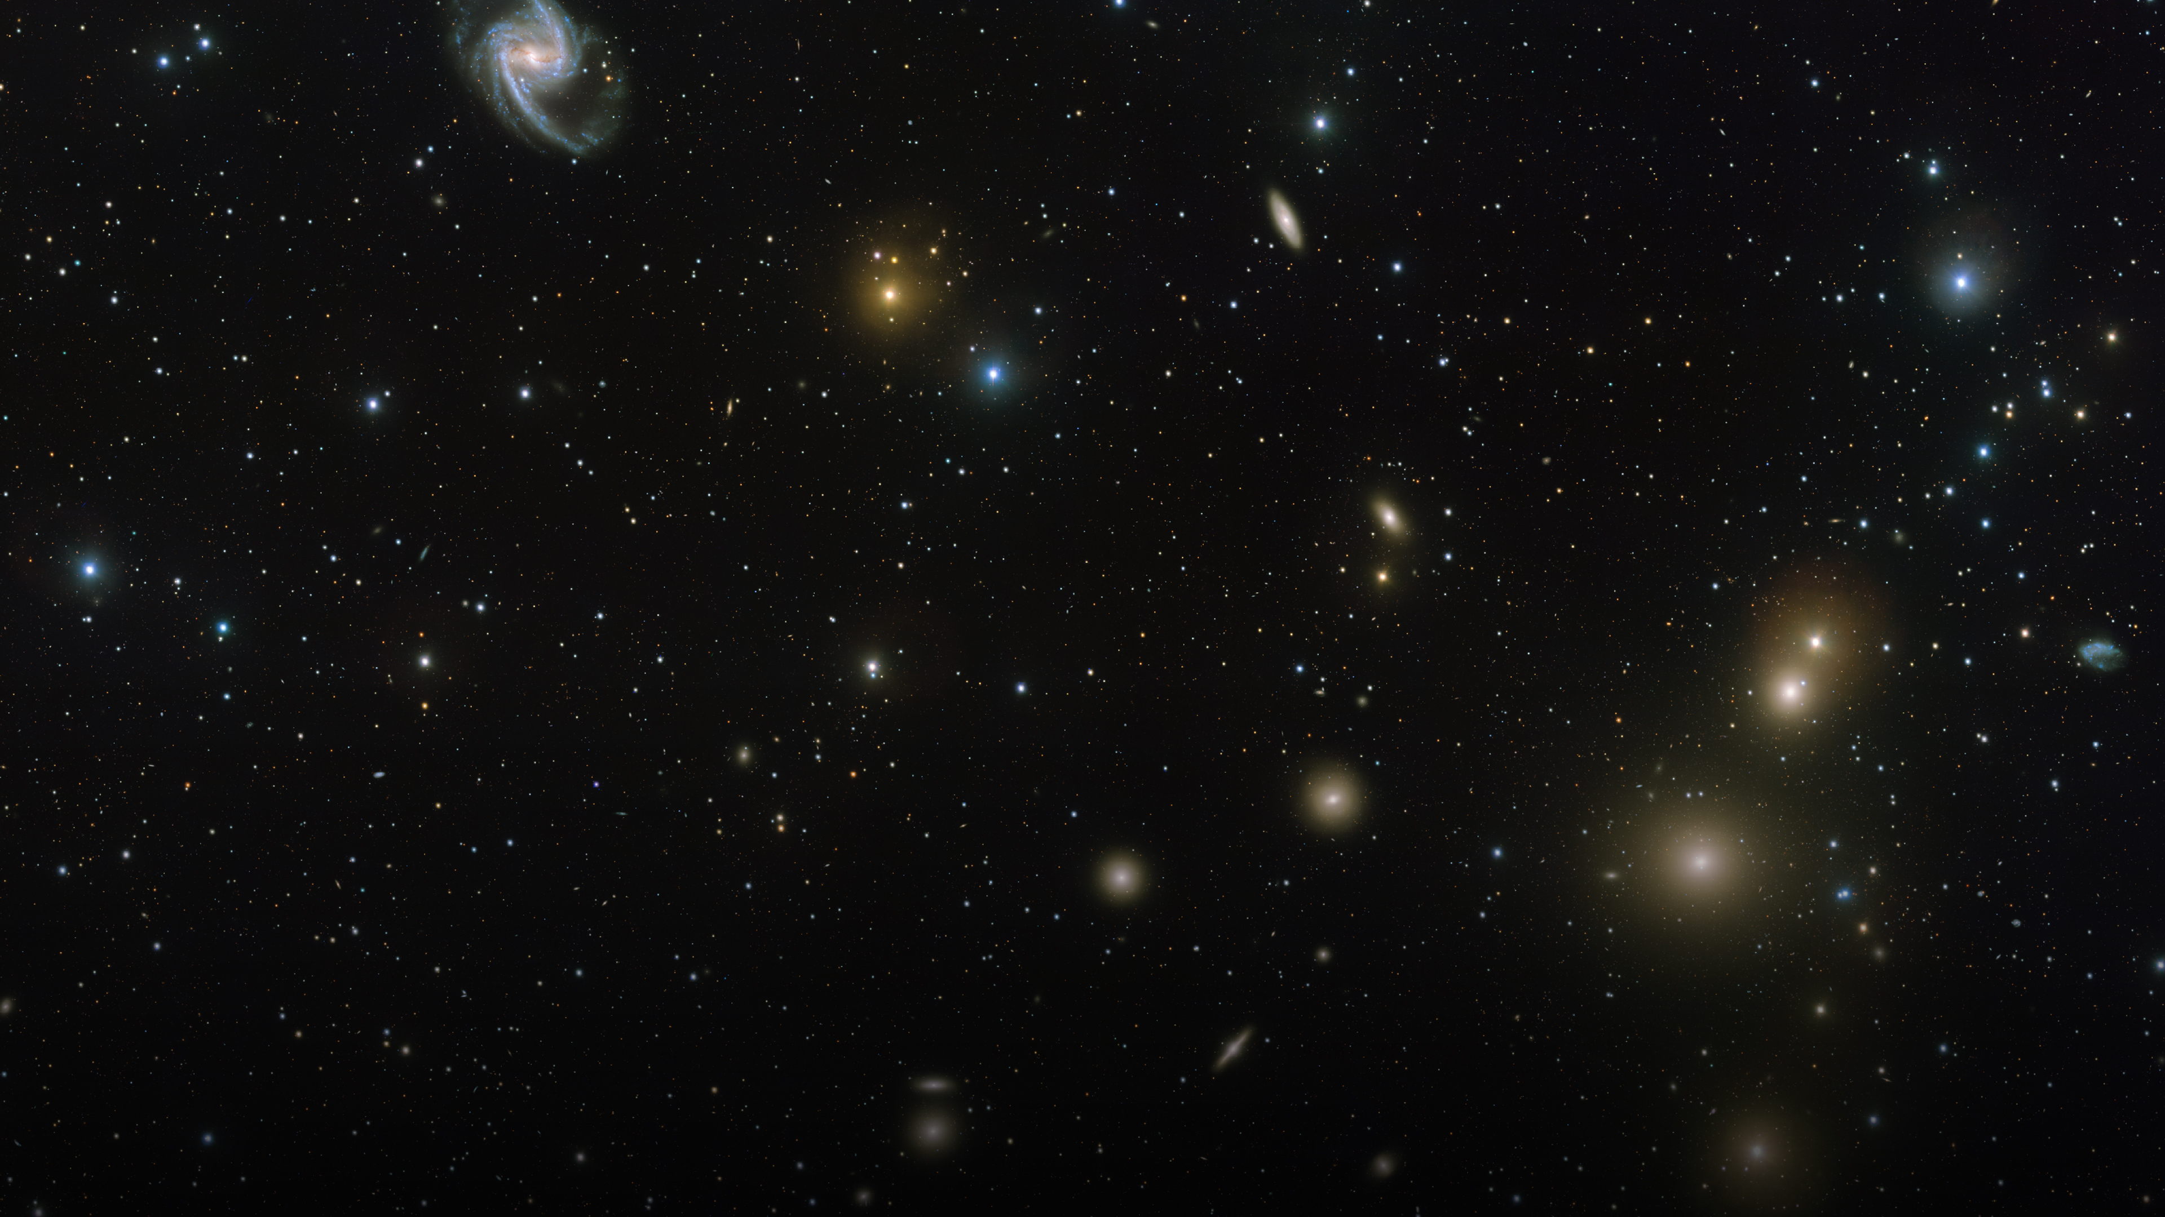
Astronomy is one of the oldest sciences. Humans have always looked up to the sky and wondered what is out there and how we came to be.
It is about asking the big questions and ESO is all about helping scientists to find answers.
Credit: ESO. Acknowledgement: Aniello Grado and Luca Limatola
How do we do that?

Slide 15
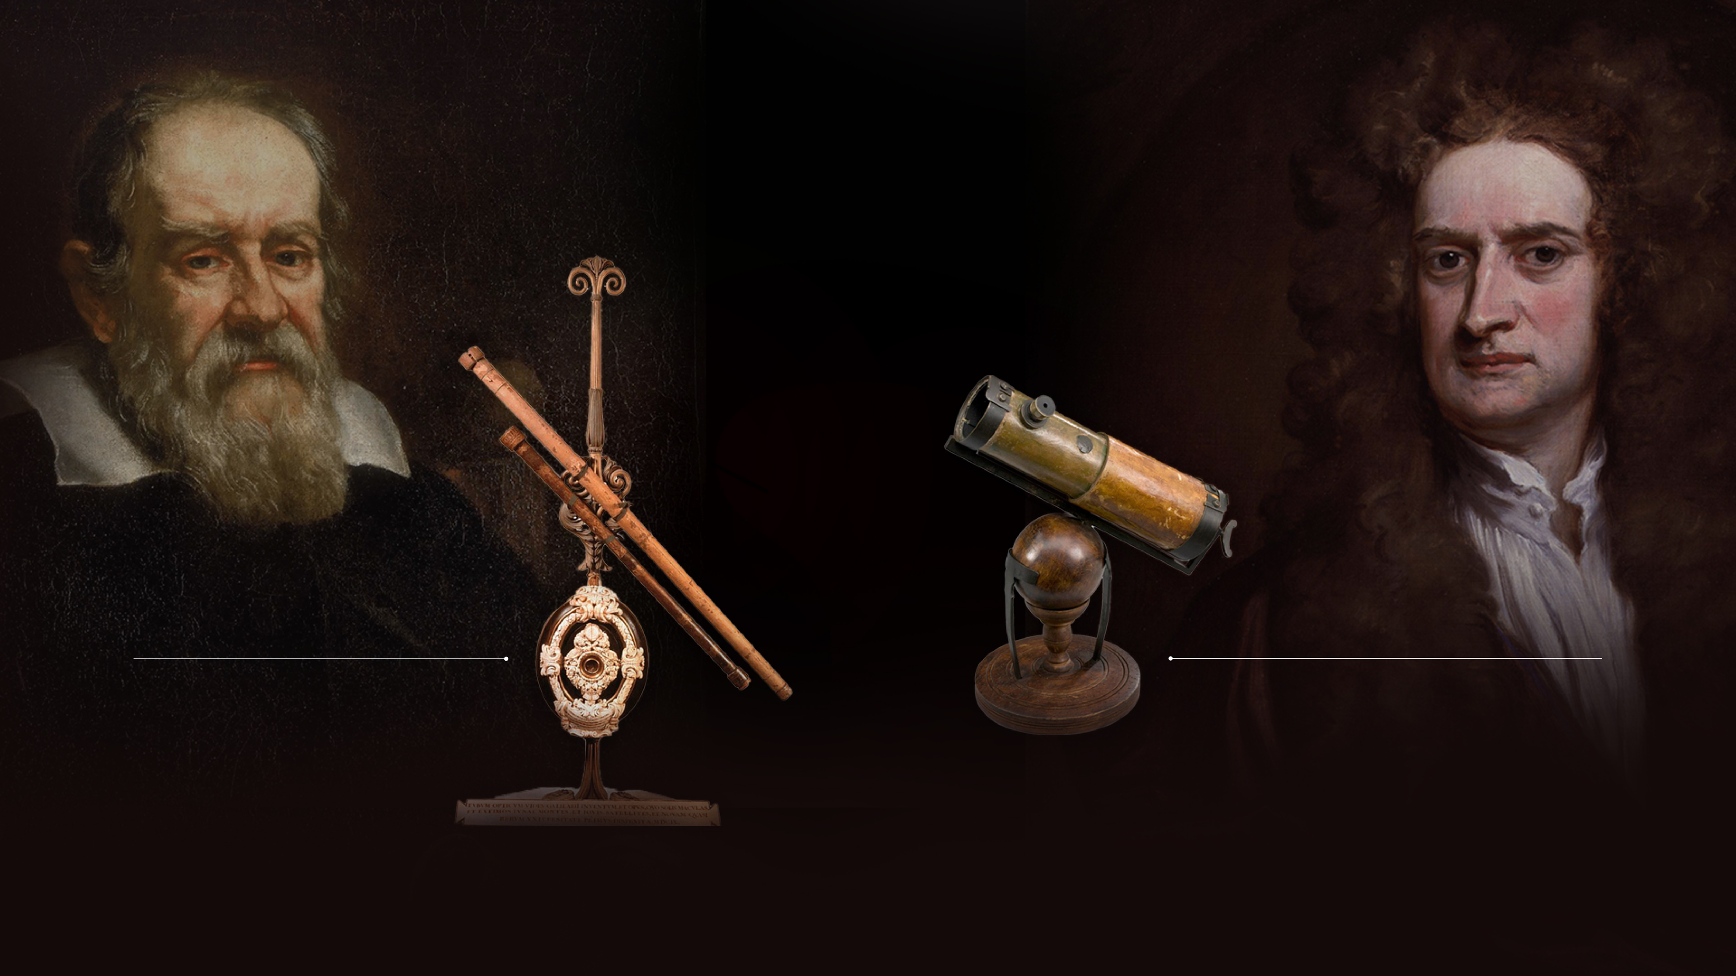
In the past, astronomers built their own equipment
1609
Galileo’s Telescope
1668
Newton’s Reflector
Today, this isn’t possible anymore

Slide 16
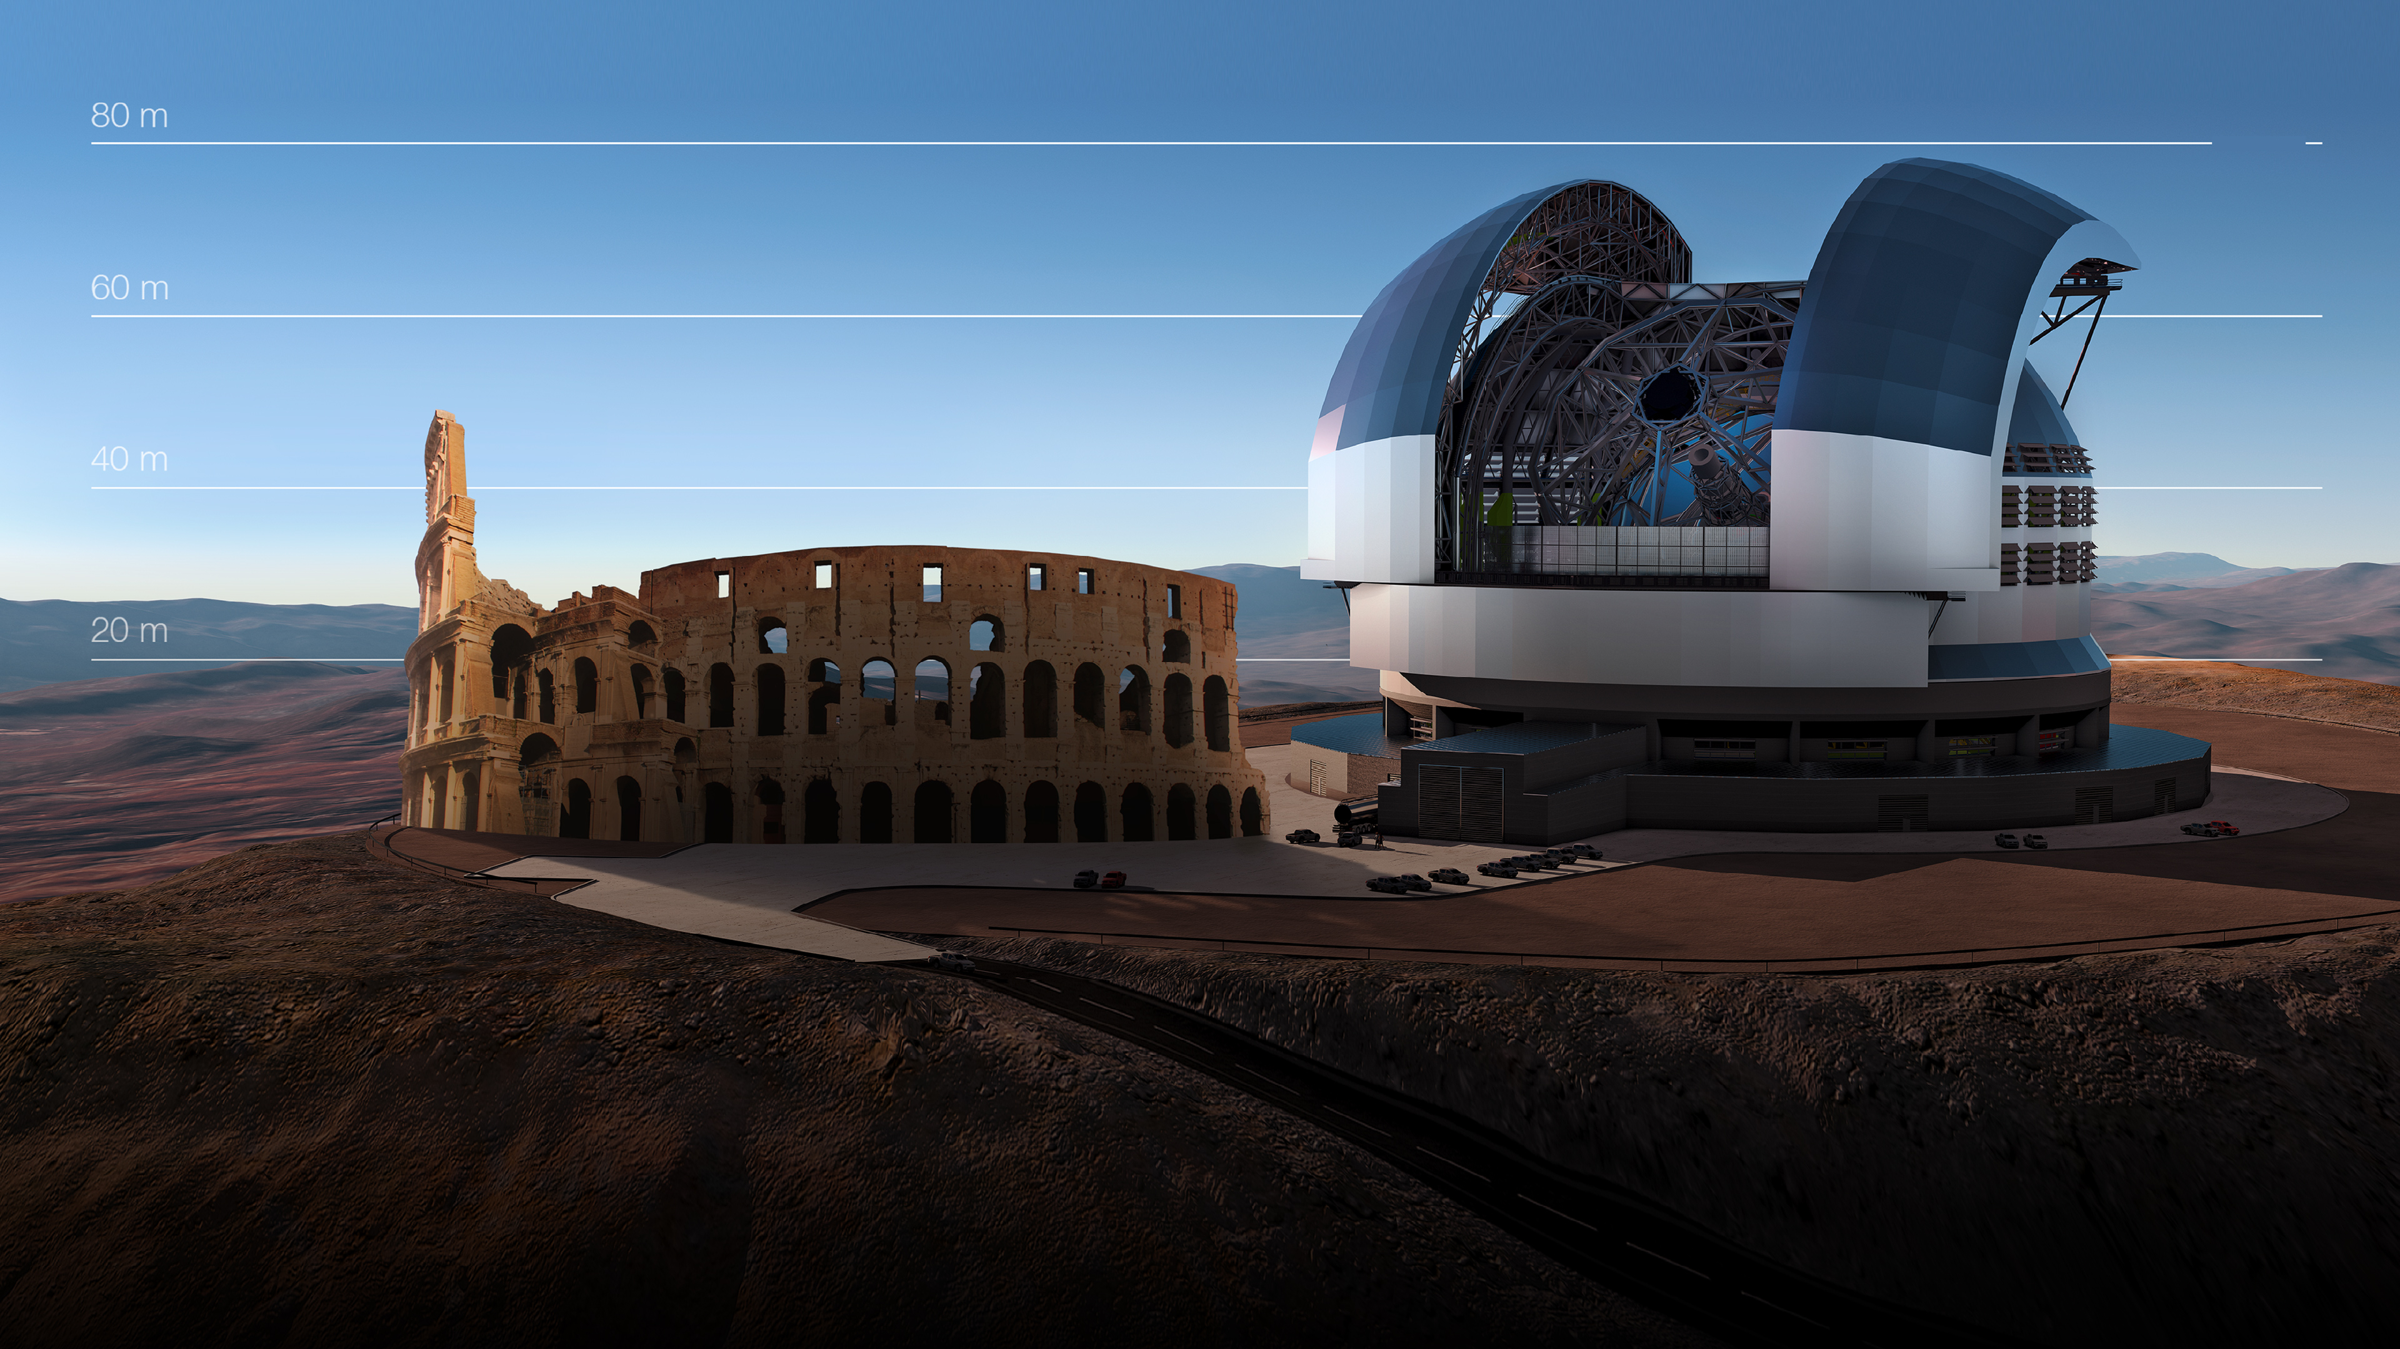
Telescopes have become huge science powerhouses the size of stadiums*
*The main mirror of ESO’s Extremely Large Telescope will have a diameter of 39 m

Slide 17
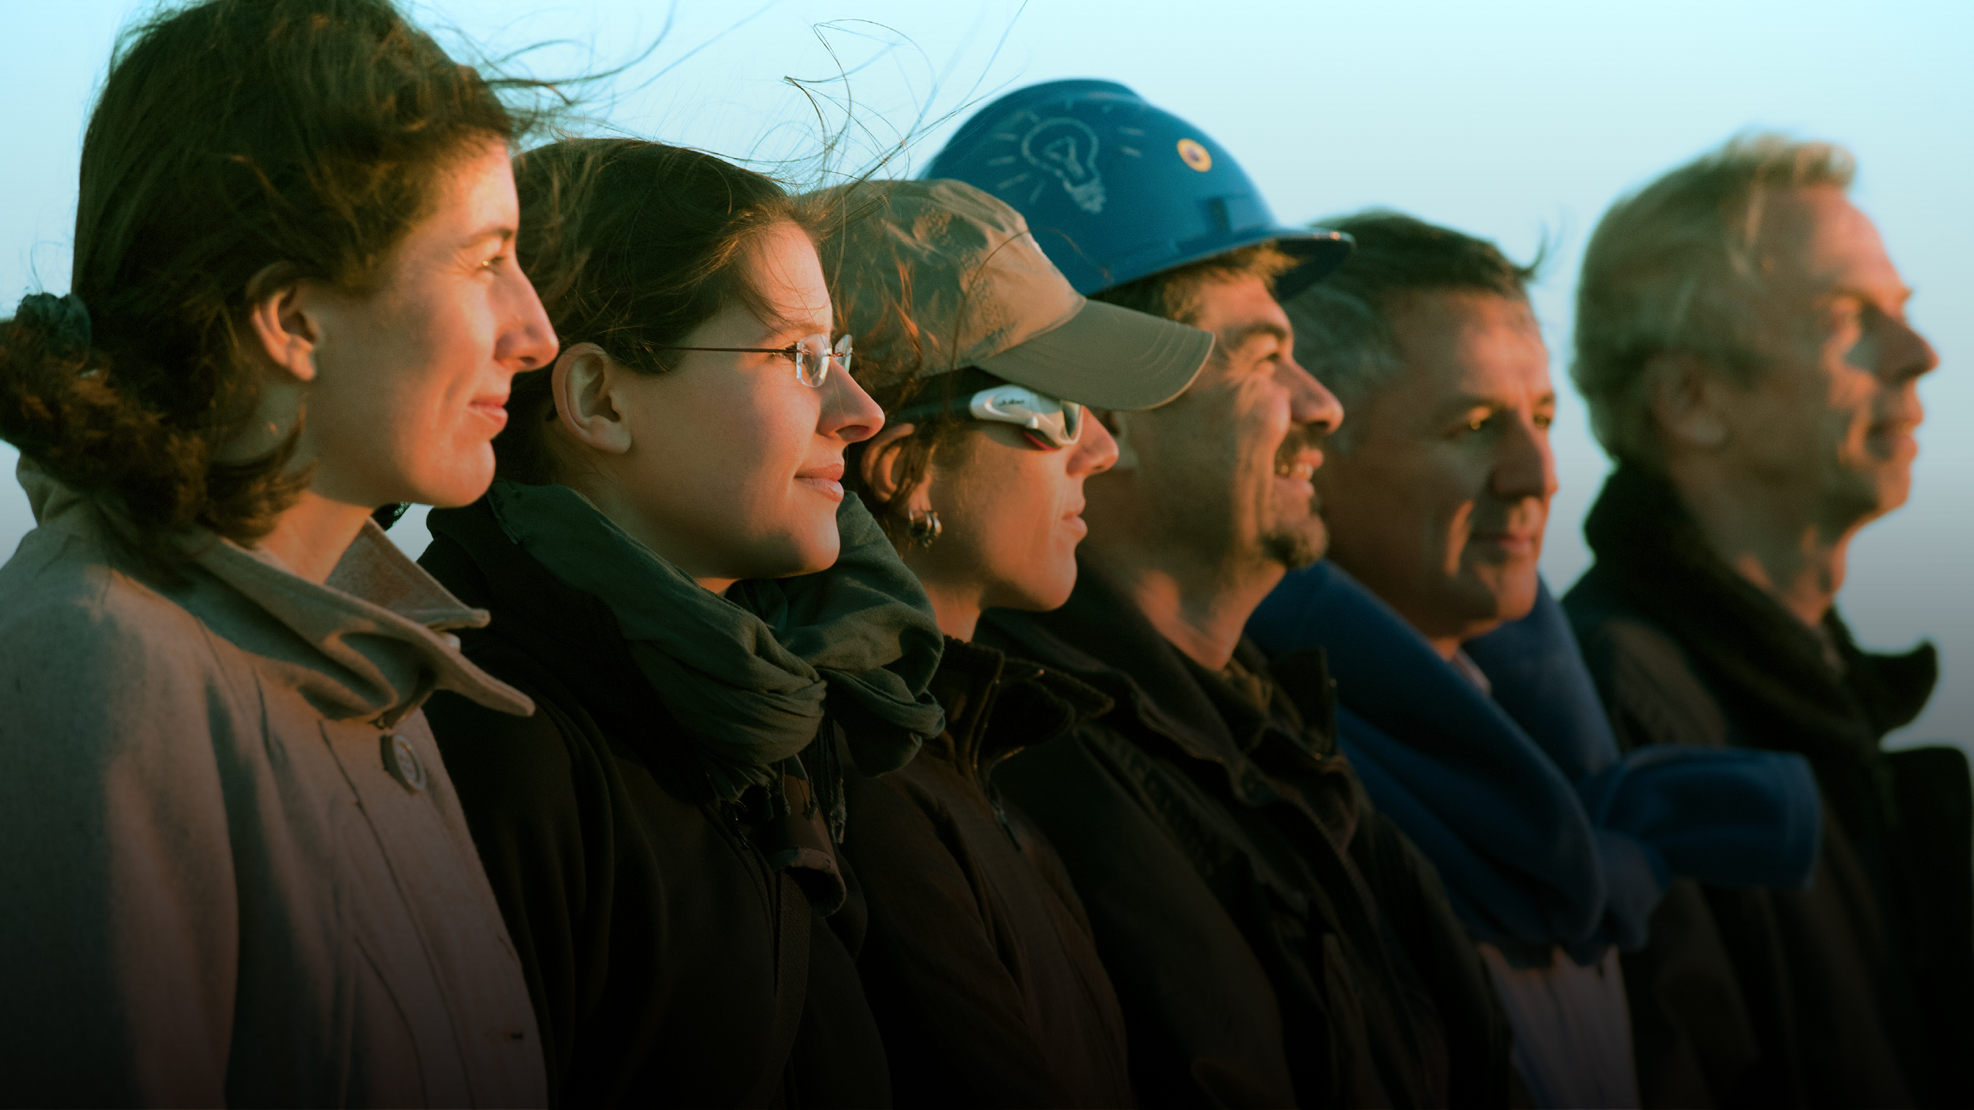
Credit: ESO/Max Alexander
Building them requires bringing together hundreds of scientists, engineers, construction workers and other suppliers from all over the world to work hand in hand

Slide 18
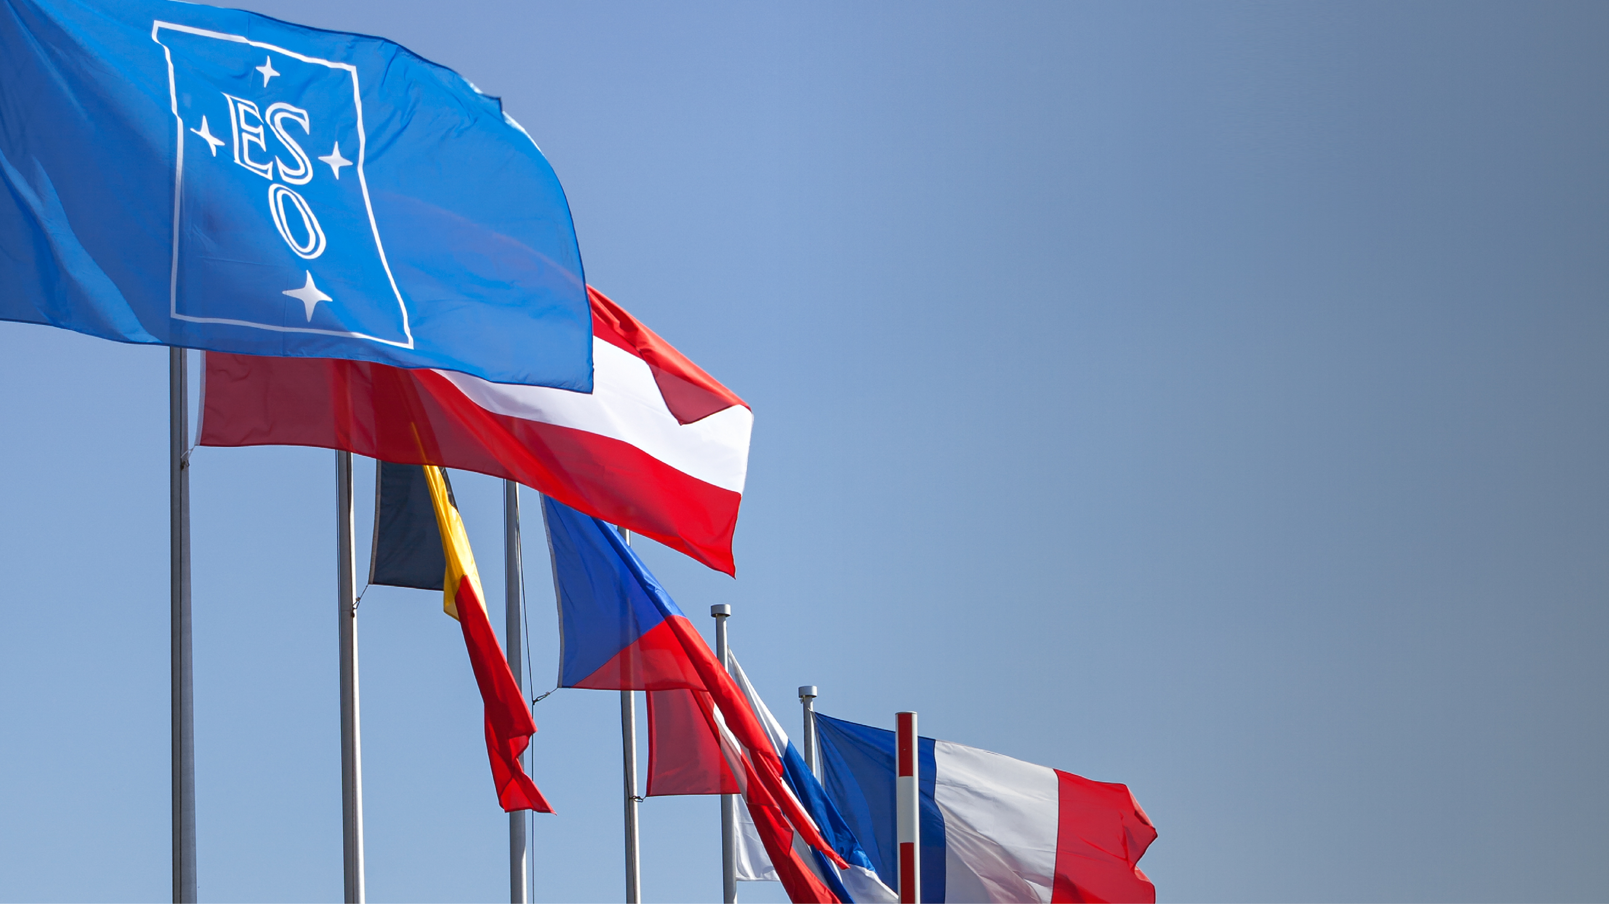
ESO stands for inherently peaceful collaboration between nations, communities and people.
Together we achieve things no Member State could do alone.
We build bridges between society, science and technology for the benefit of all humankind.

Slide 19
Our Mission
We design, build, and operate advanced ground-based observatories
We foster international
collaboration for astronomy

Slide 20
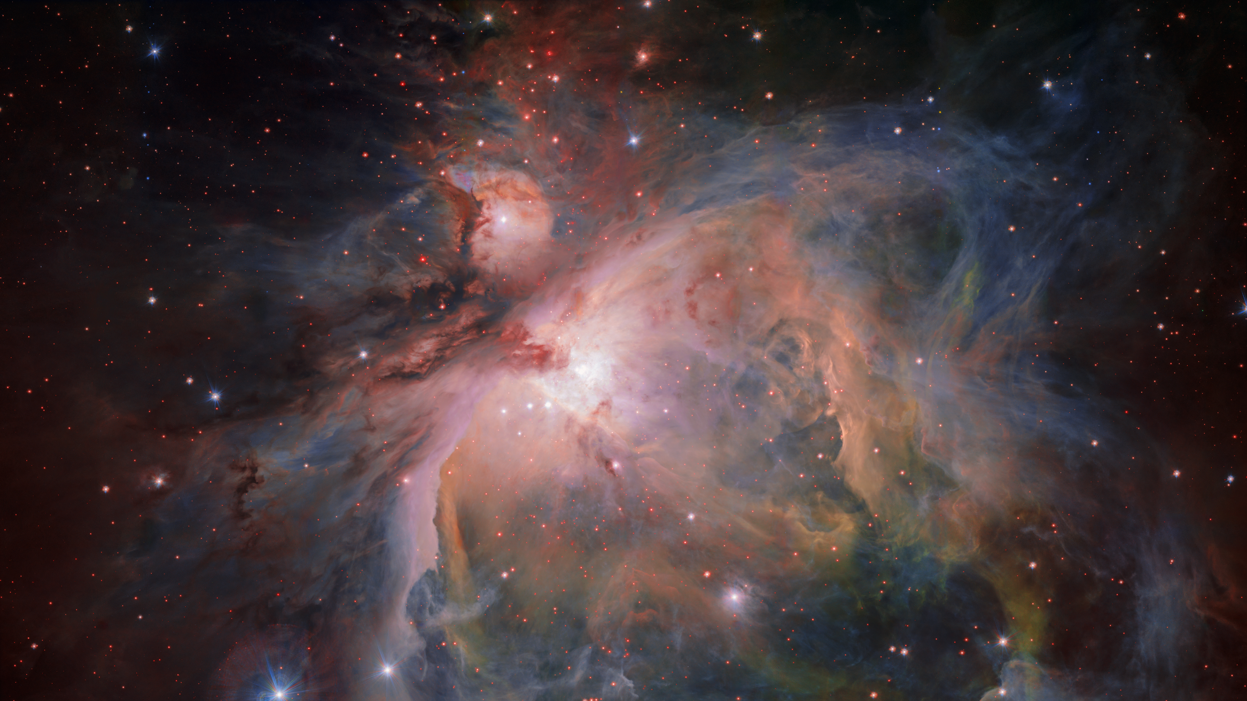
Our Vision
Credit: ESO/G. Beccari
To advance humanity’s understanding of the Universe by working with and for the astronomy community, providing it with world-leading facilities

Slide 21





Our Values
We strive for excellence
We achieve this through innovation
We provide outstanding services to our communities
We foster diversity and inclusion
We believe in the key role of sustainability for our future
These values are realised and maintained by ESO’s people

Slide 22







Our Values
Accountability
Achieving ESO’s values is only possible on the basis of personal values and attitudes
Respect
Collaboration
Integrity
Clear and open communication
Commitment

Slide 23
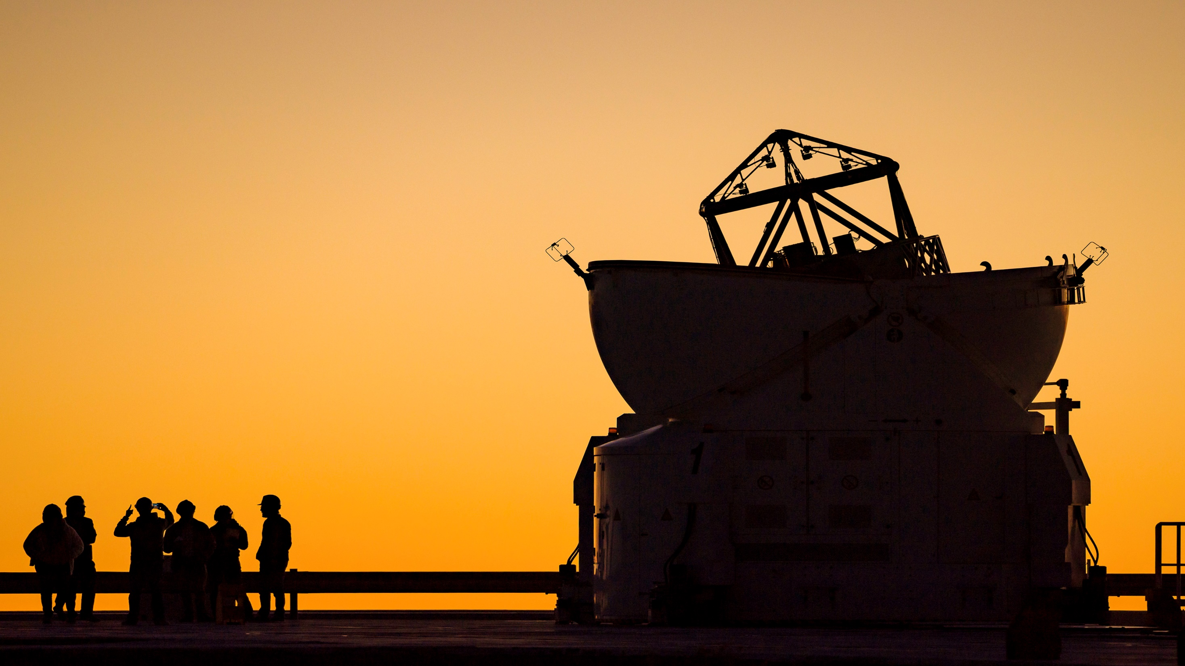
Together, we’re more than the sum of our parts
Credit: G. Hüdepohl (atacamaphoto.com)/ESO

Slide 24
ESO in a nutshell

Slide 25
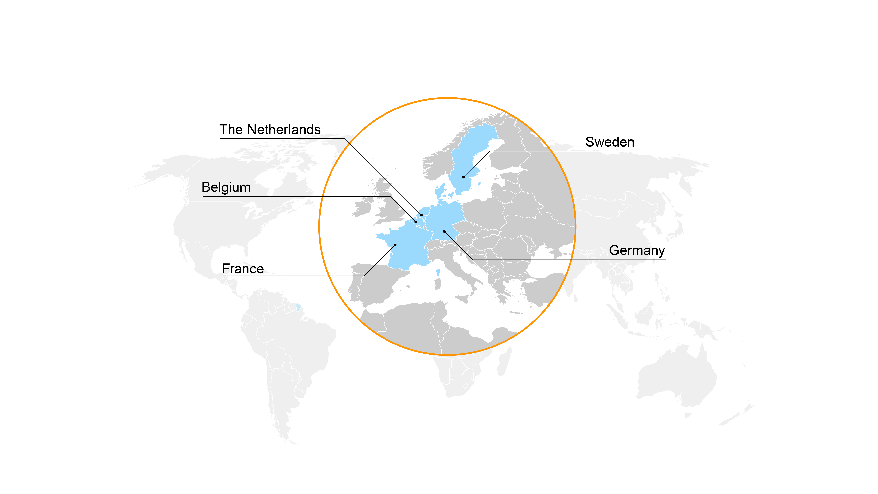
Founding Member States
Intergovernmental Treaty
Organisation, founded in 1962
by five Member States

Slide 26
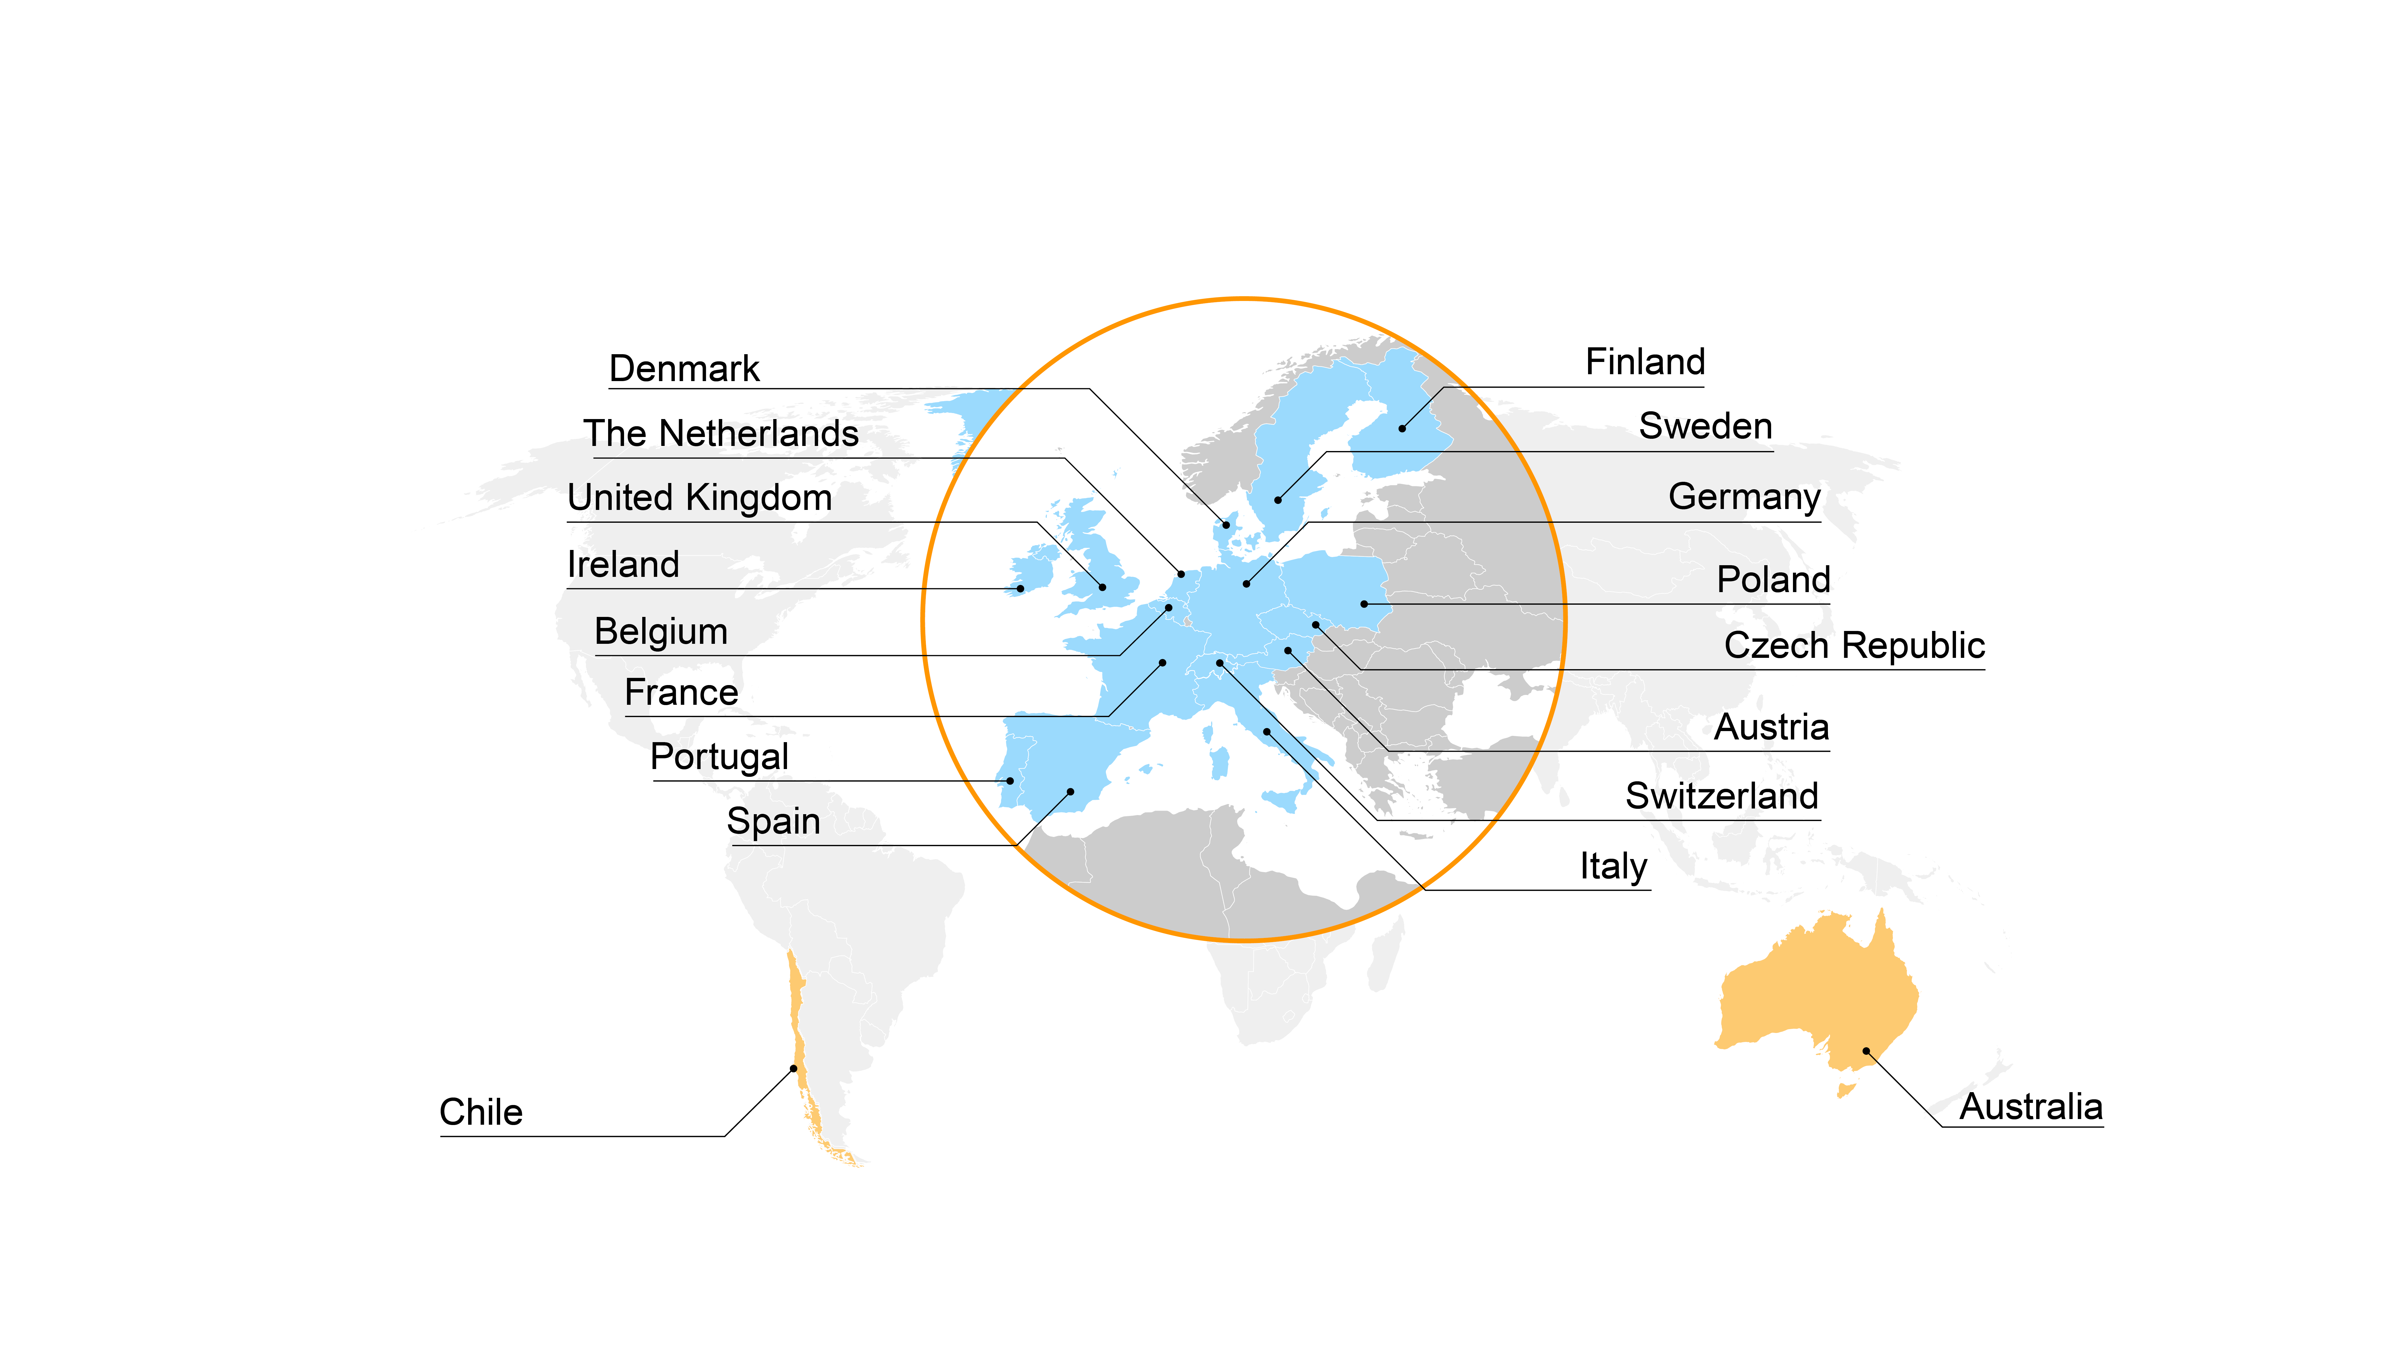
Member States and Partners
Today ESO encompasses 16 Member States
Chile is the host state to ESO’s telescopes and Australia is a strategic partner

Slide 27

Annual contributions
The annual Member States’ contribution to ESO is approximately 234 million Euros, or 0.50 Euros per person in Europe per year*
*About one large caffè latte to go in a decade

Slide 28
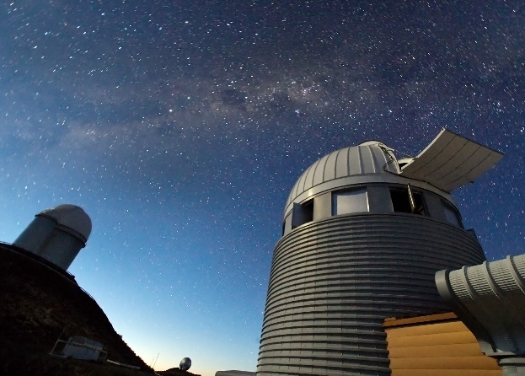
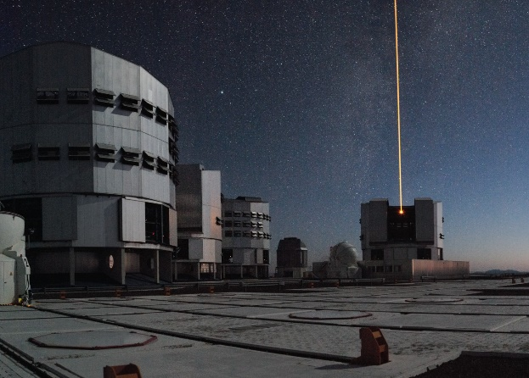
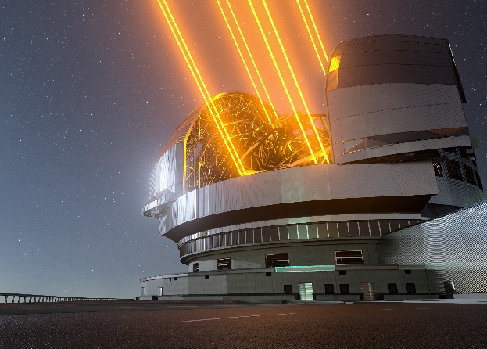
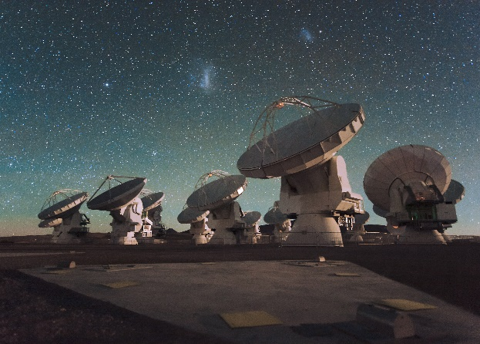
ESO telescopes
Credit: Iztok Bončina/ESO
Credit: ESO/H.H. Heyer
Credit: ESO/L. Calçada
Credit: ESO/C. Malin (christophmalin.com)
La Silla
Paranal
Armazones
Chajnantor
ESO operated: NTT 3.58 m 3.6-metre telescope
Hosted telescopes currently in operation: 11
ESO operated: VLT and VLTI 4 x 8.2 m, 4 x 1.8 m VISTA 4.1 m
Hosted telescopes currently in operation: VST, NGTS, SPECULOOS
Under construction: ELT 39 m
ALMA 54 x 12 m and 12 x 7 m antennas

Slide 29
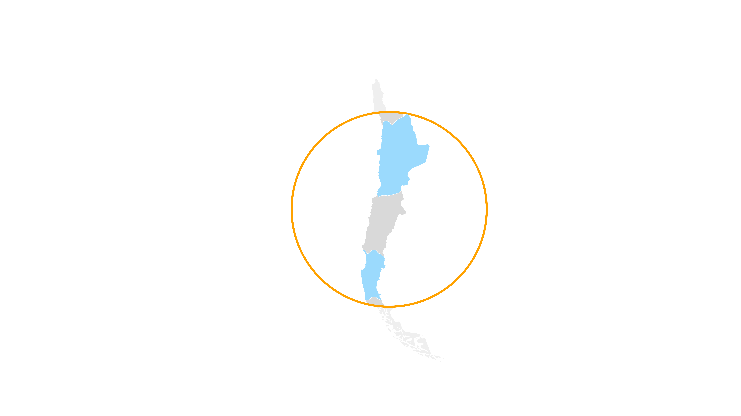







ESO telescopes
Paranal
Chajnantor
VLT
VLTI
VISTA
CTA South*
ALMA
Armazones
La Silla
ELT**
* in preparatory phase
** under construction
Telescopes at La Silla

Slide 30
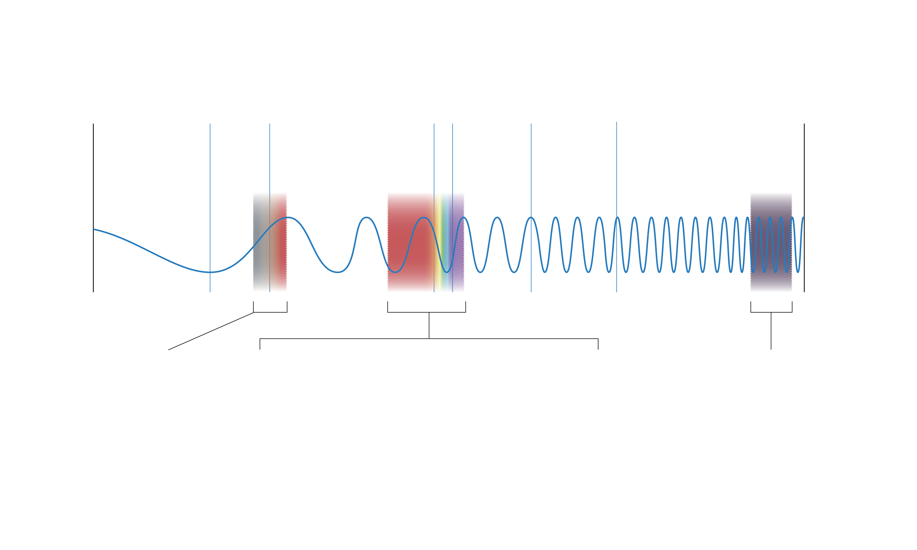


Wavelengths of ESO telescopes
Radio
Visible
X-Rays
Microwave
Infrared
Gamma Rays
ALMA
VLT, VLTI,
VISTA
ESO 3.6-metre telescope and NTT
ELT under construction
CTA-South in preparatory phase

Slide 31
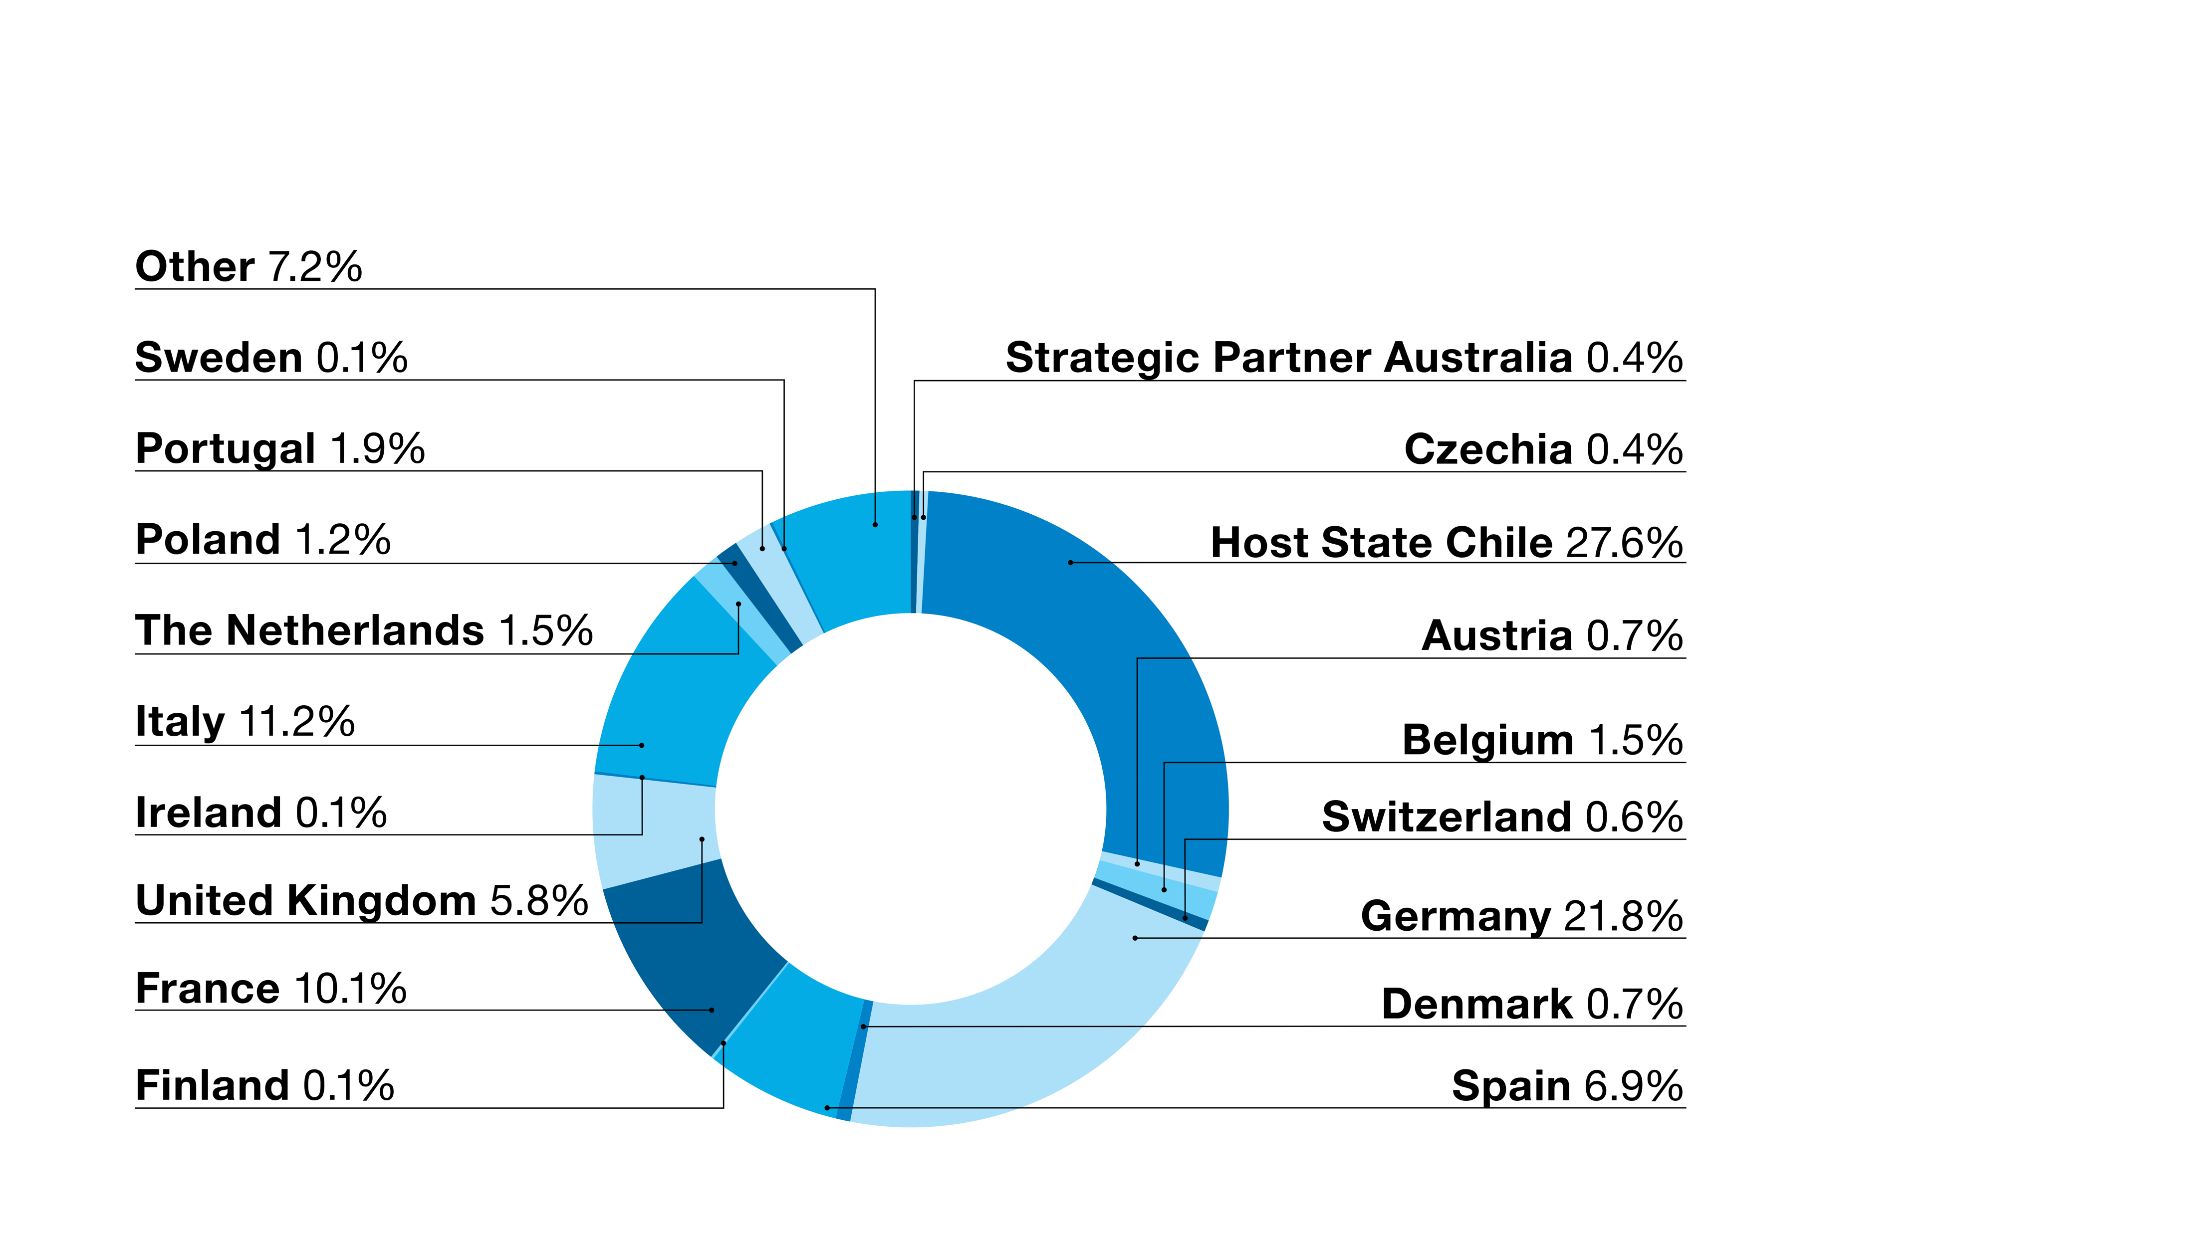
Staff
ESO employs more than 750 people of more than 30 nationalities

Slide 32
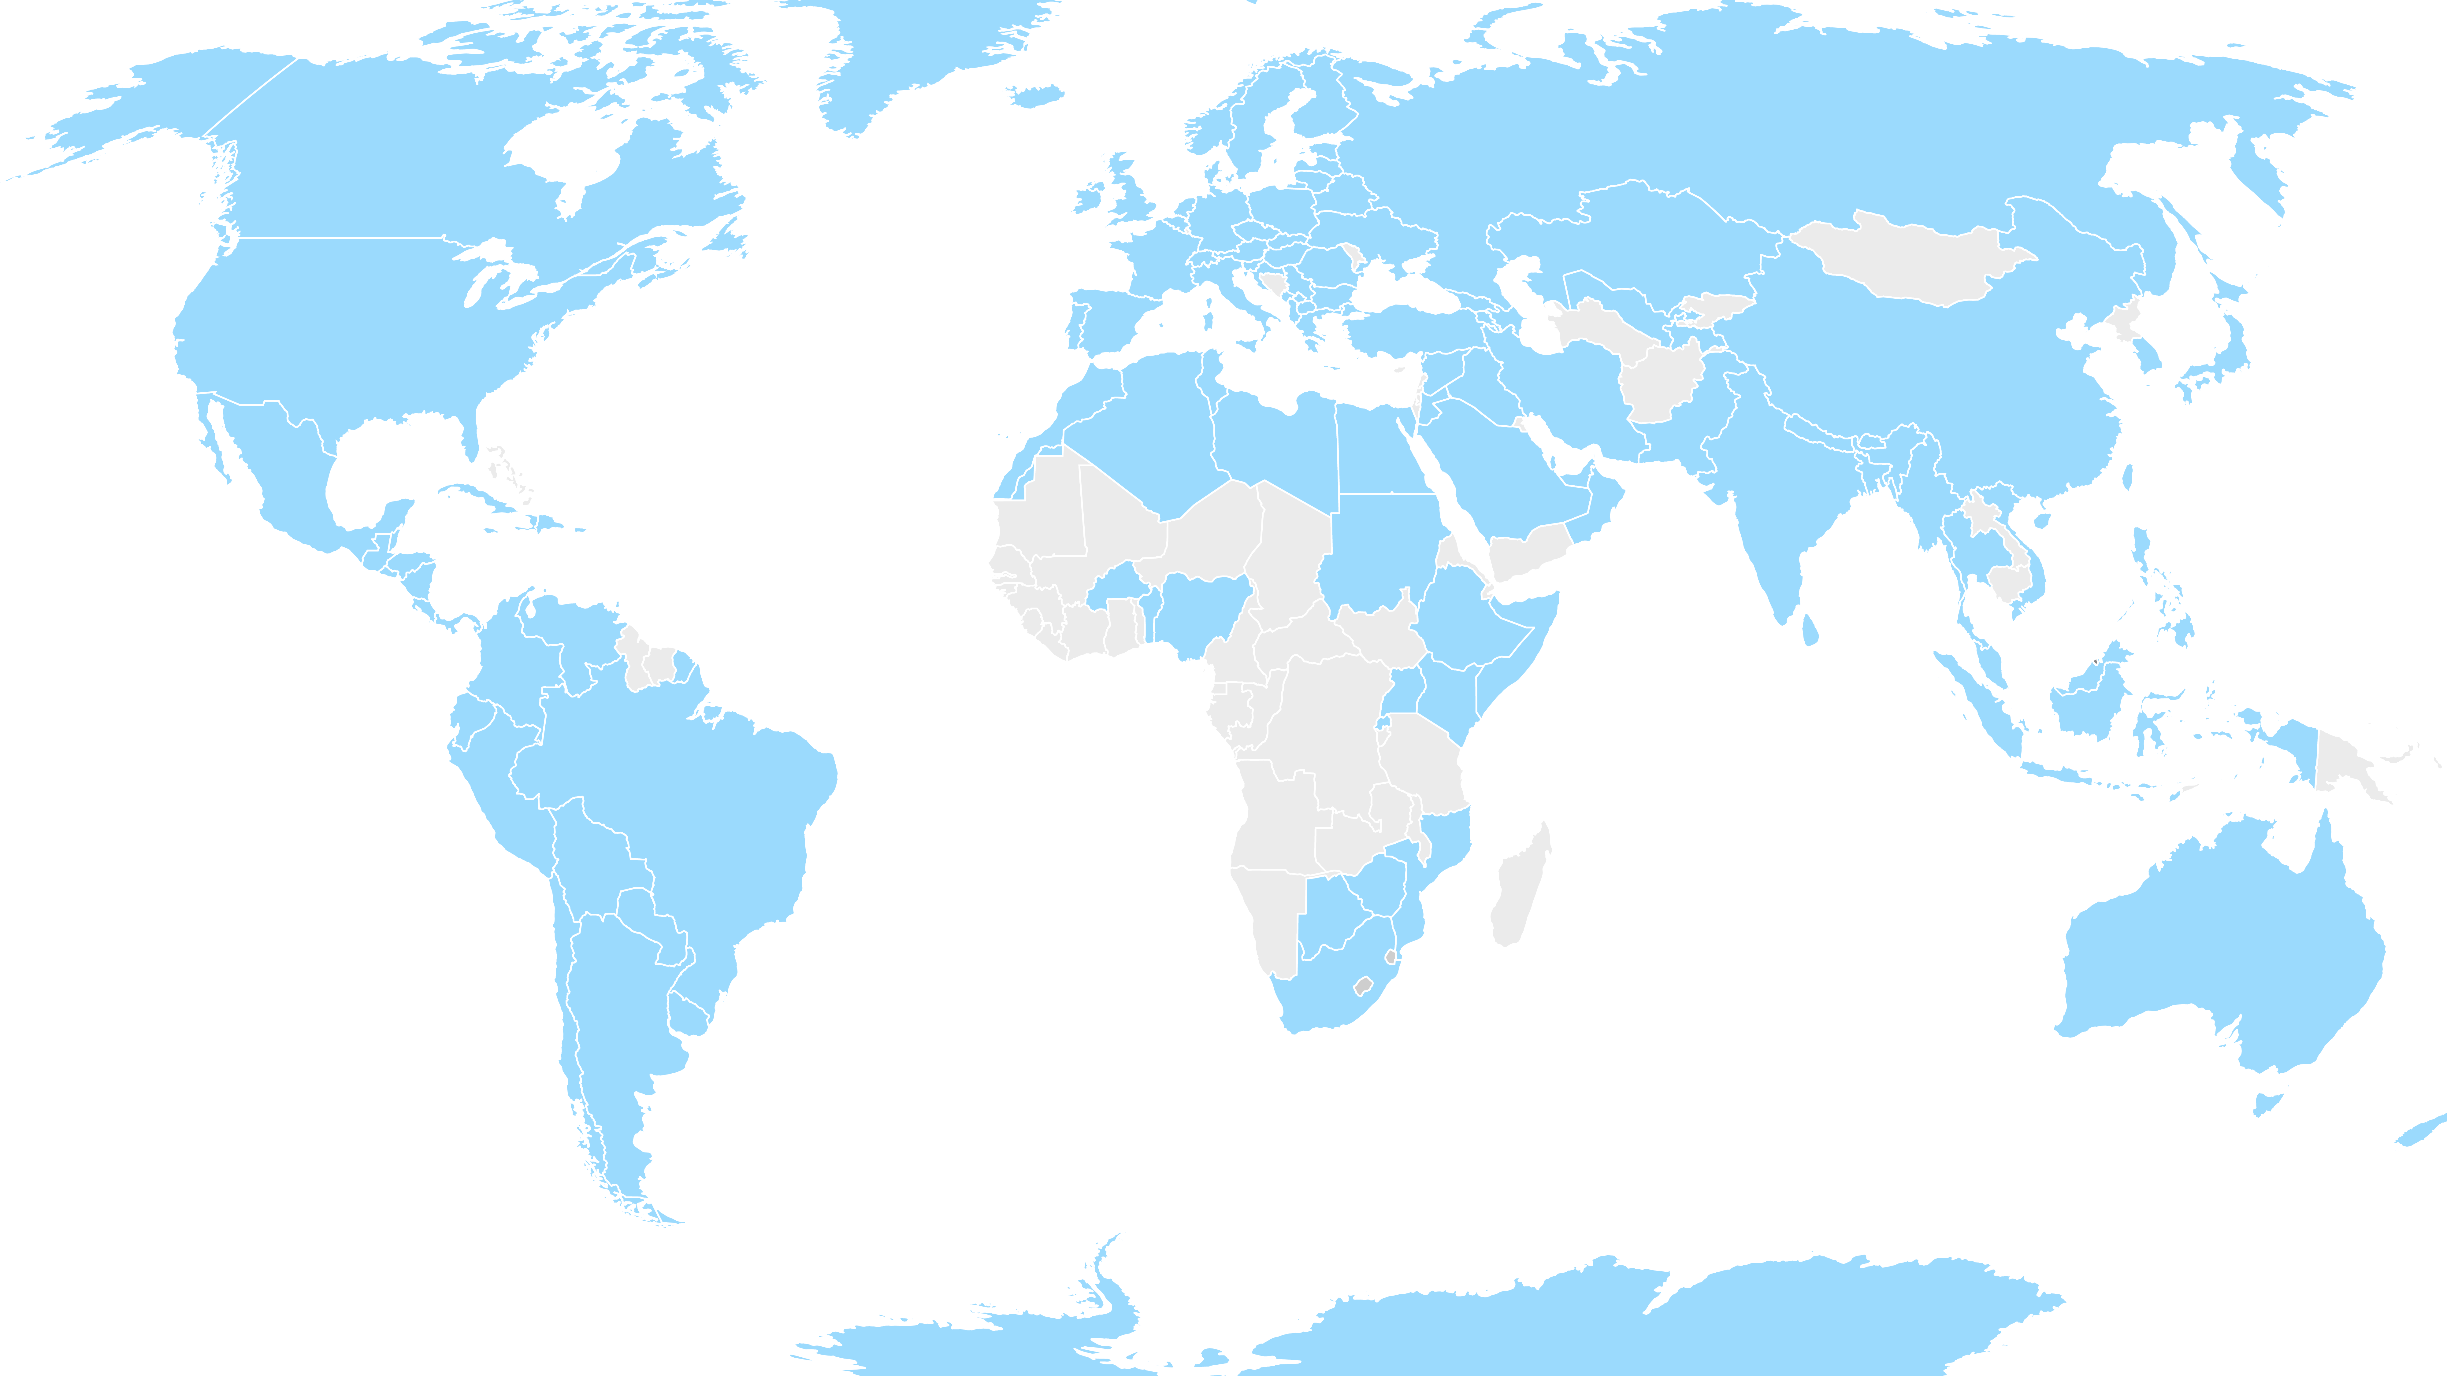
Usage of ESO data
More than 25 000 astronomers, other scientists, teachers, students, journalists, etc. in over 130 countries worldwide use ESO data

Slide 33
ESO’s publications record

