Slide 1

ESO’s impact and sustainability efforts

Slide 2






ESO’s impact areas
Science and engineering
Economy and innovation
Talent development
Education and outreach
International collaboration and policy

Slide 3

Science and engineering
Nobel Prizes in Physics in 2011 and 2020 for research with ESO telescopes
Over 2500 proposals each year for the use of ESO telescopes
ESO enables
over 1000 referred publications each year
ESO develops telescope technologies and engineering and managerial capacity
8000 astronomers downloaded
1600 terabytes of data from the ESO science archive

Slide 4
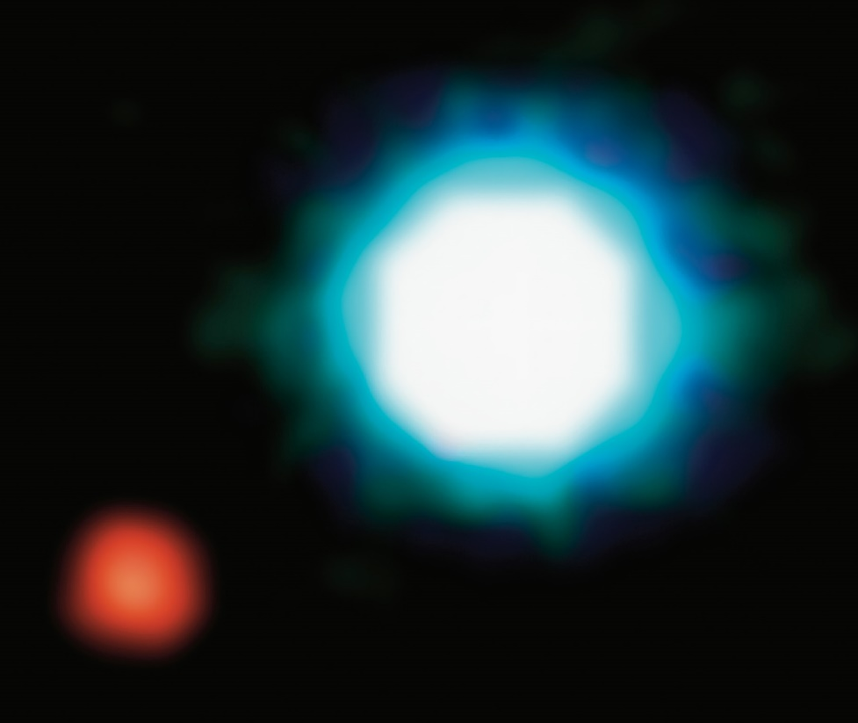
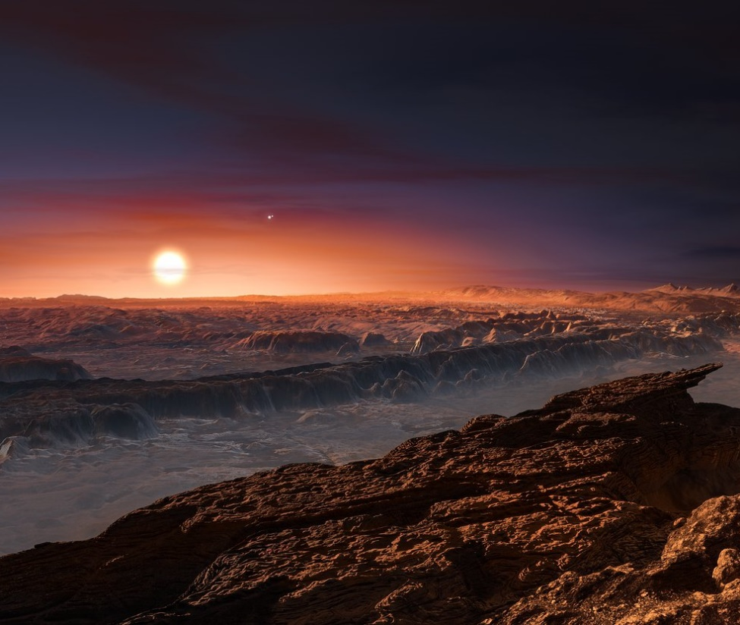
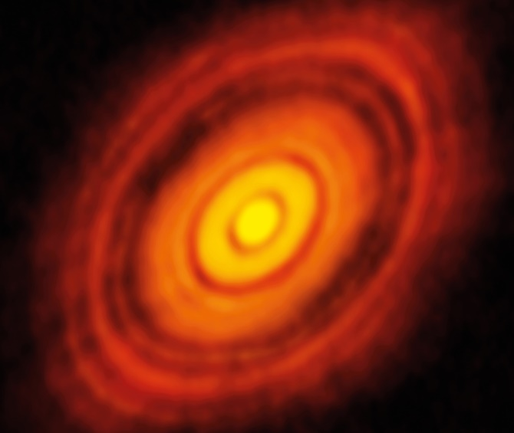
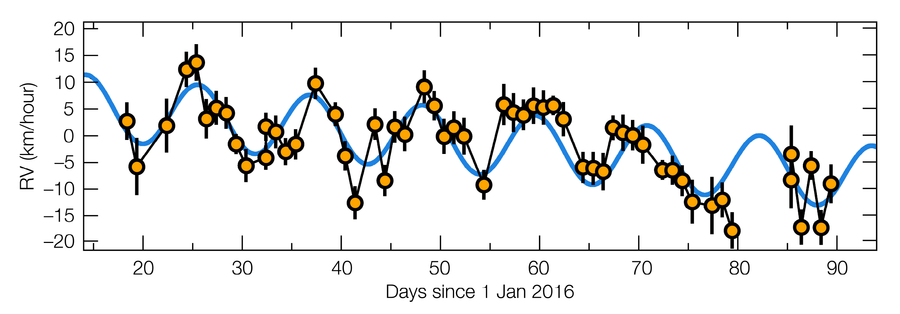
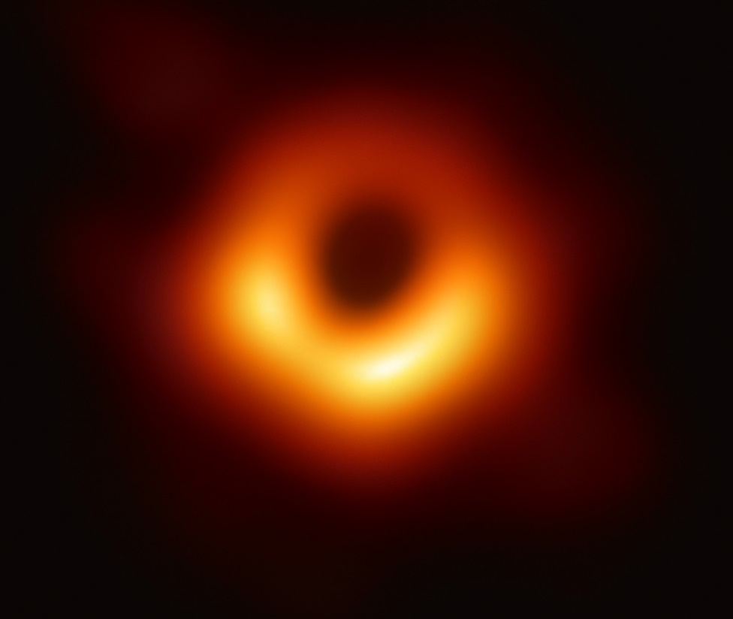
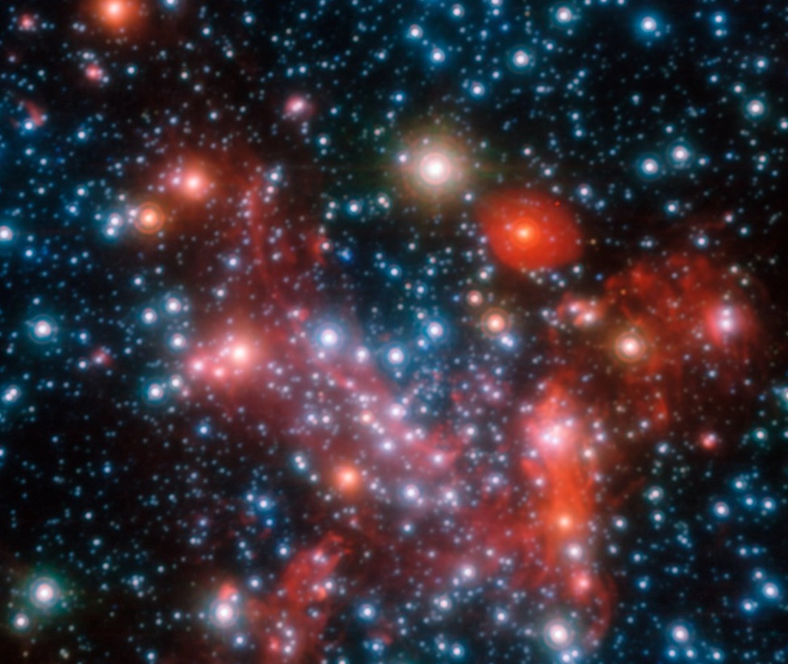
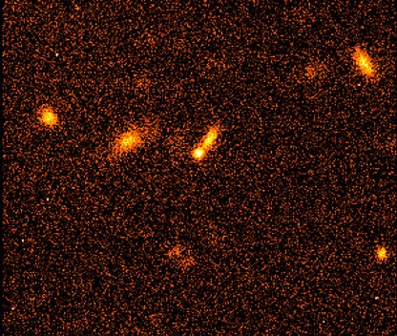
Credit: ESO/L. Calçada
First image of an exoplanet
Closest exoplanet to us
Planet formation
Credit: EHT Collaboration
Credit: ESO/S. Gillessen et al.
Credit: ESO/L. Calçada
Black hole at the centre
of the Milky Way
First image of a black hole
Accelerating Universe

Slide 5
Technology and innovation
at ESO​

Slide 6
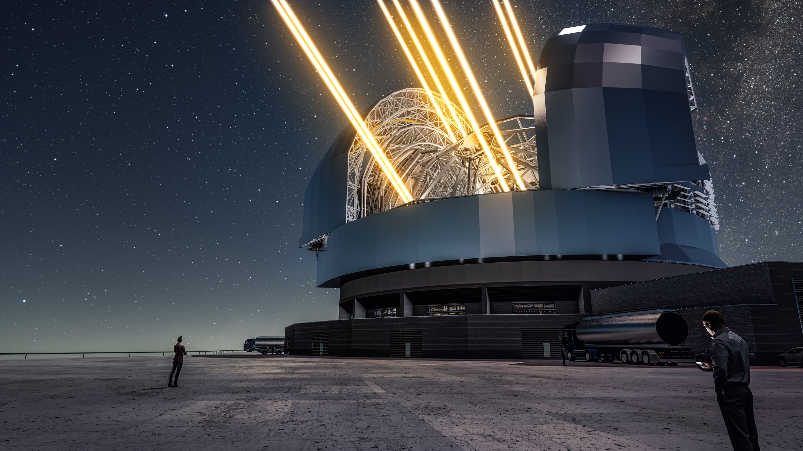
ESO promotes the emergence of new technologies and expertise, leading to new markets, jobs and industrial collaborations
Credit: ESO/L. Calçada

Slide 7
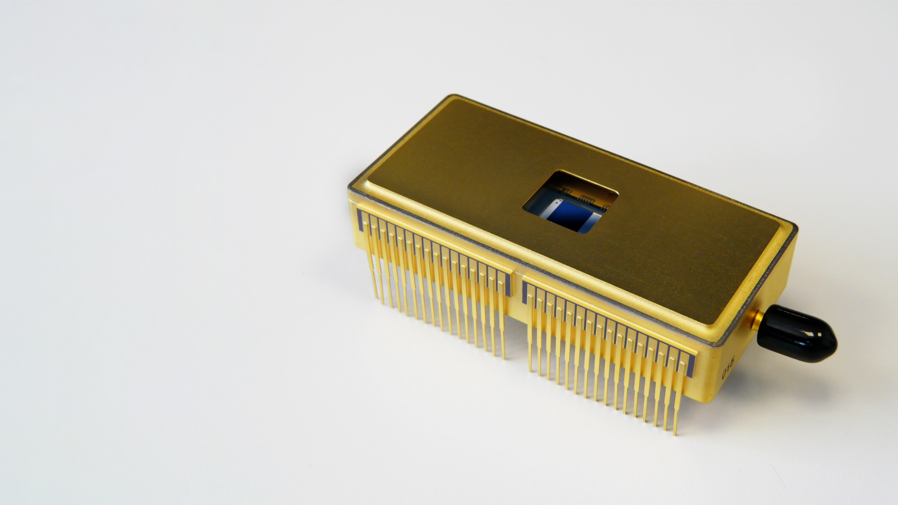
Credit: P. Balard/INSU-CNRS/ESO
New high-speed
and low-noise detectors
for astronomy, also applicable
to life sciences research

Slide 8
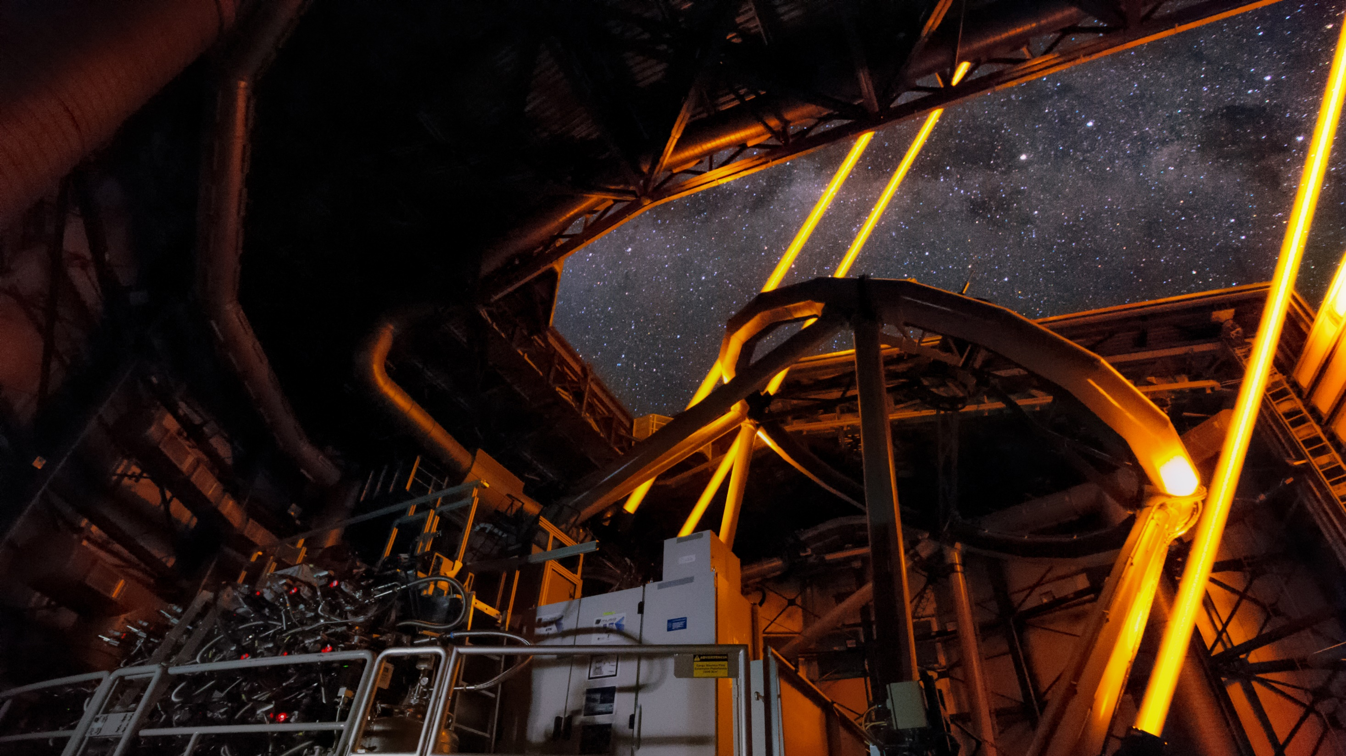
Credit: Roland Bacon/ESO
Novel high-power lasers for adaptive optics,
also applicable in space situational awareness
and optical satellite communications

Slide 9
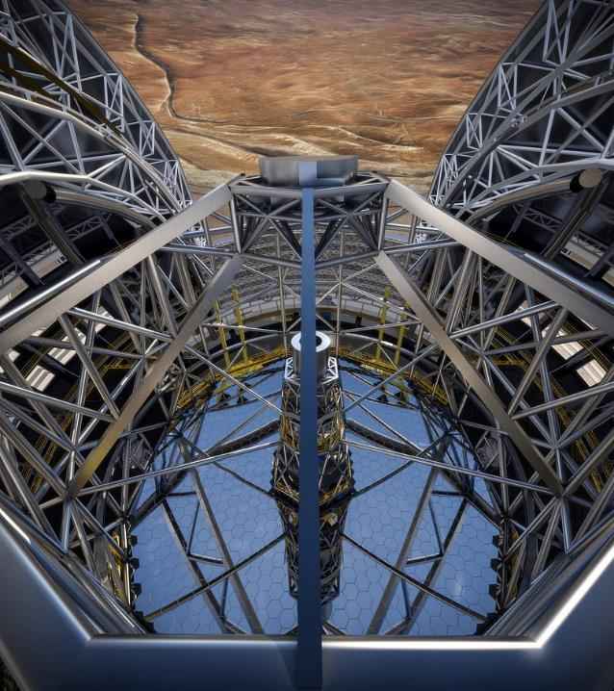
ESO’s ELT technology
innovations
ESO’s ELT is pushing the state of the art in technology beyond what was possible before, opening new business markets for industry in the Member States
Credit: ESO/L. Calçada/ACe Consortium

Slide 10
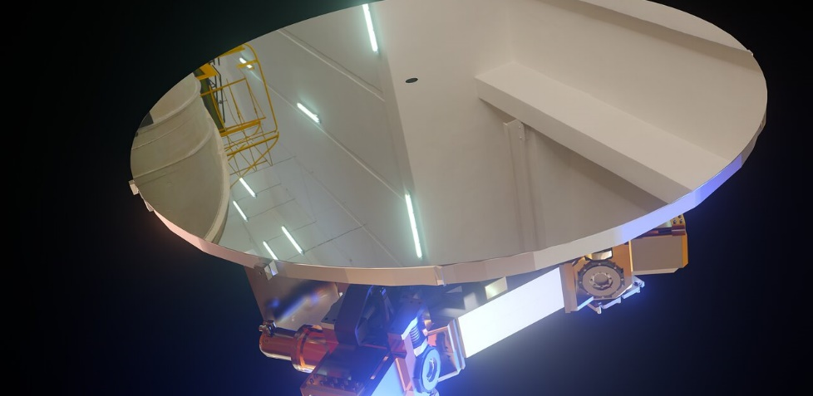
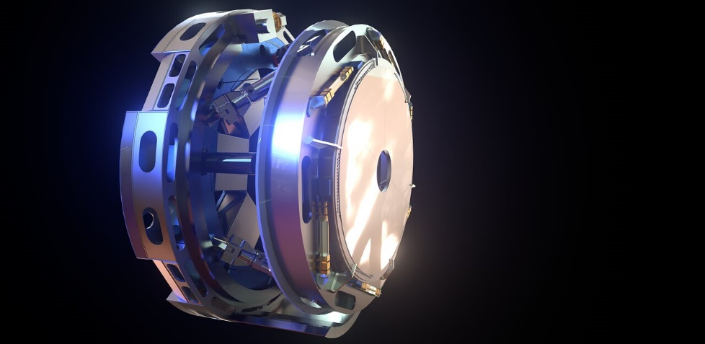
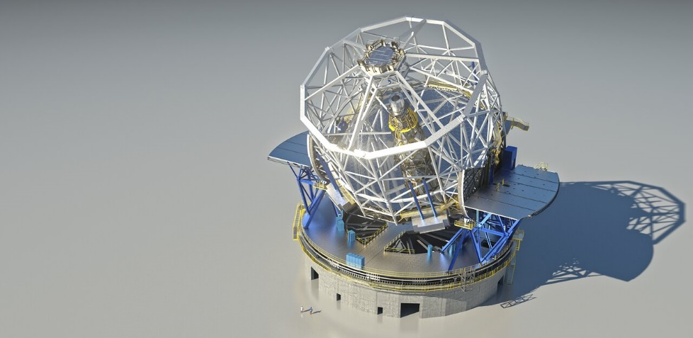
ESO’s ELT technology innovations
New large coated silicon-carbide mirrors, with applications to aviation and space missions
New cooling system for delicate locations inside the telescope that is safer and environmentally friendly
Novel seismic isolation for superheavy structures, applicable to civil engineering

Slide 11
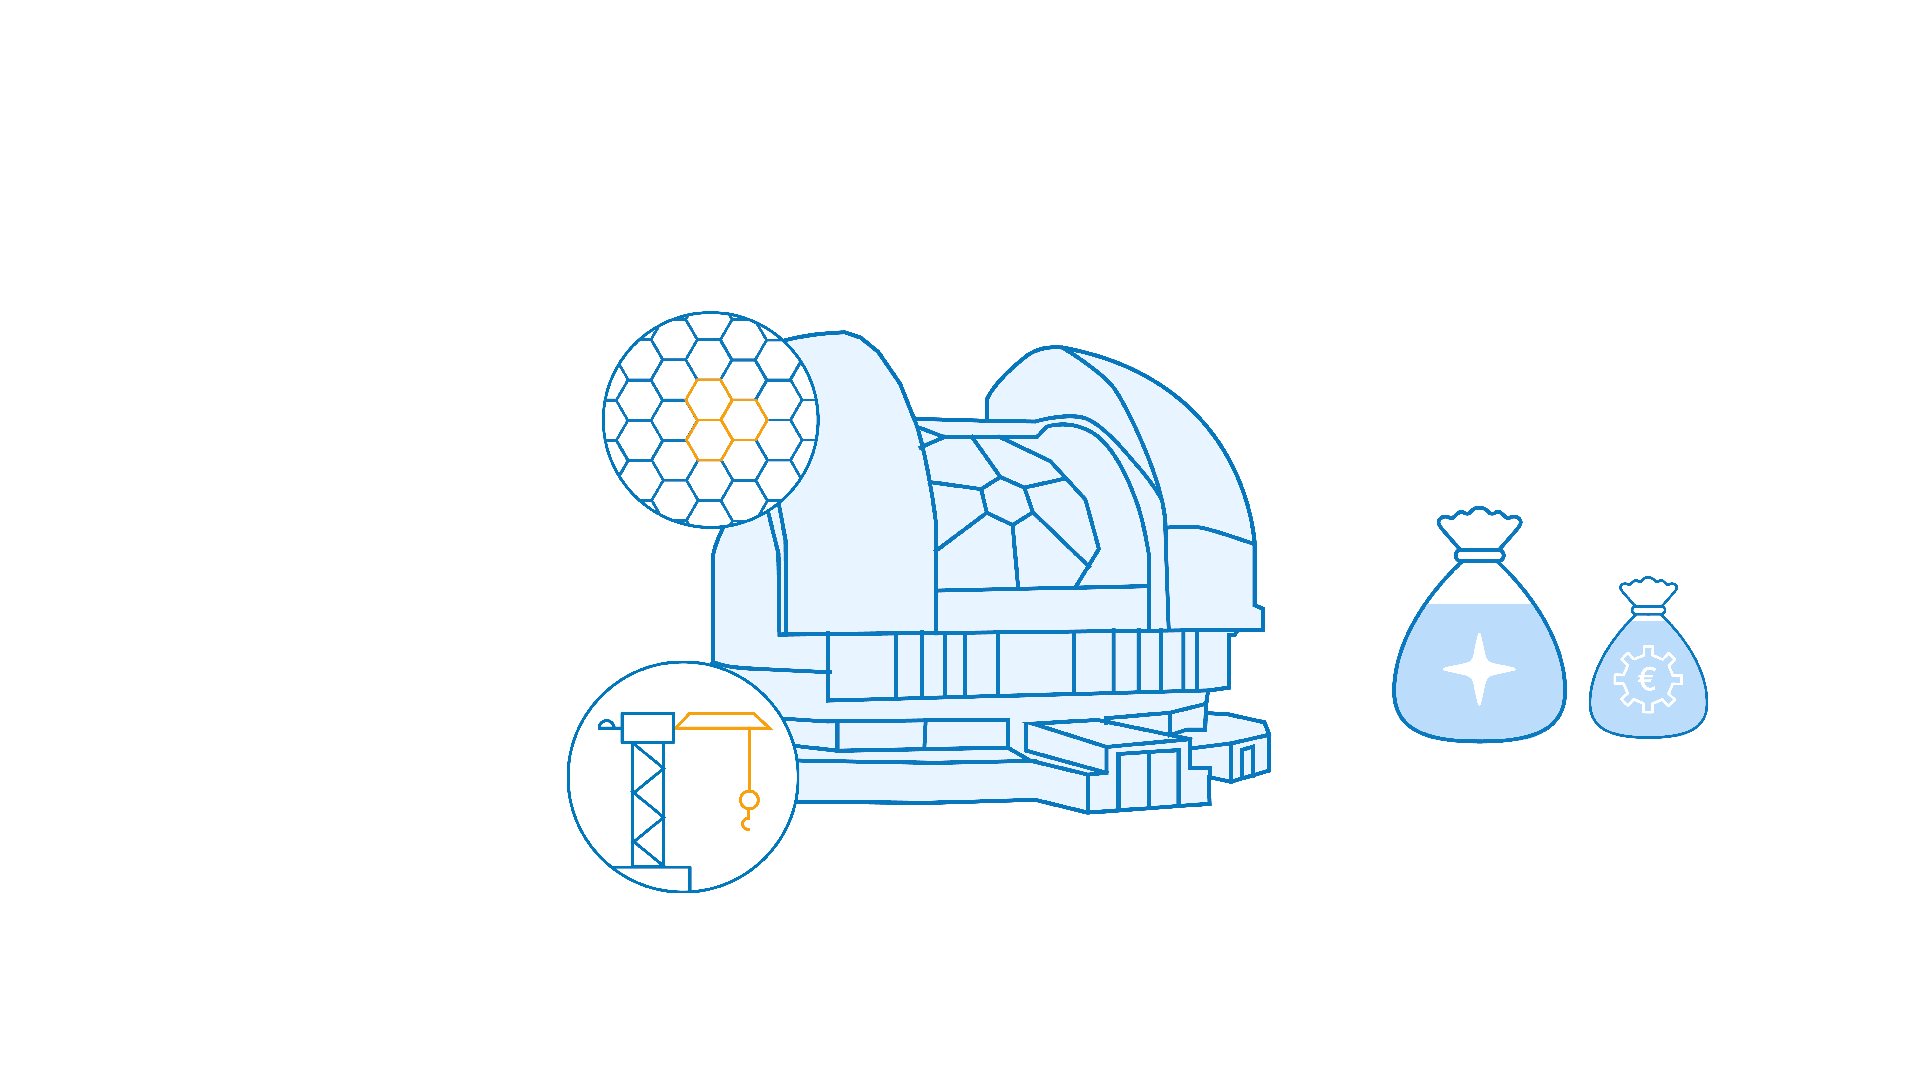
Economy and innovation impact
ESO technologies applied in optics, intercontinental data transfer, medicine, imaging, sensor and detector technology
60% of the ESO budget is for design and construction of telescopes and instruments
80% of the € 1.3 billion ELT construction budget is for contracts with industry
of that, 90% is used for high-tech innovation led by industry and research in Member States

Slide 12
Talent development

Slide 13
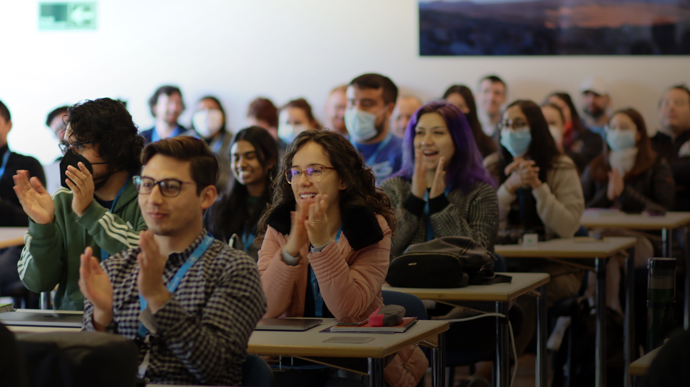
ESO is investing in the next generations,
offering programmes from undergraduate to post-doctoral level.

Slide 14
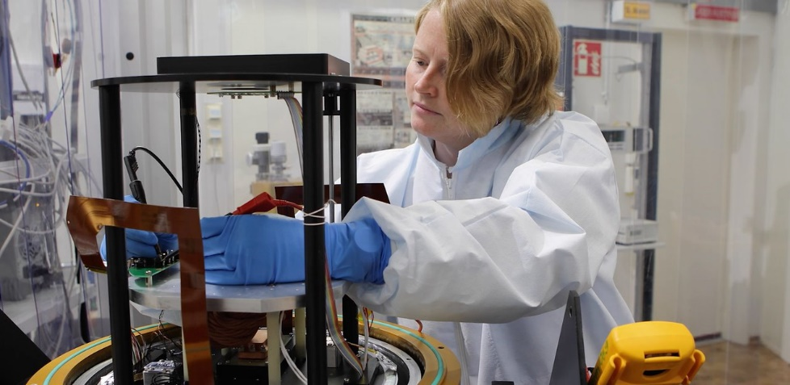
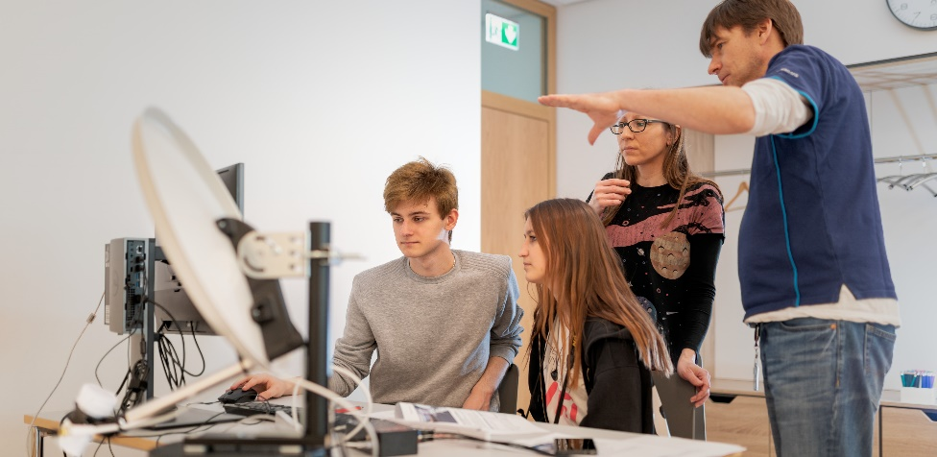
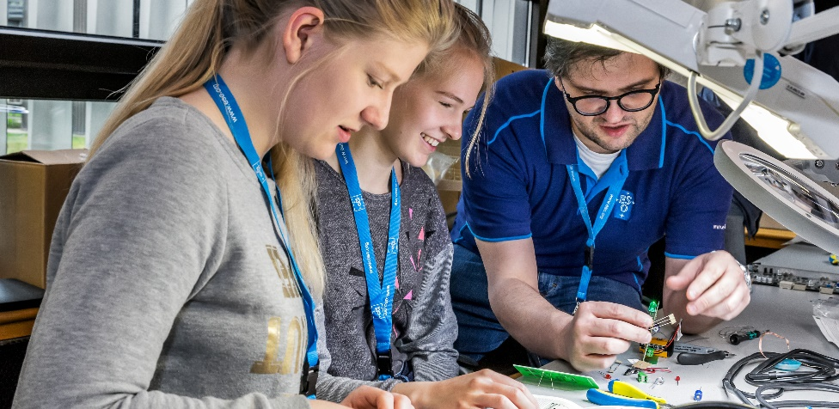
Programmes for the next generations
Competitive studentships and fellowships in astronomy and engineering
Internships in astronomy, engineering, science communication, science policy and diplomacy, human resources
Summer research programmes and observing summer schools
Credit: ESO/M. Zamani
Credit: ESO/P. Horálek

Slide 15
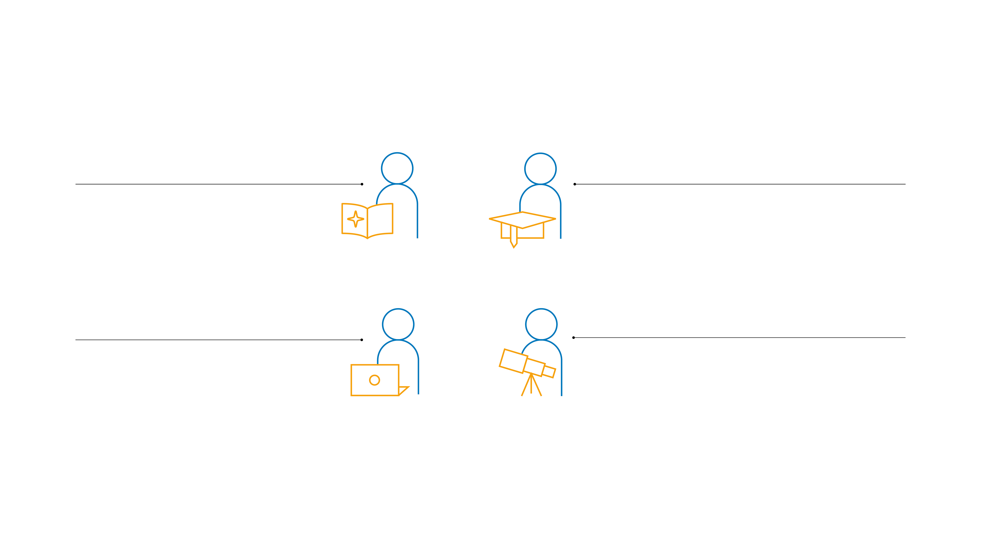
Talent development impact
260 students
150 postdoctoral fellows
from more than 40
countries in science and engineering
from more than 30 countries
90 interns
800+ ESO alumni
in science writing,
astronomy, graphic
design, engineering, science policy, and administration
in areas such as astronomy, space exploration, engineering, operations, information technology, education, business development, programme and project management, media & communications

Slide 16
Education and outreach

Slide 17
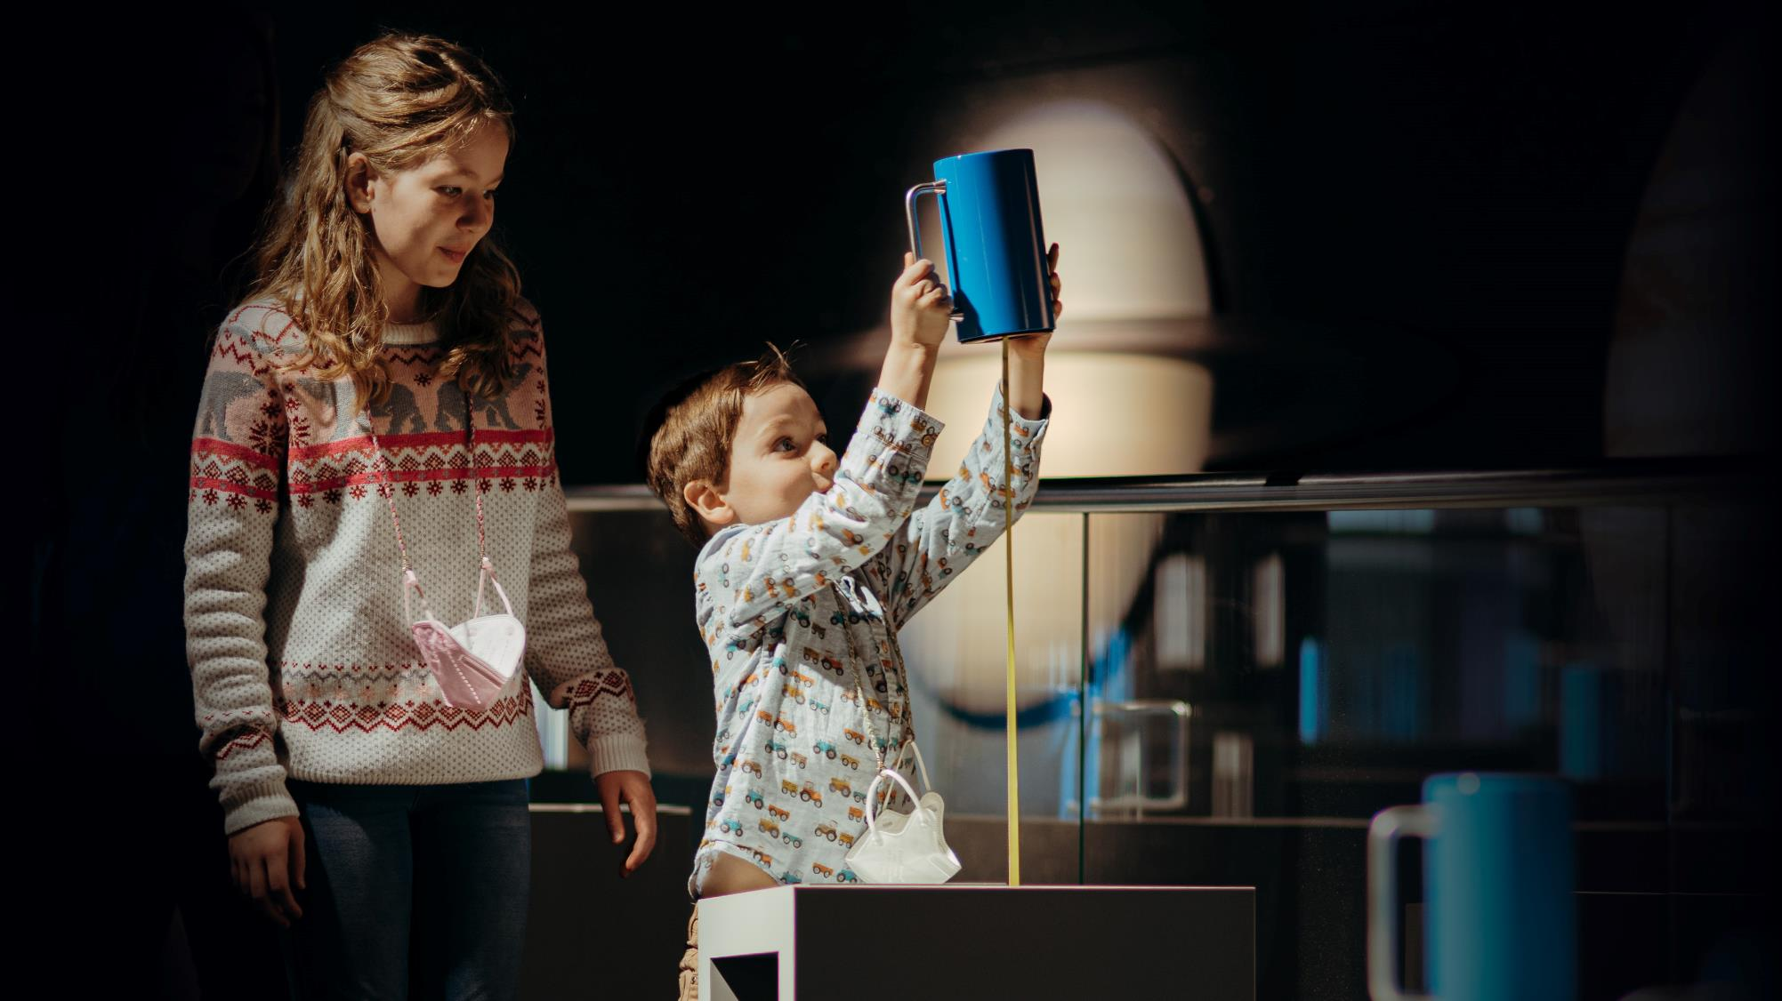
Communicate,
inspire
and educate

Slide 18
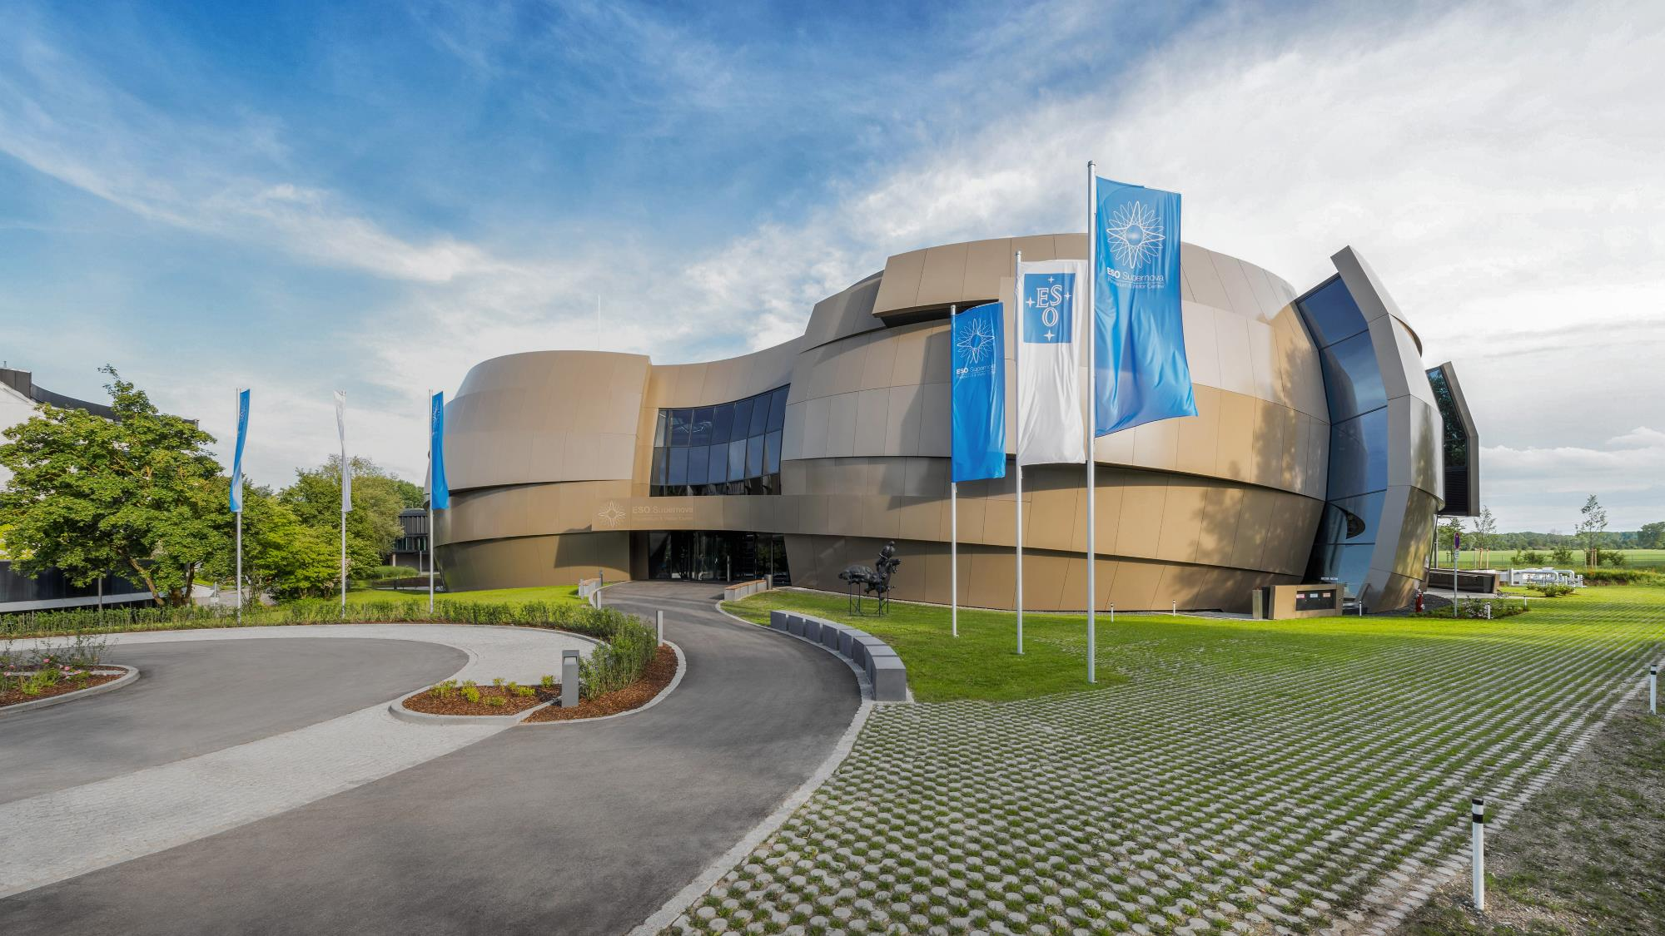
The ESO Supernova Planetarium & Visitor Centre
Credit: Fotos Brillux, Sven Rahm Fotografie
A cutting-edge free astronomy centre for the public located at the site of ESO Headquarters in Germany

Slide 19
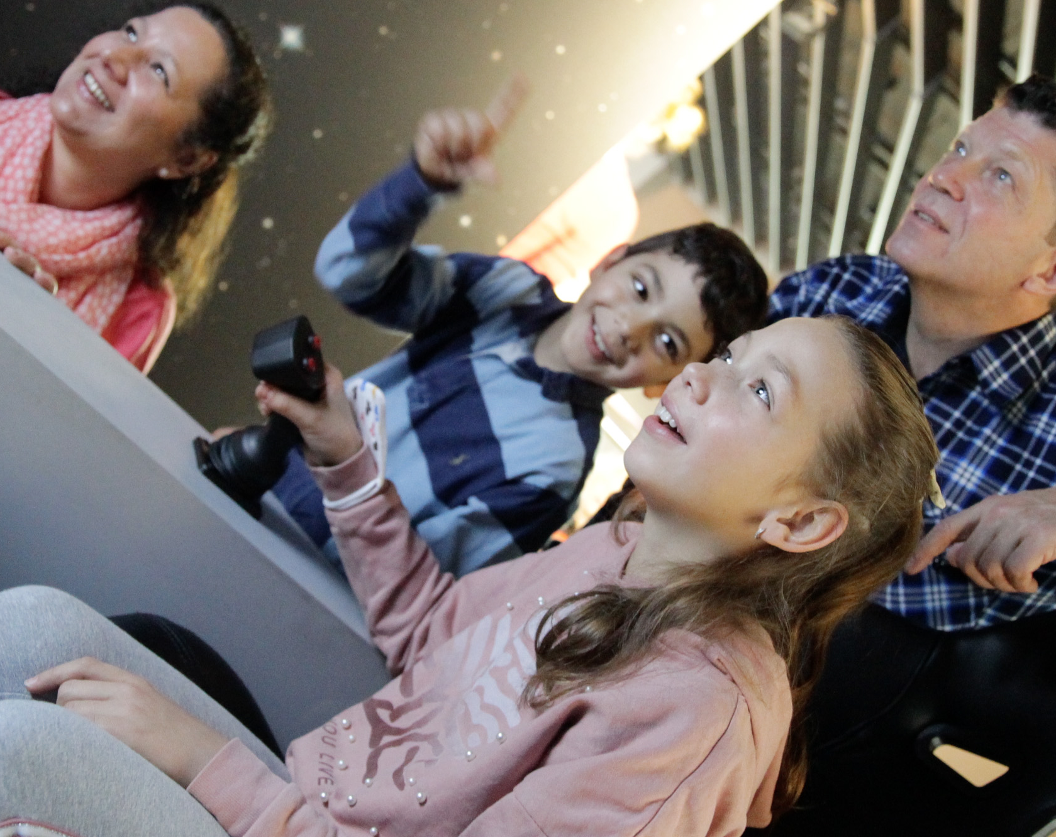
The ESO Supernova Planetarium & Visitor Centre
Interactive exhibition and planetarium
Educational workshops and materials for teachers and pupils
Supporting materials​ for planetariums and science centres worldwide
70 000 visitors per year

Slide 20
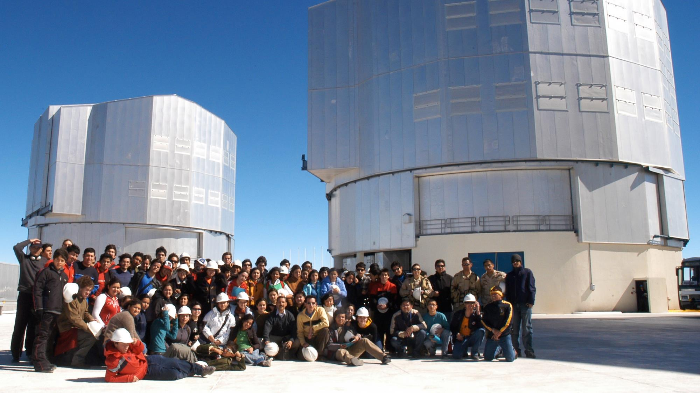
Public visits to ESO observatories

Slide 21
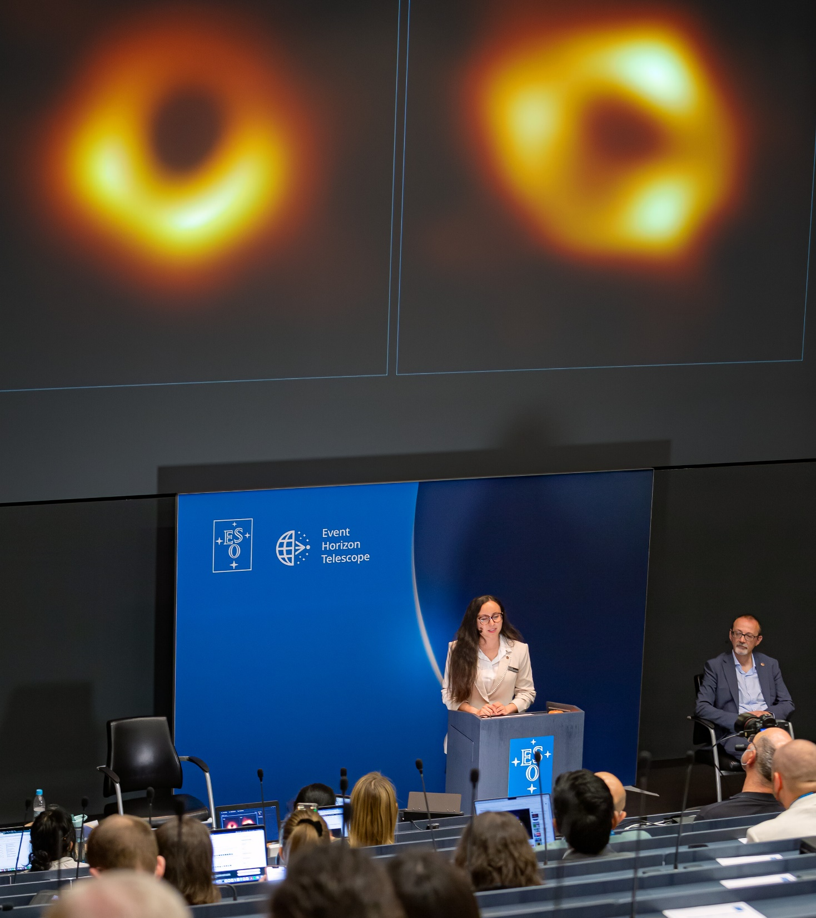
Reaching out
ESO News in 12 languages
Public astronomical outreach images and video archives
ESO Science Outreach Network
Events and Exhibitions
The Messenger – ESO’s science and technology journal
Credit: ESO/M. Zamani

Slide 22
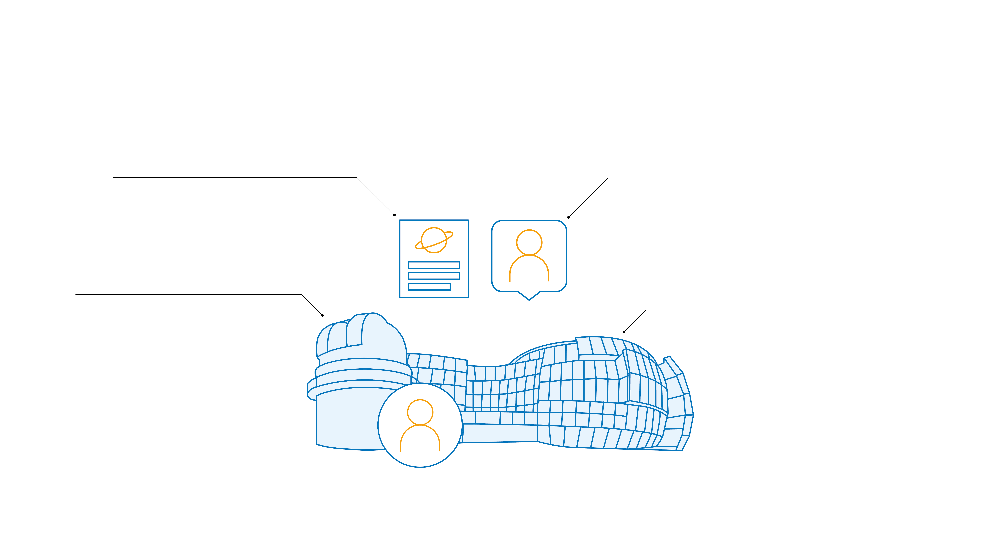
Education and outreach impact
71 press articles
Half a million
online per day
followers on social media
8000 visitors
70 000 visitors
per year to ESO observatories
per year to ESO Supernova Planetarium & Visitor Centre

Slide 23
International collaboration and policy

Slide 24
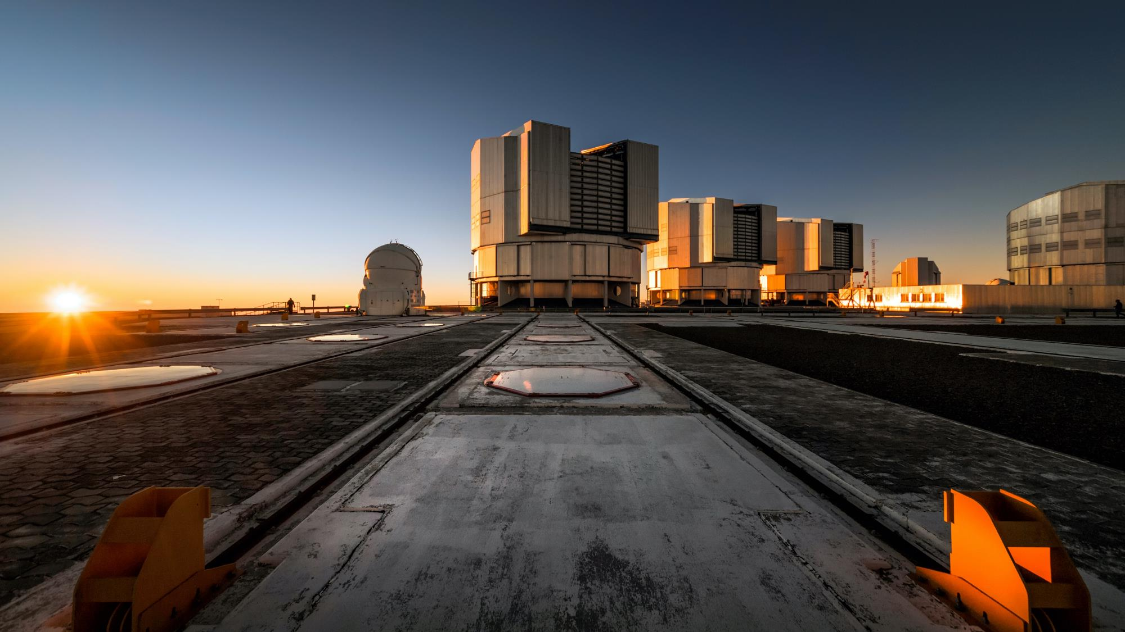
ESO: collaborations for peace
Credit: A. Ghizzi Panizza/ESO
ESO represents a model for peaceful scientific cooperation between nations as one of the first intergovernmental scientific organisations

Slide 25
ESO’s policy contributions
Open data and standards
in astronomy
United Nations Committee
on the Peaceful
Uses of Outer Space
Safeguarding
the dark sky
EIROForum
Ethical review
processes in science
Impact of satellite
mega-constellations
Protecting Earth
from asteroids

Slide 26
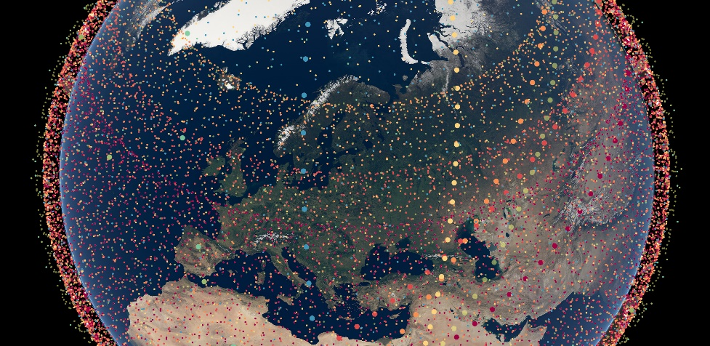
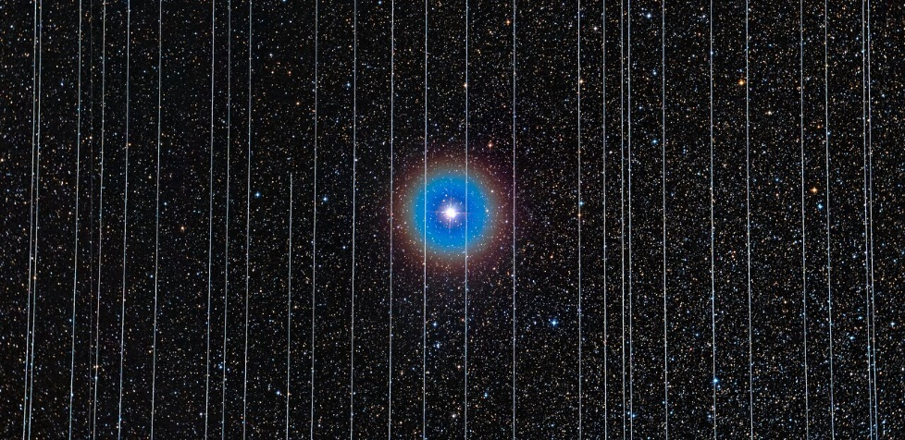
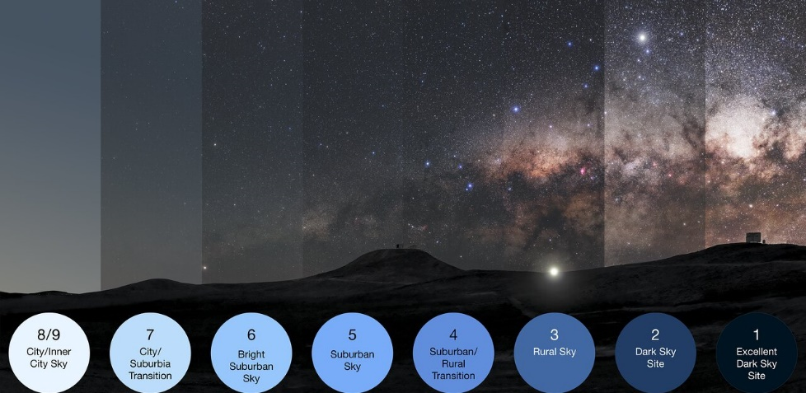
Protecting the dark and quiet sky
Study the effects of new satellite constellations
Petition for the protection of our dark and radio-quiet sky at the UN
Contribute to the IAU Centre for the Protection of the Dark and Quiet Sky from Satellite Constellation Interference
Fund regional and national initiatives in Chile on increasing light pollution awareness
Credit: ESO/P. Horálek, M. Wallner

Slide 27
Sustainability

Slide 28
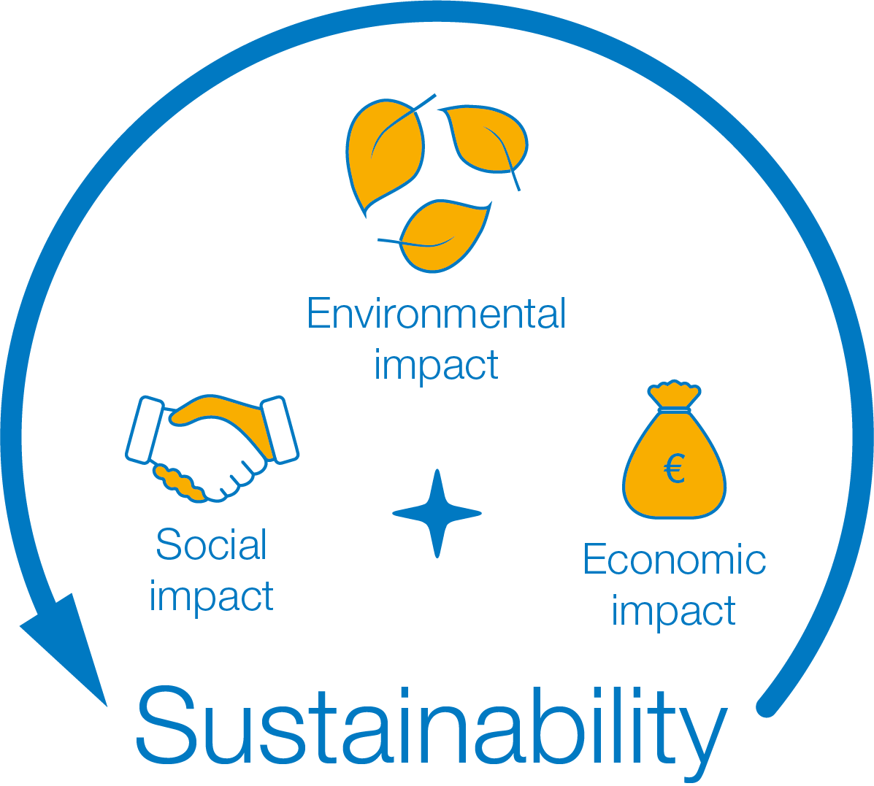
For ESO, a sustainable future addresses environmental, societal and economic concerns

Slide 29
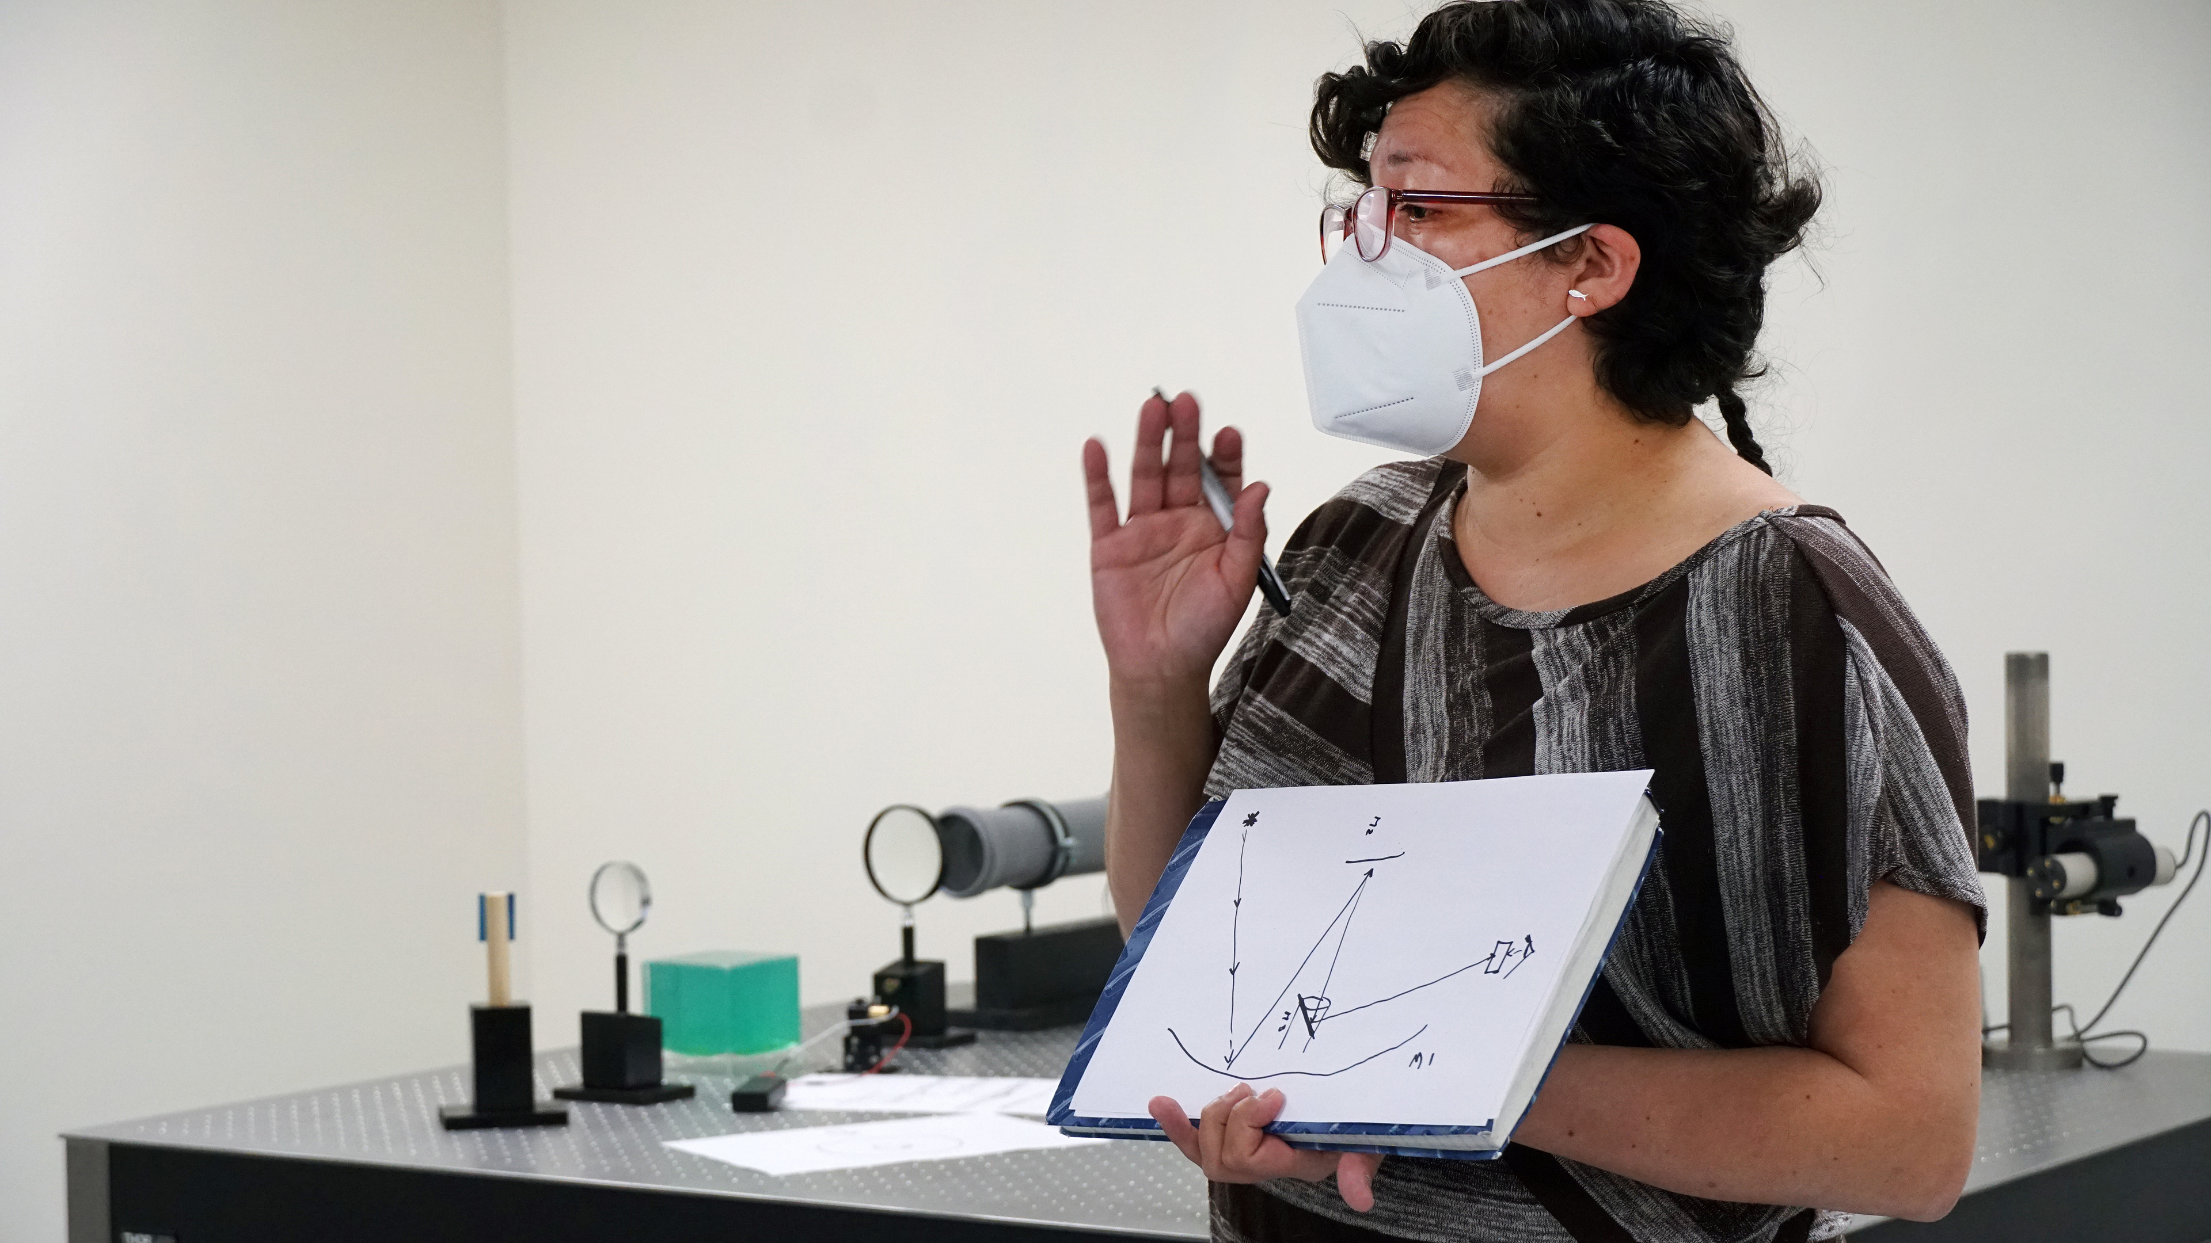
Diversity, equity and inclusion

Slide 30
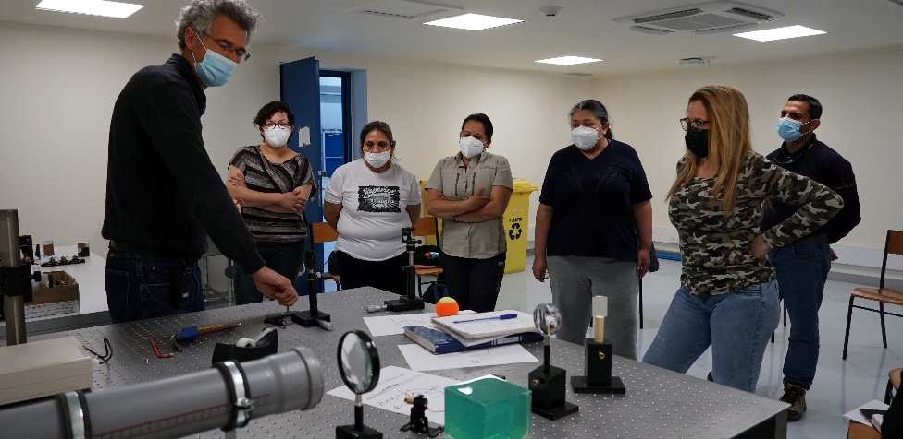
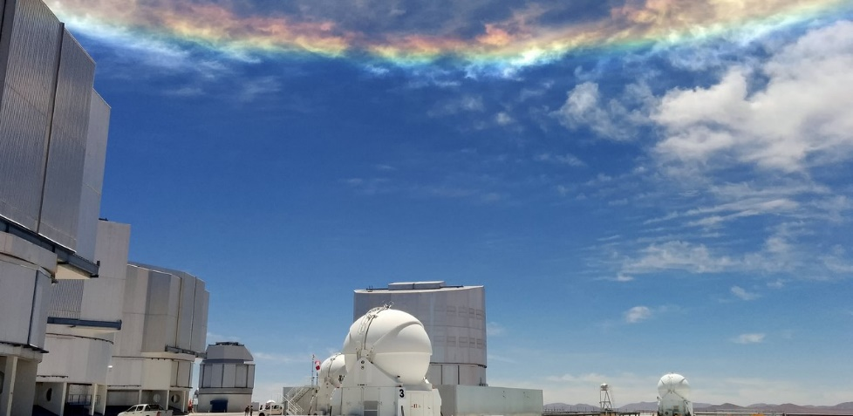
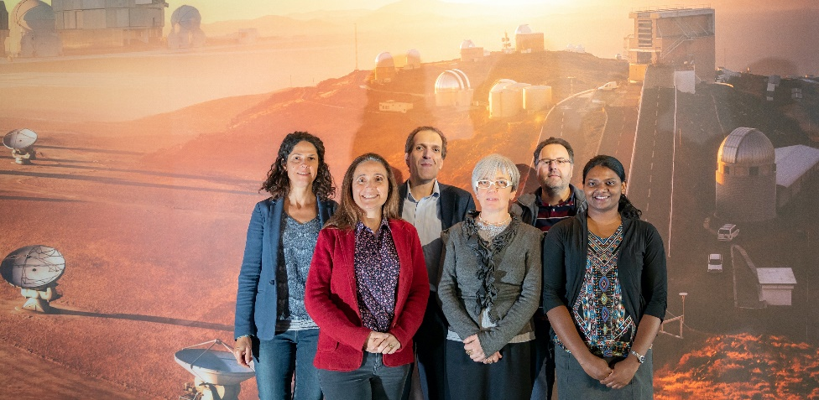
Increase diversity, equity and inclusion
Increase the percentage of women in technical, engineering, and decision-making positions
Scale-up efforts to support other diversity dimensions (people with disabilities, LGBTQ+, ethnicity, etc.)
Develop leadership training and mentoring programmes for under-represented groups
Create a welcoming and psychologically safe environment, and enable staff to work more effectively and safely through advanced work-life balance policies
Credit: G. Ávila/ESO
Credit: ESO/M. Zamani

Slide 31
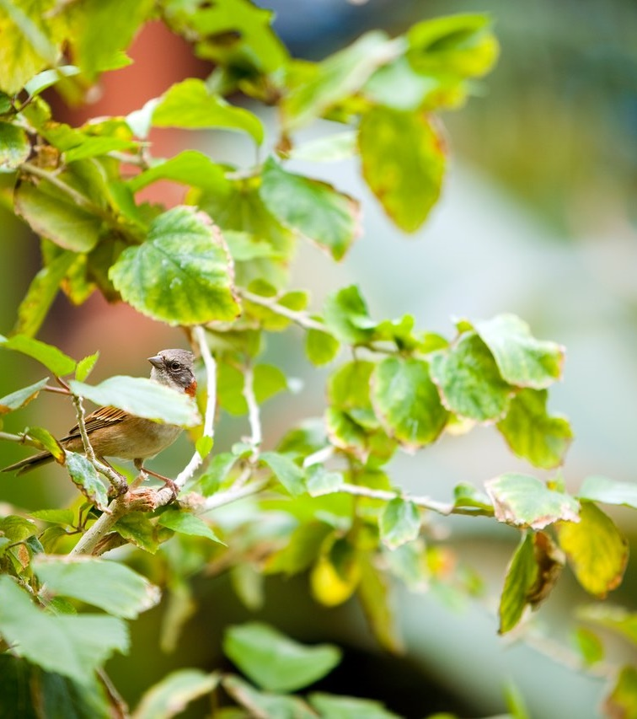
Reducing our carbon
footprint
ESO is taking immediate action to reduce
its carbon footprint, while also changing its operations for long-term impact

Slide 32
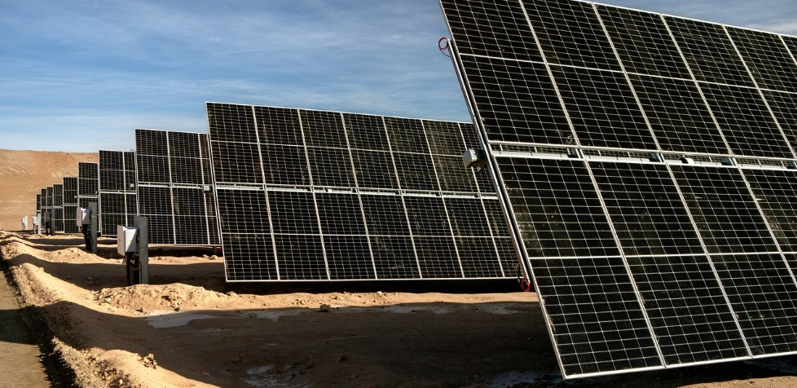
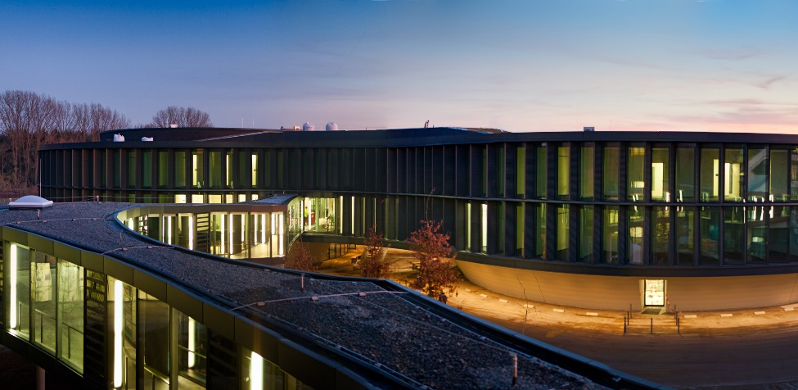
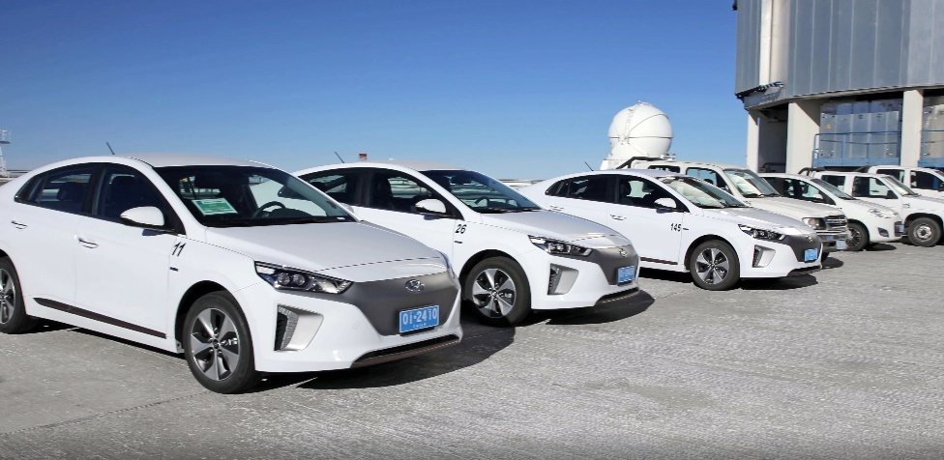
Reducing our carbon footprint
Power La Silla and Paranal observatories by renewable energy
Heat and cool the ESO Headquarters extension building through concrete core activation
Reduce business travel by air, instead opting for virtual meetings wherever possible
Divest from air shipping, preferring sea freight over air
Integrate sustainability into the design phase of new projects and procurement
Monitor our emissions regularly and update our plans accordingly

