Slide 1

How ESO saw first light

Slide 2
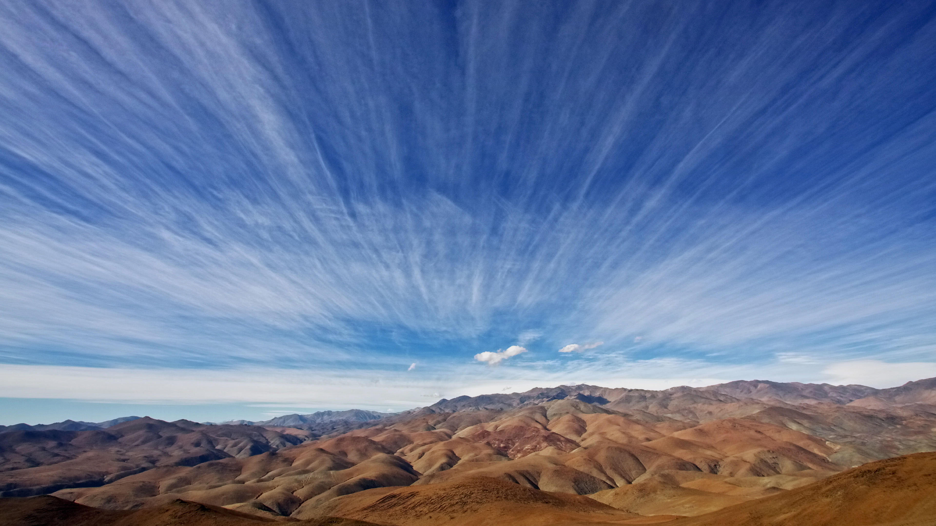
Credit: A.Fitzsimmons/ESO
“Astronomy is a school for patience.”
André Danjon

Slide 3
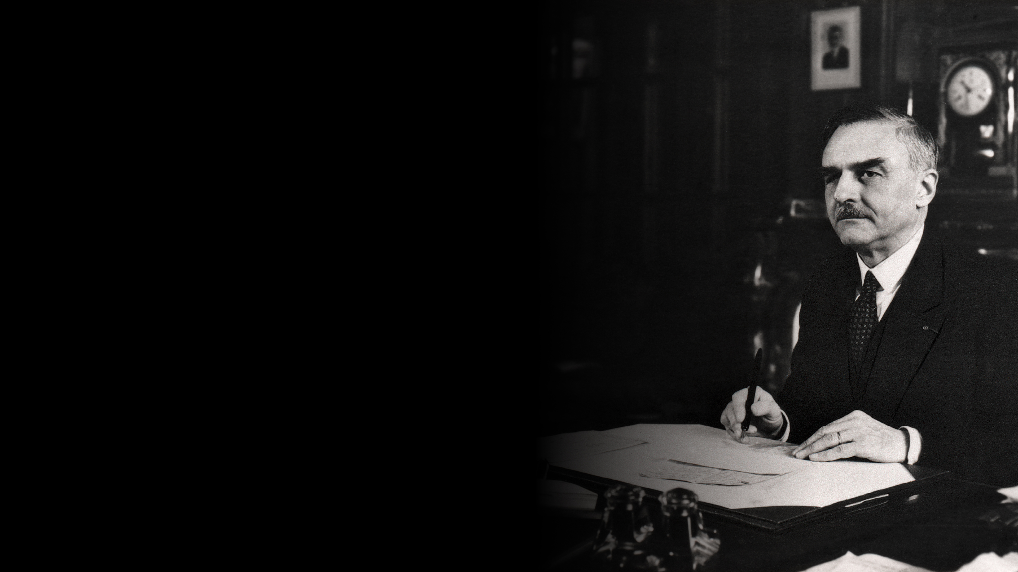
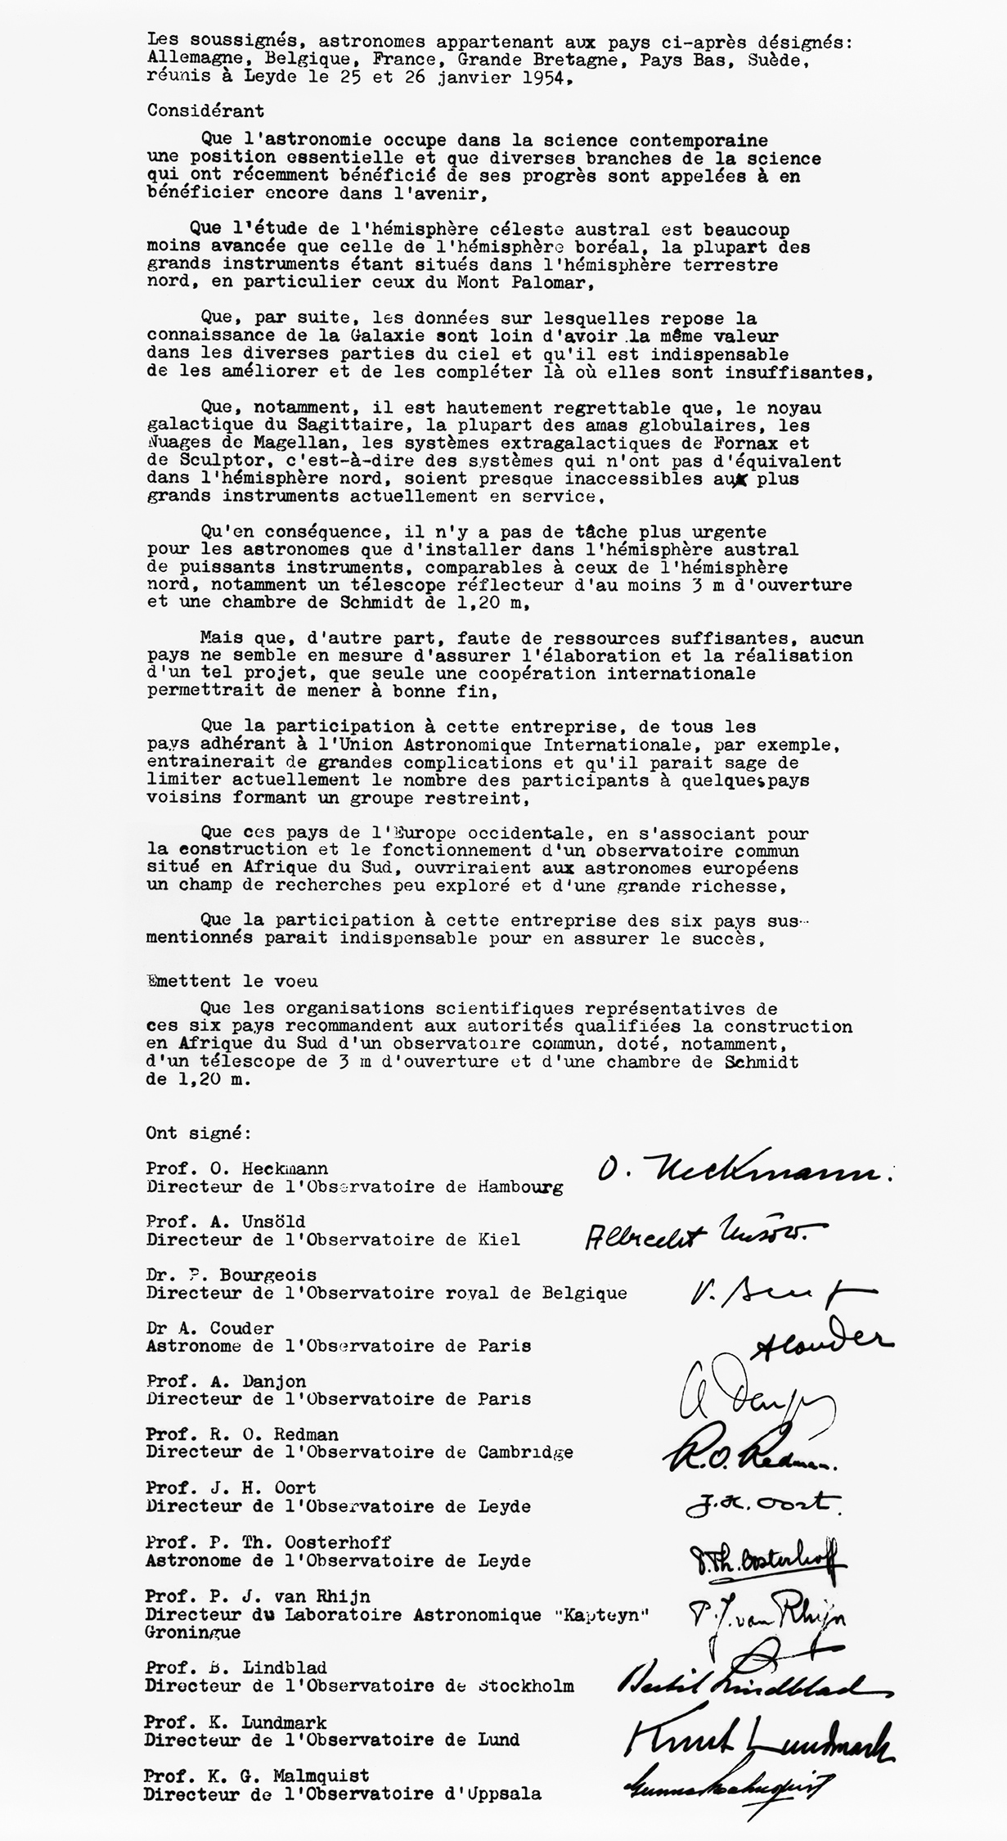
26 January 1954
Astronomers from six European countries sign a statement with the aim of establishing a joint observatory.
The observatory should house two modern telescopes with an initial staffing of 14 people.
André Danjon, one of ESO’s founding fathers, signs the statement.

Slide 4
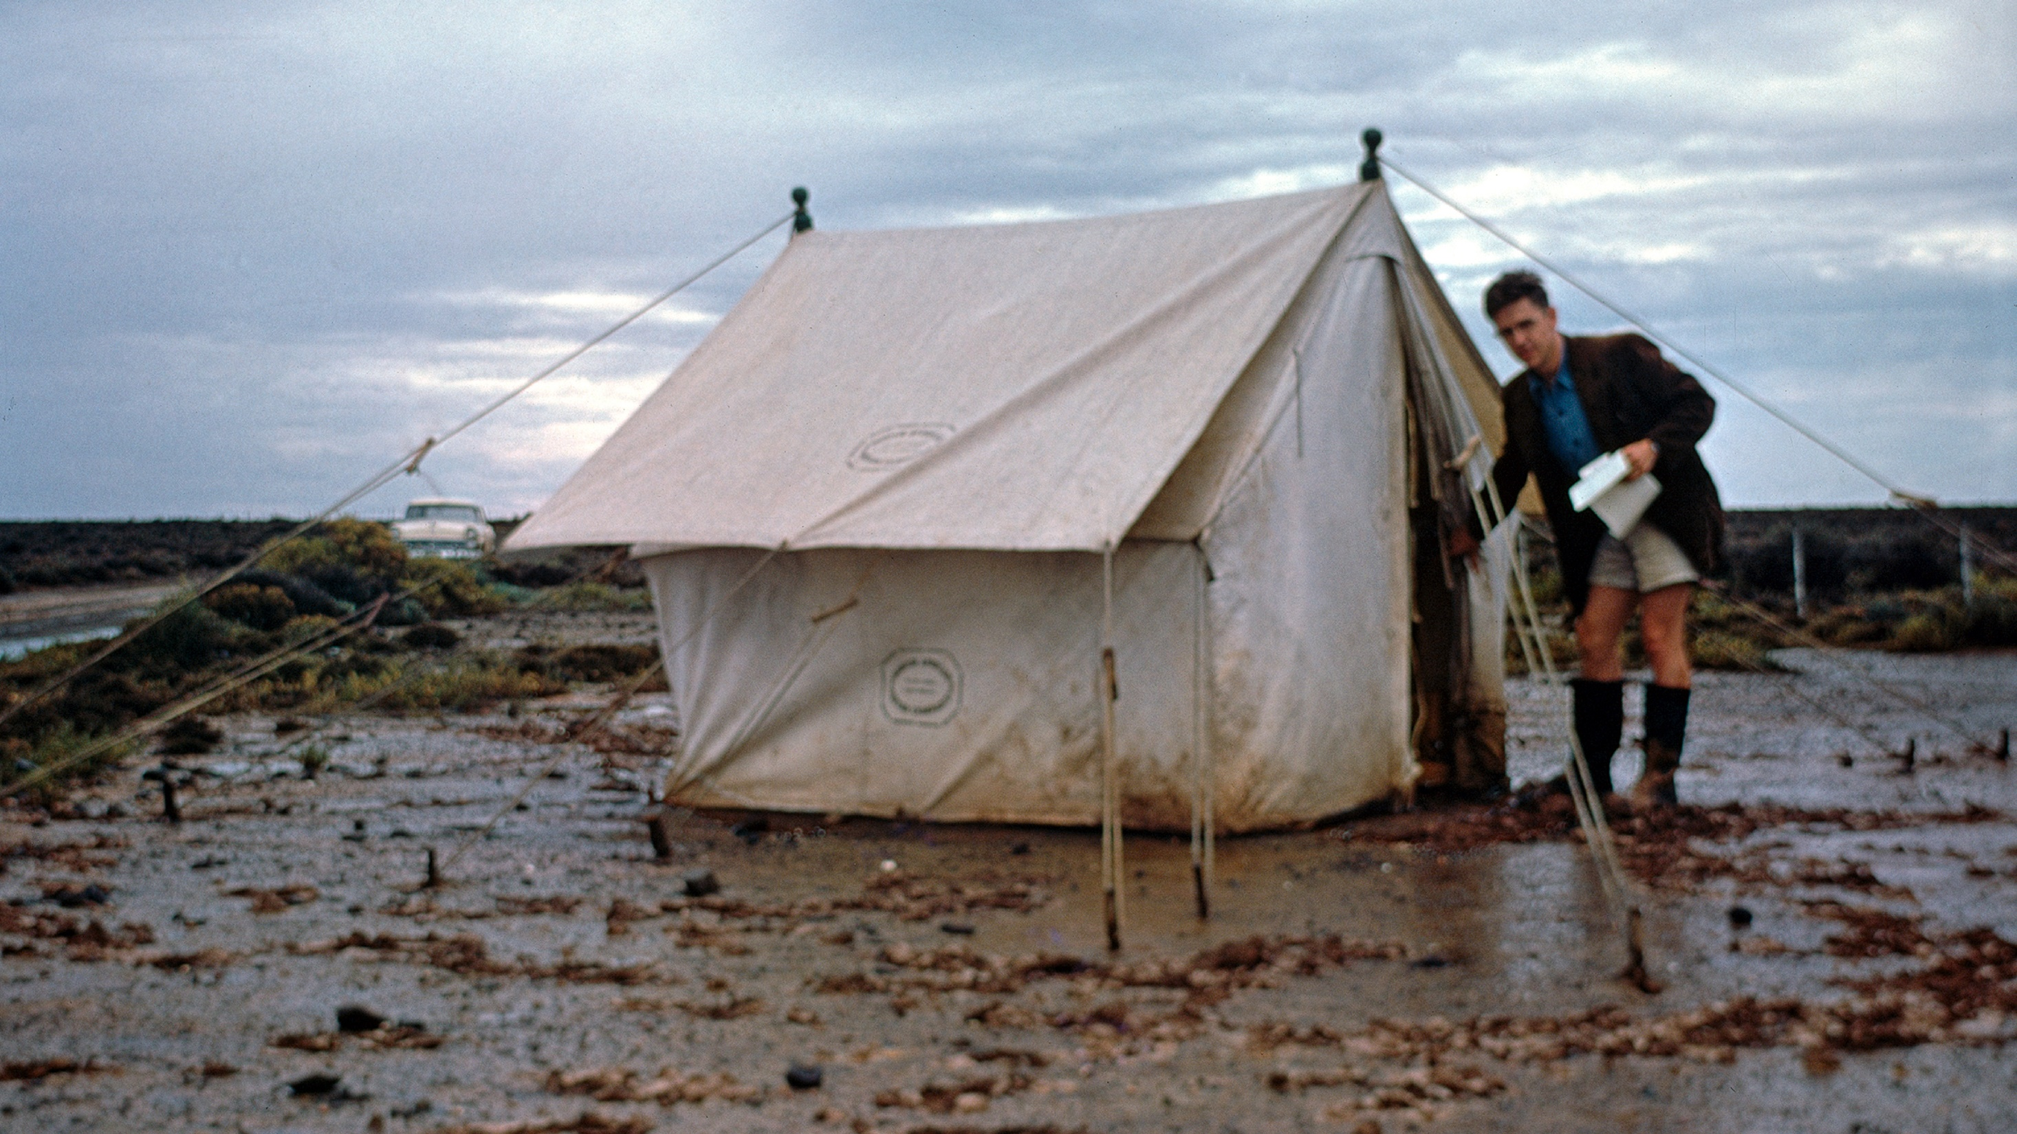
Credit: J. Dommaget/ESO and J. Boulon/ESO
However,
it would be almost ten more years before ESO was on solid ground.

Slide 5
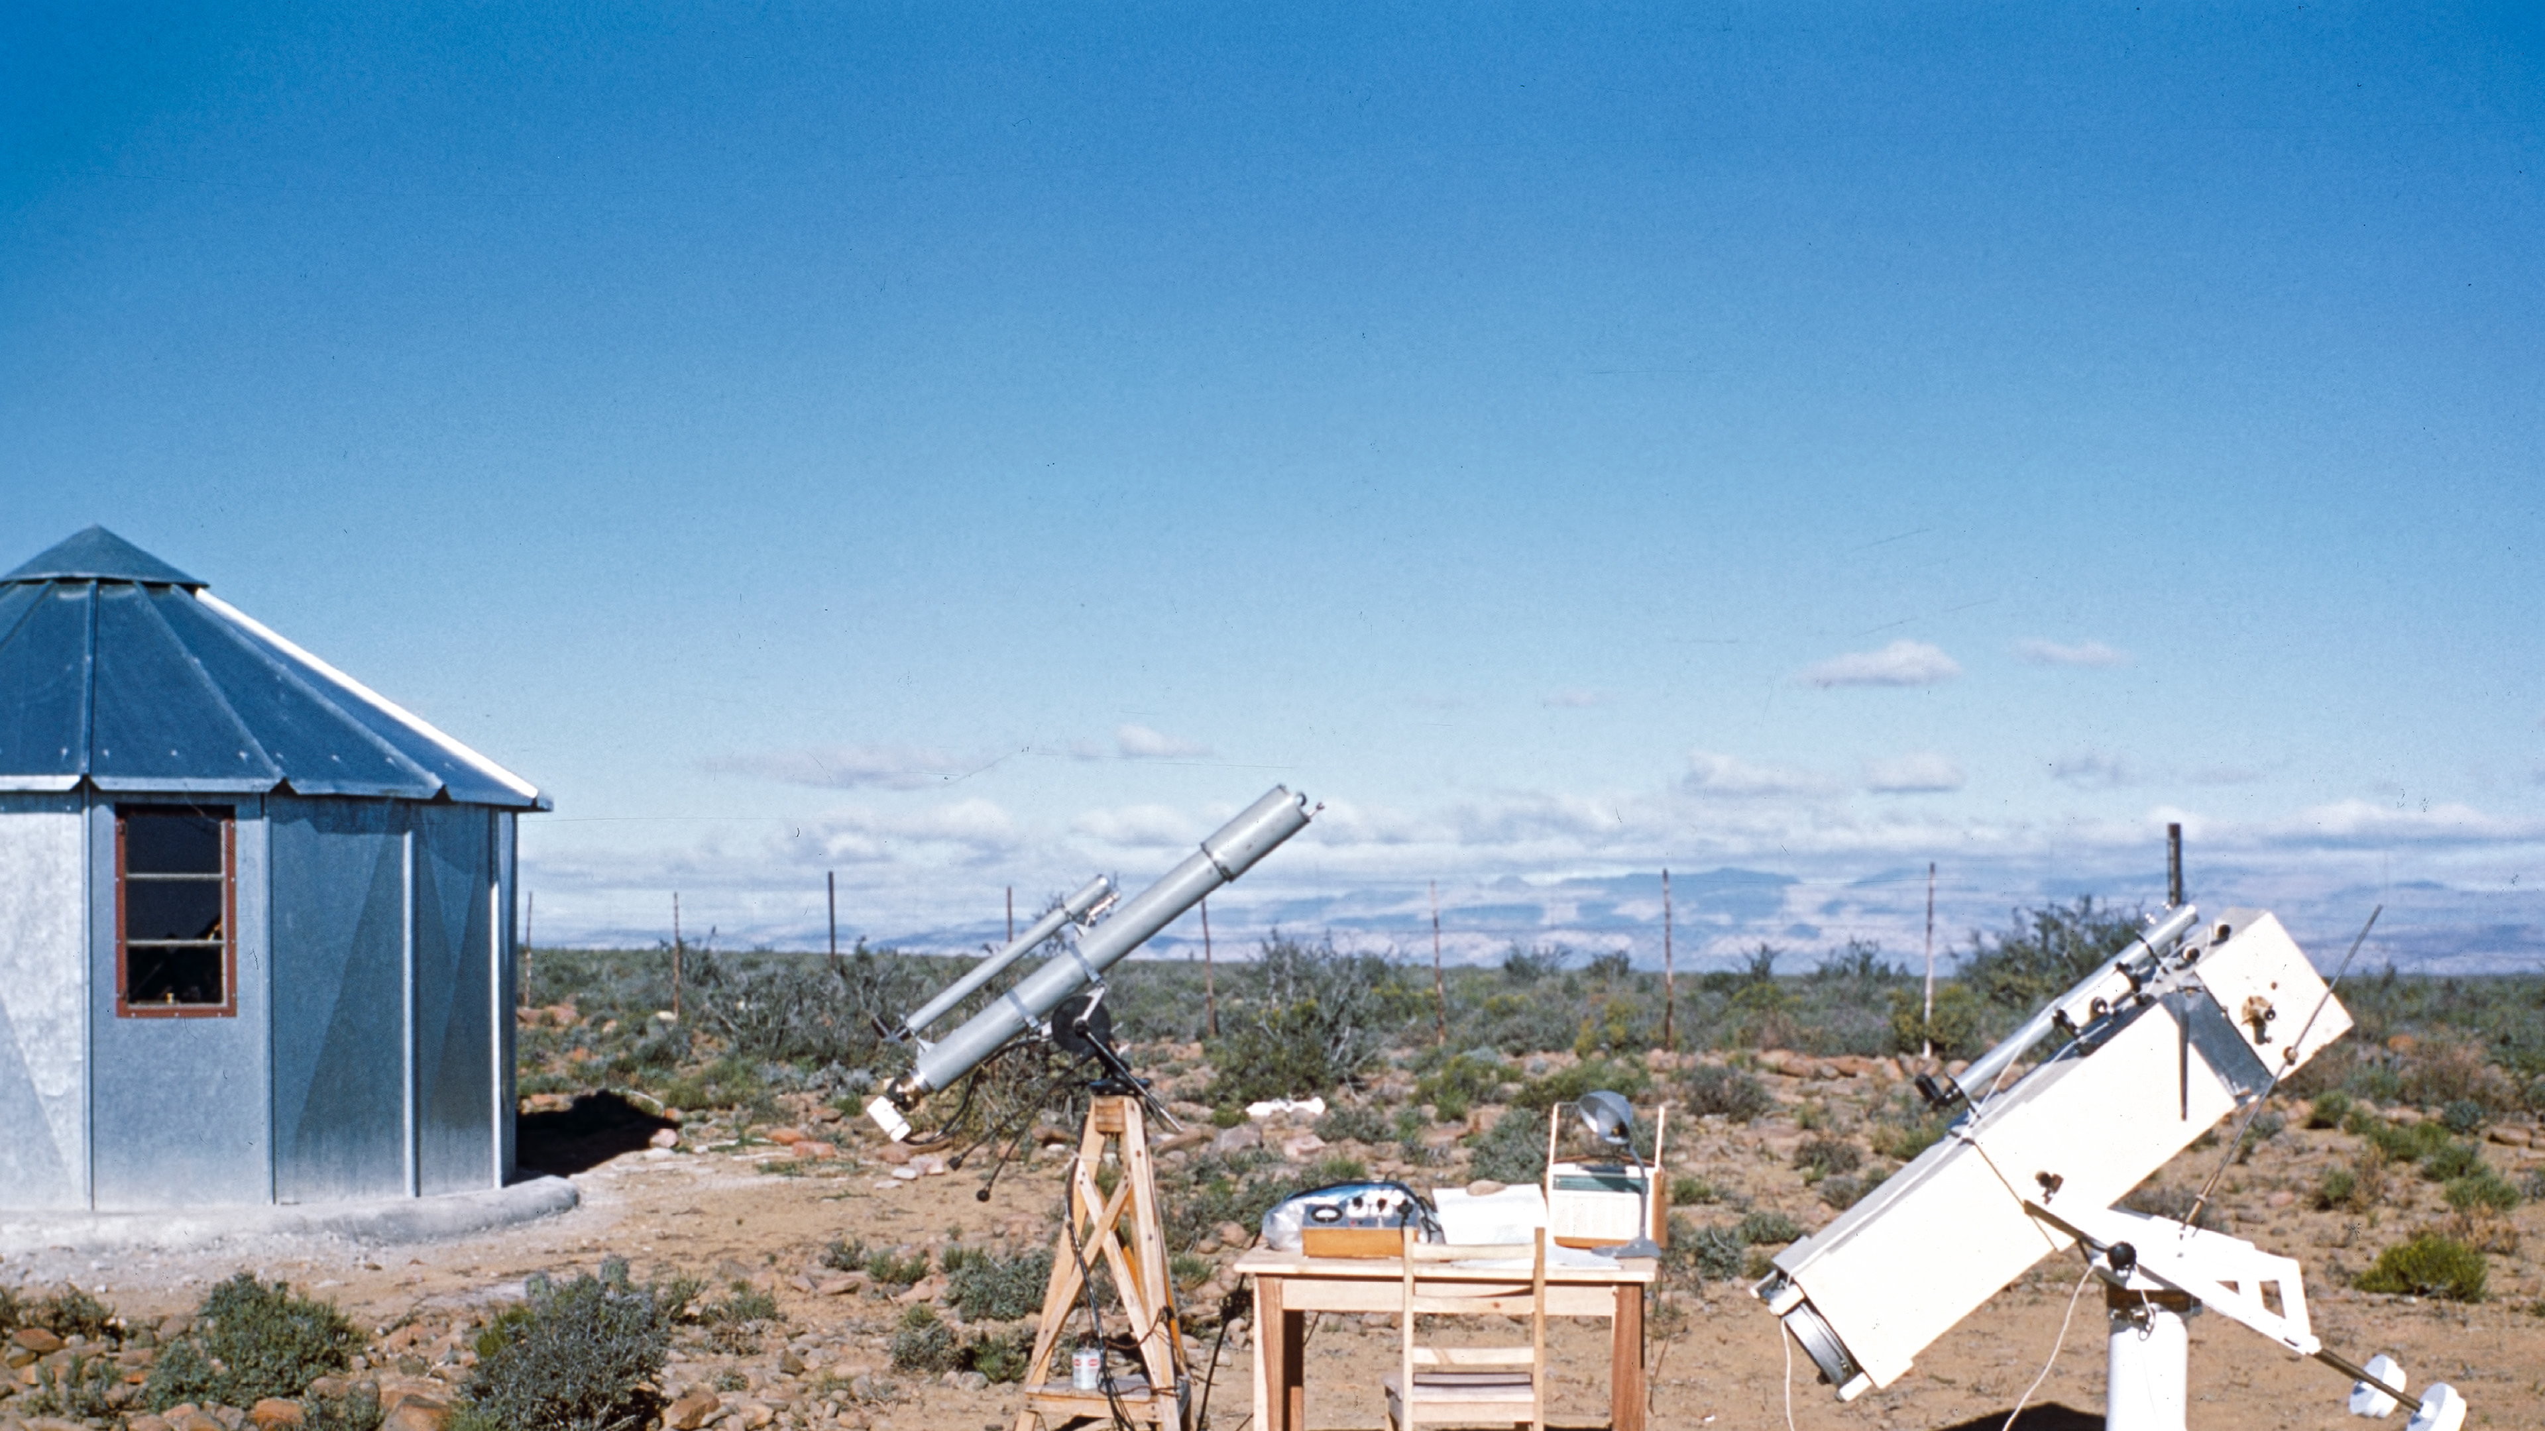
Astronomers embarked on a long journey to locate
the perfect observatory in the southern hemisphere…
Credit: ESO/W. Schlosser

Slide 6
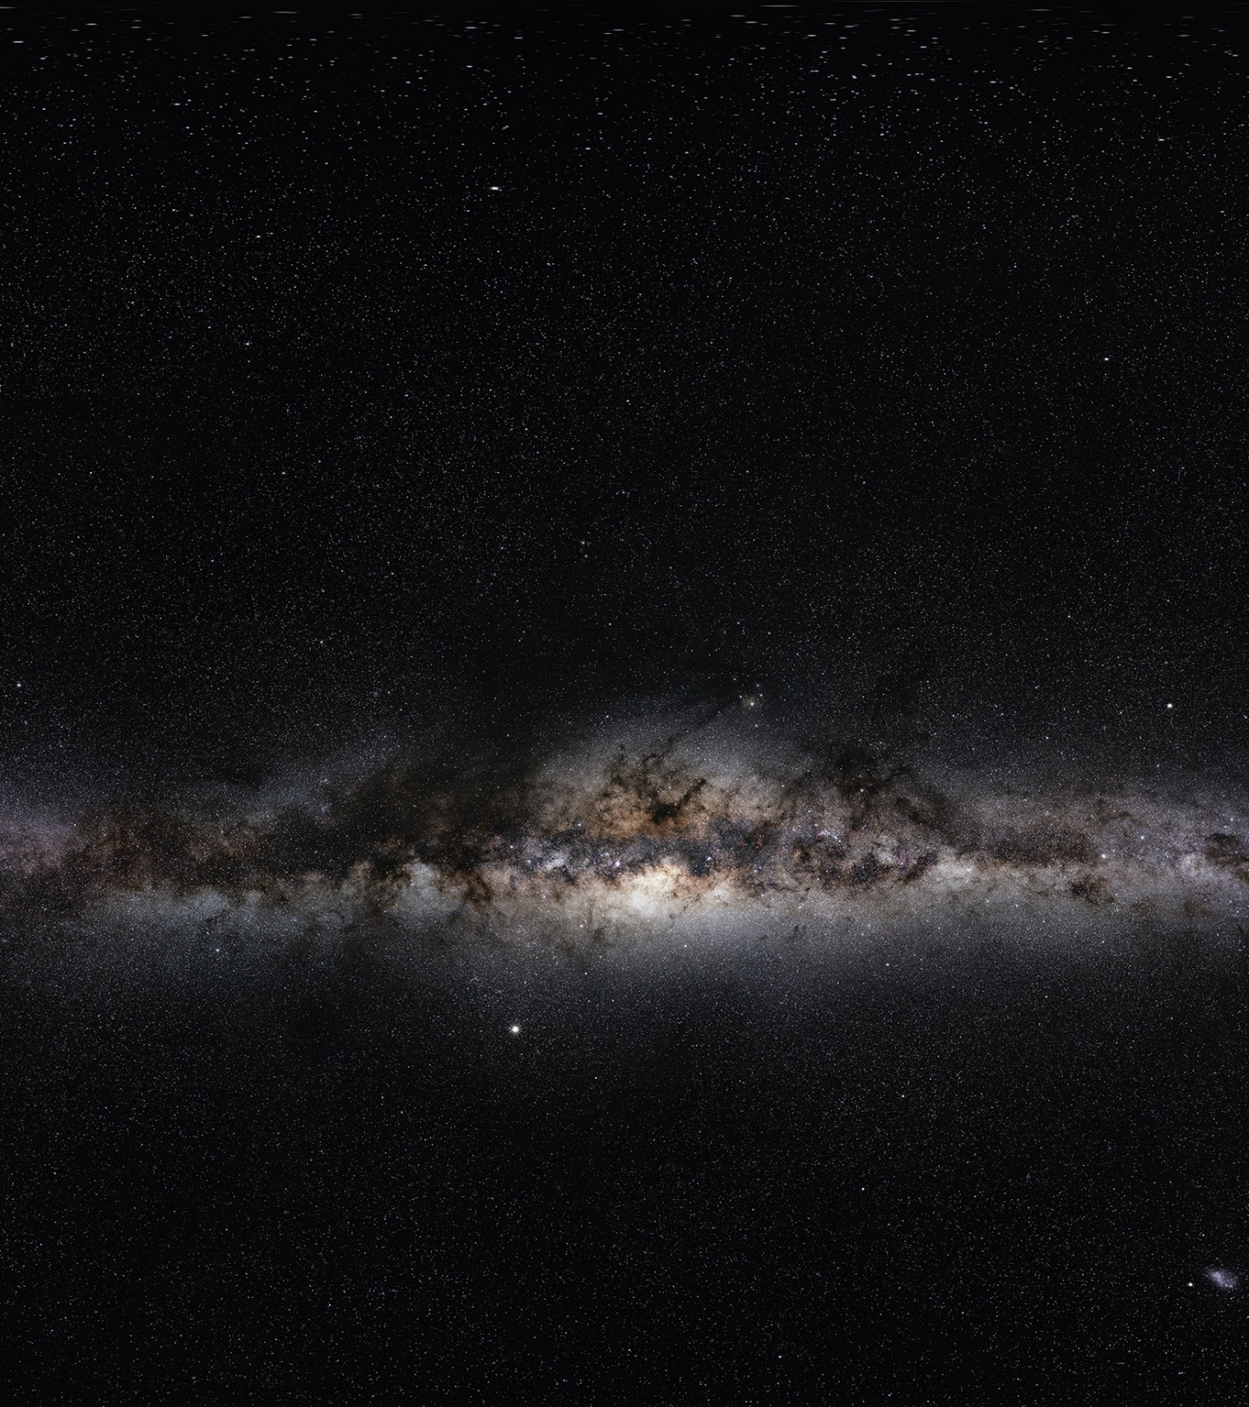
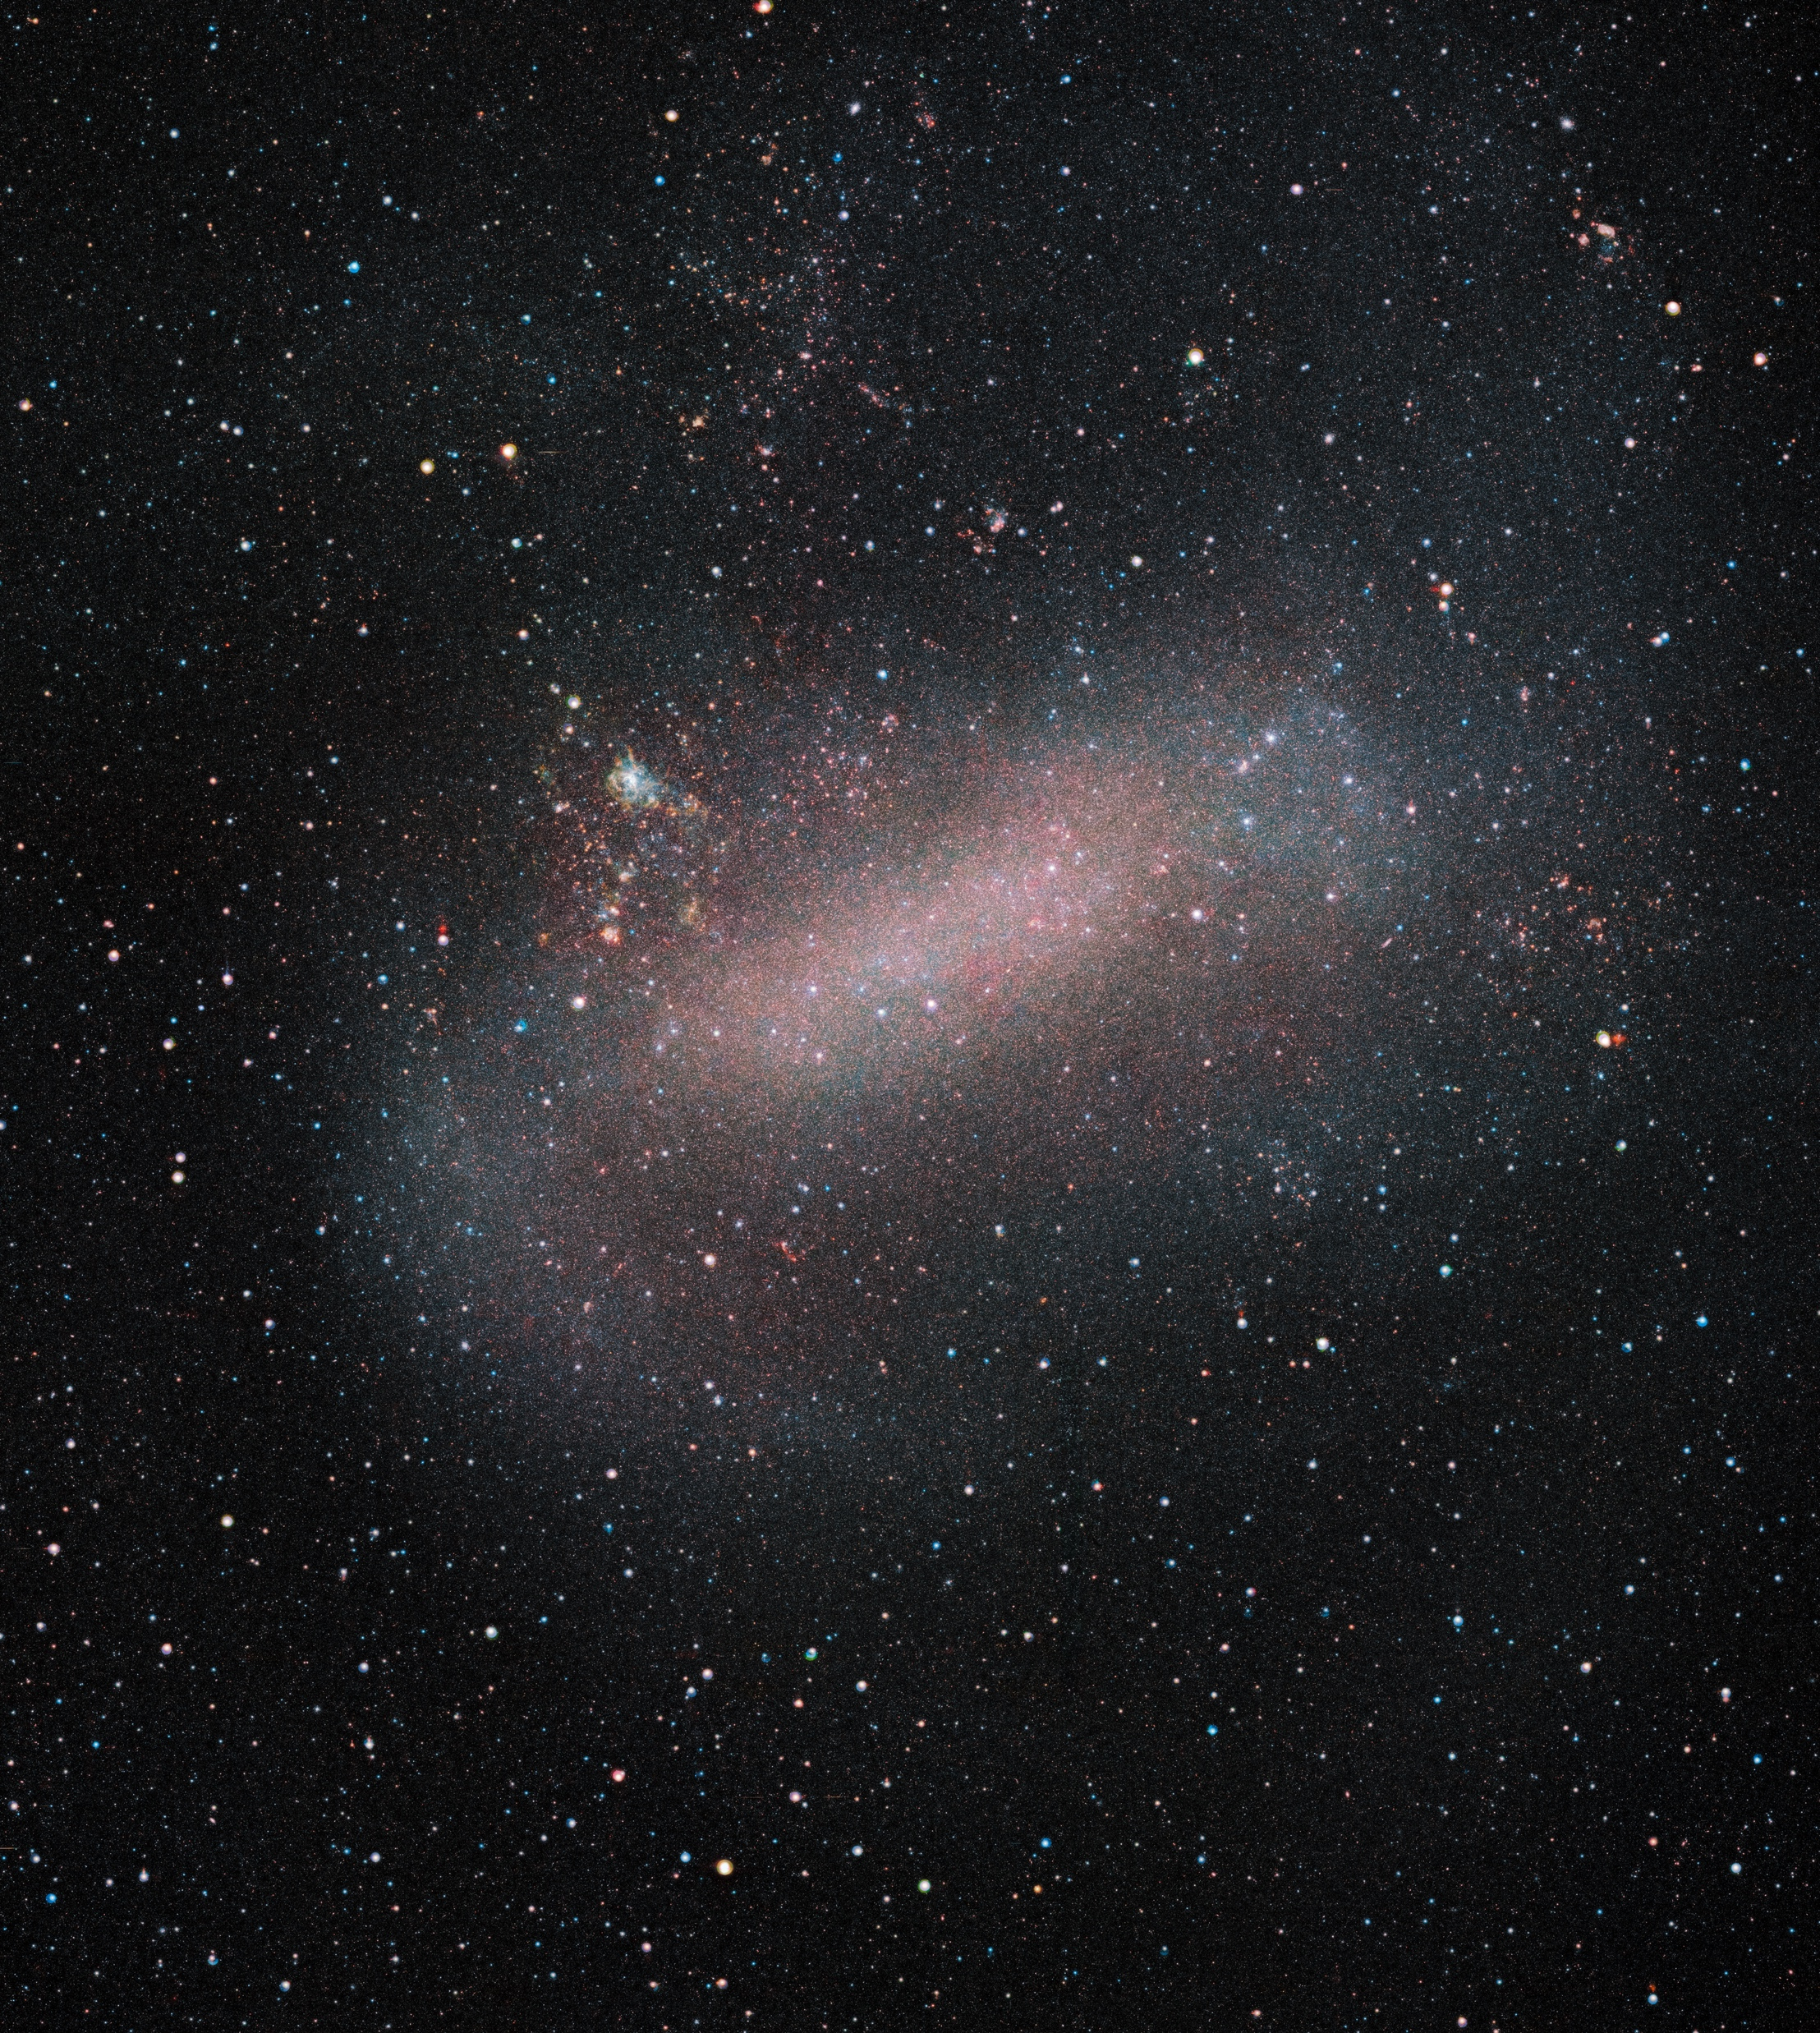
But why go south?
Because some of the most exciting objects in the Universe are best observed from there, …
Credit: ESO/S. Brunier
Credit: ESO/VMC Survey
…like the centre
of our own galaxy…
…and our
neighbouring stellar systems.

Slide 7
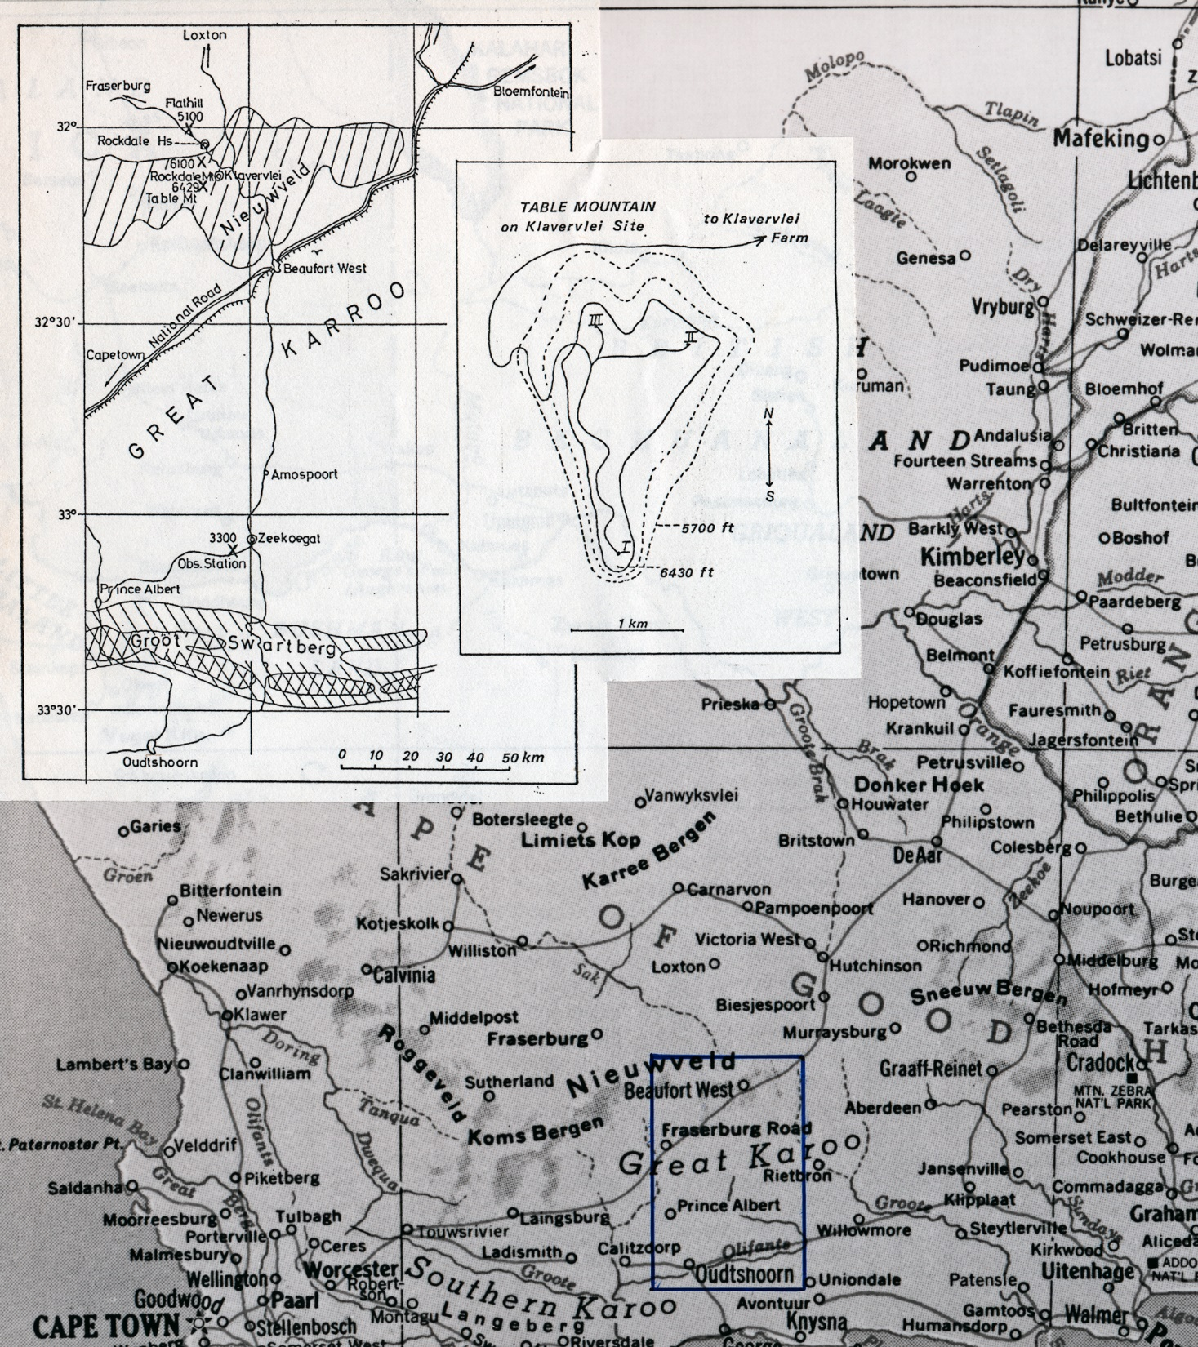

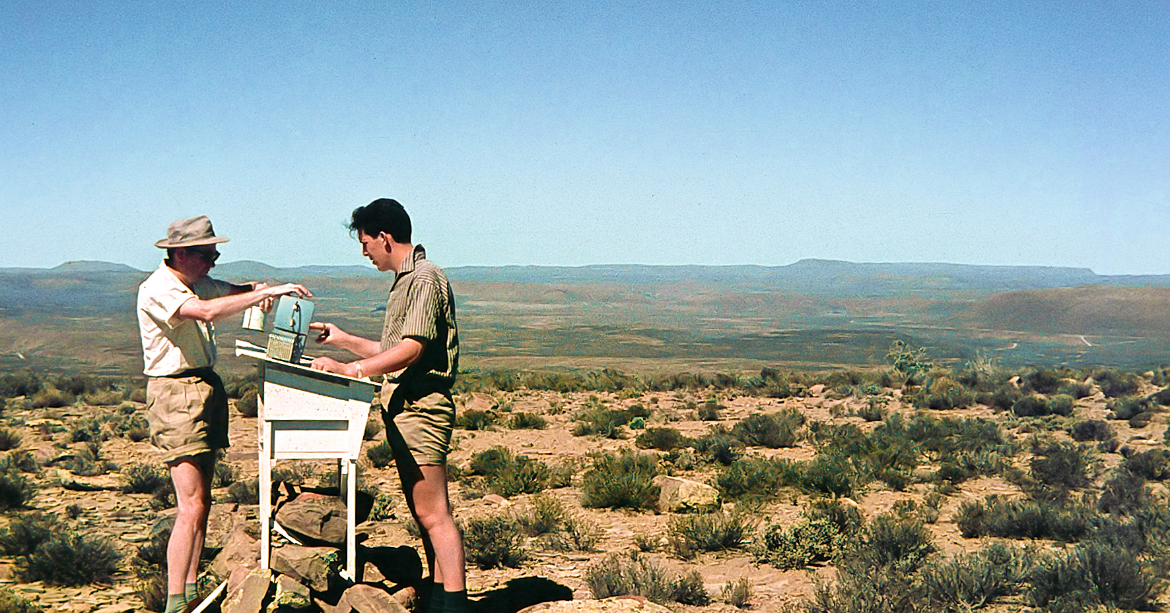
1955 to 1963
Initially, they
strongly favoured South Africa…
Credit: ESO/J.Doornenbal

Slide 8
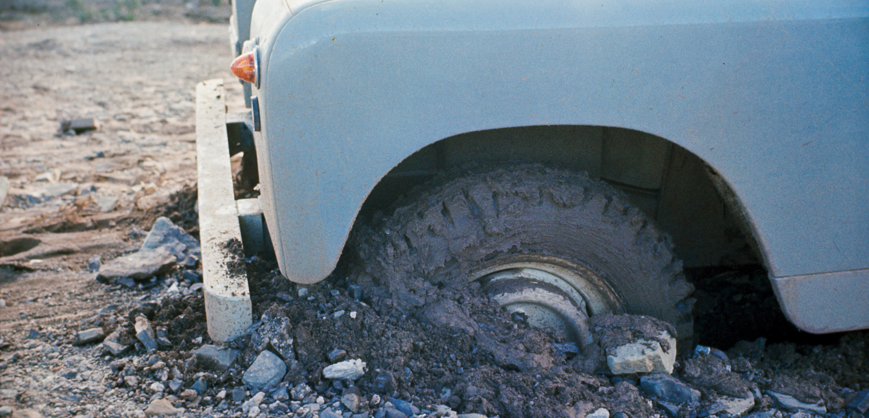
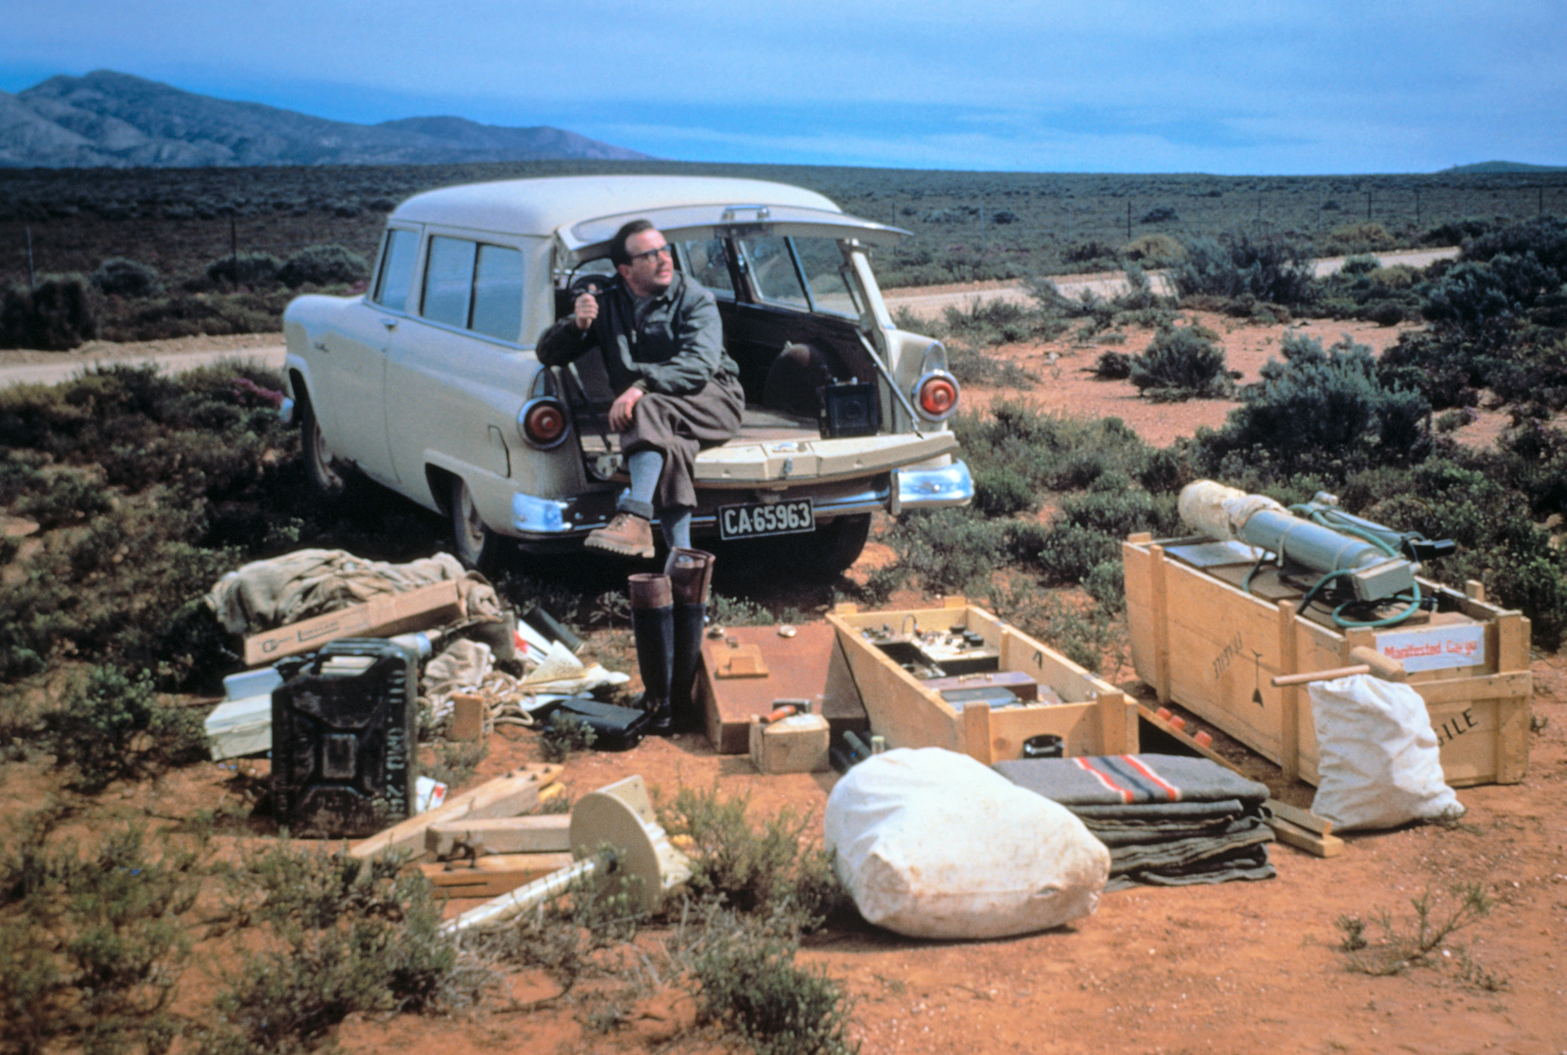
Credit: ESO/W. Schlosser
Credit: ESO/J.Doornenbal
…because several European observatories had their own facilities on the premises of South African observatories…
Credit: ESO/J.Dommanget
…and it had the best astronomical climate known at the time.

Slide 9
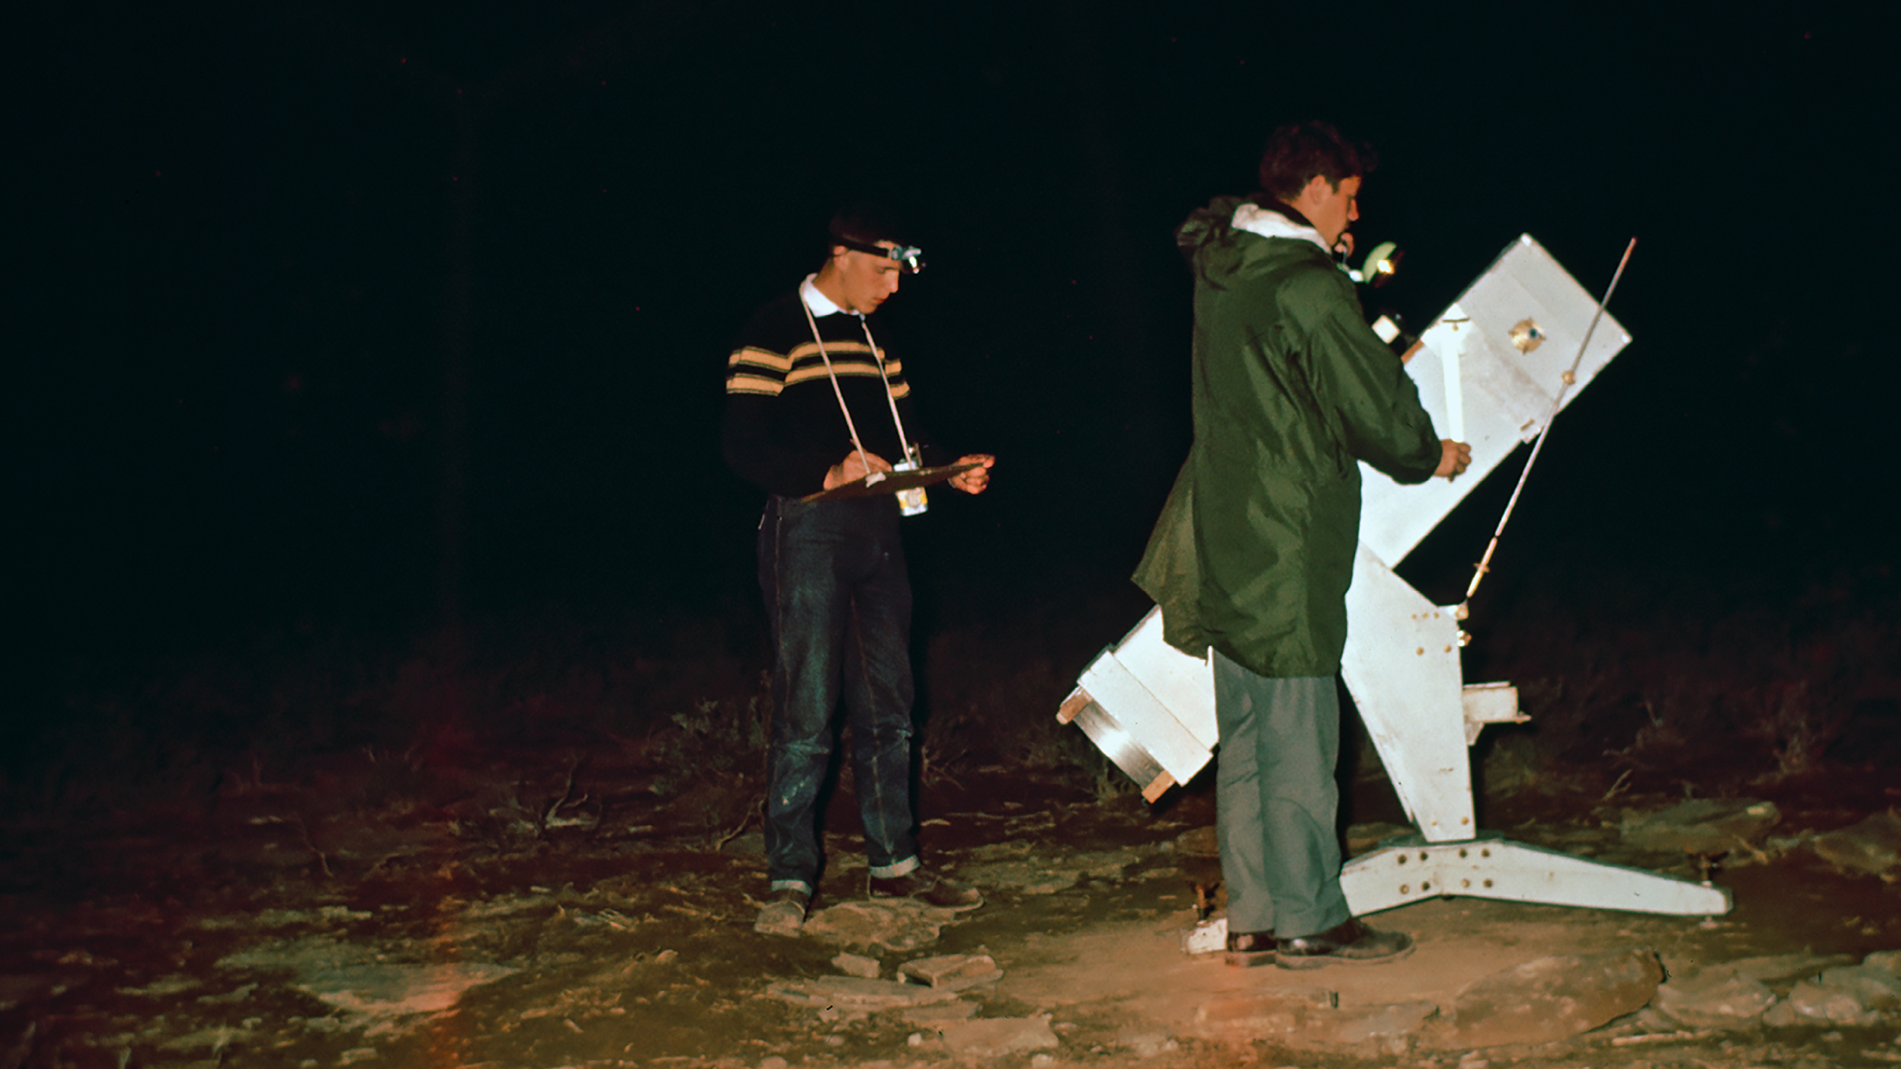
Over the course of almost nine years the astronomers tested various sites.
Credit: ESO/W. Schlosser

Slide 10
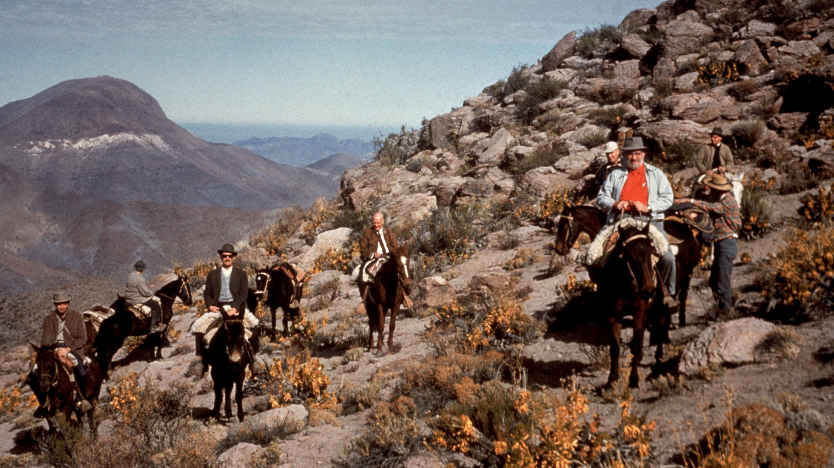
1961 to 1963
Meanwhile in South America…
Credit: ESO/F.K.Edmondson

Slide 11
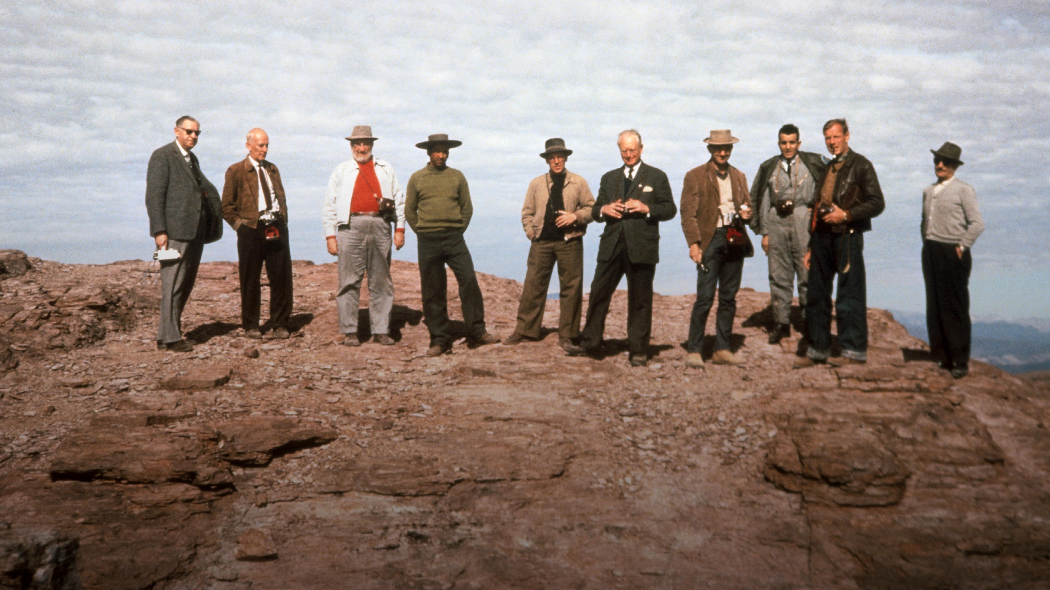
Credit: ESO/F.K.Edmondson
Thanks to a collaboration with US astromoners,
ESO sends a team to test various mountain tops in Chile.

Slide 12
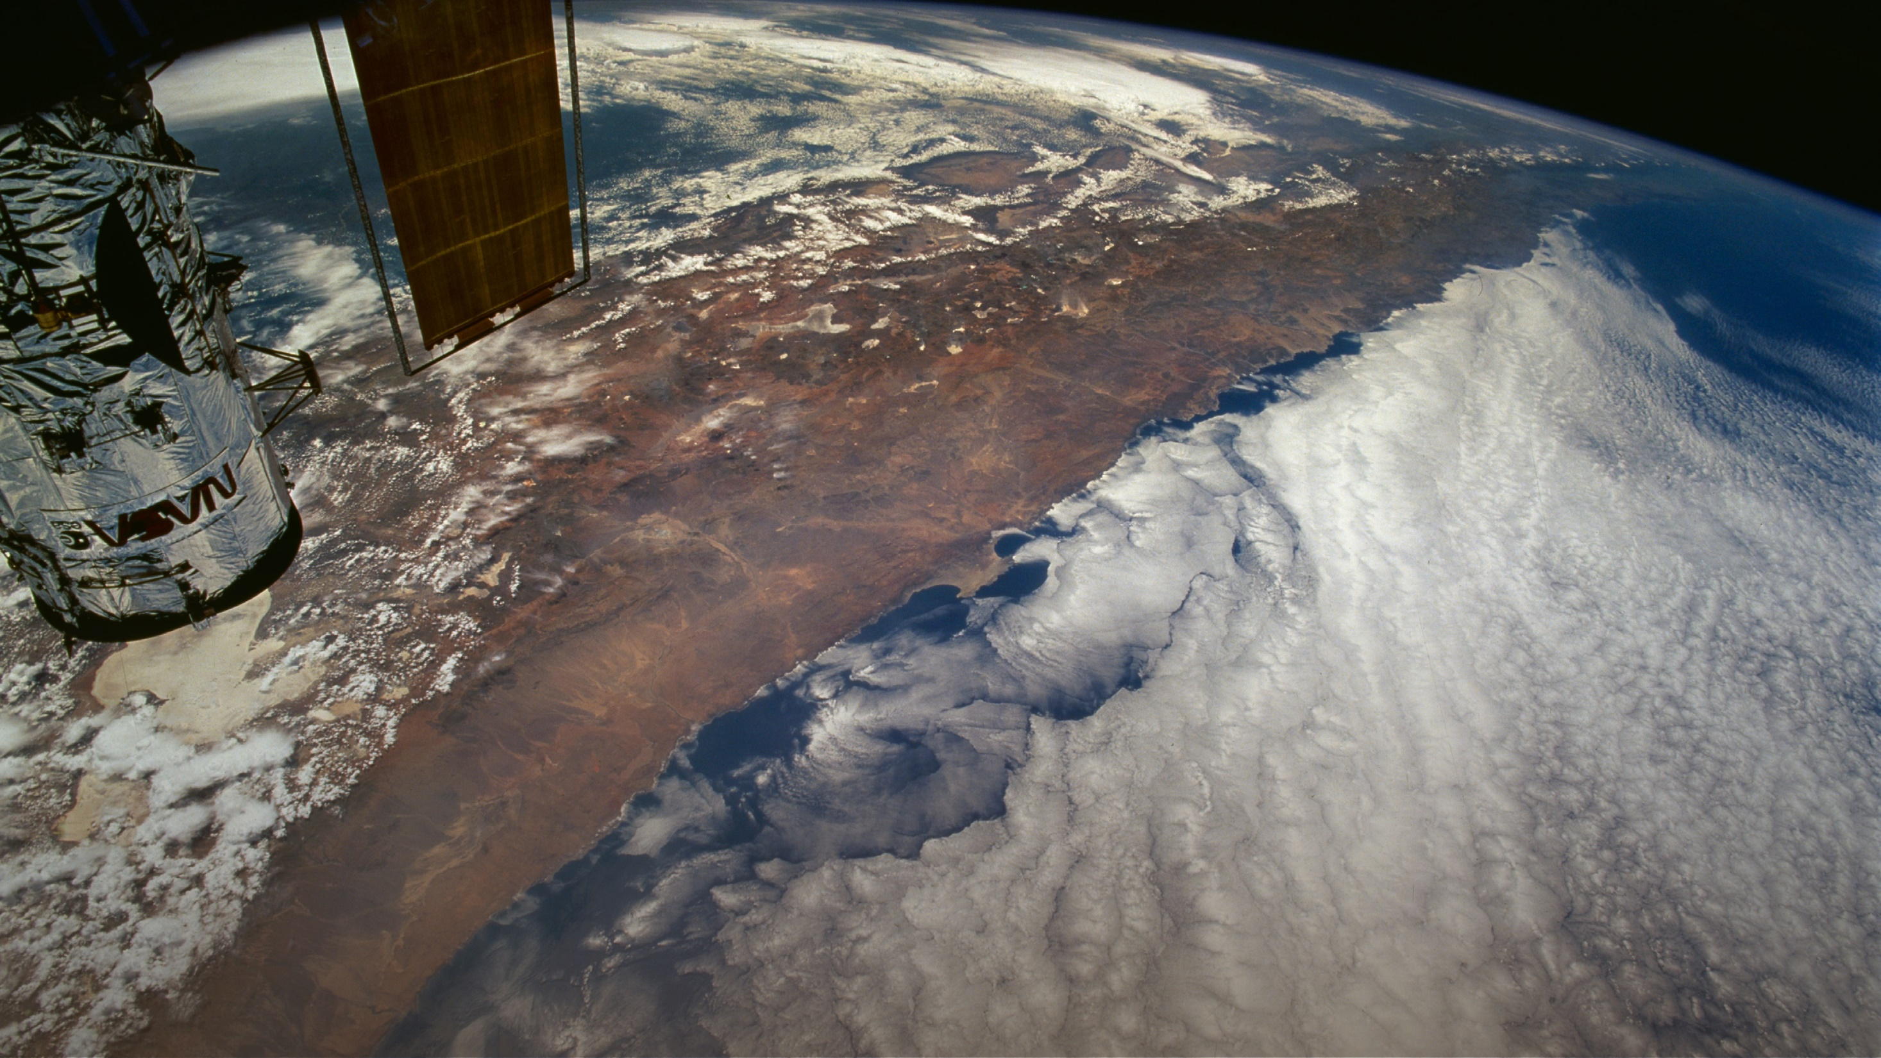
Credit: Claude Nicollier
Chile’s Atacama Desert offers
unique astronomical sites with over 300 clear nights per year,
free from radio interference and with minimal light pollution

Slide 13
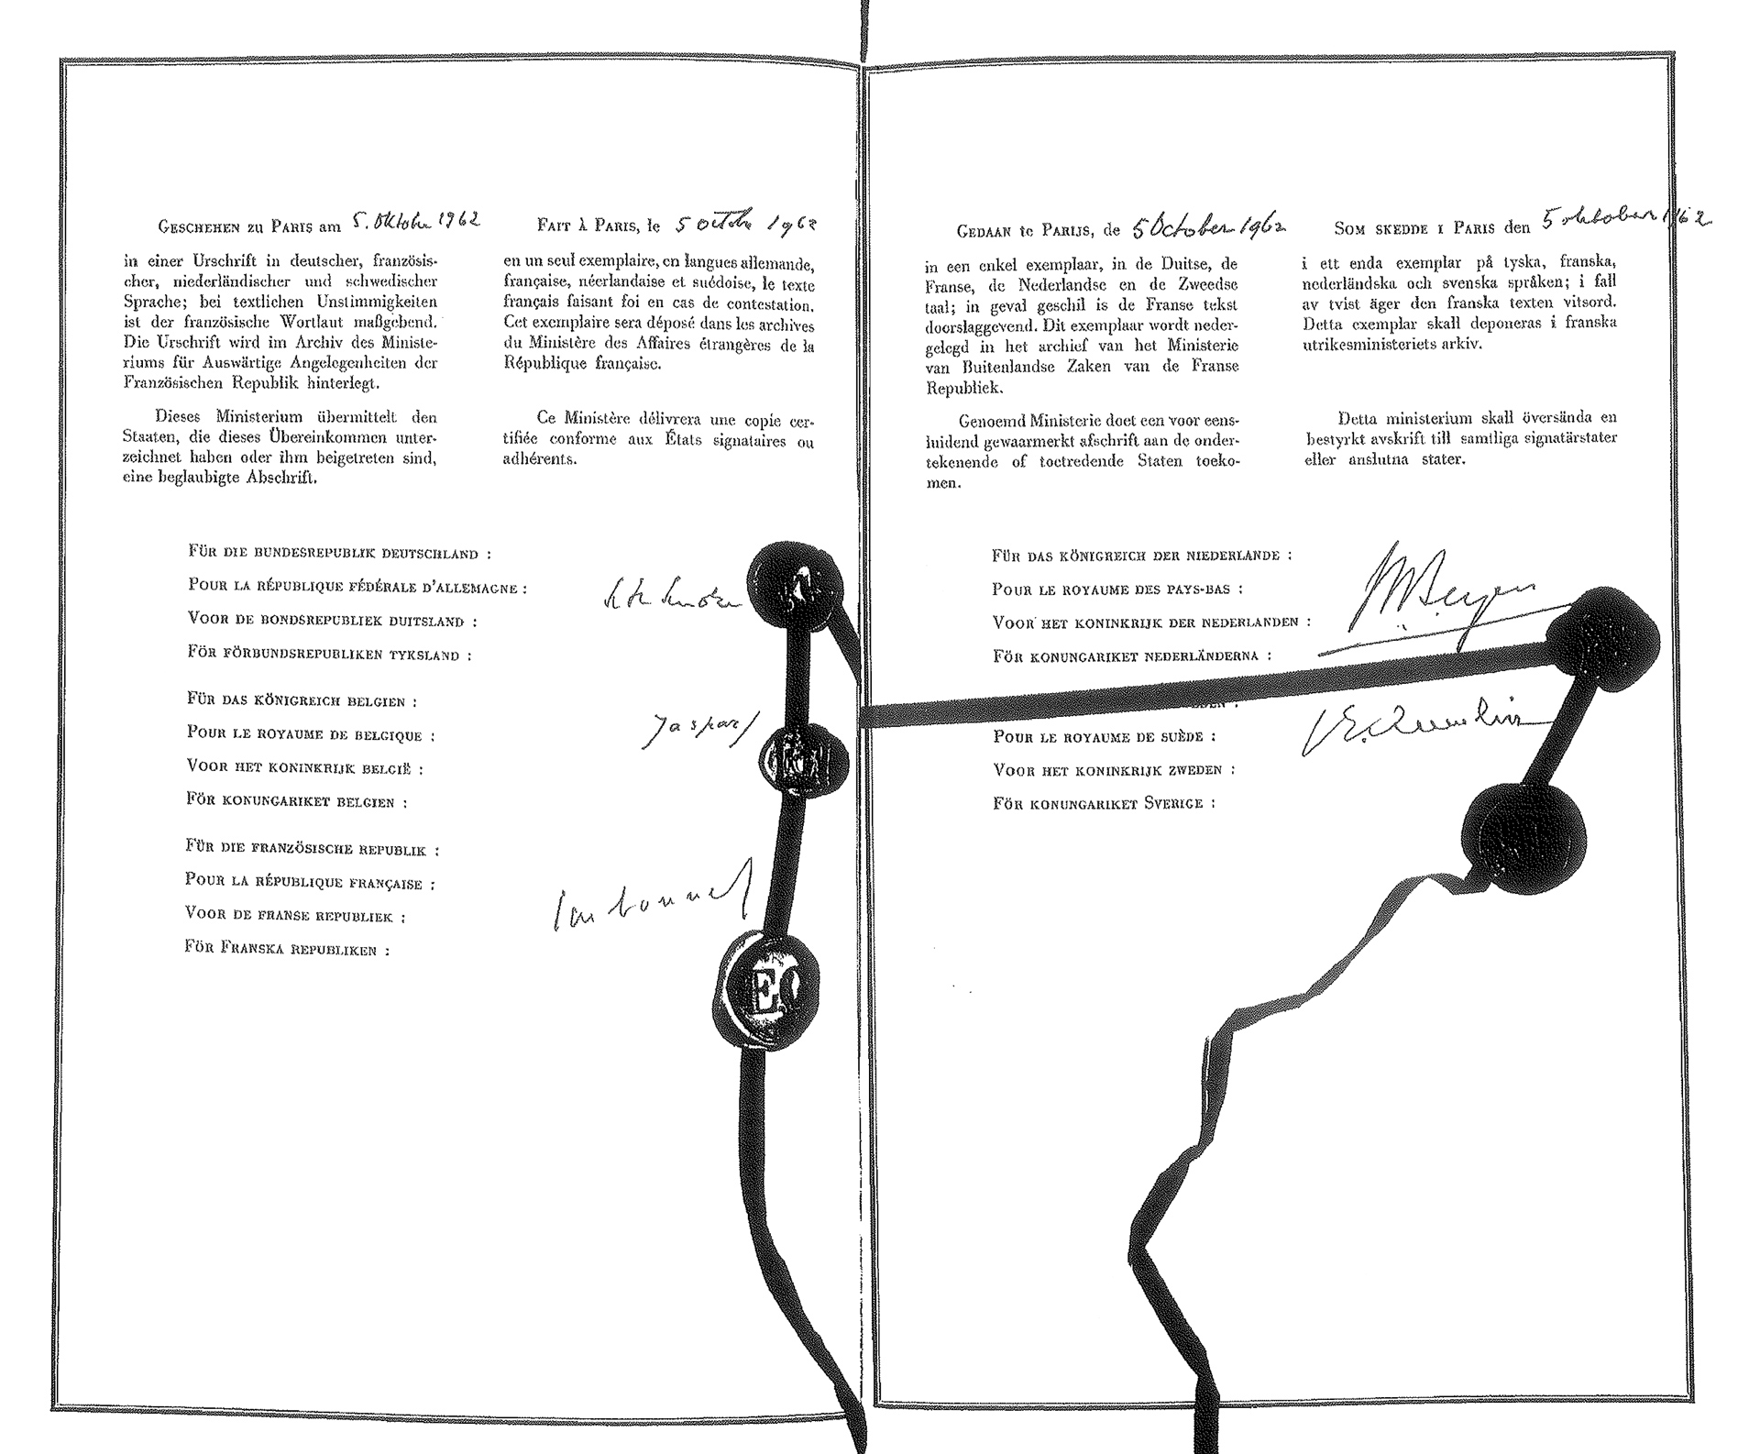
5 October 1962, Paris
Suddenly it all comes together!
Belgium, France, Germany, the Netherlands and Sweden sign the ESO Convention to establish the:
European Organisation for Astronomical Research in the Southern Hemisphere
– today commonly referred to as the European Southern Observatory.

Slide 14
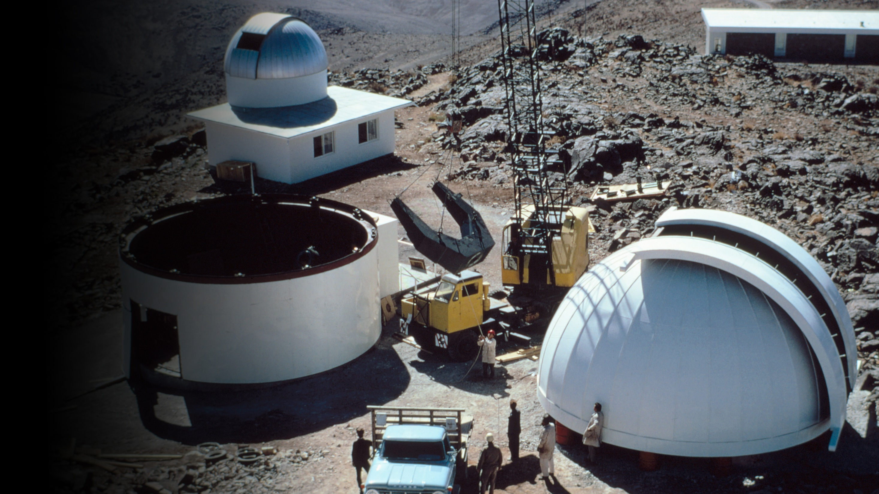
1966
The 1-metre telescope
sees first light, followed by many more ESO telescopes
in La Silla, Chile.

Slide 15


















Timeline
1962
1963
1967
1982
2001
2002
2004
2007
2009
2015
2017
2018
24 August
Denmark
joins ESO
1 March
Switzerland
joins ESO
24 June
The United Kingdom joins ESO
14 February
Spain joins ESO
5 August
Poland joins ESO
9 October
Ireland joins ESO
5 October
Founding members Belgium, France,
the Netherlands, Germany and Sweden sign the ESO convention
24 May
Italy joins ESO
30 April
The Czech Republic joins ESO
6 November
ESO signs agreement with Chile
7 May
Portugal joins ESO
7 July
Finland joins
ESO
1 July
Austria joins ESO
11 July
Australia enters strategic partnership with ESO

Slide 16
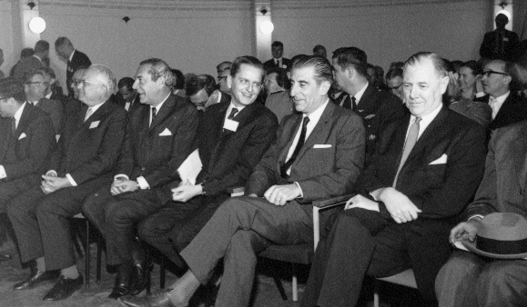
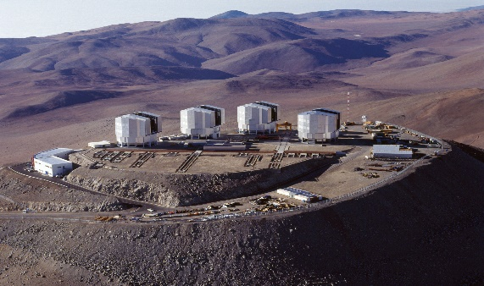
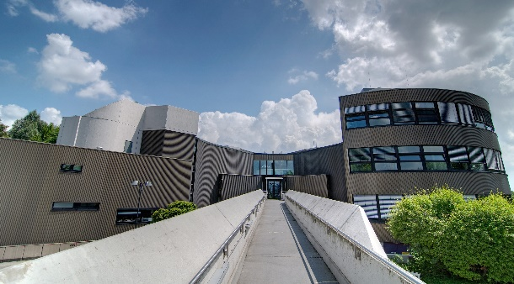
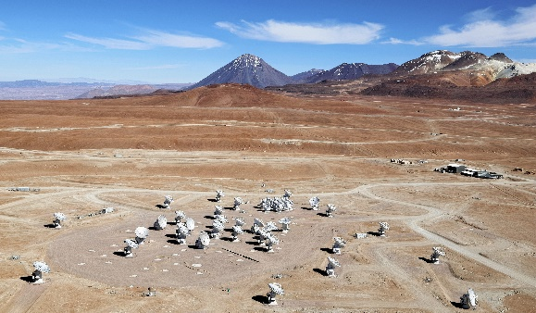
Timeline
1969
1981
1999
2013
2014
25 March
Inauguration of the ESO site at La Silla and the ESO Chile Headquarters
5 March
Official inauguration of Paranal Observatory
19 June
Groundbreaking ceremony for ESO’s Extremely Large Telescope (ELT)
Credit: Clem & Adri Bacri-Normier (wingsforscience.com)/ESO
5 May
Inauguration of the new ESO Headquarters in Garching
13 March
ALMA Observatory inauguration

Slide 17
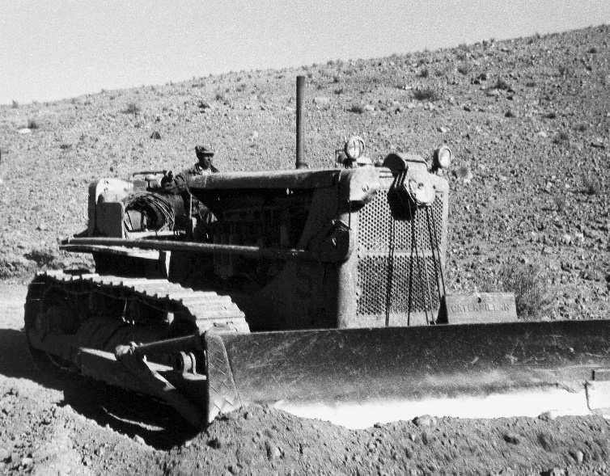
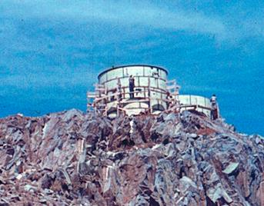
ESO Timeline (detailed)
1962
5 October
Founding members Belgium, France, Germany, the Netherlands and Sweden sign the ESO convention
1963
6 November
ESO signs agreement with Chile
1965
March
Construction of the
La Silla Observatory begins

Slide 18
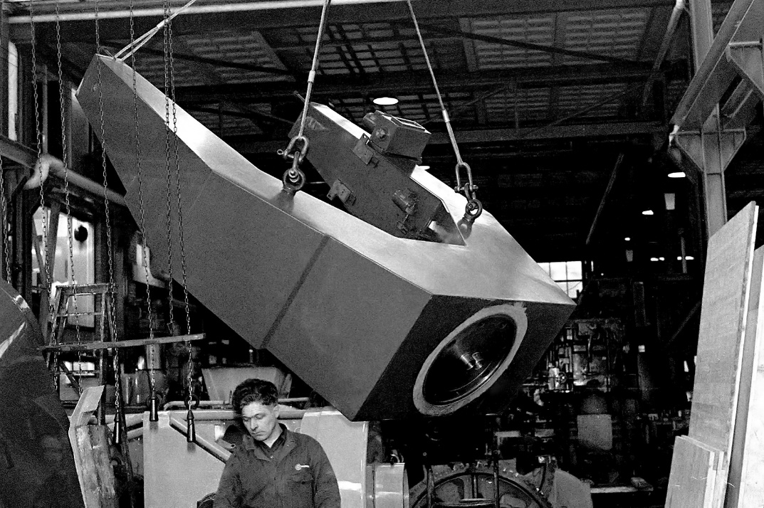
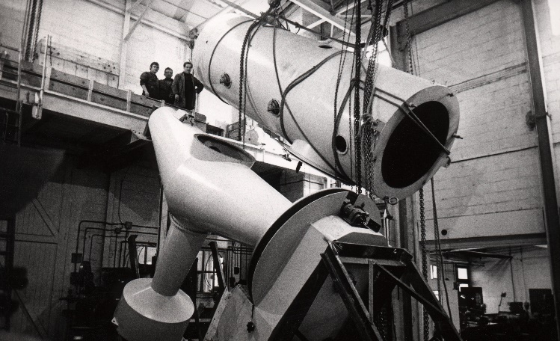
1966
30 November
First light for the
ESO 1-metre telescope
1967
24 August
Denmark joins ESO
1968
24 July
First light for the
ESO 1.52-metre telescope

Slide 19

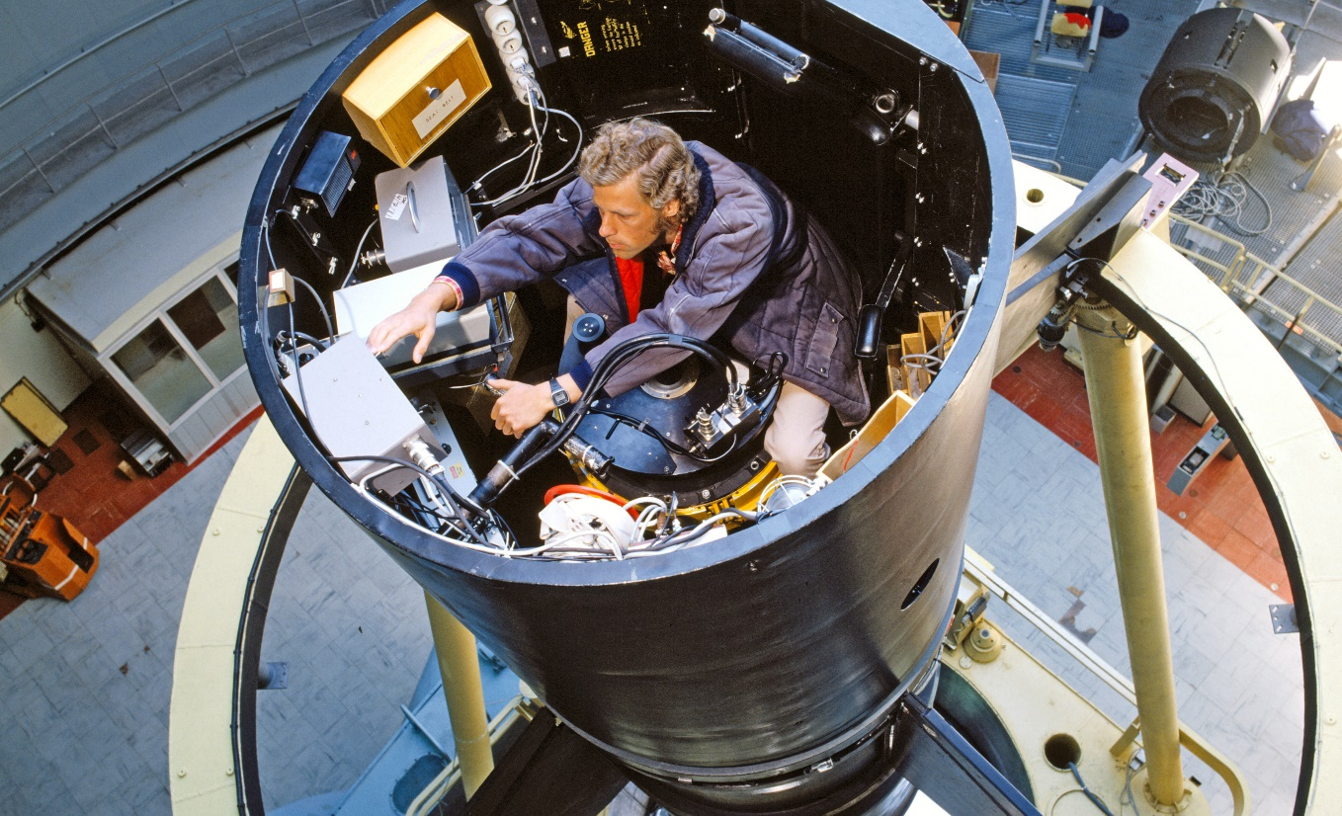
1969
25 March
Inauguration of the ESO site at La Silla and the ESO Chile Headquarters
1976
7 November
First light for the
ESO 3.6-metre telescope

Slide 20
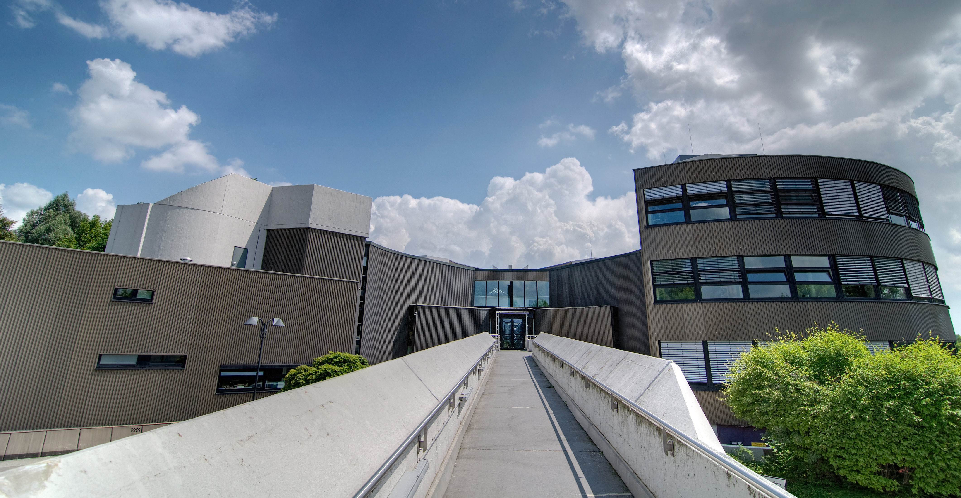
1981
5 May
Inauguration of the new ESO Headquarters in Garching
1982
1 March
Switzerland joins ESO
24 May
Italy joins ESO

Slide 21
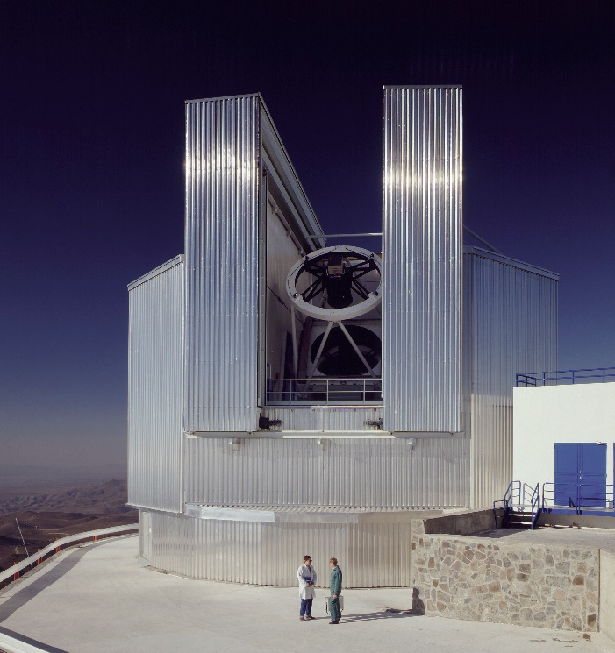
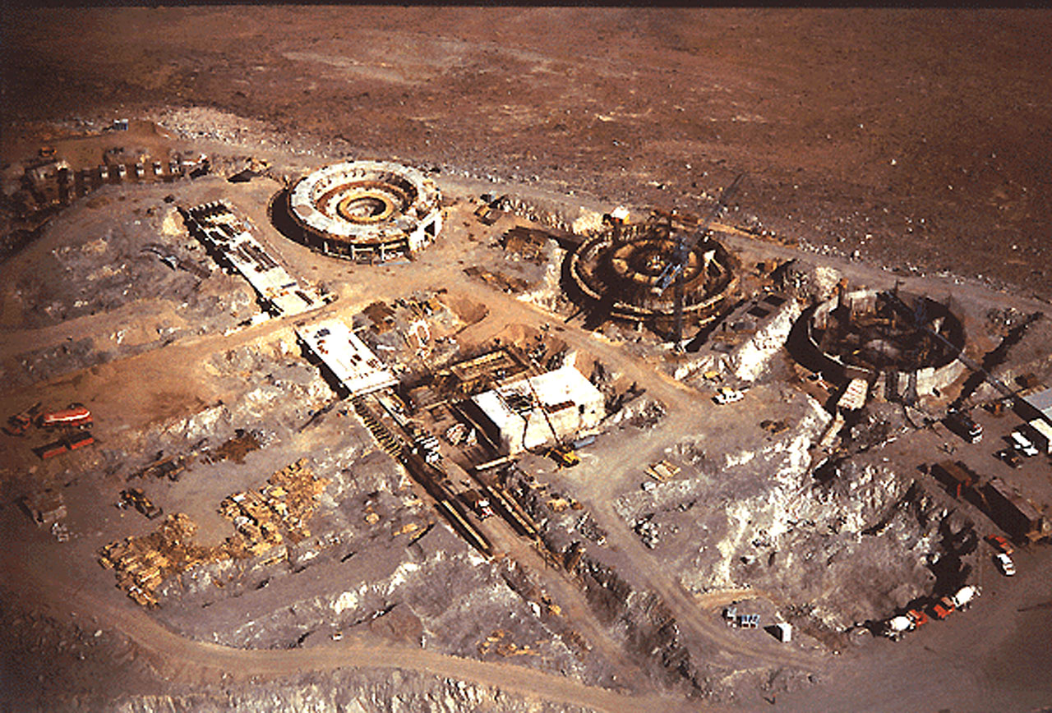
1989
23 March
First light of the New
Technology Telescope (NTT)
Credit: ESO/C. Madsen
1991
23 September
Construction of Paranal Observatory begins

Slide 22
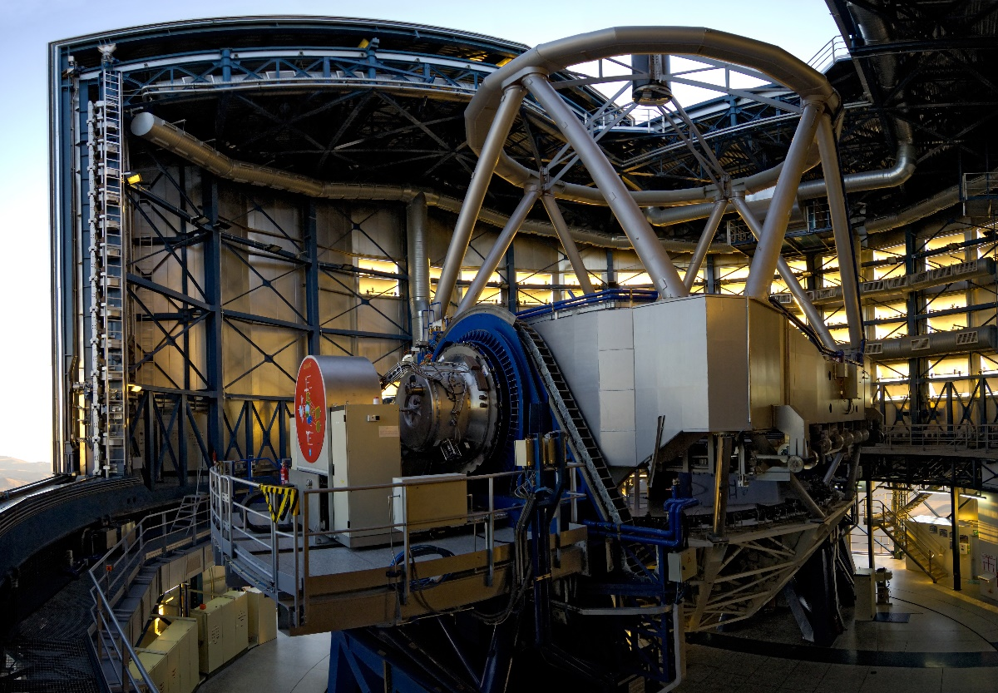
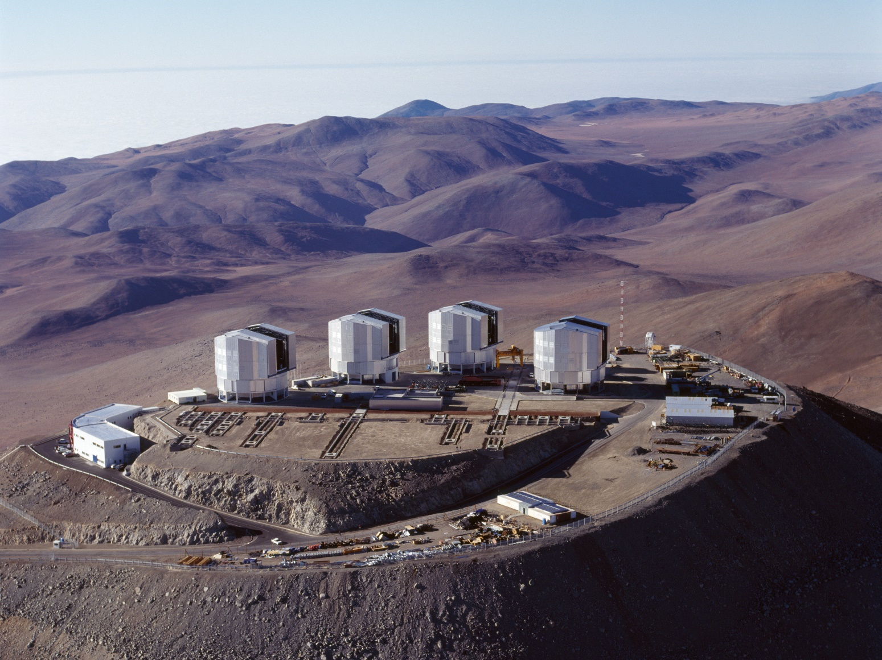
1998
25 May
First light for Antu, the VLT’s first Unit Telescope (UT1)
Credit: ESO/G.Hüdepohl (atacamaphoto.com)
1999
1 March
First light for Kueyen, the VLT’s second Unit Telescope (UT2)
5 March
Official inauguration of Paranal Observatory

Slide 23
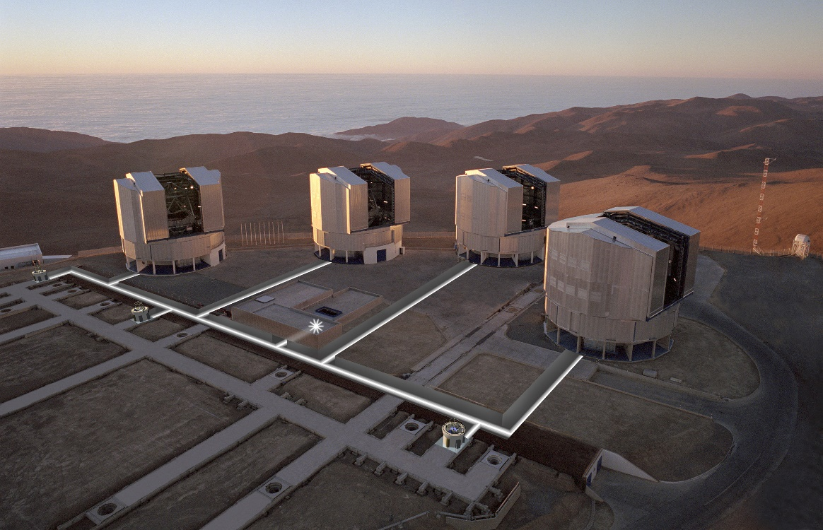
2000
26 January
First light for Melipal, the VLT’s third Unit Telescope (UT3)
4 September
First light for Yepun, the VLT’s fourth Unit Telescope (UT4)
2001
17 March
First light for the Very Large Telescope Interferometer (VLTI)

Slide 24
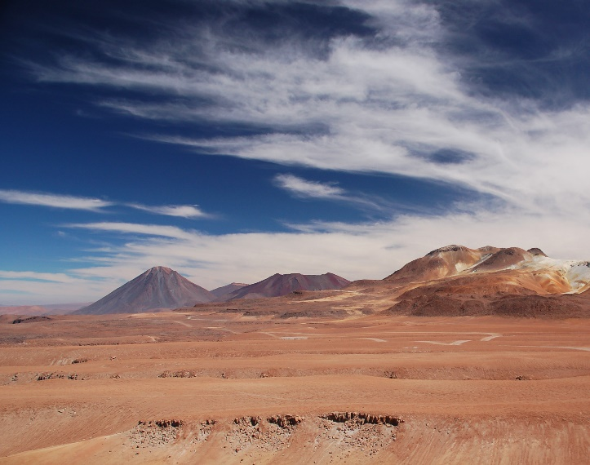

2001
7 May
Portugal joins ESO
2002
24 June
The United Kingdom joins ESO
2003
Credit: ALMA (ESO/NAOJ/NRAO)
6 November
ALMA groundbreaking ceremony

Slide 25
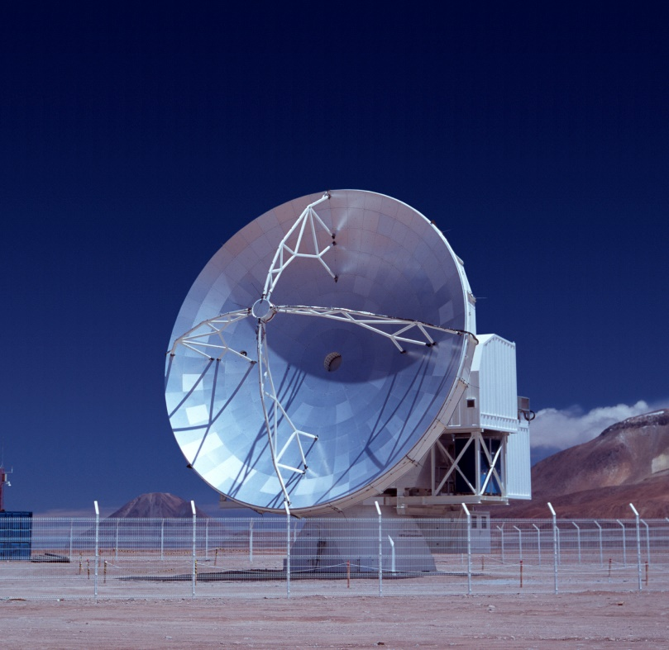
2004
7 July
Finland joins
ESO
2005
14 July
First light for APEX, the Atacama Pathfinder Experiment
2007
14 February
Spain joins ESO
30 April
The Czech Republic joins ESO

Slide 26
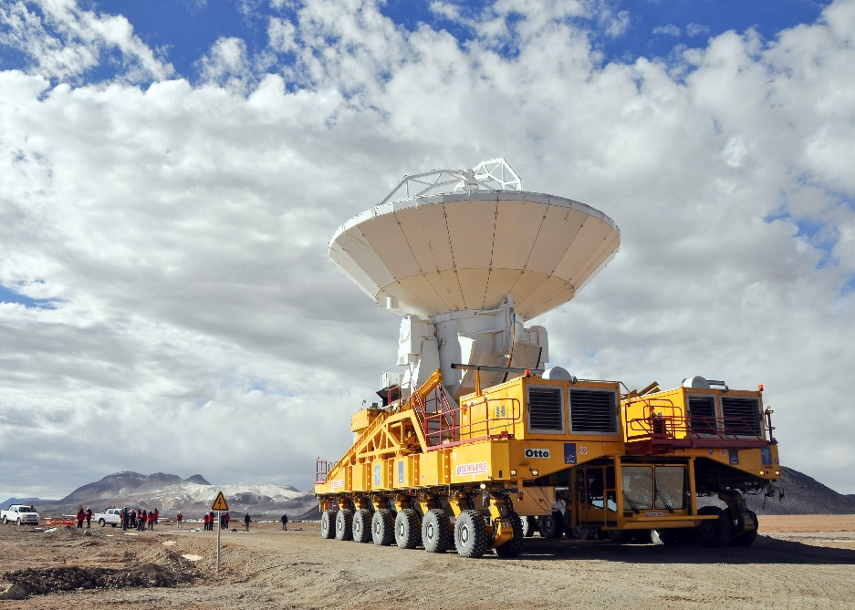
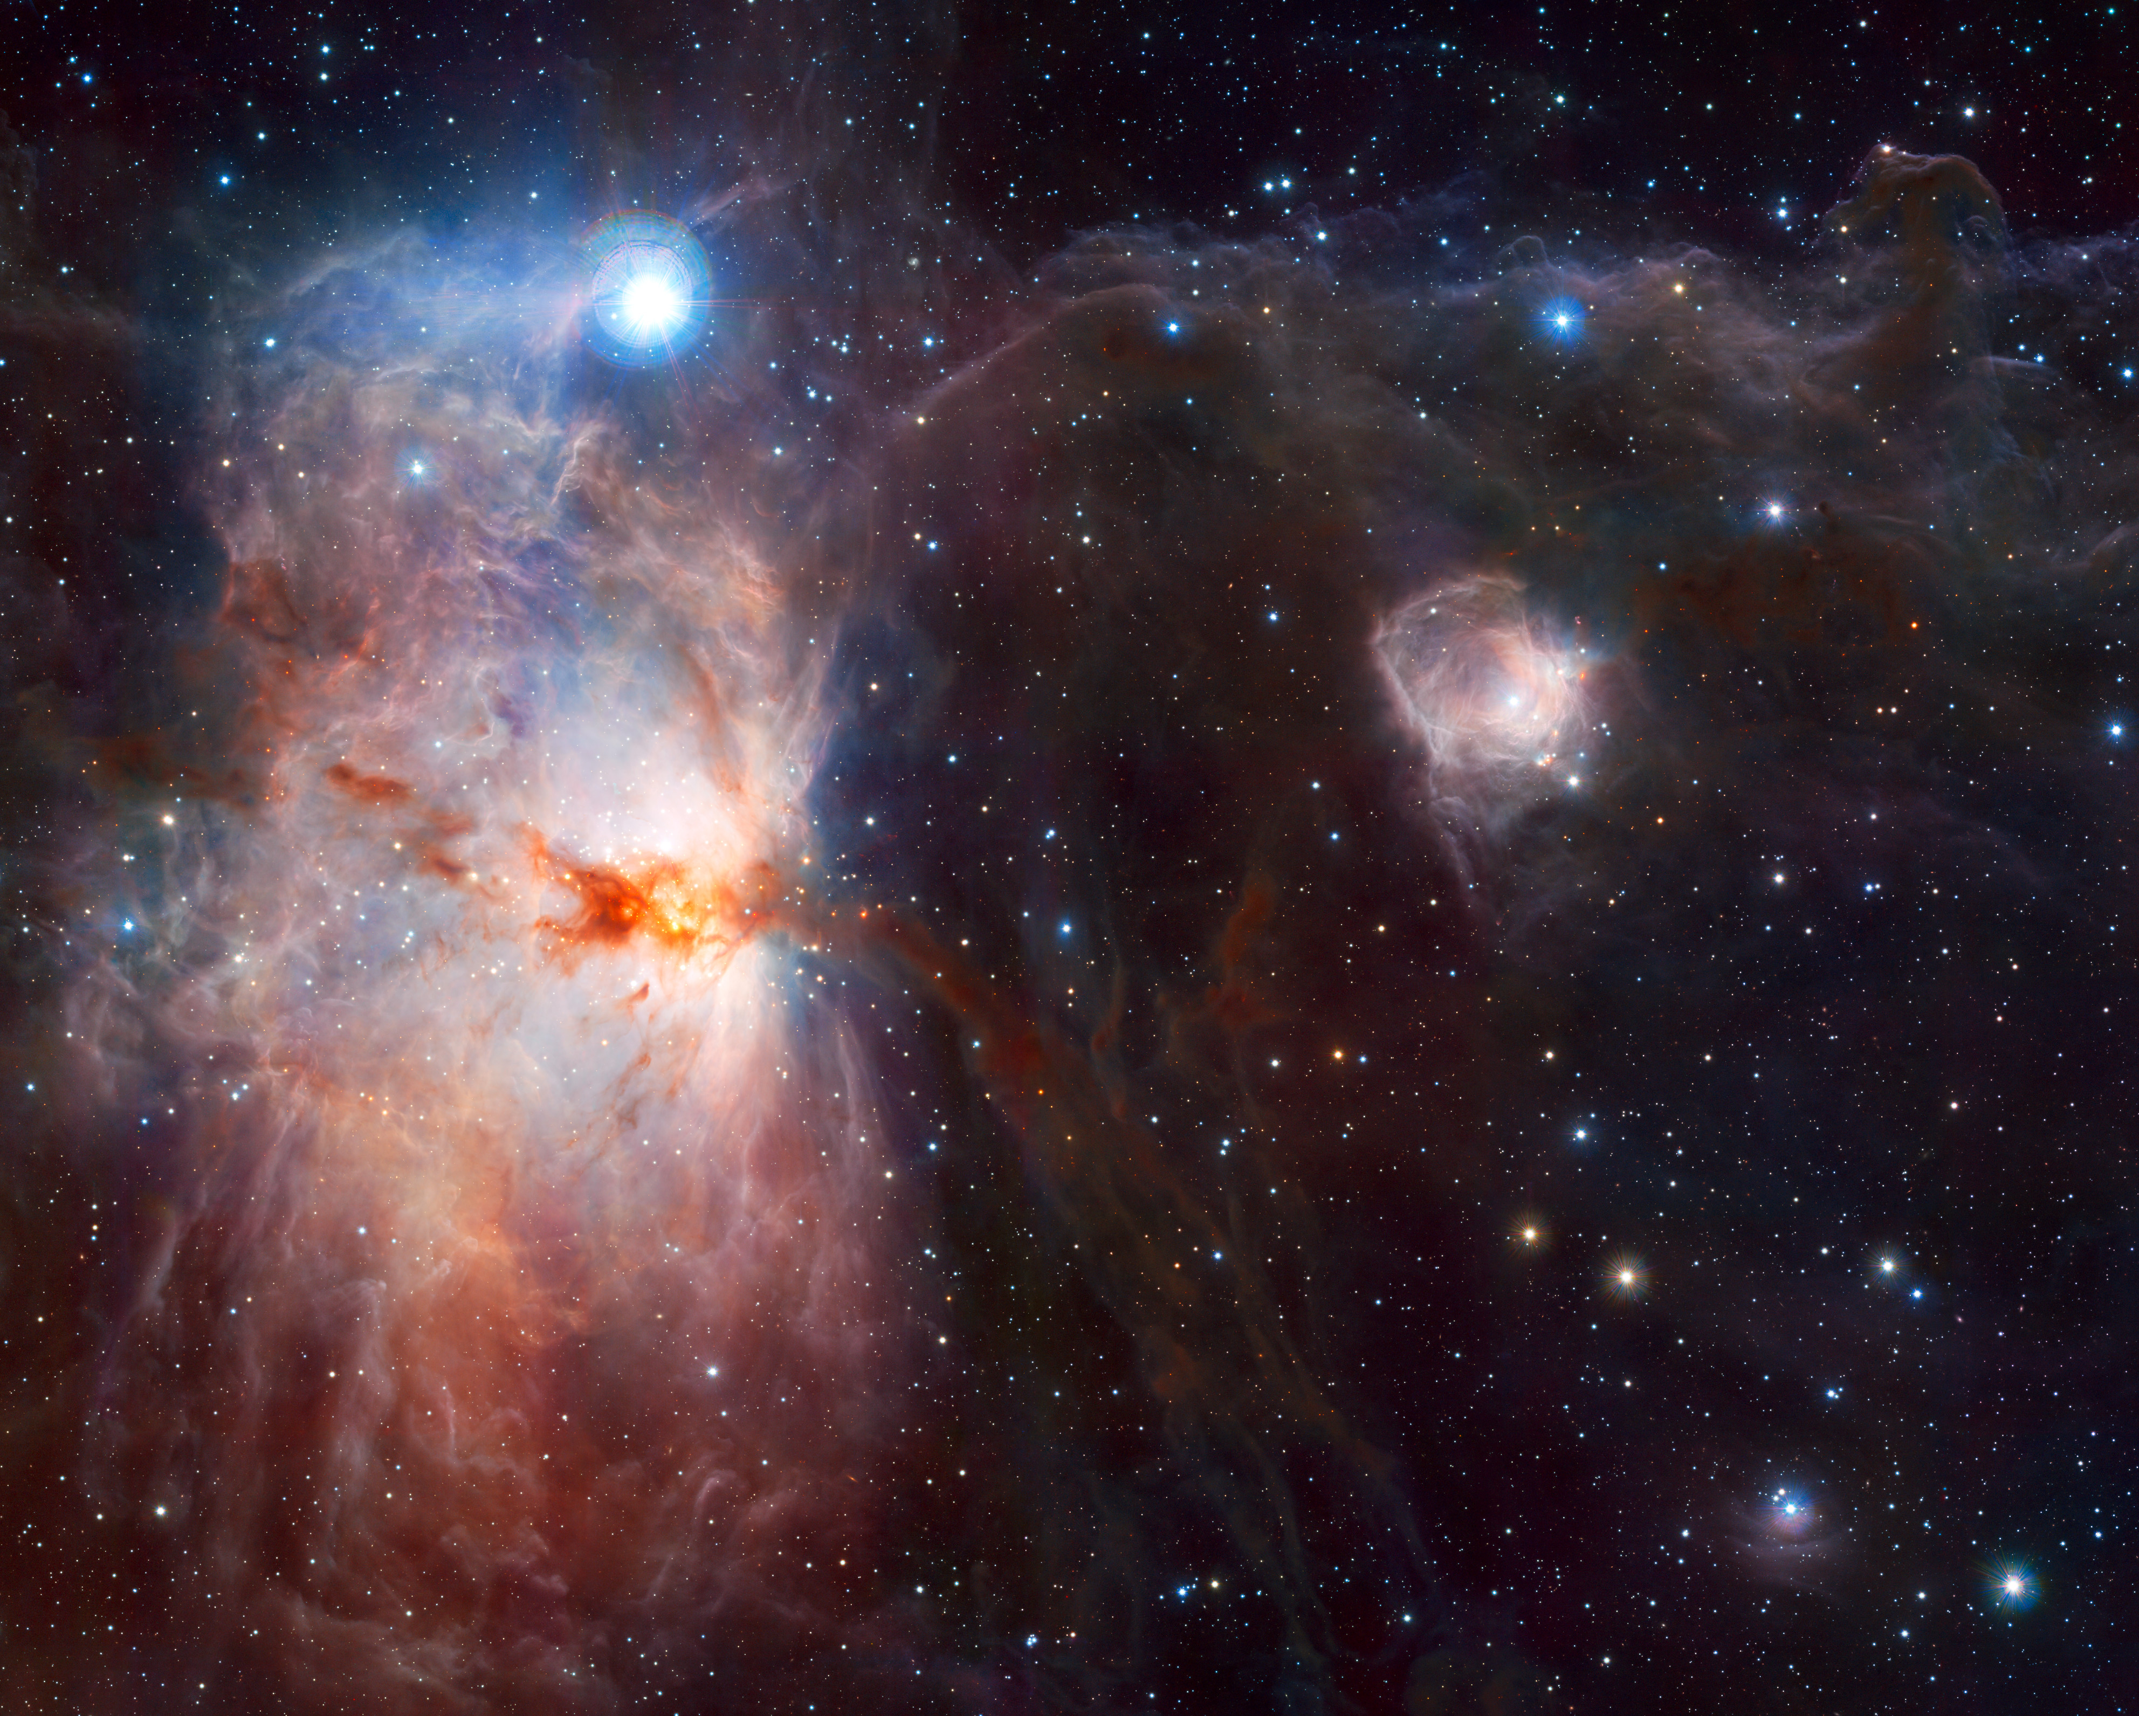
2009
1 July
Austria joins ESO
17 September
First ALMA antenna arrives at 5000-metre altitude Chajnantor site
Credit: ALMA (ESO/NAOJ/NRAO)
Credit: ESO/J. Emerson/VISTA. Acknowledgment: Cambridge Astronomical Survey Unit
11 December
VISTA, the pioneering new survey telescope, starts work

Slide 27
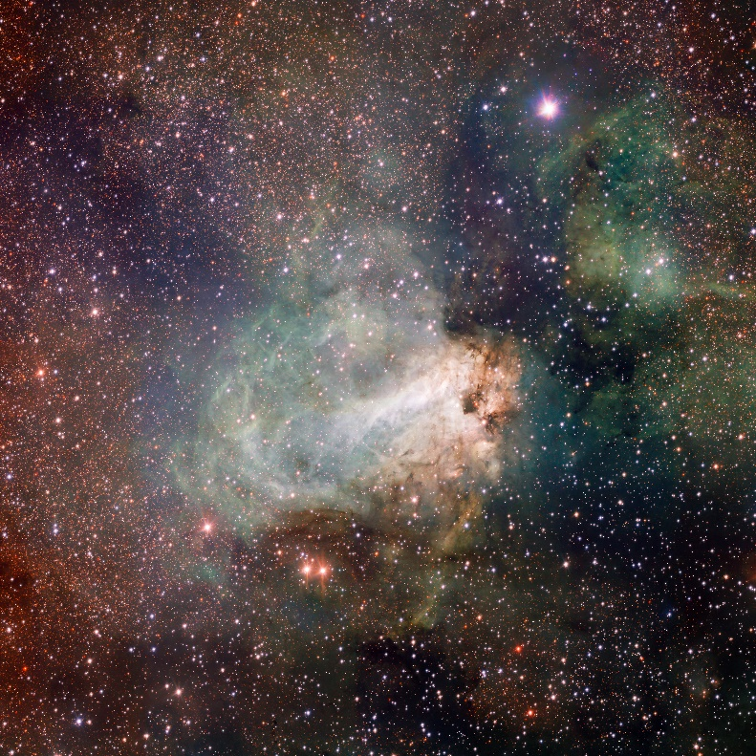
2011
8 June
First images from the VLT Survey Telescope (VST)
Credit: ESO/INAF-VST/OmegaCAM. Acknowledgement: OmegaCen/Astro-WISE/Kapteyn Institute
2013
13 March
ALMA Observatory inauguration
2014
19 June
Groundbreaking ceremony for ESO’s Extremely Large Telescope (ELT)

Slide 28
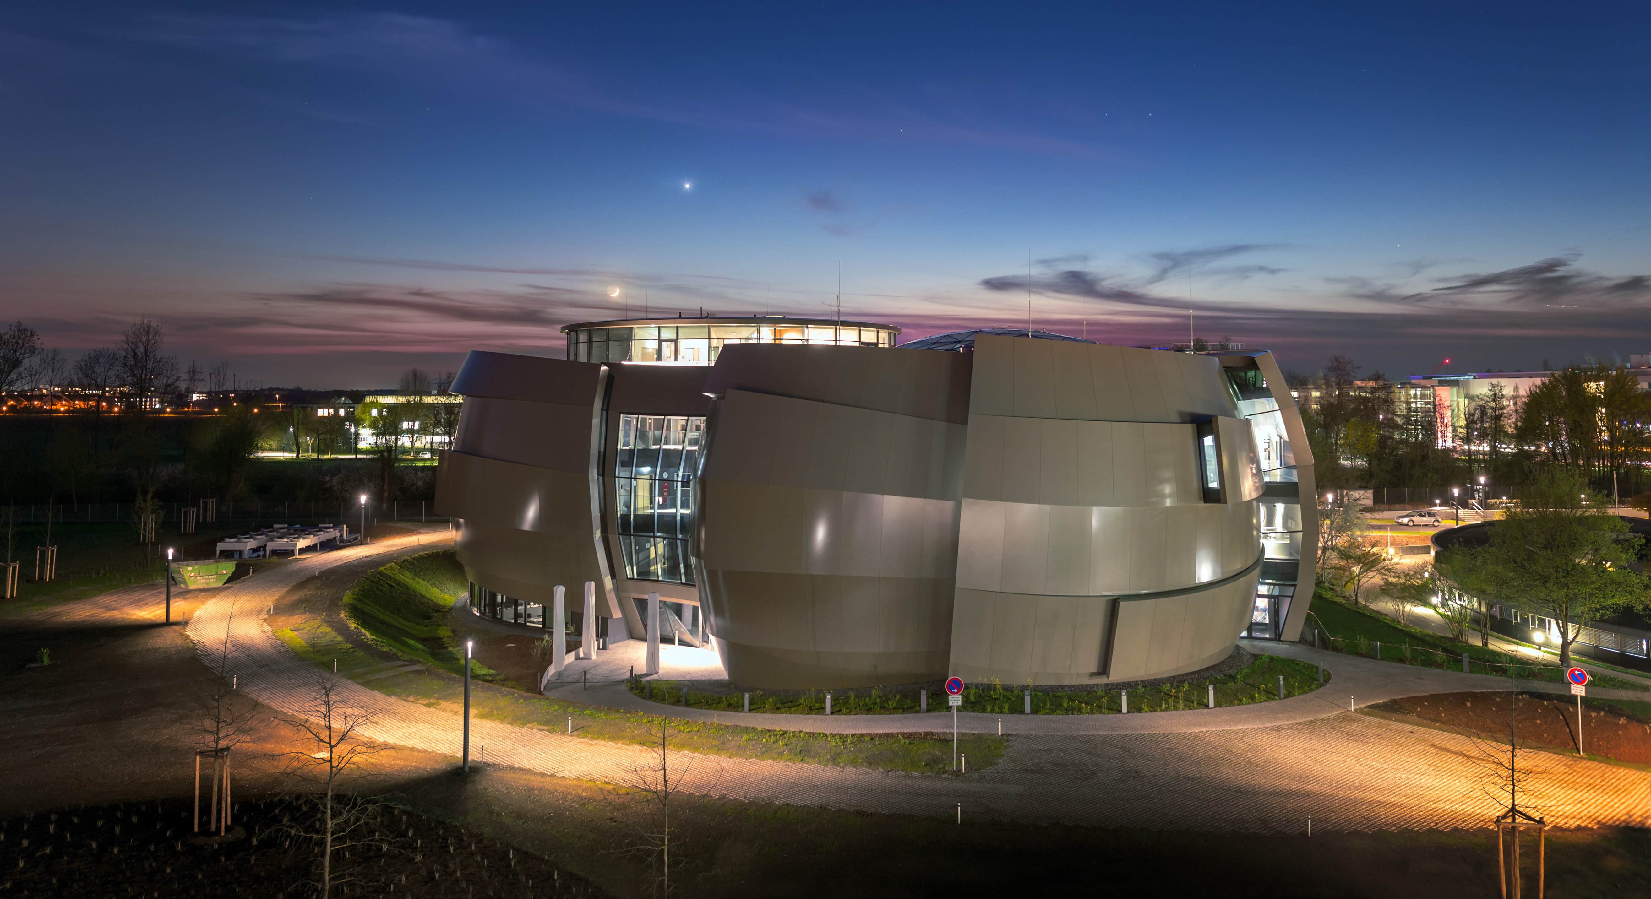
2015
5 August
Poland joins ESO
2017
11 July
Australia enters strategic partnership with ESO
2018
Credit: ESO/P. Horálek
26 April
The ESO Supernova opens

Slide 29
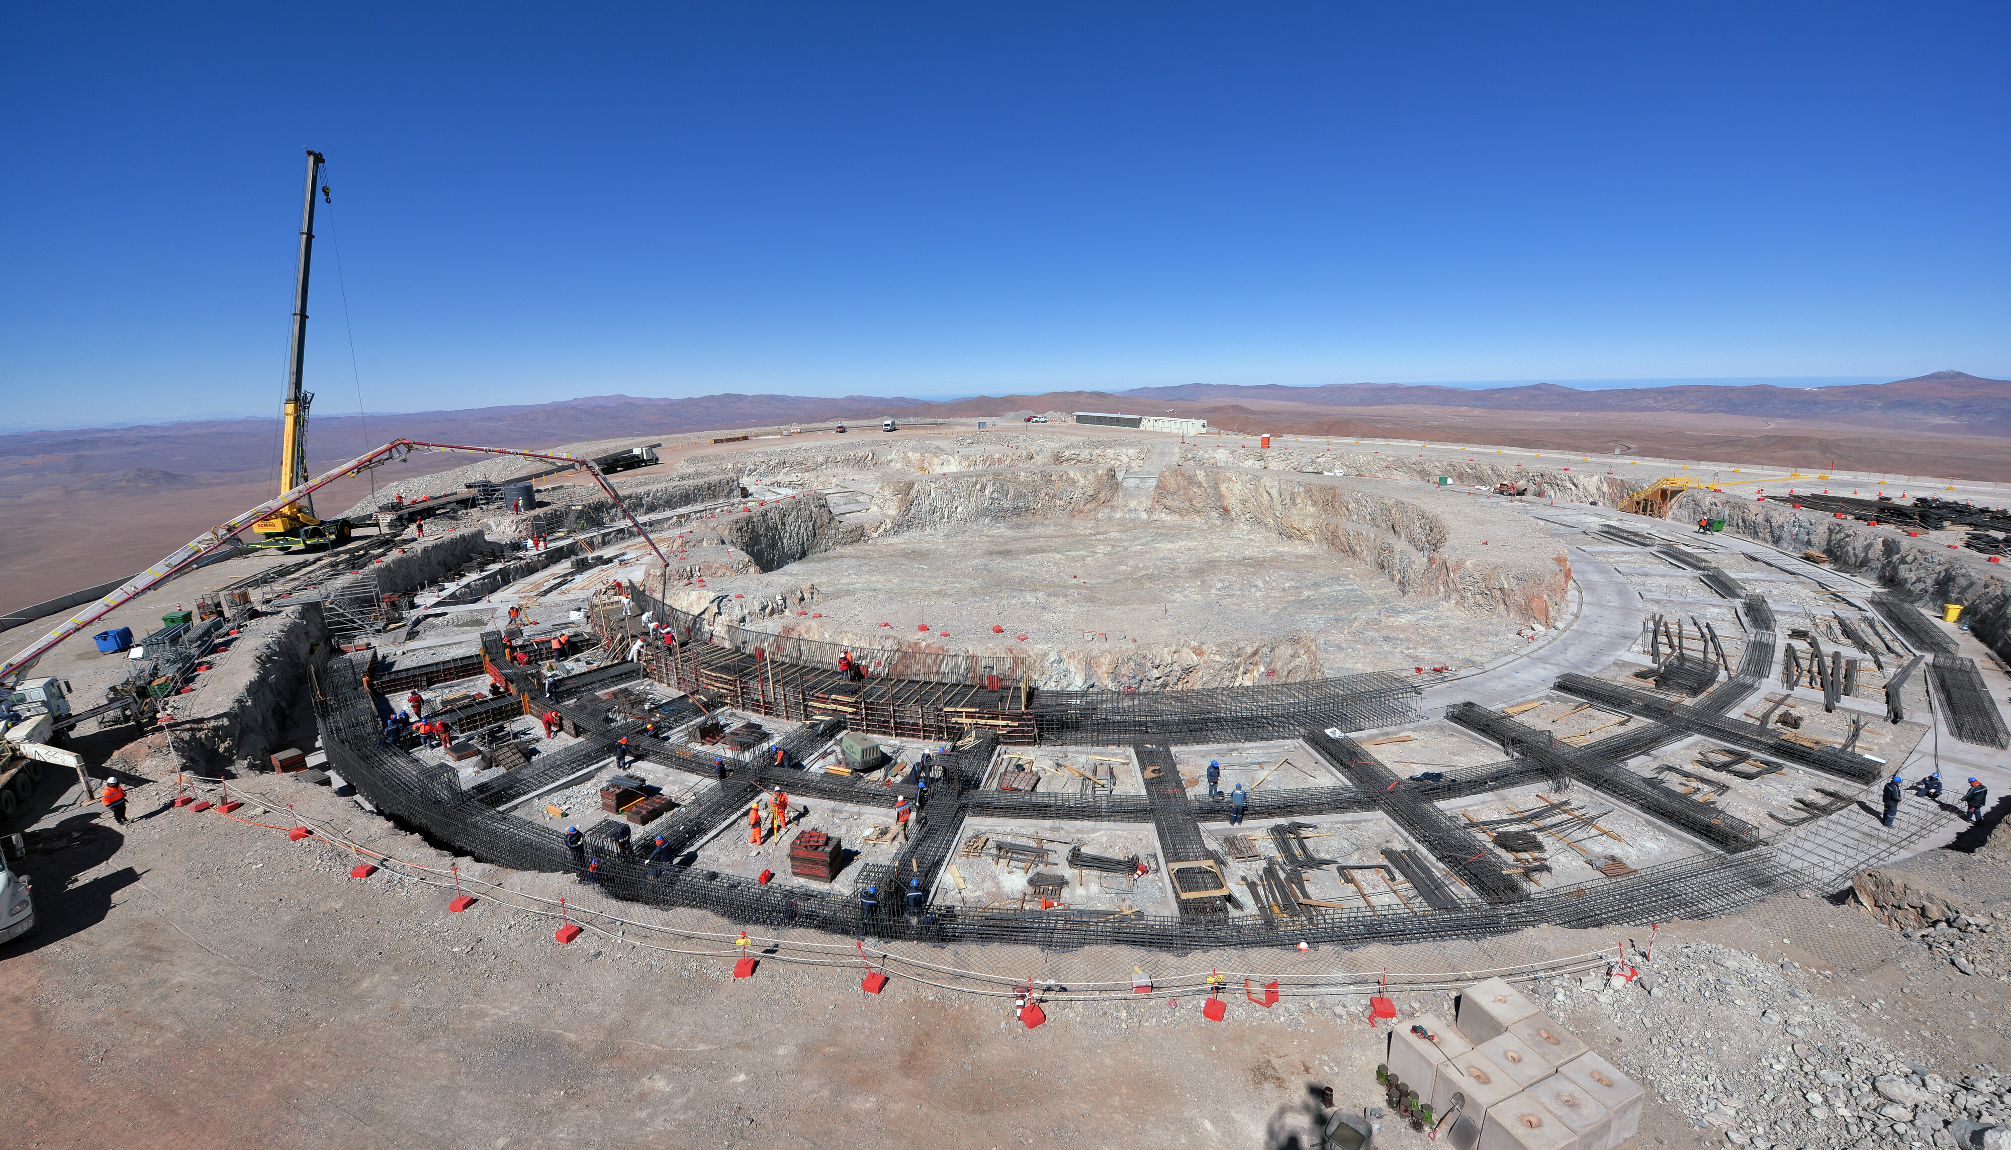
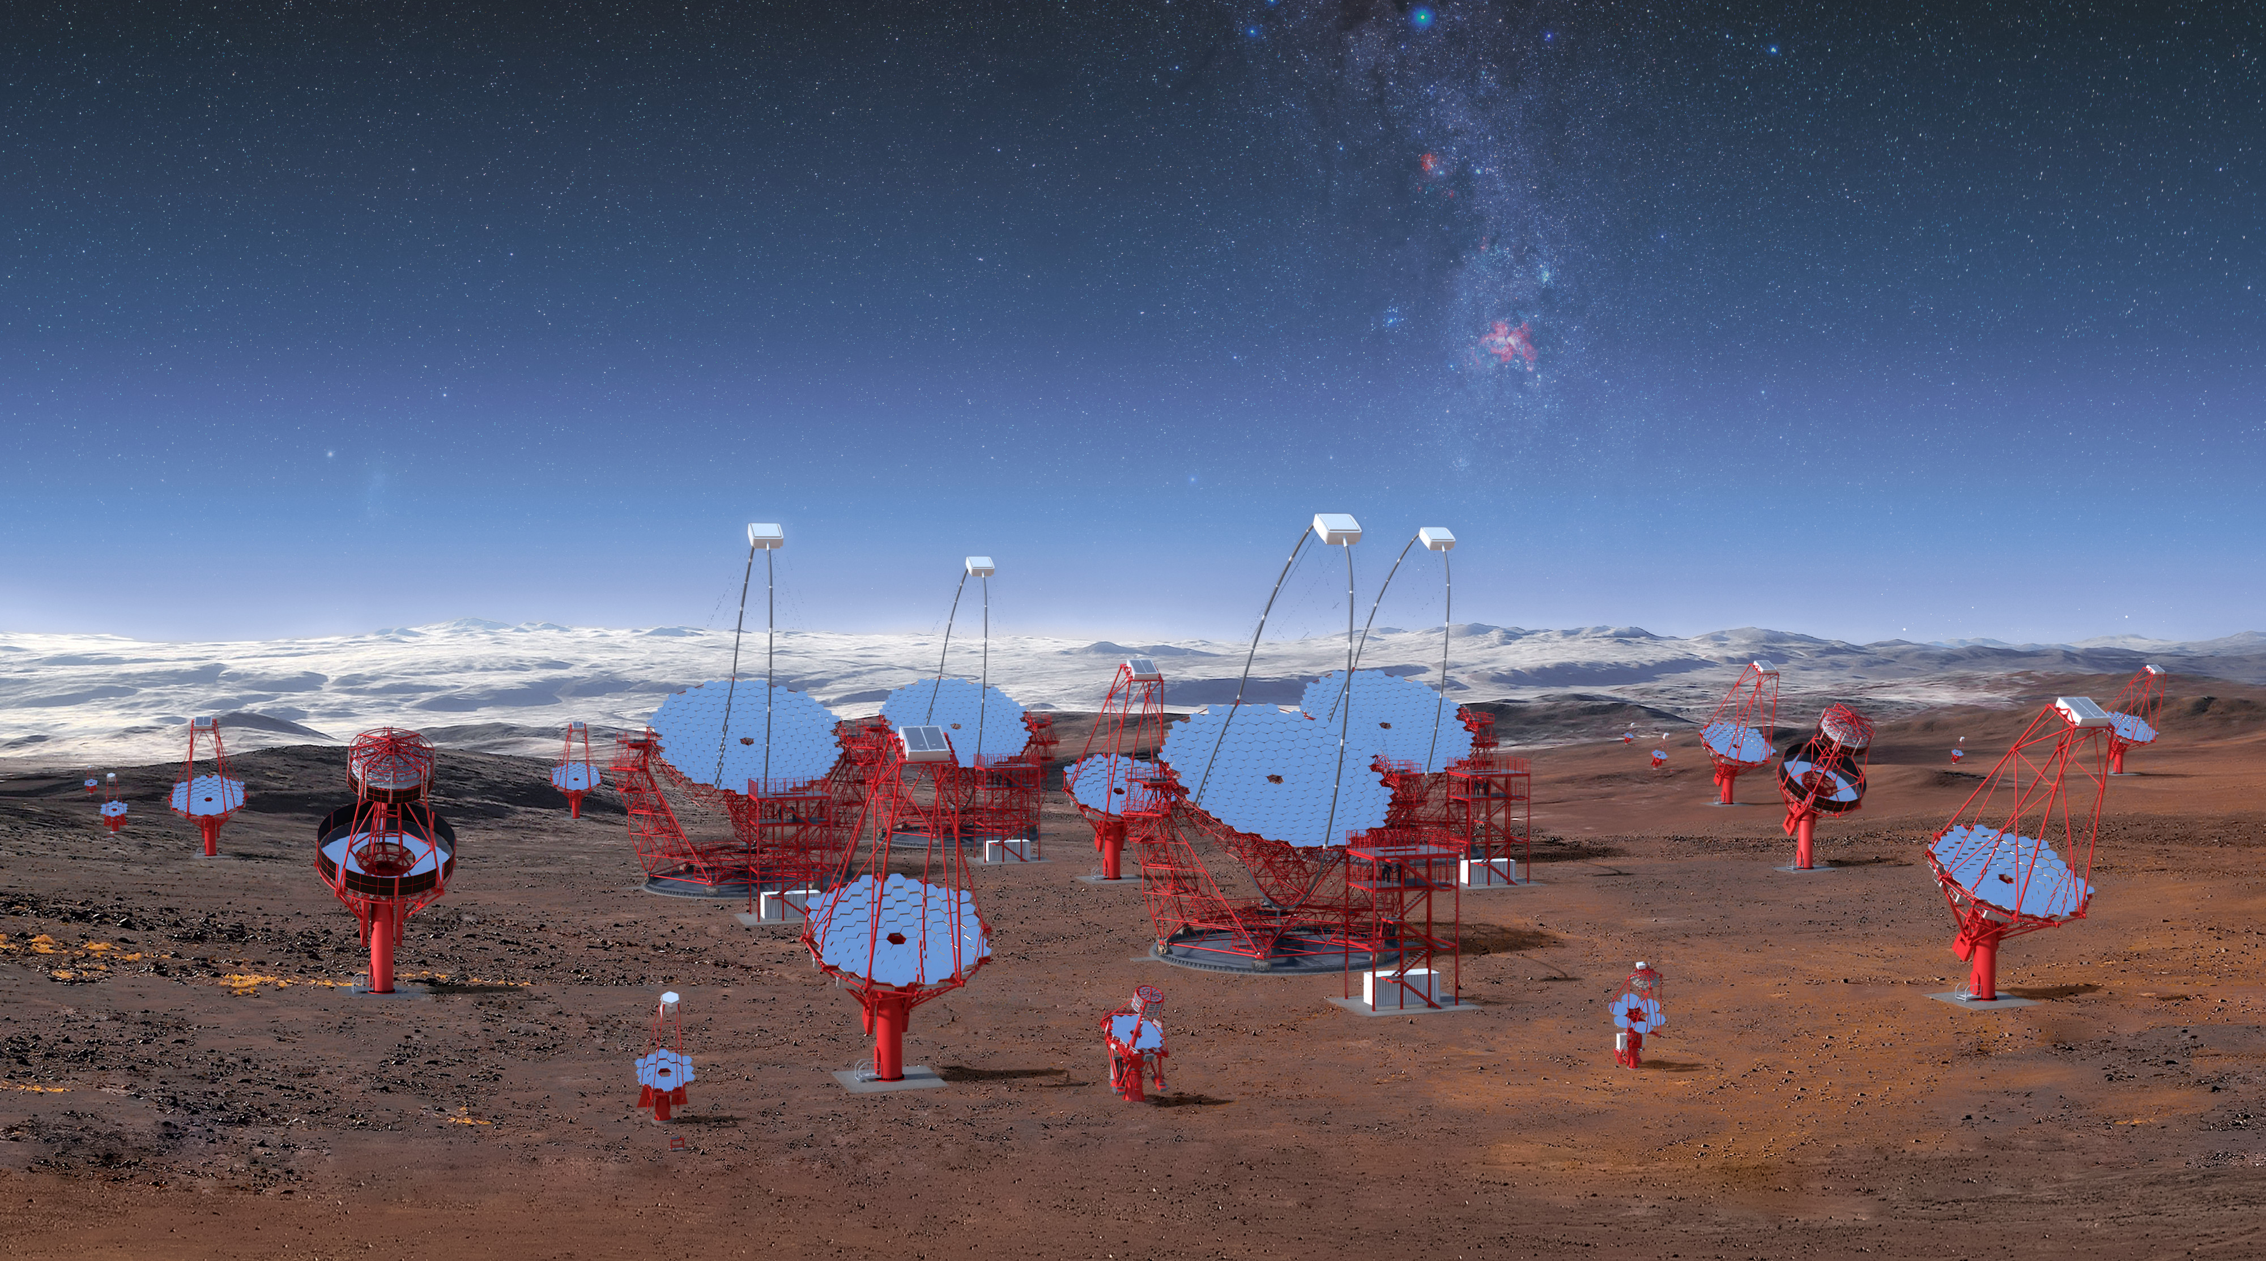
2018
9 October
Ireland joins ESO
2019
27 September
Construction of the
ELT Dome foundations begins
14 March
ESO becomes shareholder in Cherenkov Telescope Array (CTA)
Credit: CTA/M-A. Besel/IAC (G.P. Diaz)/ESO

