Slide 1


Mid-J CO Diagnostics of Turbulent Dissipation in Molecular Clouds
Andy Pon

Slide 2











Doug Johnstone
Michael J. Kaufman
Paola Caselli
Francesco Fontani
Aina Palau
Michael J. Butler
Izaskun Jiménez-Serra
René Plume
Jonathan C. Tan
Felipe Alves
Pau Frau
Erik Rosolowsky

Slide 3
GMCs Contain Supersonic Turbulence
¹³CO J = 1-0
Observed
(FWHM = 1.9 km / s)
Thermal broadening alone
(FWHM = 0.2 km / s)
Ridge et al. (2006)
Notes:
Mention why turbulence is important to clouds

Slide 4
Turbulent Energy Decay in MHD Simulations
Turbulent Energy (E/ρL³ C_{s}²)
B = 14 μG
B = 4.4 μG
B = 1.4 μG
B = 0 μG
Stone et al. (1998)
Sound Crossing Times (t / t_{s})
Notes:
B = 1.4 muG beta^(-1/2) (T / 10K)^1/2 (n_H2 / 10^2 cm^-3)^1/2
Ts = L / cs
Turbulence decays under a crossing time -> they actually show tdiss less than the turbulent crossing time which is about 0.2 sound crossing times

Slide 5
Key Prediction:
Mid J CO lines should trace shocked gas!

Slide 6
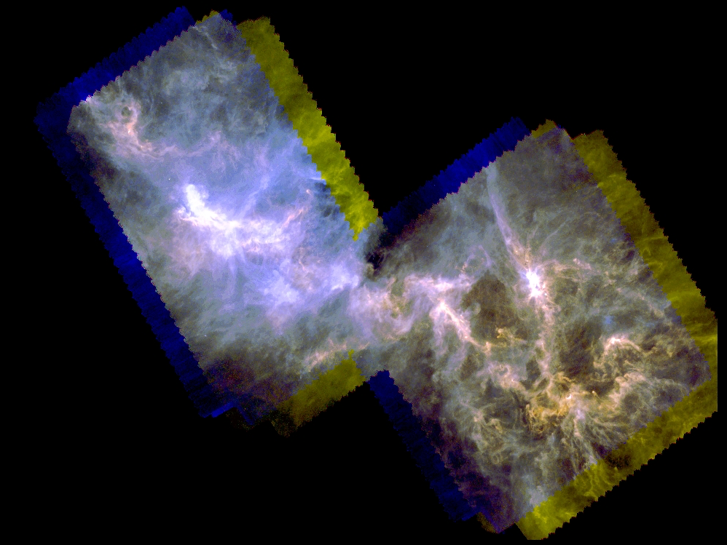
Perseus B1-E5
Sadavoy et al. (2013)

Slide 7
CO Observations
÷1.5
x7
x50
Notes:
5-4 scaled by 7, 6-5 by 50. 1-0 down by 1.5

Slide 8
CO SED
Key Observation:
CO 6-5 line is too bright for PDR models!

Slide 9
Consistent with Shock Models
Notes:
Predict 0.07% filling. Get 0.11 and 0.04%.

Slide 10
Shock Properties
Volume filling factor of the shocked gas is 0.15%.
Turbulent energy dissipation rate is 3.5 x 10³² ergs s⁻¹.
Turbulent energy dissipation timescale is three times smaller than the flow crossing timescale.

Slide 11
Archival Value
This shock emission should be ubiquitous. It should be present towards any molecular cloud, if one looks deep enough and away from other heating sources.
SPIRE has sensitivity to these mid-J lines.
SPIRE has an array of 19 pixels for the 6-5 to 8-7 lines.
Is there anything in your ‘uninteresting’ off-source pixels?
Notes:
Reference to paper (full)

Slide 12
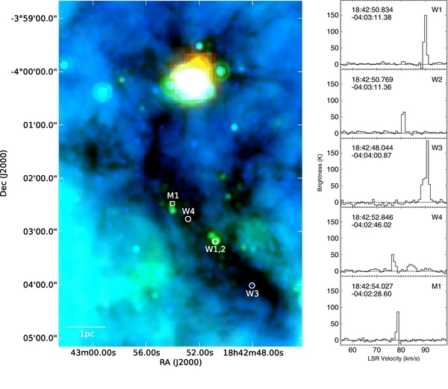
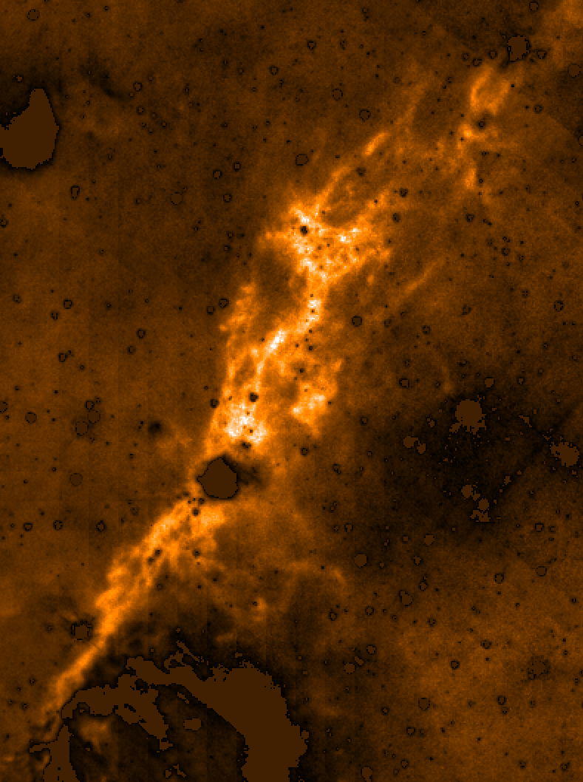
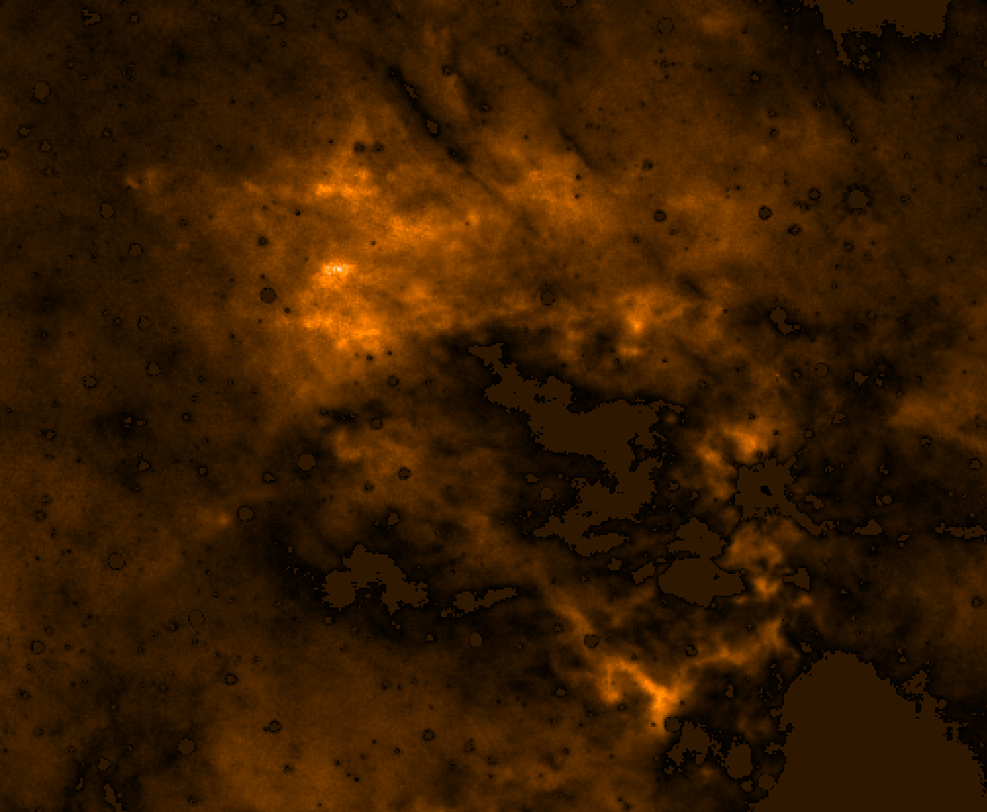
IRDCs
Butler & Tan (2012)
Wang et al. (2012)

Slide 13
IRDC F

Slide 14
IRDC C

Slide 15
IRDC G

Slide 16
IRDCs

Slide 17
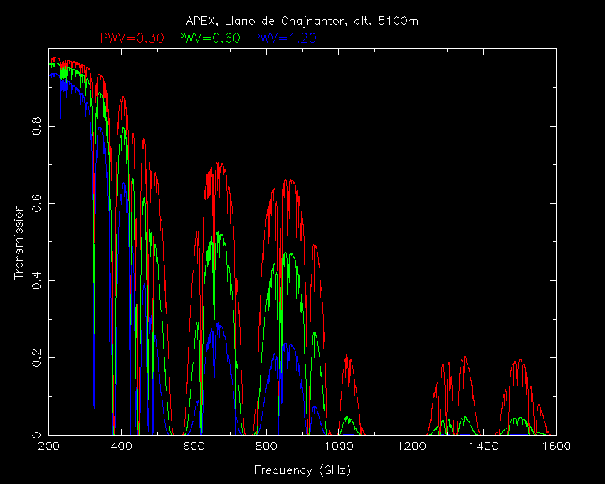
Band 9
Band 10
5-4
6-5
7-6
8-7

Slide 18
Why ALMA?
Key difference between shock heating and cosmic ray or ISRF heating is that shocks are intermittent.
Shock heated gas should be highly spatially variable such that this emission will not be filtered out by ALMA.
The shocks should also be somewhat randomly distributed, rather than well collimated as in protostellar outflows.
ALMA should reveal the spatial distribution of shocks
The locations of shocks may hold clues to the formation mechanisms of GMCs
ALMA should benefit from much larger beam filling factors

Slide 19
Summary
Molecular clouds contain supersonic turbulence and this turbulence should decay relatively rapidly.
Most of this turbulent energy is dissipated via CO lines.
Mid to high J CO lines trace shock emission and are observable!
Perseus B1-E5 has emission in mid J CO lines above that predicted by PDR models, as expected for shock emission.
IRDCs show regions with enhanced mid J CO emission, inconsistent with PDR models
ALMA provides the capability to resolve individual shock structures
Notes:
Reference to paper (full)

Slide 20
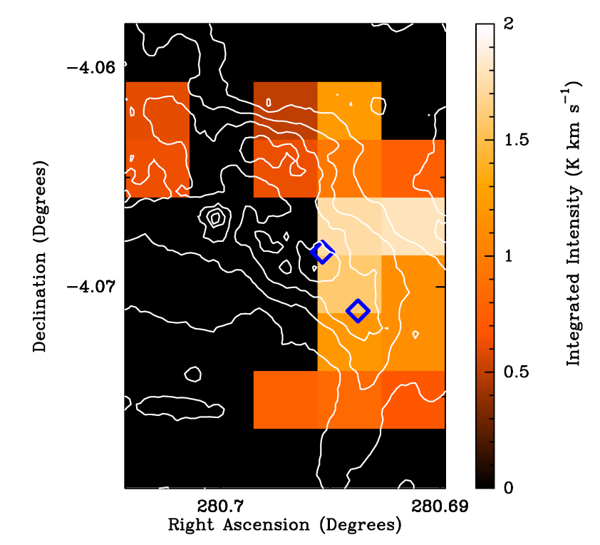
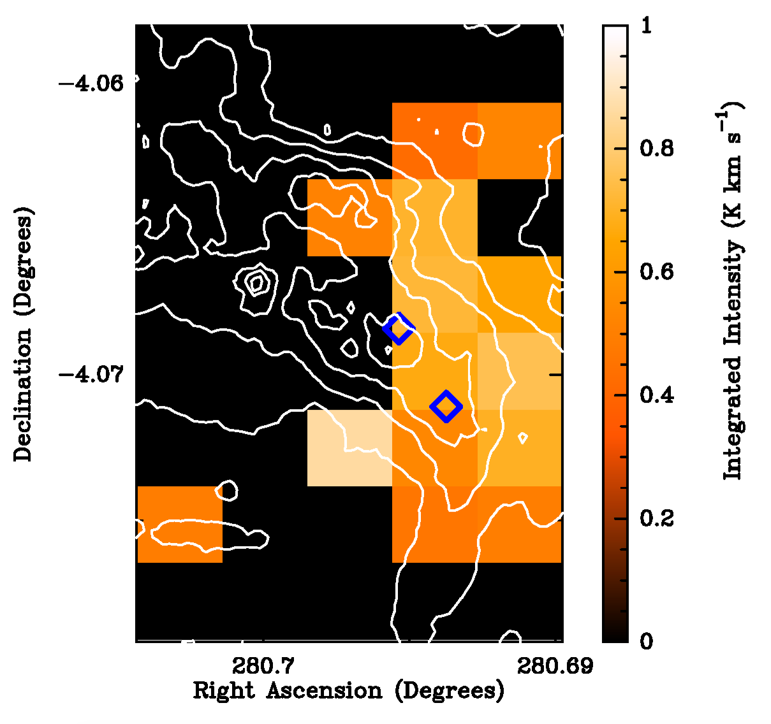
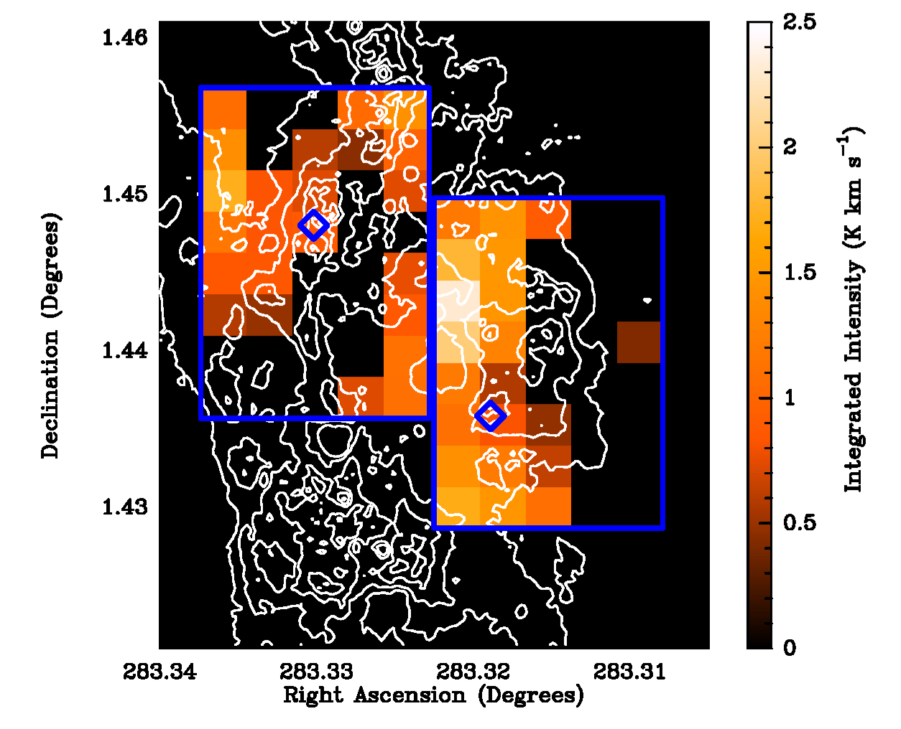
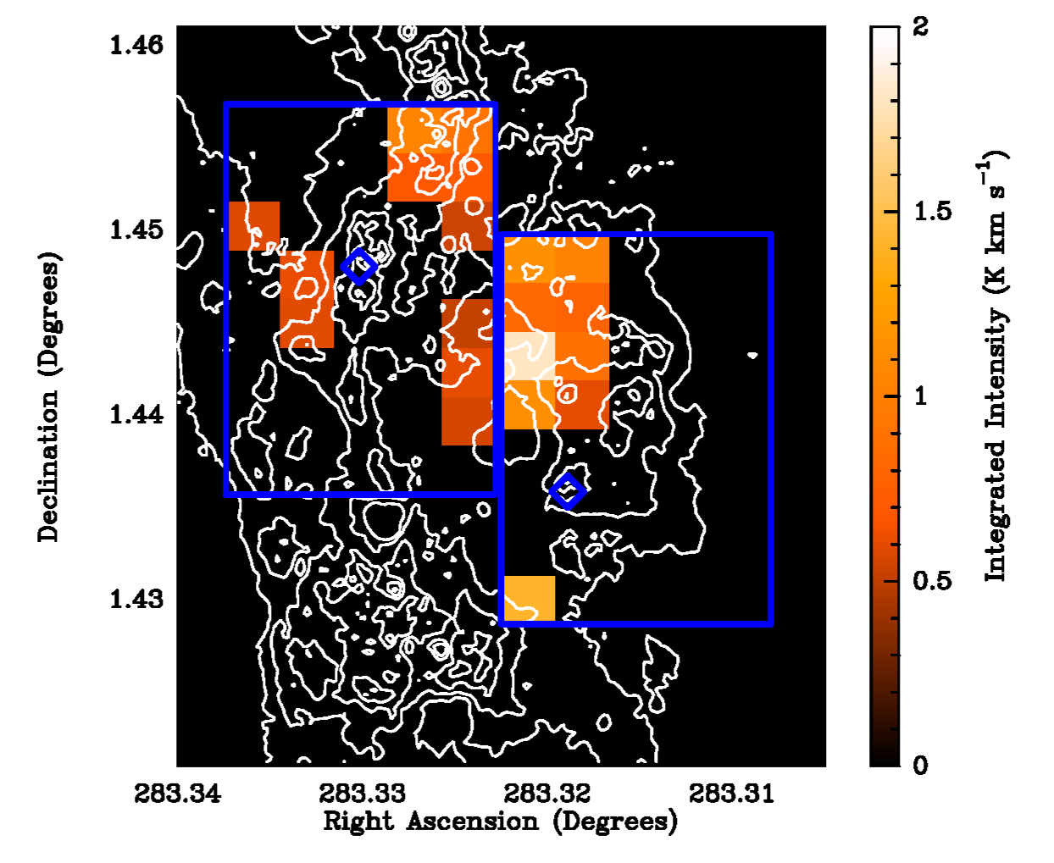
IRDC Observations
8 to 7
9 to 8
IRDC C
IRDC F

Slide 21
 | n = 10^{2.5} cm⁻³ | n = 10³ cm⁻³ | n = 10^{3.5} cm⁻³
v = 3 km s⁻¹ b = 0.3
v = 2 km s⁻¹ b = 0.1
v = 3 km s⁻¹ b = 0.1

Slide 22
CO 6 - 5
CO 5 - 4

Slide 23
CO SED

