Slide 1
Detectors in Astronomy
Alain Smette
System Scientist for VLT Instrumentation
ESO

Slide 2
Introduction
Detectors based on photo-electric effect:
CCD
CMOS detectors
MAMA & photo-multiplier tubes
Characteristics of CCD and CMOS detectors
Signal-to-noise ratio
FITS files
Summary

Slide 3
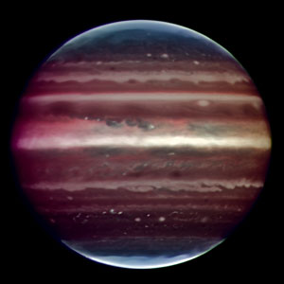
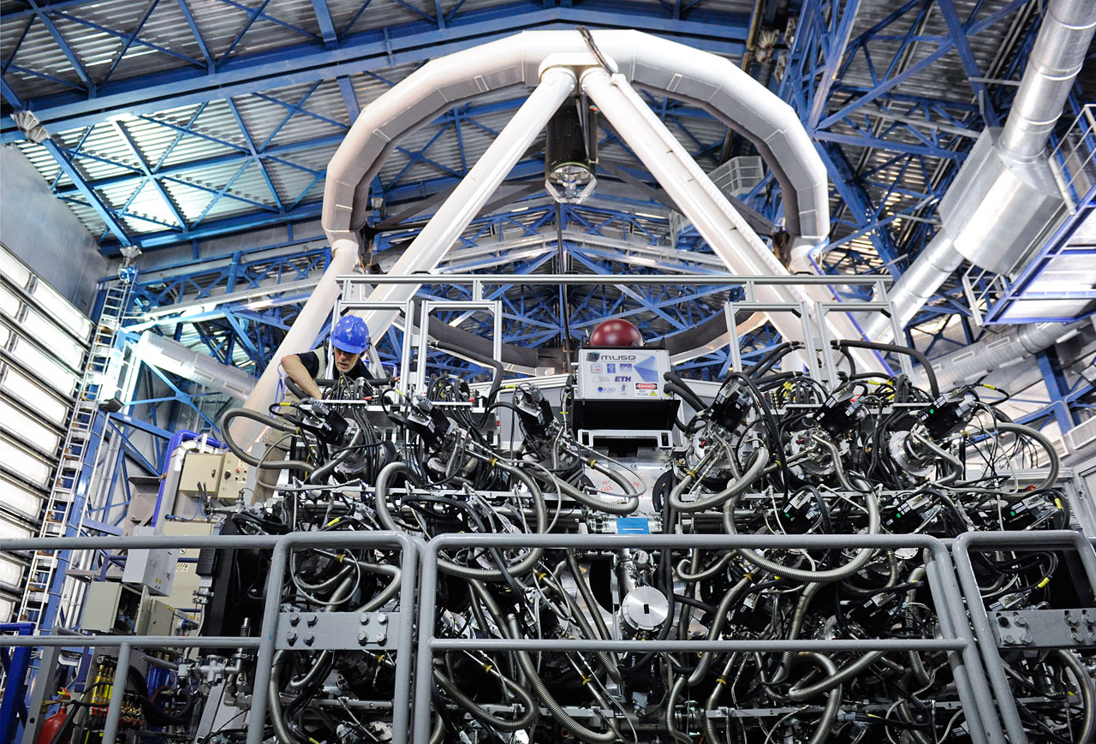
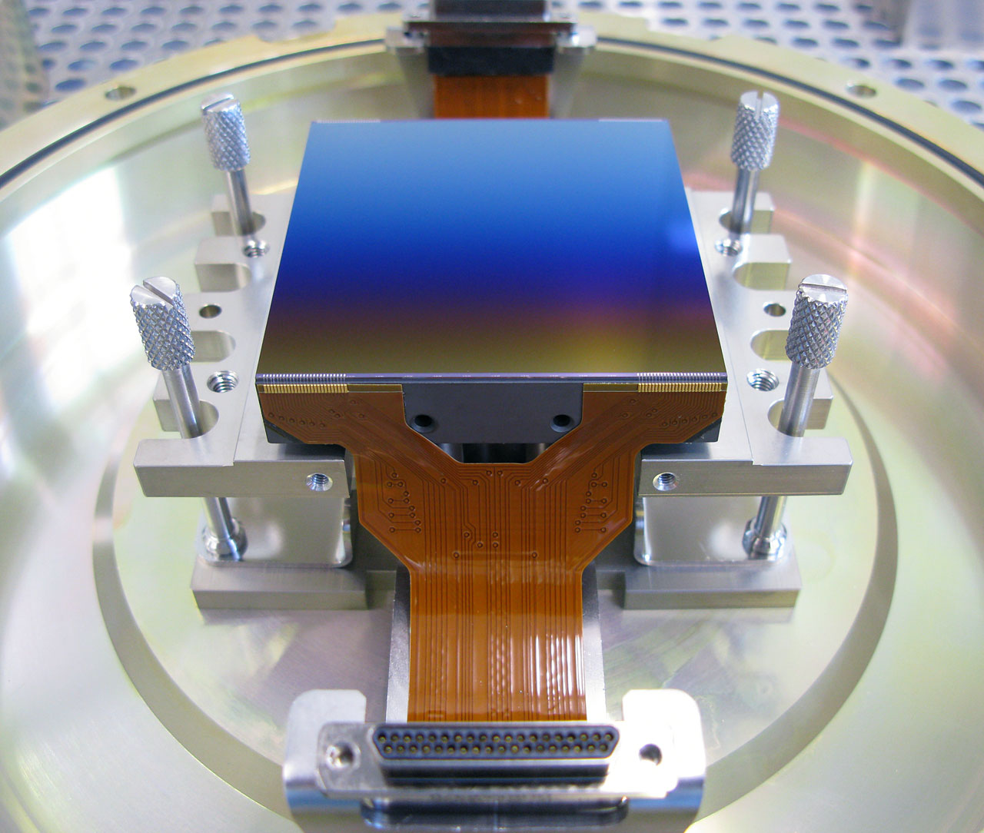
Optical, near- and mid-IR observation
Science object
Atmosphere (optional)
Telescope
Instrument
Detector

Slide 4
Disclaimer
This talk is only about UV, optical, IR photons detectors;
It does not describe radio detectors…
… neither neutrino, cosmic rays, nor gravitational wave detectors!

Slide 5
Ideal detector
An ideal detector of light would record all information carried by each of the photons provided by the object/atmosphere/telescope/instrument system – and only them, with no loss, – within quantum uncertainty limits:
Energy (wavelength, frequency)
Polarization
Phase
Location of arrival on detector
Time of arrival

Slide 6
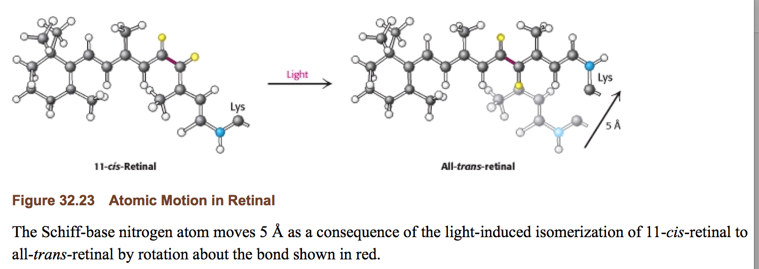
Different methods of detection. Retina: isomerization
Eye retina: absorption of one photon changes the structure of a molecule, which triggers a number of chemical reactions before a neuron signalling (http://www.ncbi.nlm.nih.gov/books/NBK22541/)
Biochemistry. 5th edition.
Berg JM, Tymoczko JL, Stryer L.
New York: W H Freeman; 2002.
Isomerization: process by which one molecule is transformed into another molecule which has exactly the same atoms, but the atoms have a different arrangement

Slide 7
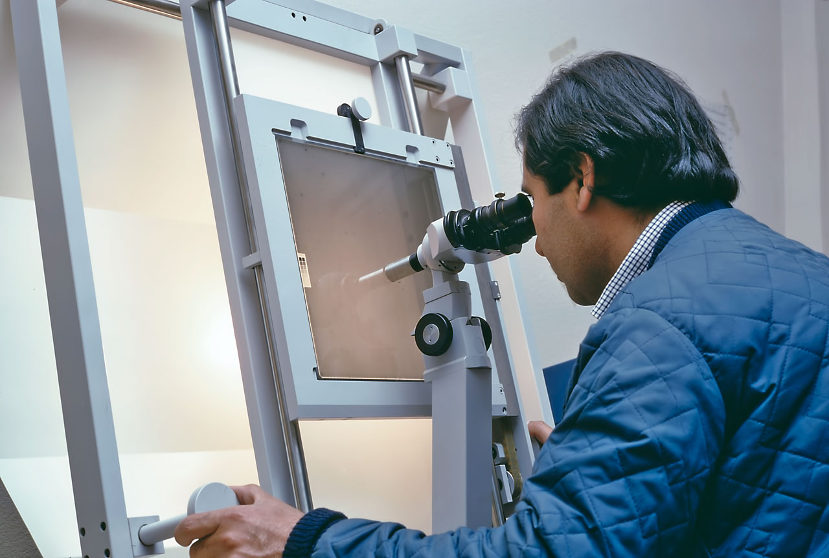
Different methods of detection. Photographic plate: chemical reaction
Photographic plates:
Ag⁺Br⁻ (crystal) + hv (radiation) → Ag⁺ + Br + e⁻
Ag⁺ + e^{- →} Ag⁰
Chemical process to remove Br
Hardly used anymore in modern observatories

Slide 8
Different methods of detection. (Current) astronomical detectors: photo-electric effect
Photo-electric based detectors
Charge Coupled Devices (CCD): optical
CMOS: infra-red, optical
Multi-Anode Microchannel Array (MAMA): STIS, ACS, COS (UV)

Slide 9
Introduction
Detectors based on photo-electric effect:
CCD
CMOS/IR detectors
MAMA & photo-multiplier tubes
Characteristics of CCD and CMOS detectors
Signal-to-noise ratio
FITS files
Summary

Slide 10
Absorption of photons in a semiconductor: Valence & Conduction Bands
In a crystal lattice, the allowed bands of electrons can be described by valence and conduction bands (similar to quantum orbits of electrons in Hydrogen).
valence band = "ground states" that are normally completely filled
conduction band = "excited states" that are normally completely unfilled, electron in the conduction band can move if there is electric field
electrons are either in a valence or in a conduction band
Dorn 2009

Slide 11
Photo-electric effect in a semi-conductor
Parameters: Quantum Efficiency (QE) , Dark current
QE =$\frac{\# of photo−electrons in the conduction band}{\# of photons which reached the detector}$
Dark level: # of thermally excited electrons which reached the conduction band

Slide 12
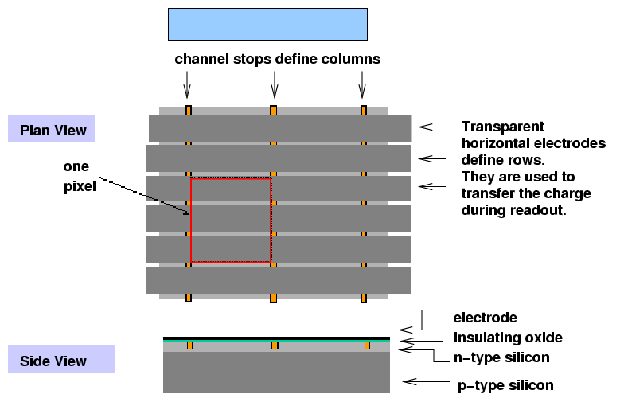
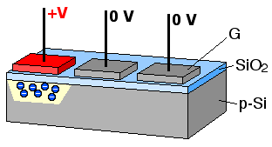
A. Charge Coupled Device (CCD) & variations
Animation by Michael Schmid

Slide 13
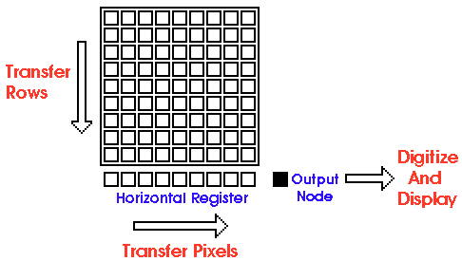
A. Charge Coupled Device (CCD) & variations
Analog-to-Digital Converter : Converts charges to ADU
amplifier
Parameters: full-well capacity, bias level, gain, ADC saturation level
Gain: ⚠ g = number of ADUs/electron or number of electrons/ADU (g = 1/CONAD)
Full well capacity: maximum # of photo-electrons in a pixel
Bias level: artificial electronic offset which ensures that the ADC always receives a positive signal.
ADC saturation level: # of bits used by the A/D converter is: 16 bits -> 65 535 ADUs

Slide 14
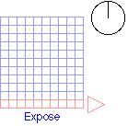

Slide 15
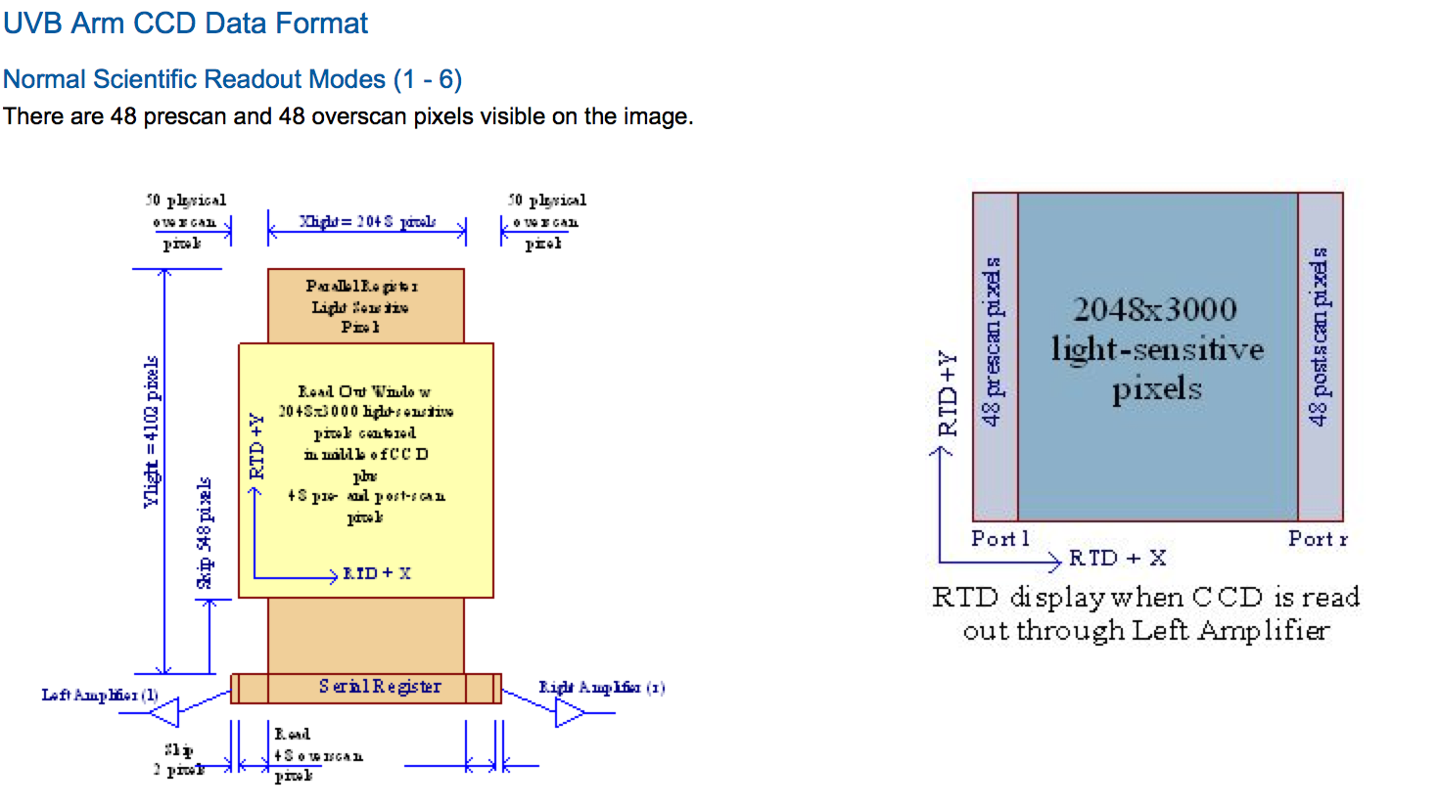
Pre-/post-/over-/under- scan regions
Regions not exposed to light: pseudo-pixels generated by sending additional clock cycles to the output electronics

Slide 16
One of the 2 CCDs used in ESPRESSO:
81 millions pixels

Slide 17
OmegaCAM detector array:
32 2048x2048 detectors;
268 millions pixels

Slide 18
B. Hybrid Complementary Metal Oxide Semiconductor (CMOS) detectors

Slide 19
B. Hybrid Complementary Metal Oxide Semiconductor (CMOS) detectors
Dorn 2009
Charge diode capacity by reverse bias voltage
Floating capacity is discharged by absorbed photons
Read voltage across diode capacity by addressing unit cell source follower
Each pixel is read individually.
Each pixel can be read multiple times during an exposure.
Exposure time is reported as DIT. A file usually includes the average of NDIT individual exposures.
Parameters: full-well capacity, gain
Full well capacity: maximum # of photo-electrons in a pixel
Gain: g = number of ADUs/electron

Slide 20
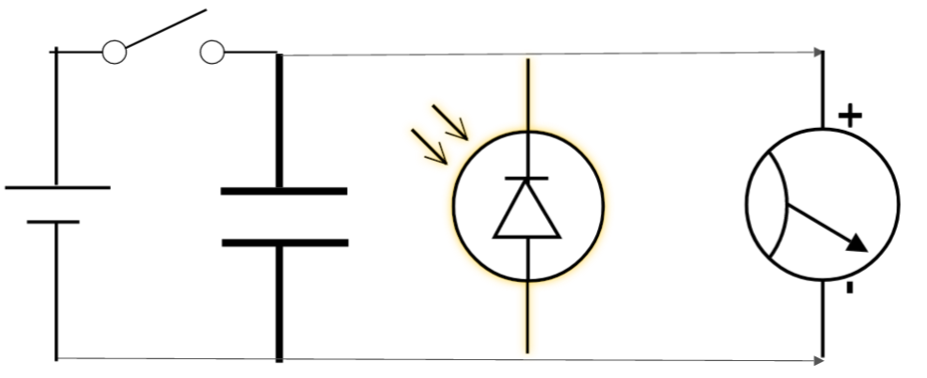
B. Hybrid Complementary Metal Oxide Semiconductor (CMOS) detectors
The signal lifetime in the pixel: reset to black level (high voltage V DD : yellow), photocharge integration (dropping voltage: green), and voltage readout (red).
De Groof et al. 2008

Slide 21
Mosaic of 16
2048x2048 CMOS detectors used in VIRCAM

Slide 22
Comparison: CCD vs CMOS
Requires a shutter
Usually, no need for a shutter

Slide 23
C. Multi-Anode Microchannel Array (MAMA)

Slide 24
Introduction
Detectors based on photo-electric effect:
CCD
CMOS/IR detectors
MAMA
Characteristics of CCD and CMOS detectors
Signal-to-noise ratio
FITS files
Summary

Slide 25
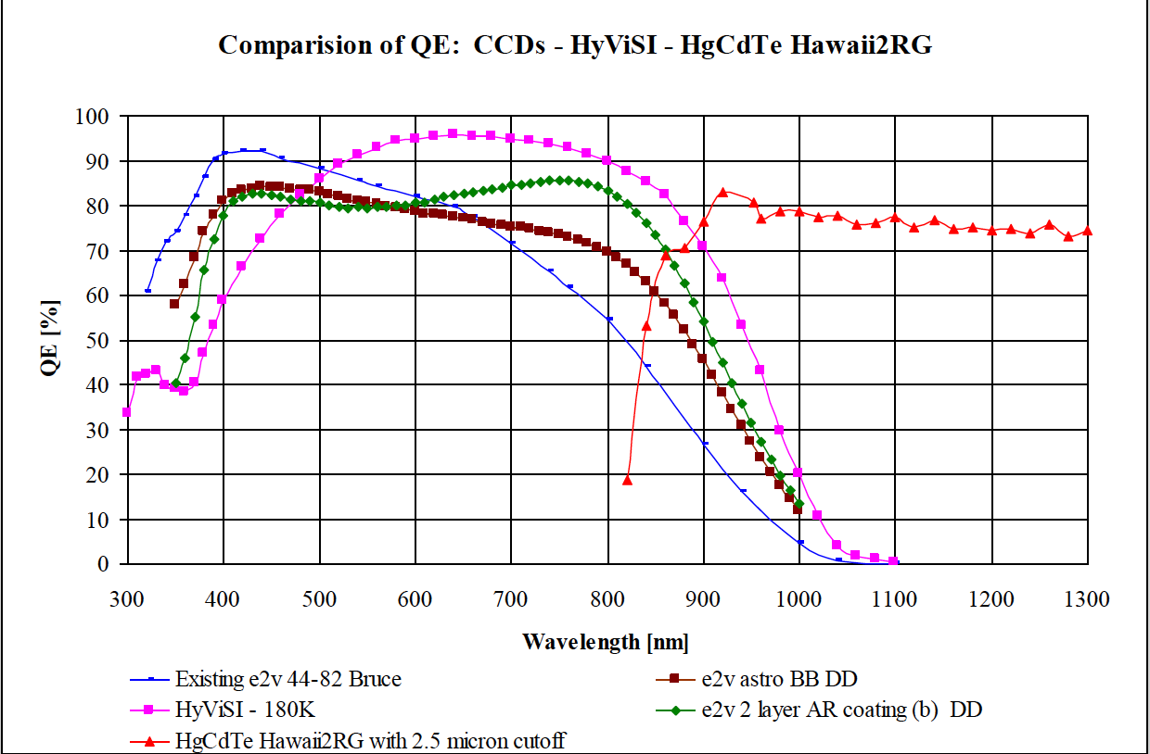
Behavior relative to ideal detector (for optical, near- and mid-IR astronomy)
Dorn 2009
Energy:
Broad band sensitivity
Need for filters or
spectrograph
Polarization: N/A: need for polarization optic
Phase: N/A: specific optics; interferometry

Slide 26
Behavior relative to ideal detector (for optical, near- and mid-IR astronomy)
Time of arrival:
MAMA: Time-tag to each individual photon individually
But not too many photons can arrive at the same time!
CCDs: time associated with each exposure
Limited by the read-out time
Most CCDs tuned to faint target observations leading to long read-out time;
Can be windowed
Trick: move charges in a direction while integrating
HIT mode on FORS
Time delay and integration to match sidereal rate for fixed telescopes
CMOS detectors: time associated with each exposure
limited by the read-out time, but faster then CCD
‘burst’ mode can allow to save each frame
pixels are often read one after the other

Slide 27
Behavior relative to ideal detector (for optical, near- and mid-IR astronomy)
One electron for each photon?
Linearity
Behavior at low/high flux: see next slides
Pixel-to-pixel variation (also called fixed pattern noise)
Fringing
Charge transfer efficiency
Are there electrons not associated with incoming photons?
Bias level
Hot columns/rows, hot pixels, traps…
Dark current
Radiation events (‘cosmic rays’)
Read-out noise
Quantization noise

Slide 28
Behavior relative to ideal detector (for optical, near- and mid-IR astronomy)
Linearity
MAMA: good behavior at low flux only, otherwise pile-up
CCD:
old CCDs (1980’s…) were not linear at low flux: they needed to be ‘flashed’. Solved in current CCDs.
good behavior in general
saturation when approaching the full well capacity
pixel-to-pixel variation caused by small differences between pixels
CMOS detectors: intrinsically non-linear, as accumulation of charges changes bias on detector for simple readout
more complex readout electronics (up to 70 transistors per pixel!)
pixel-to-pixel variation (fixed-pattern noise): mostly caused by small difference between electronics assigned to each pixel

Slide 29
CCD Linearity
This graph and following: from http://www.eso.org/sci/facilities/develop/detectors/optdet/instruments.html

Slide 30
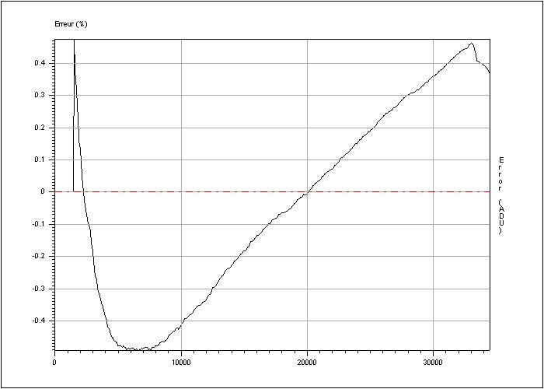
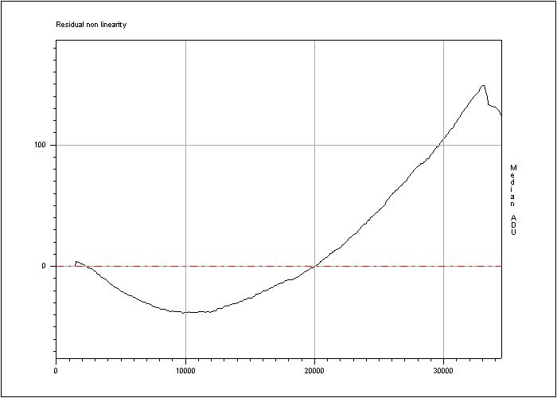
CCD Linearity
OmegaCAM, detector #84 ‘Centaurus’

Slide 31
CCD linearity
Different quantities:
ADC saturation level: set by the Analog/Ditigal Converter.
(here: 15 bits: 2^15 = 32767)
Full-well capacity: physical limit set by the characteristics of the pixel; usually higher than ADC saturation level
Linear range: range within which the CCD responds linearly within a given level (say 1%)

Slide 32
Photon transfer curve
Dorn 2009
Take 2 images with same illumination levels
Change illumination level
Make difference
Measure variance
Report vs signal
Slope is gain of the ADC converter

Slide 33
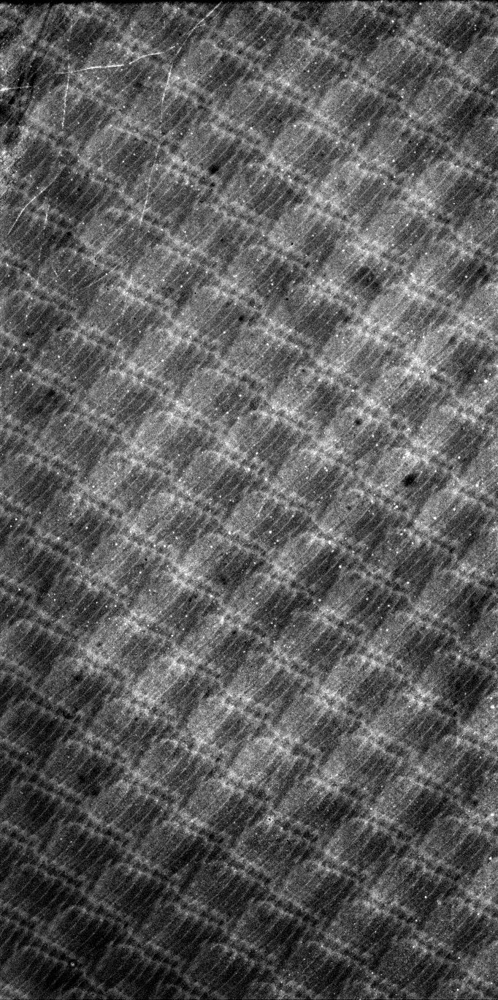
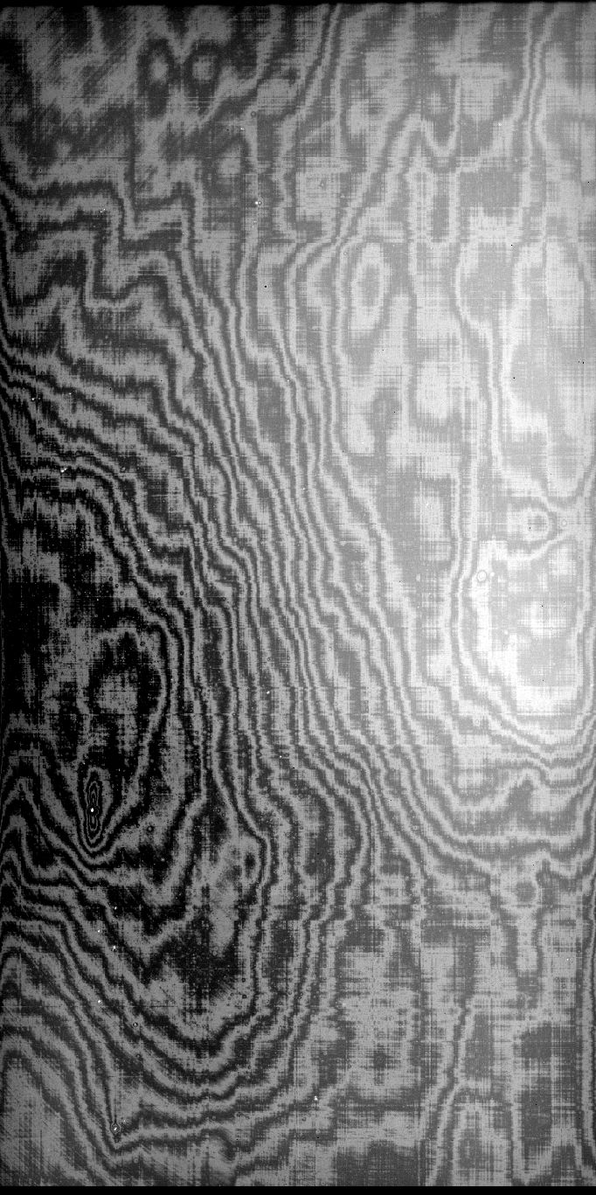
Pixel-to-pixel variation; fringing

Slide 34
Bias level, hot columns, pixels
bias
3600s dark
Zoom on dark

Slide 35
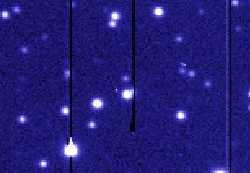
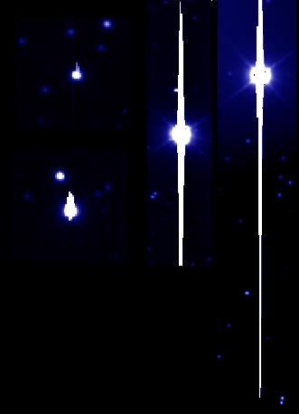
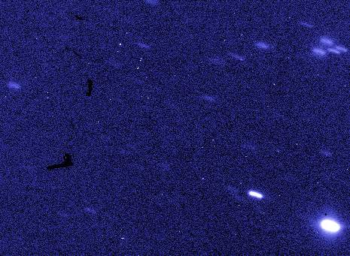
Defects: bad columns, traps, ‘stuff’, saturation, blooming
https://www.eso.org/~ohainaut/ccd/CCD_artifacts.html

Slide 36
Radiation events (‘cosmic rays’)
Smith et al. 2002, SPIE 4669, 172

Slide 37
Radiation events

Slide 38
Charge Transfer Efficiency (CTE)
Fraction of electrons that are successfully moved from one pixel to another during read-out
Charge Transfer Inefficiency: CTI = 1 - CTE
Values can differ between parallel and serial readout: E.g.: OmegaCAM CENTAURUS:
Serial: 1
Parallel: 0.9999995 (1 charge loss every 1000 for a pixel at row 2048)
Degrades due to radiation:
in particular, affects space instruments
depends on signal level

Slide 39
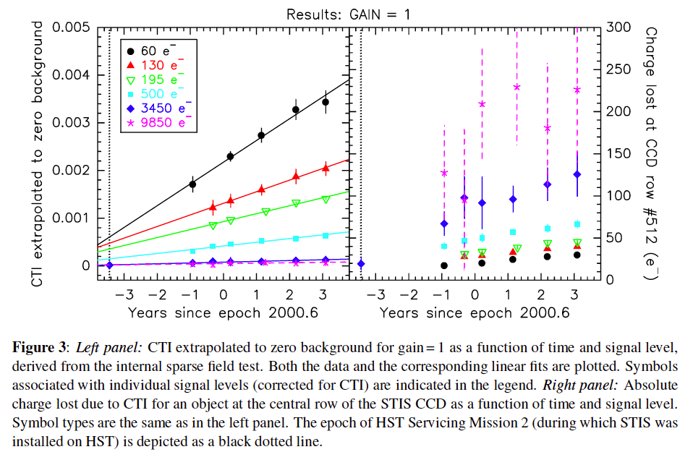
CTI evolution for HST/STIS CCD
Goudfrooij, P., Wolfe, M. A., Bohlin, R. C., Proffitt, C. R., and Lennon, D. J., 2009,
“STIS CCD Performance after SM4,” Instrument Science Report STIS 2009-02.

Slide 40
Sources of noise
Read-out noise (RON):
Noise produced by the electronics of the amplifier
Follows a gaussian distribution
Thermal noise: thermal excitation of electrons in valence band
origin of dark current, reason to cool detectors
Poisson distribution
kTC noise in CMOS/IR detectors: reset voltage is not always constant
Usually dealt with by readout mode
Quantization noise (QN):
Analog-to-digital converter (ADC) converts electrons to ADUs
16-bits ADCs produced a max of 2^16 = 65 535 ADUs
ADC only outputs discrete levels: range of analog inputs can produce same output: round-off error is quantization noise
QN = 1/sqrt(12) ADU

Slide 41
CMOS (IR) detectors read-out mode
Dorn 2009

Slide 42
CMOS (IR) detectors read-out mode
Dorn 2009

Slide 43
RON decrease using Fowler-sampling

Slide 44
Source of noise
1/f, pink noise, flicker noise: affects a number of electronics, origin not well understood
Noise behaving as ${1/f}^{α}$, (f = read-out frequency)
$α \sim 0 −2,$often close to 1
Consequence: SNR does not increase with # of integrations
Usually not relevant in modern detectors
Unfortunately affects AQUARIUS arrays: VISIR, MATISSE, JWST/MIRI
For VISIR, requires high chopping frequency

Slide 45
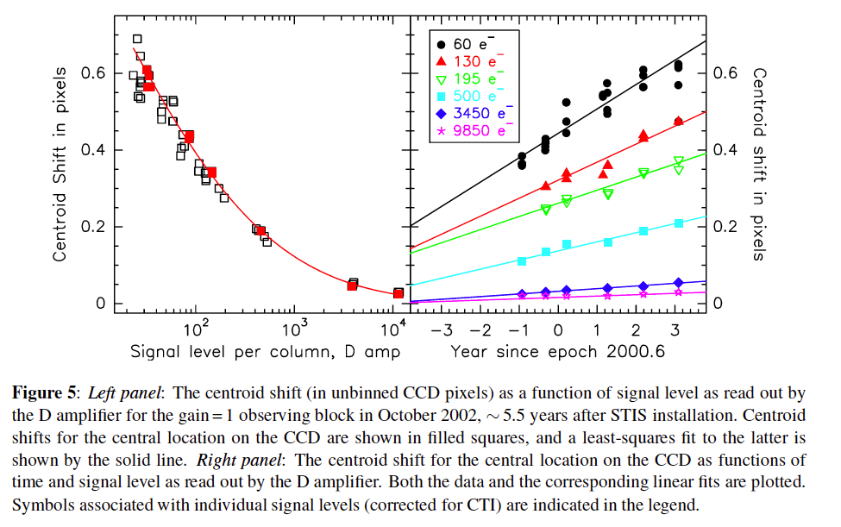
Behavior relative to ideal detector (for optical, near- and mid-IR astronomy)
Location of arrival of photons on detector
Pixel size is often chosen as to satisfy the Nyquist sampling criterion (2 pixels/resolution element)
However, different problems can occur:
CCD:
Coating can increase the FWHM of the PSF
Bad clocking pattern
Lateral charge diffusion
Thickness combined with a
fast camera
For space instrument:
Significant CTE leads to shift of
PSF centroid.

Slide 46
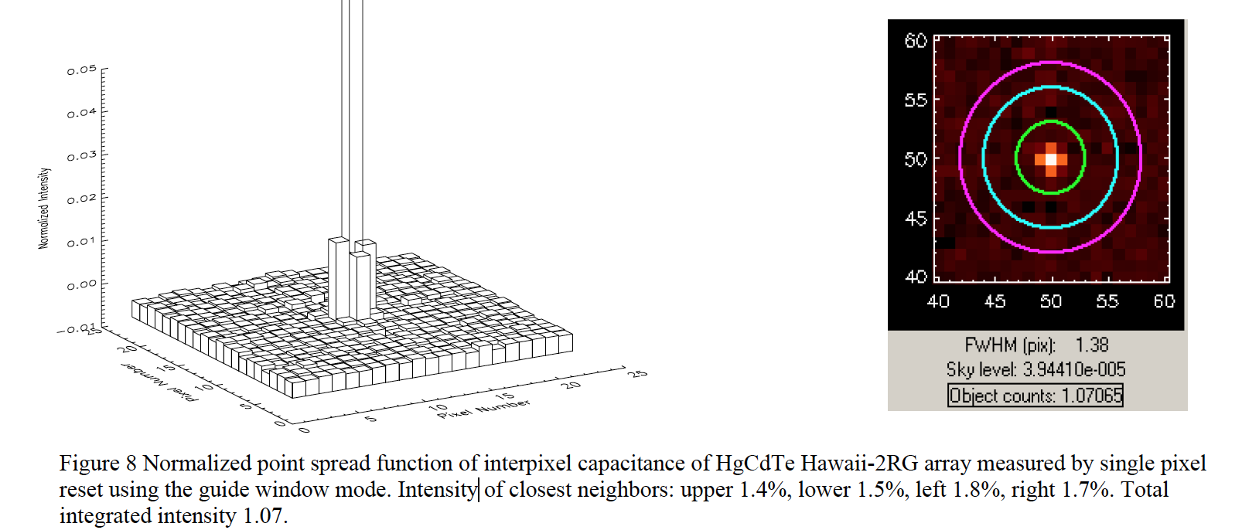
Behavior relative to ideal detector (for optical, near- and mid-IR astronomy)
CMOS (IR) detectors:
Interpixel capacitance
affects the point-spread function
affects the determination of the gain
Finger et al 2006, SPIE 6267

Slide 47
Introduction
Detectors based on photo-electric effect:
CCD
CMOS/IR detectors
MAMA & photo-multiplier tubes
Characteristics of CCD and CMOS detectors
Signal-to-noise ratio
FITS files
Summary

Slide 48
Signal-to-noise ratio
SNR = $\frac{Signal}{Noise}$
Signal = object detected photons = $O_{e}$(t)
Noise = σ = $\sqrt{variance}$
Variance from
Photon noise: (in electrons)
object: object detected photons = $O_{e}$(t)
sky: sky detected photons = $S_{e}(t)$
thermal background: background detected photons = $B_{e}(t)$
detector dark current: dark current rate = $D_{e}(t)$
Read-out noise: in electrons ${RON}_{e}^{2}$
Quantization noise:${\text{(} 1/{√12} × \text{g}\text{)}}^{2}$
Other noise: can often be corrected (if enough care taken during calibrations)

Slide 49
Signal-to-noise ratio
SNR = $\frac{O_{e}(t)}{{√(O}_{e}(t)+S_{e}(t)+B_{e}(t)+D_{e}(t)+{RON}_{e}^{2}+\frac{g^{2}}{12}\text{)}}$
Different regimes:
Read-out noise limited:
faint target, little sky
RON contribution larger all other contributions
Exposure should be as long as possible: limited by radiation events, observing constraints
Photon noise limited:
bright target, bright sky (extreme case: mid-infrared imaging from ground), large thermal background, dark current (UV in space)
little affected by number of exposures:
trade-off with overheads associated with individual exposures

Slide 50
Signal-to-noise ratio
Object photon noise limited: SNR = $√O_{e}(t)$ $∝ √t$
RON limited: SNR = $\frac{O_{e}(t)}{{RON}_{e}^{}}∝ t$
Background limited
SNR = $\frac{O_{e}(t)}{√X_{e}(t)}$ (X is either S, B, D) $∝ √t$
Often limited by systematics affecting the determination of the background or the determination of${ O}_{e}$

Slide 51
Special case of mid-infrared wavelengths
Number of photons from sky and telescope is larger than number of photons from the object ($S_{e}$>> $O_{e}$) !
Very short exposure times (~ 10 ms)
Synchronization of detector reading with chopping (~ Hz motion of a mirror in the light path – such as M2)
VISIR User Manual

Slide 52
Introduction
Detectors based on photo-electric effect:
CCD
CMOS/IR detectors
MAMA & photo-multiplier tubes
Characteristics of CCD and CMOS detectors
Signal-to-noise ratio
FITS files
Summary

Slide 53
Flexible Image Transport System (FITS) files
Widely used format for transporting, analyzing and archiving astronomical images. Much more than just a format.
Primarily designed to store scientific data sets of multidimensional arrays (images) and 2-dimensional tables organized into rows and columns of information
Endorsed by ESO, NASA and the International Astronomical Union (Vatican Library, …)
Header keywords provide descriptive information about the data:
Site, Telescope, Instrument and Detector information
World Coordinate System parameters
Header keywords and data format follow a (strict) standard

Slide 54
FITS file
A FITS file is comprised of segments called Header/Data Units (HDUs),
First HDU is called the `Primary HDU', or `Primary Array’:
can contain a 1-999 dimensional array of 1, 2 or 4 byte integers or 4 or 8 byte floating point numbers using IEEE representations.
typically a 1-D spectrum, a 2-D image, or a 3-D data cube.
Any number of additional HDUs may follow the primary array: FITS `extensions'. Types of standard extensions are currently defined:
Image Extensions contain a 0-999 dimensional array of pixels, similar to a primary array (header begins with XTENSION = 'IMAGE ')
ASCII Table Extensions store tabular information with all numeric information stored in ASCII formats (header begins with XTENSION = 'TABLE ')
Binary Table Extensions store tabular information in a binary representation. Each cell in the table can be an array but the dimensionality of the array must be constant within a column. (header begins with XTENSION = 'BINTABLE')

Slide 55
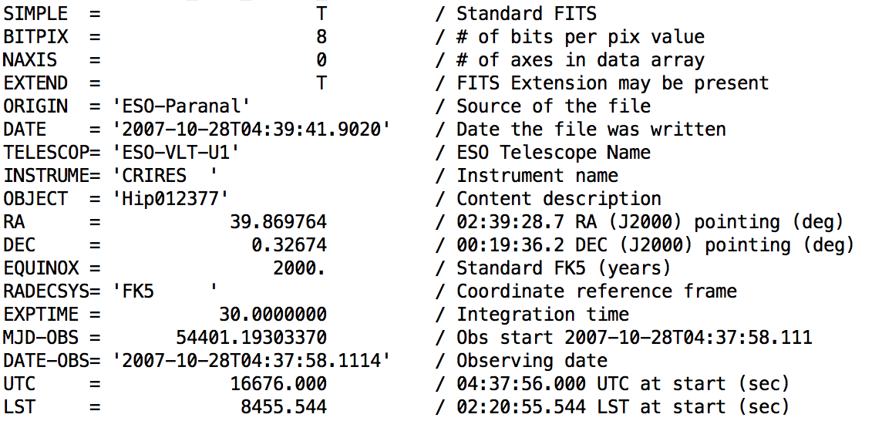
First entries in a FITS Primary HDU header:
Data types in an image array:
8-bit (unsigned) integer bytes
16-bit (signed) integers
32-bit (signed) integers
32-bit single precision floating point real numbers
64-bit double precision floating point real numbers

Slide 56
Summary
Bias
Read-out noise (RON)
Dark level
Quantum efficiency (QE)
Full-well capacity
Gain (g); pixel-to-pixel variation, fixed-pattern noise
ADC saturation level
Linearity
Exposure time; DIT/NDIT
Fringing
Charge Transfer Efficiency (CTE)
Detector defects: bad/hot columns; hot pixels.
Radiation events ‘cosmic rays’

Slide 57
