Slide 1
CCS UI Framework Taurus Prototype
Arturo Hoffstadt<ahoffsta@eso.org>
Short Introduction to MVC
Taurus MVC

Slide 2
MVC Overview
Model
View
User
Controller
Edits
Renders
Manipulates
Informs
Notes:
Pattern used in UI development. Aims for reusability of components, and modularization of development.

Slide 3
MVC Overview
Model
View
User
Controller
The Model is a section of the data from the domain of the application.
Responsabilities:
Contains the data
Knows how to read from its source
Knows how to write it back to its source
Translate any metadata into usable Roles
Manipulates
Updates
Interacts
Informs
Notes:
Model example: From a motor, the encoder value, brake state, power state, incoming voltage.
From a database, the results from select * from table_students;

Slide 4
MVC Overview
Model
View
User
Controller
The View presents to the user the data from the model.
Responsabilities:
Takes a subset of entries in the model, and presents it.
Determines the layout of the presentation (list, table, tree, heterogenous, etc)
Each piece of data can use a different Widget, these are called Delegates.
Manipulates
Updates
Interacts
Informs
Notes:
Examples of views: List, ComboBox, Table, Tree, Columns

Slide 5
MVC Overview
Model
View
User
Controller
The Controller takes the inputs from the user, and makes the necessary changes to the model.
Responsabilities:
Keeps references to Model and View.
Process input from the user, converting it to domain compatible notations.
Can also alter the user input.
Can manipulate the model, so it changes what is presented.
Manipulates
Updates
Interacts
Informs

Slide 6
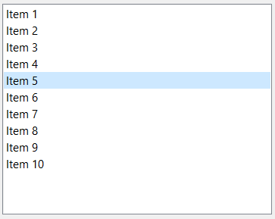
MVC in Qt
QStandardItemModel model;
for( int i = 0 ; i < 10; i ++){
auto *item = new QStandardItem( QString("Item %0").arg(i+1) );
this->model.setItem(i,0,item);
}
this->ui->listView->setModel(&this->model);
QList<QStandardItem>
The setModel() method in the view creates this connection
signal dataChanged() -> slot dataChanged()
QListView

Slide 7
Taurus
https://taurus-scada.org/

Slide 8
What is Taurus?
Is a UI framework developed in python.
Its based on MVC pattern.
It is extended through “scheme” plugins. Each plugin provides connections to new protocols.
Tango, Epics, python evaluated functions, HDF files, pandas, CII OLDB
It uses URI to identify datapoints or devices. A datamodel is defined by one or more URIs.
OpenSource, LGPL V3

Slide 9
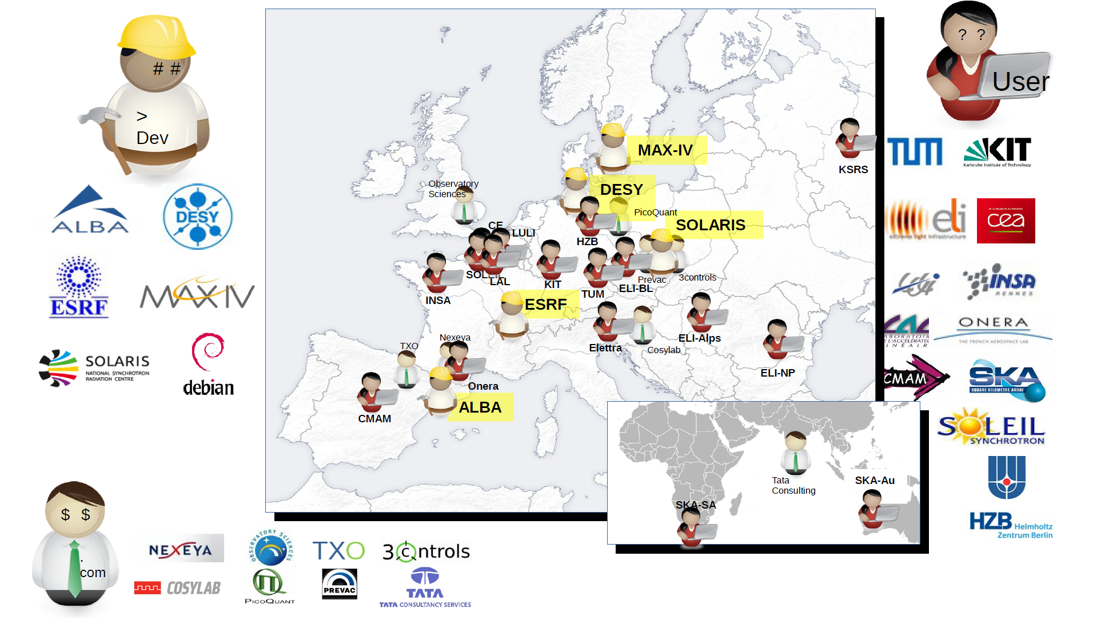
Taurus Community
Notes:
Developed by ALBA Synchrotron with the work of several contributors. The repository indicates is active in development.
Active community. A lot of learning material available. Meetings and development still ongoing.

Slide 10
What does Taurus Framework provides
CLI interfaces
Several new QWidgets (LEDs, wheels, LCD)
MVC for attributes and devices.
TaurusWidgets
Common QWidgets that have model capabilities.
You can still use the common ones.
Quick prototyping tools
Application creation wizard

Slide 11
Taurus Model
A set of 5 classes:
TaurusModel, the base class for all model elements.
TaurusDevice, which represents branches in a tree like structure.
TaurusAttribute, which represents leaves in this tree like structure.
TaurusModel base class and TaurusDevice class implements a Composition pattern: Any device can have multiple children, but attributes cannot.

Slide 12
Taurus Attributes and Devices
Example CII OLDB contents:
/root/
example/
double/
sine <- datapoint
cosine <- datapoint
tan <- datapoint
boolean/
switch <- datapoint
We map a CII OLDB datapoint to a TaurusAttribute:
cii.oldb:/root/example/double/sine
cii.oldb:/root/example/switch/Boolean
A Device from the CII OLDB point of view could be:
cii.oldb:/root/example/double

Slide 13
Taurus Model

Slide 14
Taurus Model
The TaurusFactory in the model provides an Abstract Factory pattern, that will provide most of the logic to create the needed entities, but specifics are left to a particular scheme plugin.
import taurus
taurus.Attribute(‘cii.oldb:/root/example/double/sine’)
taurus.Attribute(‘eval:rand(256)’)
Then the TaurusFactory will find out the scheme for the attribute.
Using the matching plugin, it will request instances of the CiiFactory and CiiValidator.
Will check the validity of the uri using the CiiValidator
And the create the attribute using the CiiFactory.

Slide 15
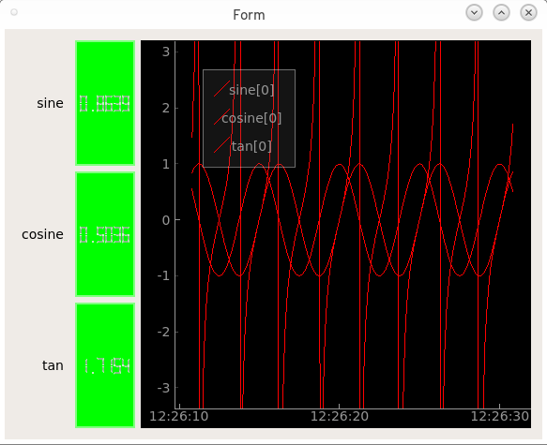
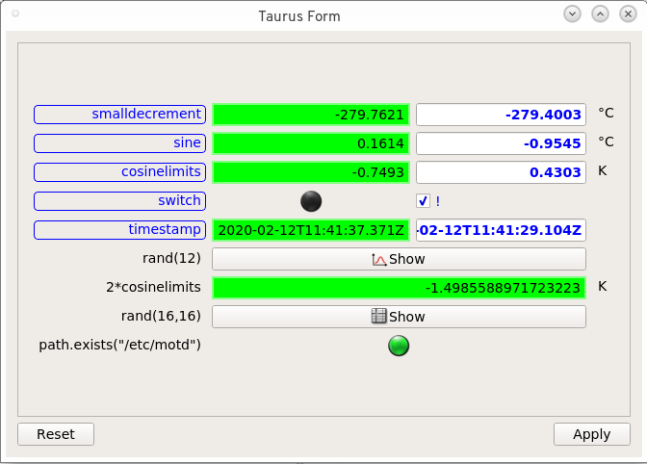
Taurus Model
cii.oldb:/root/example/double/sine
cii.oldb:/root/example/double/cosine
cii.oldb:/root/example/double/tan
cii.oldb:/root/example/double/cosinelimits
cii.oldb:/root/example/boolean/switch
cii.oldb:/root/example/string/timestamp
eval:rand(12)
eval:2*{'cii.oldb:/root/example/double/cosinelimits'}
eval:rand(16,16)
eval:@os.*/path.exists("/etc/motd")

Slide 16
Taurus Model
Model objects are singletons
Model names are URIs
Each scheme provides:
A model factory for:
Authority
Device
Attribute
Model URIs validators
cii.oldb:/root/example/double/sine
cii.oldb:/root/example/double/cosine
cii.oldb:/root/example/double/tan
cii.oldb:/root/example/double/cosinelimits
cii.oldb:/root/example/boolean/switch
cii.oldb:/root/example/string/timestamp
eval:rand(12)
eval:2*{'cii.oldb:/root/example/double/cosinelimits'}
eval:rand(16,16)
eval:@os.*/path.exists("/etc/motd")

Slide 17
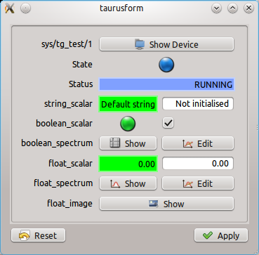
Taurus Views
Taurus Widgets
Taurus Form
TaurusDevicePanel
Array Editor
Table View
Plots, Trends

Slide 18
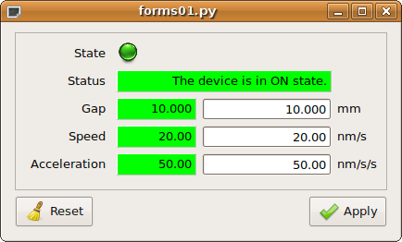
Taurus Controllers
Each Basic QWidget implemented in Taurus has a controller.
It transforms the value from the device into something meaningful.
It also takes the user value and transforms it into the control system can use.

Slide 19
DEMO TIME!

Slide 20
Conclusions
Model is reusable through several widgets.
Extending Taurus is rather easy. 5 classes needs implementation, and can be done in a modular way.
Model is not actually tied to Qt, you can use it for CLI programs as well.
Quick prototype: bash line:
$> taurus form ‘cii.oldb:/…’
Application Wizard:
$> taurus newgui
… to more complicated interfaces:
Design a .ui file in Qt Designer, with Taurus Widgets.

Slide 21
MVC in Qt

Slide 22
MVC in Qt
QStandardItemModel model;
for( int i = 0 ; i < 10; i ++){
auto *item = new QStandardItem( QString("Item %0").arg(i+1) );
this->model.setItem(i,0,item);
}
this->ui->listView->setModel(&this->model);
QList<QStandardItem>
signal dataChanged() -> slot dataChanged()
Where is the Controller?
QListView

Slide 23
Model-View framework in Qt
Model
View
User
Delegate
Edits
Renders
Informs
Renders

Slide 24
MVC in Qt
Qt offers a series of ready to consume Views.
QListView
QTableView
QTreeView
QColumnView
The controller is already implemented. The signal/slot mechanism makes the implementation of the controller trivial.
Views implements the QAbstractItemView interface
Models implements the QAbstractItemModel interface
Notes:
The fact that views and models implements the same generic interfaces, is what makes the example from mvc-01 possible. That we can take any model, and put it on any view. Though they not necessarily make much sense.

Slide 25
MVC in Qt
Double click on an item
QListView will create a new instance of the proper Editor Delegate. In particular, the delegate for Strings -> QTextField.
We enter a new value, and press enter.
Entering a new value triggers a signal, valueChanged().
The View has already connected for us the signal for that particular delegate, against the model setData(index, value).
The model takes care of updating the value.
When the value in the model changes, a signal from the model is emitted, dataChanged()
All other views are connected to this signal. This is how each one of them also updates their own representation of the value changed.

Slide 26
MVC in Qt
Role
Each item in the model can have many other metadata set.
We can customize appearance, or store other values.
Qt::DisplayRole: what is displayed in the Delegate
Qt::UserRole: an extra data container. For example, a complex type, or a int that represents the real value.
Qt::DecorationRole: An icon or color used while rendering the item.
Qt::StatusTipRole: String to present as tooltip on mouseover.
Qt::SizeHintRole: The size of the delegate.
Qt::BackgroundRole: Brush or color used to draw the background of the delegate.
Qt::ForegroundRole: Brush or color used to draw the foreground of the delegate.

Slide 27
MVC in Qt
Delegate:
Widgets used to present an item.
The delegates normally uses the type of the DisplayRole to determine what widget to present.
For example: If DisplayRole has a Date, then a date selector is the Delegate.

Slide 28
MVC in Qt
Role and Delegate customization:
Qt suggests custom behavior to be programmed through Roles, and then through Delegates.
We can add new roles.
We can change the delegates.
We can create new roles or delegates.
When full control of the items on the Model is needed, use the QAbstractItemModel.
You need to implement logic to get data from its source, and save it back.
You need to understand how the QModelIndex Works.

Slide 29
MVC in Taurus

Slide 30
MVC in Taurus
Simple widgets are Views in Taurus as well:
TaurusLabel, TaurusLED, TaurusLCD, etc
These have an associated model.
The Widget is just responsible for storing “configuration” properties (model, which role is going to be used for presentation)
The Controller for each one of those widgets:
TaurusLabelController, TaurusLEDController, TaurusLCDController, etc
The Controller is in charge of handling the attribute and its metadata, to present it in the correct manner.
The Controllers uses the model roles for this.

Slide 31
MVC in Taurus
class TaurusLabelController(TaurusBaseController):
def _updateForeground(self, label):
fgRole, value = label.fgRole, ‘’
# handle special cases (that are not covered with fragment)
if fgRole.lower() == 'state’:
value = self.state().name
elif fgRole.lower() in ('', 'none’):
pass
else:
value = label.getDisplayValue(fragmentName=fgRole)
self._text = text = label.prefixText + value + label.suffixText
…
def _updateToolTip(self, label):
if not label.getAutoTooltip():
return
toolTip = label.getFormatedToolTip()
if self._trimmedText:
toolTip = u"<p><b>Value:</b> %s</p><hr>%s" % (self._text, toolTip)
label.setToolTip(toolTip)
Notes:
You can see here that the preparation of data is done in the controller. The widgets is just in charge of presenting what the controller indicates it to do so.

Slide 32
MVC in Taurus
class TaurusLabel(Qt.QLabel, TaurusBaseWidget):
DefaultPrefix = ''
DefaultSuffix = ''
DefaultBgRole = 'quality'
DefaultFgRole = 'rvalue’
def _calculate_controller_class(self):
ctrl_map = _CONTROLLER_MAP
ctrl_klass = ctrl_map.get(model_type, TaurusLabelController)
return ctrl_klass
def resizeEvent(self, event):
if not getattr(self, '_inResize', False):
self._inResize = True
self.controllerUpdate()
self._inResize = False
Qt.QLabel.resizeEvent(self, event)
def setModel(self, m):
self._controller = None
self._permanentText = None
TaurusBaseWidget.setModel(self, m)
if self.modelFragmentName:
self.setFgRole(self.modelFragmentName)
Notes:
TaurusLabel, and other display widgets, only handle the storage of properties, like the fgRole and bgRole, and other data.
Also, they have to delegate the events to its base class, and also notify the controller of changes.
There is not logic of transformation of data in here.

Slide 33
Taurus Controllers
TaurusReadWriteSwitcher:
Controller that allow to present a read widget, an on doubleclick, a write widget.

Slide 34
Higher Level Models
With access to a TaurusAuthority, developers can requests the following models
All these models inherits from TaurusDbBaseModel, which is a QAbstractItemModel
TaurusDbSimpleDeviceModel
A Qt model that structures device elements in 1 level tree with device name as node leafs. This model contains only 1 column
TaurusDbPlainDeviceModel
A Qt model that structures device elements in 1 level tree. Device nodes will have attribute child nodes if the device is running.
TaurusDbDeviceProxyModel
Filter & sorting facility for taurus models

Slide 35
Higher Level Models
For the models from the previous slide, Taurus offers:
TaurusDbTreeView
TaurusDbTableView
Auxiliary models:
QConfigEditorModel

Slide 36
Taurus – Other features
BaseConfigurableClass
Allows to indicate a widget should persist its configuration.
Taurus.qt.qtcore.model
creates qt pure models from TaurusModels.
TaurusGrid
Instead of presenting the models as a form, presents them in a grid.
Logging
uses python logging module. Every class is a logger.
Factory Class registratations
It is possible to override the default class used to represent a device or attribute.

Slide 37
Taurus in detail
TaurusWidget, TaurusBaseWidget
Base class for all widgets, introduces new properties (models, quality, modifiable)
Base class for all widgets
Drag and Drop handling
Configuration of widgets persistence
TaurusBaseWritableWidget
Base class for all input widgets
Dangerous operations
TaurusBaseController
Indicates how the values are presented form the TaurusAttribute to the widget, and written back. Also, the map between quality/state and background.
TaurusMainWindow
MainWindow with support for fullscren, settings, perspectives and other features. Customizable on run-time or by wizard form.

Slide 38
Future Work

Slide 39
Future Work
Implement Device and Authority in cii.oldb scheme
Will allow to have the tree like nature of the database directly represented.
Implement cii.mal scheme
Is a multi-protocol scheme (reply-request and subscription)
IMO, the hardest, due to the safe-typed nature of the interface.
Will implement one prototype for one particular IF
Then, will implement a generic one
At some point, a map between URIs and IFs will be needed.

Slide 40
Taurus Authority

Slide 41
Future Work
Customization of Views
The requirement in INS widget library documents specify views and layouts that are not the same ones as the defaults of Taurus.
Deployment:
To use newer version of Qt, we need a new version of python. This will take some time to integrate well into the devenv.
Bugs:
During a long running session, events from REDIS can me missed. This needs further research.
Changing the value in the write widget triggers 4 checks on the data value. Ideally, there should only be one.

Slide 42
Taurus Resources (just a few)
Wiki:
https://github.com/taurus-org/taurus/wiki
Best Practices:
https://github.com/taurus-org/taurus/wiki/Best-Practices-for-Taurus-4
Status of Taurus presentation:
https://github.com/taurus-org/taurus/wiki/SardanaAndTaurusStatus-TangoMeeting2018.pdf
Introduction to Taurus:
(conference video + slides + paper)
Tutorials:
https://github.com/sardana-org/sardana-followup/blob/master/20180605-Prague/AGENDA.md

Slide 43
