Slide 1
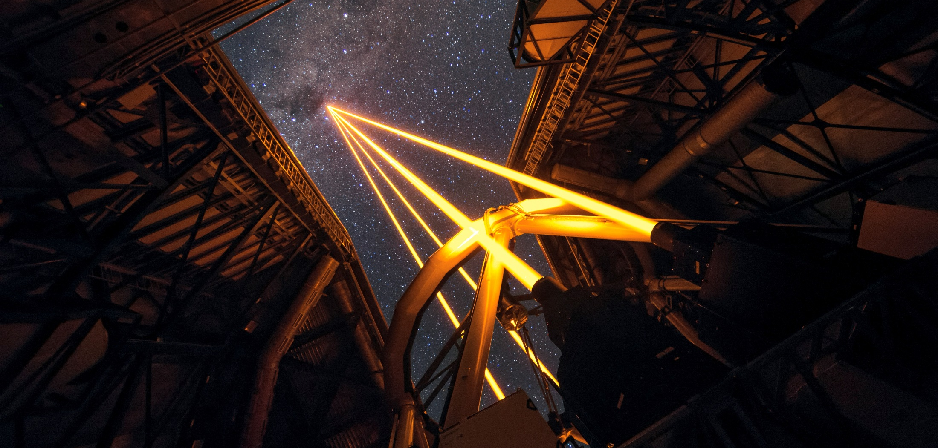
MUSE/GALACSI NFM: VLT’s LTAO mode and its upgrades
Sylvain Oberti On behalf of the AOF / GALACSI / IRLOS+ team LAM seminar - 04.11.21
Notes:
I am Sylvain Oberti, from ESO
I was in charge of the LTAO mode tests and commissioning
More recently I am the project manager and project engineer of the IRLOS upgrade project whose status will be presented today.
I am talking on the behalf of the AOF project, GALACSI project and IRLOS upgrade project team.

Slide 2
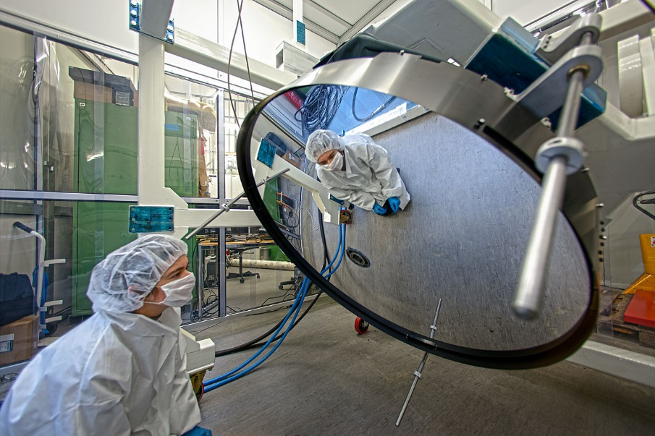
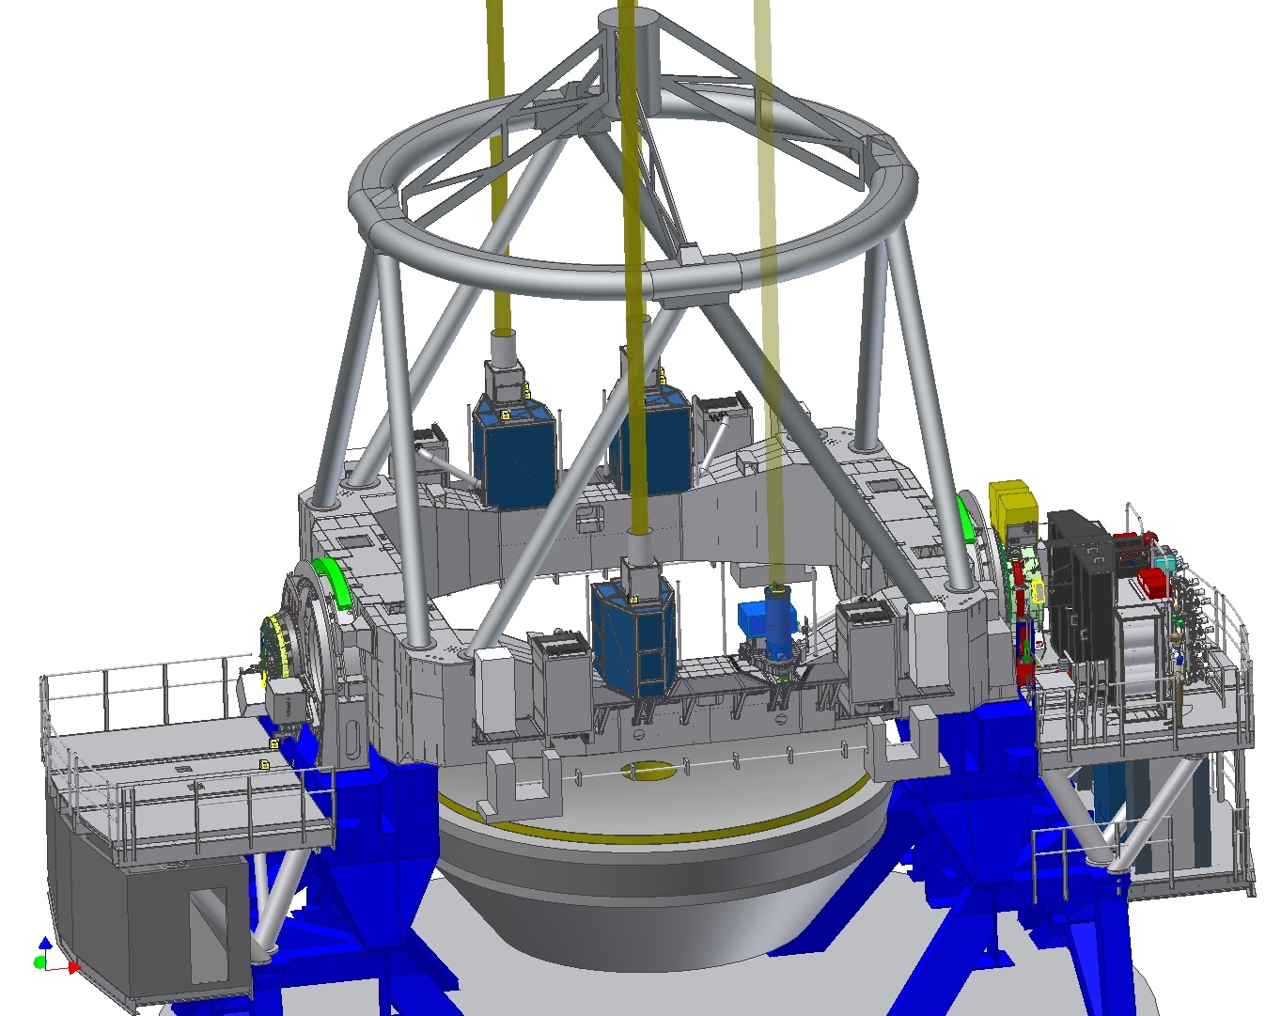
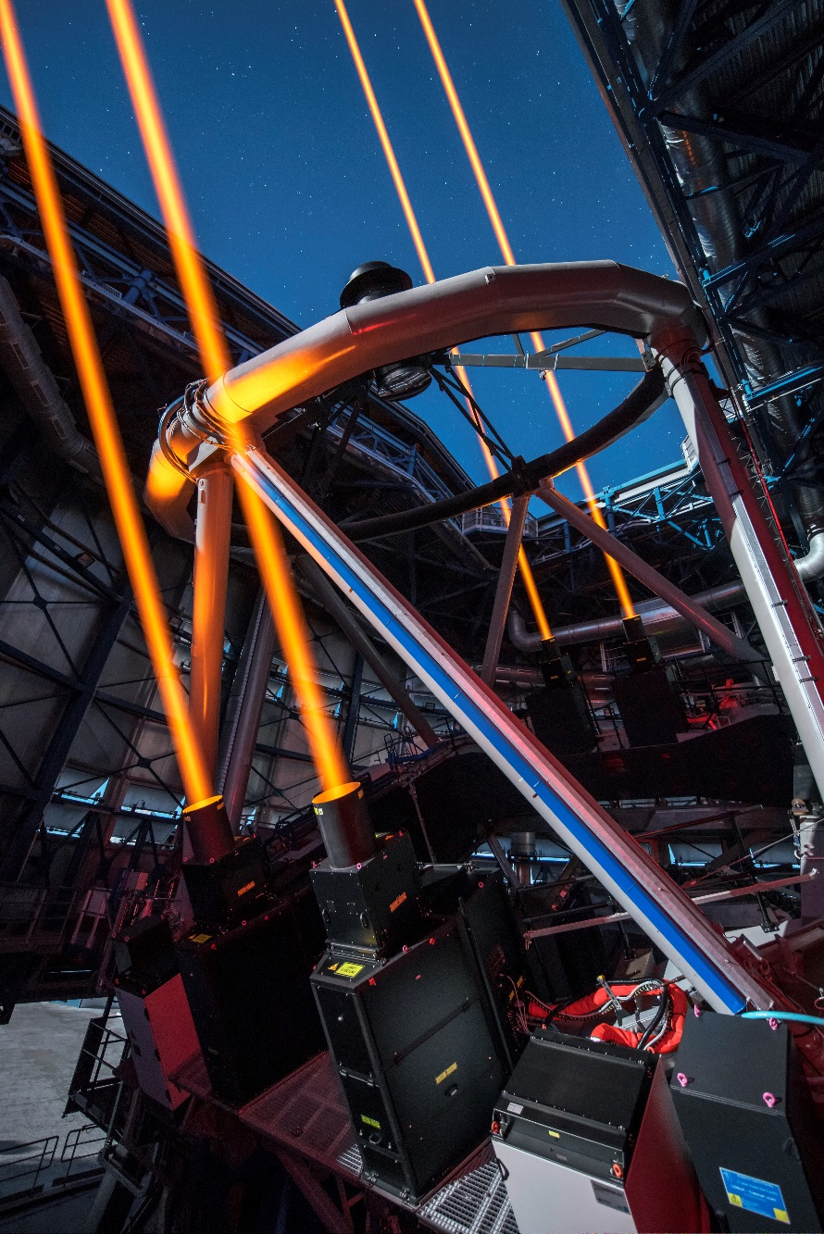
The Adaptive Optics Facility @ VLT’s UT4
DSM
Nasmyth B
GALACSI
For MUSE
Nasmyth A
GRAAL for HAWK-I
Future: MAVIS
4LGSF
Cassegrain
Near future: ERIS
Notes:
AOF turns one VLT UT (UT4) into an adaptive telescope by means of deploying the following subsystems:
DSM, voice coil actuator technology with 1156 useful actruators
4 LGSF, with 20W CW Lasers, successfully commissioned with good spot size and high return flux
GRAAL, installed between HAWK-I and the Nasmyth adaptor. Seeing improver for HAWK-I by means of GLAO
GALACSI, the AO module for MUSE

Slide 3
AOF team: 2006-2021

Slide 4
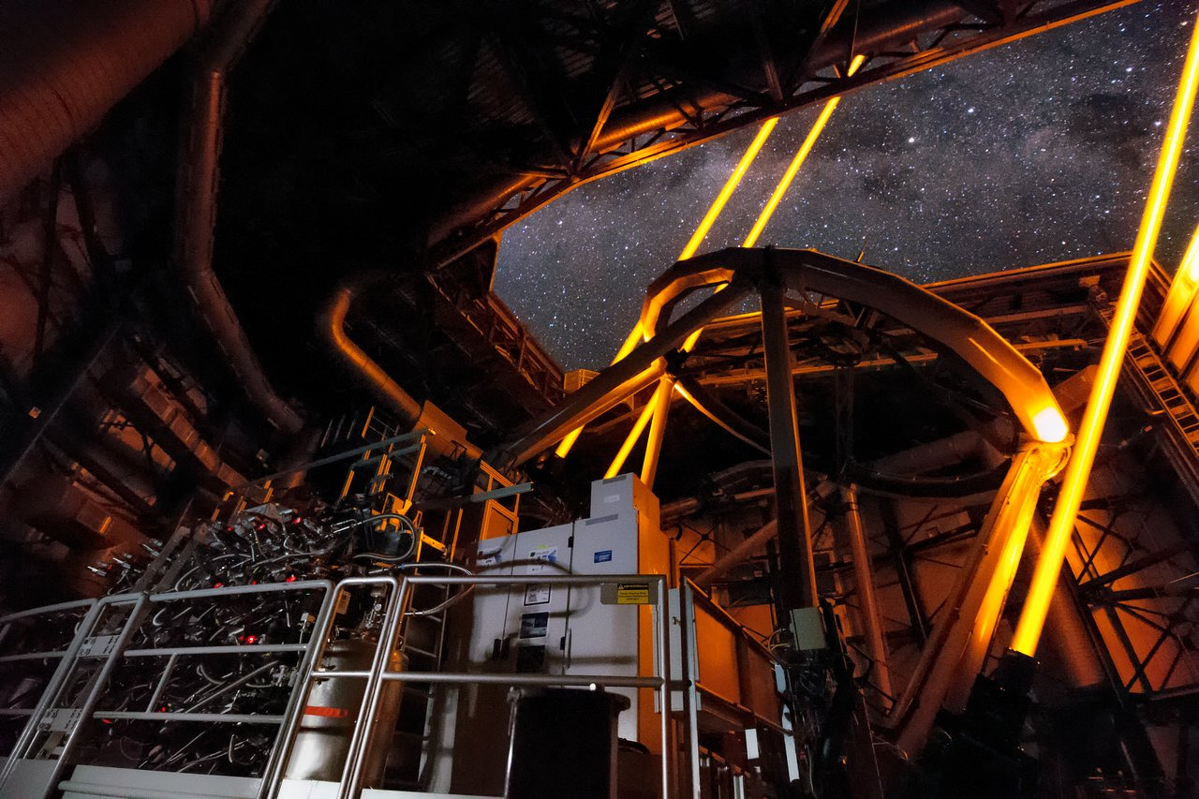
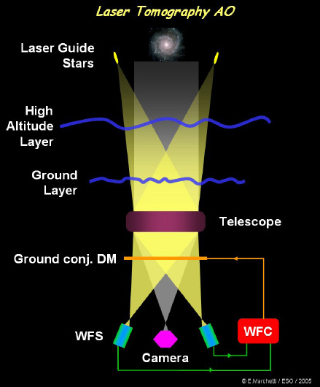


MUSE: AO modes of GALACSI
GALACSI
NFM
Laser GLAO
Laser tomography AO
Laser Guide
Stars
Sodium
Layer
(≅ 90 km)
High
Altitude
Layer
Performance requirements
WFM: improve EE x2 in 0.2” over 1’
NFM: SR > 5% (goal 10%) @ 650 nm
4
Notes:
AOF offers 3 AO modes, 2 for GRAAL, 2 for GALACSI
GRAAL MCM, NGS SCAO to commission DSM in AO mode – I will not discuss this but focus on the LGS modes
GRAAL GLAO for Hawk-I gain of 30 % in EE
GALACSI WFM: improve EE by ~2 in pixel of 0.2” for MUSE
GALACSI NFM: Strehl ratio above 5% in the visible

Slide 5
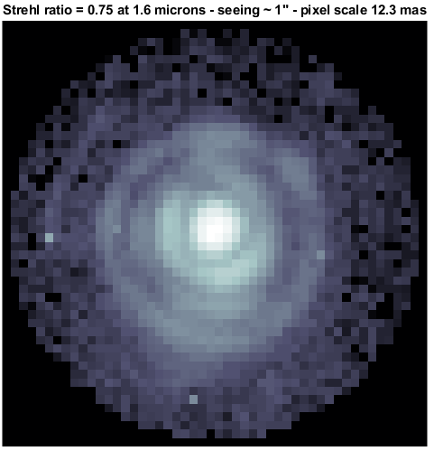
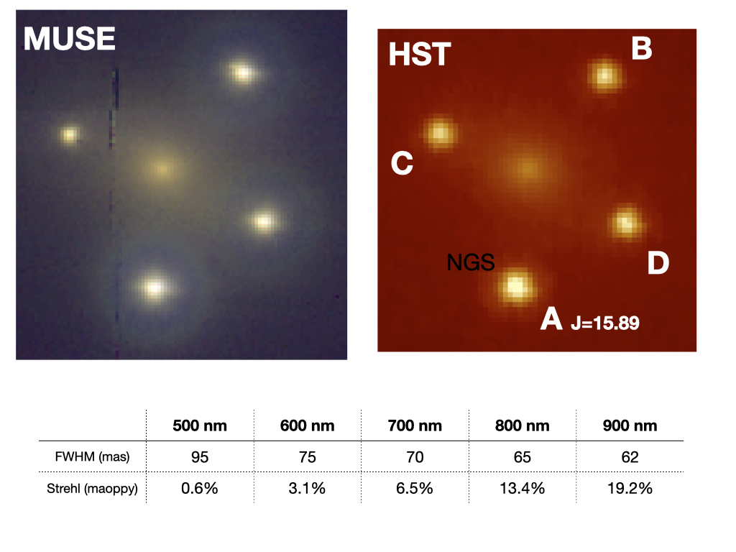
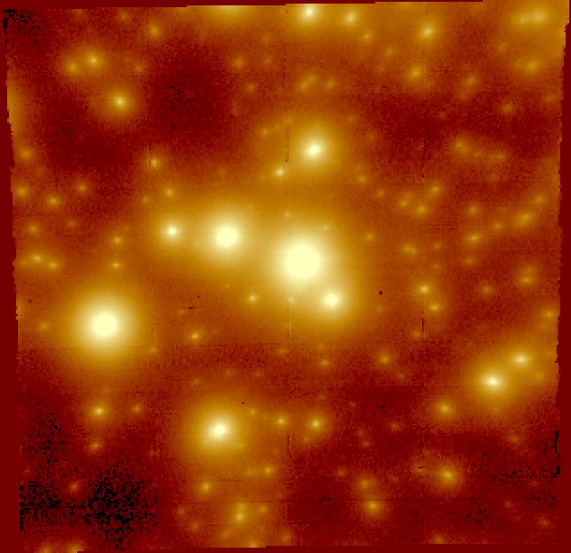
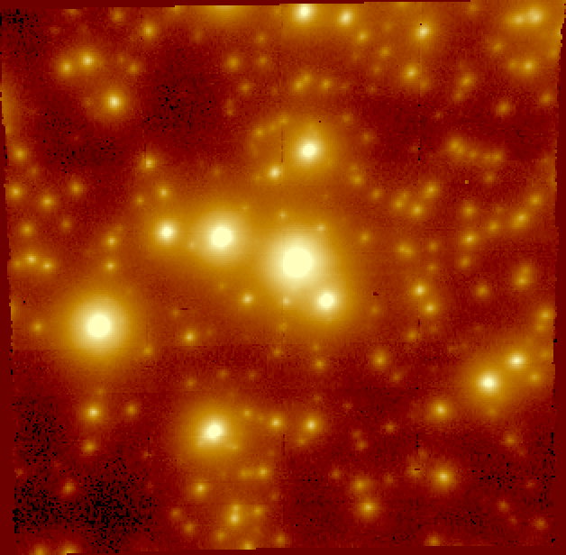
GALACSI NFM Upgrades Timeline
NFM
commissioning
Q1 2018
IRLOS+ Start
March 2019
Tomography
optimization
October 2019
IRLOS+
AIV & Comm 1
March 2021
IRLOS+
Comm 2
July 2021
Notes:
I will today describe the status of the IRLOS Upgrade project. IRLOS+ actually is the last update in the timeline of MUSE upgrade.
1st MUSE was upgraded in 2017 with AO, in terms of GLAO WFM for the wide field of 1’ with spaxels of 200 mas
The NFM was commissioned in 2018. It was a game changer in terms of spatial resolution for MUSE gaining a factor ~10 w.r.t WFM in terms of FWHM
Then the IRLOS upgrade project was kicked off in 2019 to improve the limiting magnitude
At the end of 2019, the AO tomography was optimized
Finally, this year IRLOS+ has been remotely commissioned in 2 steps

Slide 6
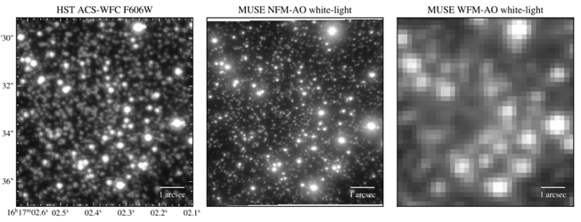
GALASCI/MUSE Narrow Field Mode
Goettgens et al., subm.
The LTAO mode of MUSE is providing high spatial resolution in the visible domain
Performance limitation by suboptimal tomography
TT residuals and limiting magnitude of Jmag=15
Tomography optimization
IRLOS Upgrade
Notes:
Here an image of a globular cluster observed in the visible by HST [Left], MUSE WFM with AO [Middle] and MUSE NFM [Right]. So, as you can see, we get a very high spatial resolution in NFM
BUT
Performance was limited by suboptimal tomography → this is why I led a technical mission to improve it
The limiting magnitude of 14.5 in H band was limiting extra galactic science and the bright end performance was suffering from TT residual amplitude → motivation for the IRLOS upgrade

Slide 7
GALACSI NFM Upgrades Timeline
NFM
commissioning
Q1 2018
IRLOS+ Start
March 2019
Tomography
optimization
October 2019
IRLOS+
AIV & Comm 1
March 2021
IRLOS+
Comm 2
July 2021
Notes:
I will start by going back in time to describe what was done in terms of tomography optimization in October 2019 during a very efficient mission at Paranal (6 half nights)

Slide 8
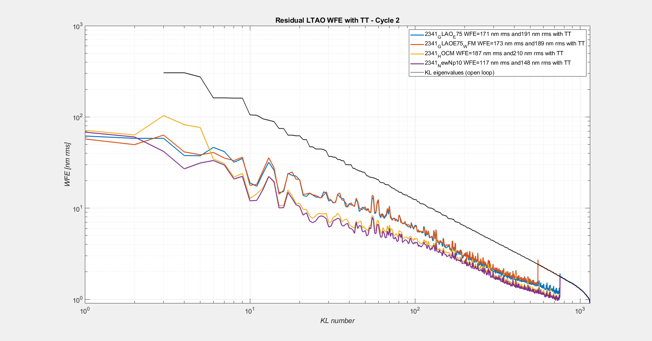
Tomography Optimization in October 2019: I
Pseudo-synthetic reconstructor
Tuned tomographic reconstruction of LO modes
More aggressive tuning of LTAO reconstructor leading to controlling 850 modes
Tuning of temporal controller in presence of new vibrations
Operation under worse seeing conditions than initially expected
WFE [nm rms]
Focus
Astigmatisms
Notes:
On graph you can see the cumulative histogram of recorded SR during the mission, in red BEFORE and in yellow AFTER
The work consisted in optimizing the LTAO reconstruction and control
LO tomography tuned
More aggressive tuning of the HO reconstructor → control of more modes
Temporal controller tuned with vibrations
The result was a doubling of the SR on the commissioning camera @ 940 nm

Slide 9
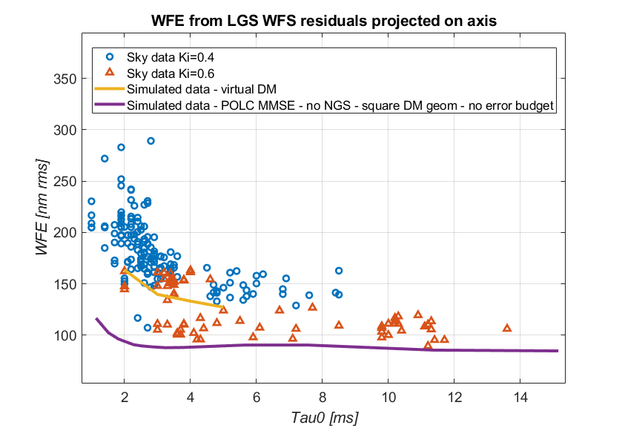
Tomography Optimization in October 2019: I
Pseudo-synthetic reconstructor
Tuned tomographic reconstruction of LO modes
More aggressive tuning of LTAO reconstructor leading to controlling 850 modes
Tuning of temporal controller in presence of new vibrations
Operation under worse seeing conditions than initially expected
Notes:
On graph you can see the cumulative histogram of recorded SR during the mission, in red BEFORE and in yellow AFTER
The work consisted in optimizing the LTAO reconstruction and control
LO tomography tuned
More aggressive tuning of the HO reconstructor → control of more modes
Temporal controller tuned with vibrations
The result was a doubling of the SR on the commissioning camera @ 940 nm

Slide 10
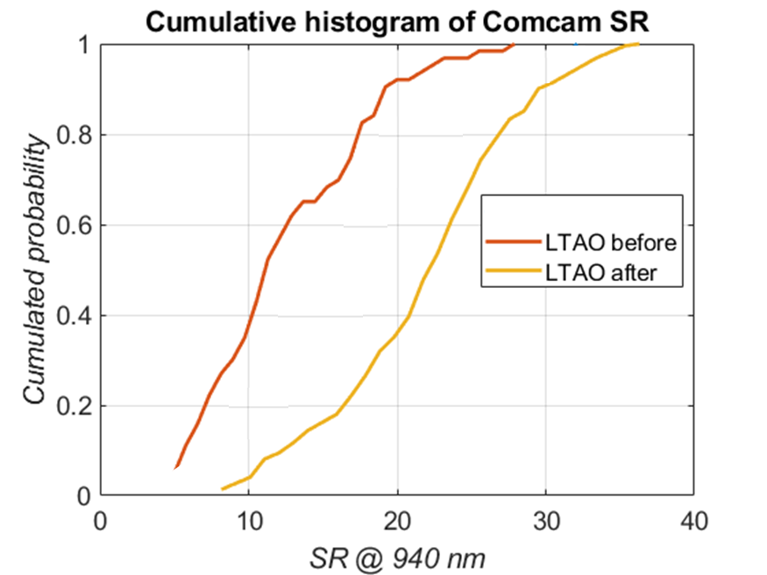
Tomography Optimization in October 2019: I
Pseudo-synthetic reconstructor
Tuned tomographic reconstruction of LO modes
More aggressive tuning of LTAO reconstructor leading to controlling 850 modes
Tuning of temporal controller in presence of new vibrations
Operation under worse seeing conditions than initially expected
Notes:
On graph you can see the cumulative histogram of recorded SR during the mission, in red BEFORE and in yellow AFTER
The work consisted in optimizing the LTAO reconstruction and control
LO tomography tuned
More aggressive tuning of the HO reconstructor → control of more modes
Temporal controller tuned with vibrations
The result was a doubling of the SR on the commissioning camera @ 940 nm

Slide 11
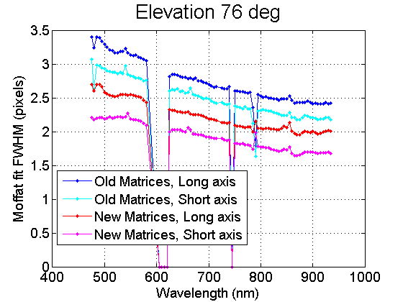
Tomography Optimization in October 2019: II
Before
After
Credit: Johanna Hartke and Claudia Reyes
Under good to median seeing conditions, PSF FWHM are as low as 35 mas (28 mas on the commissioning camera) at wavelengths ~ 900 nm.
Notes:
Improvement confirmed on MUSE with a significant improvement of the resolutsion. The FWHM was brought as low as 35 mas on MUSE (28 mas on the commissioning camera)

Slide 12
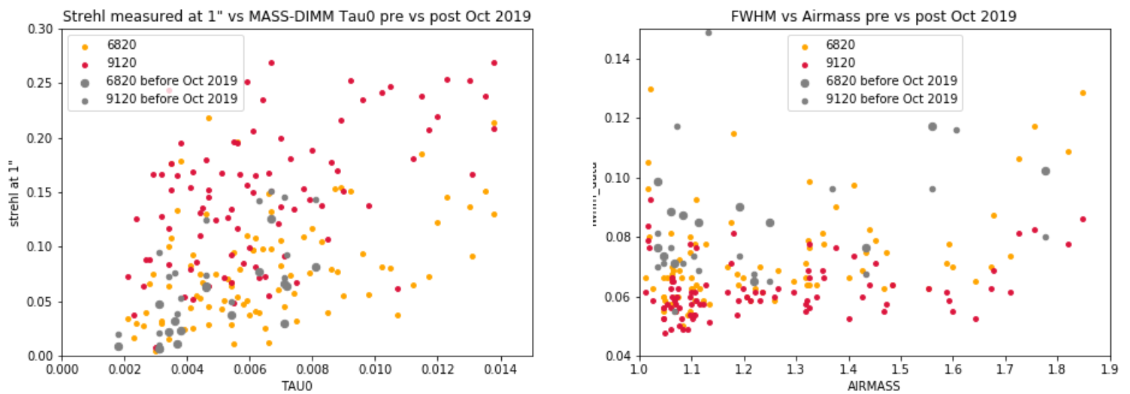
LTAO reconstruction improvement
Tomography Optimization in October 2019: III
MUSE Strehl Ratio
MUSE FWHM [“]
Credit: Fernando Selman and Johanna Hartke
Notes:
Then, over the next months of operation, this improvement was confirmed when observing standard calibrators with MUSE
In Grey you can see the performance points acquired before October 2019, in color after October 2019

Slide 13
GALACSI NFM Upgrades Timeline
NFM
commissioning
Q1 2018
IRLOS+ Start
March 2019
Tomography
optimization
October 2019
IRLOS+
AIV & Comm 1
March 2021
IRLOS+
Comm 2
July 2021
Notes:
I will now describe what happened in the framework of IRLOS+

Slide 14
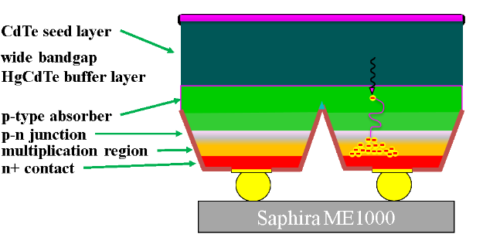
IRLOS: The Low Order WFS for MUSE NFM
IRLOS: InfraRed Low Order Sensor operating in J + H band
IRLOS provides:
Fast Tip/Tilt control
Truth sensing for Defocus and Astigmatisms
Large scale for extended targets
Old IRLOS Hawaii I with RON ~ 11 e- rms
IRLOS Upgrade TLRs
Move to Saphira technology (baseline for MAVIS, HARMONI and MAORY)
Gain 2 magnitudes (goal)
Complete project within 2 years
SAPHIRA Mark14b MOVPE
Notes:
IRLOS is the Low Order Sensor for GLACSI/ MUSE NFM.
It operates in J+H band, in a wavelength band that is complementary to the science wavelength, MUSE operating in the visible
IRLOS provides fast Tip/Tilt correction and truth sensing for low order modes such as Defocus and Astigmatisms
The current version of IRLOS is based on an Hawaii 1 detector with a RON of 11e- rms
So the IRLOS upgrade project was launched to implement a new cryostat with a Saphira detector with the following TLRs:
Gain more than 2 magnitudes in the limiting performance of MUSE NFM
Complete the project within 2 years
We started in March 2019

Slide 15
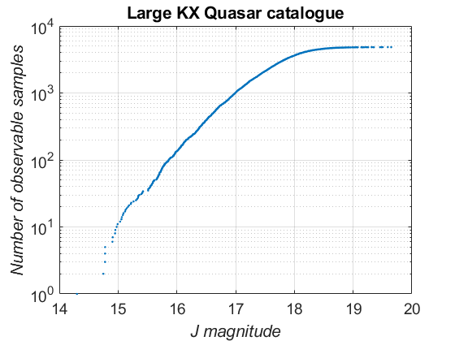
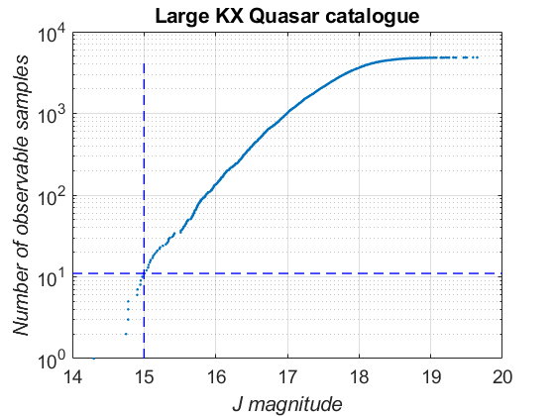
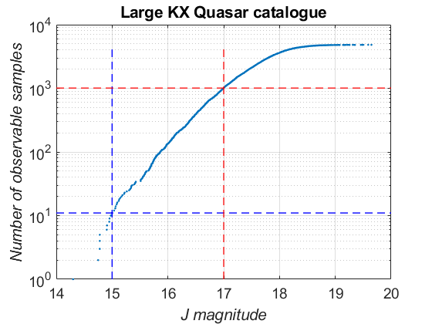
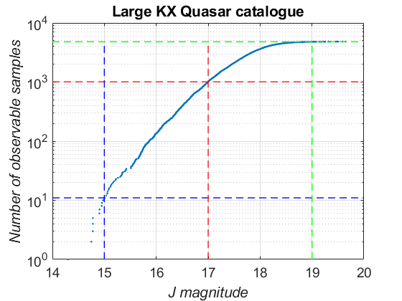
Why upgrading IRLOS ? Design driver1: limiting magnitude
Maddox et al. 2012
Tomorrow
Jmag=19
Today
Jmag=17
Yesterday Jmag=15
Notes:
- Increasing sky coverage is the main objective of the IRLOS+ project
- However, sky coverage is not a straightforward metric to quantify the direct science benefit.
- Now counting Quasars from this large area KX Quasar database (the survey utilizes the UKIRT Infrared Deep Sky Survey (UKIDSS) Large Area Survey (LAS)), we see that we can gain an order of magnitude of additional targets per gained NGS magnitude.
So, by completing the first step of our upgrade we will go from a handful to about a thousand of observable quasars
The second step will essentially allow observing all targets described in this catalog

Slide 16
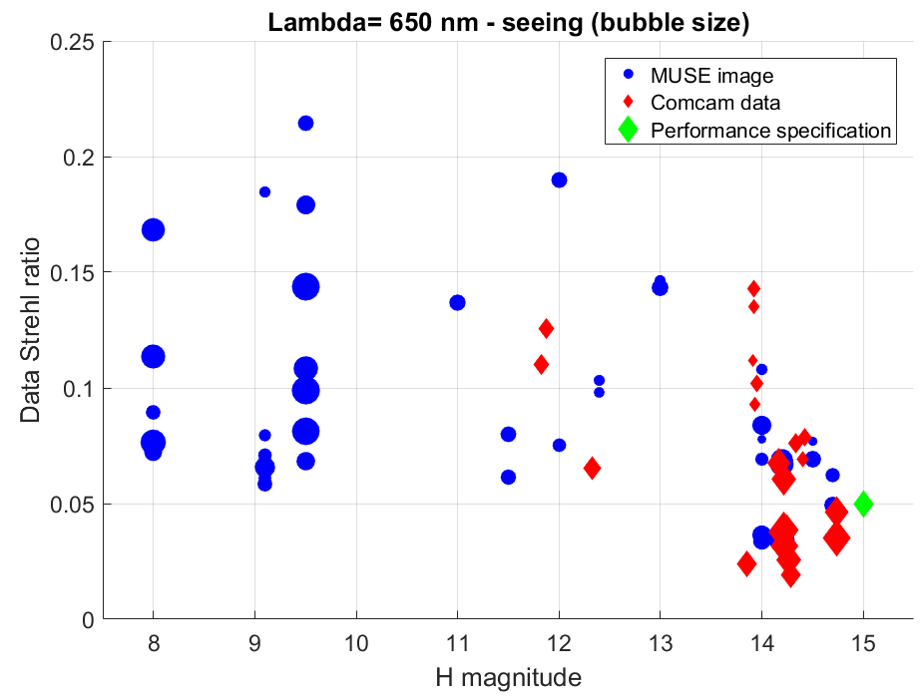
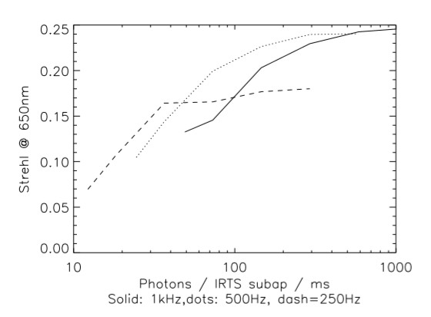
Design driver 2: improved performance
Yesterday, limited at 200 Hz because of the RON, now 500 Hz becomes nominal → SR/EE increase
Notes:
The second design driver is to improve the bright end performance plateau by increasing the framerate to reduce the TT residual jitter and vibration. We hope to bring the best strehl ratio at 650nm from 0.15 to 0.25

Slide 17
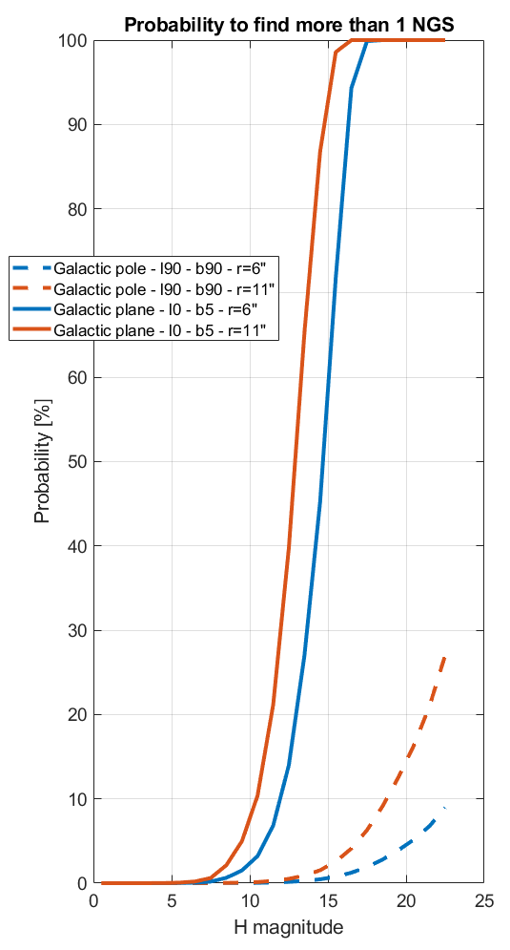
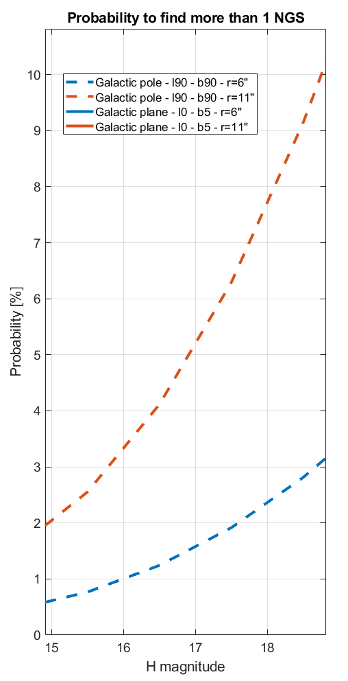
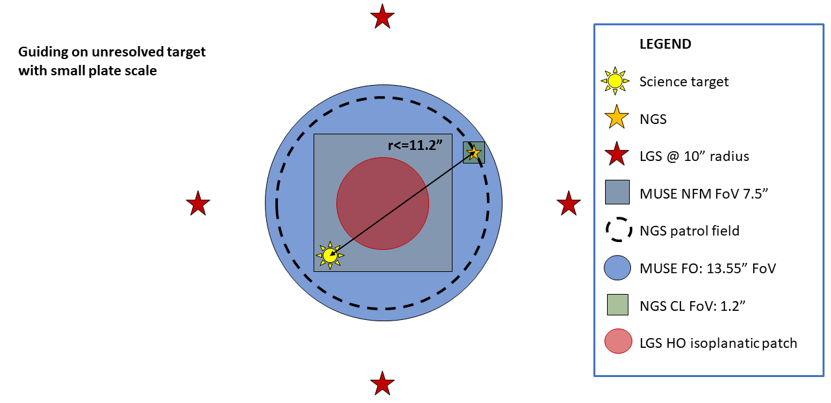
Design driver 3: increased sky coverage
Larger patrol field
Larger sky coverage: Besançon model →
Improved offsetting / dithering possibilities
Notes:
Finally, we want to increase the patrol field which has a major influence on the sky coverage.
By increasing at the same time the limiting magnitude and the patrol field from 3 to 6” radius, we can bring our sky coverage from fraction of a percent to 3 to 10 % depending on the off axis guiding scheme

Slide 18
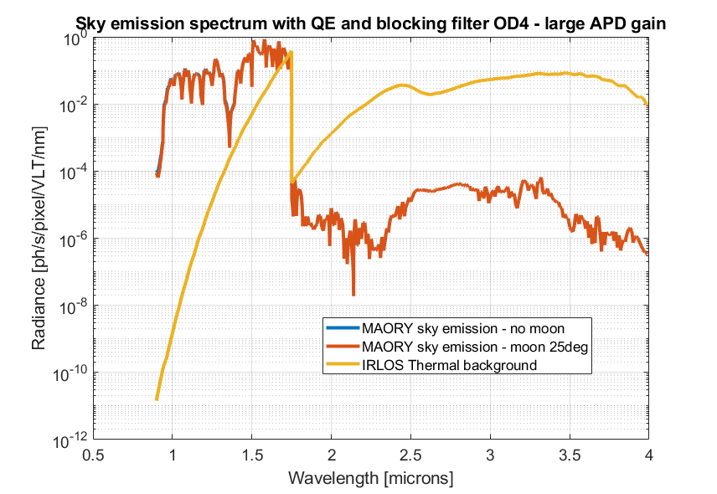
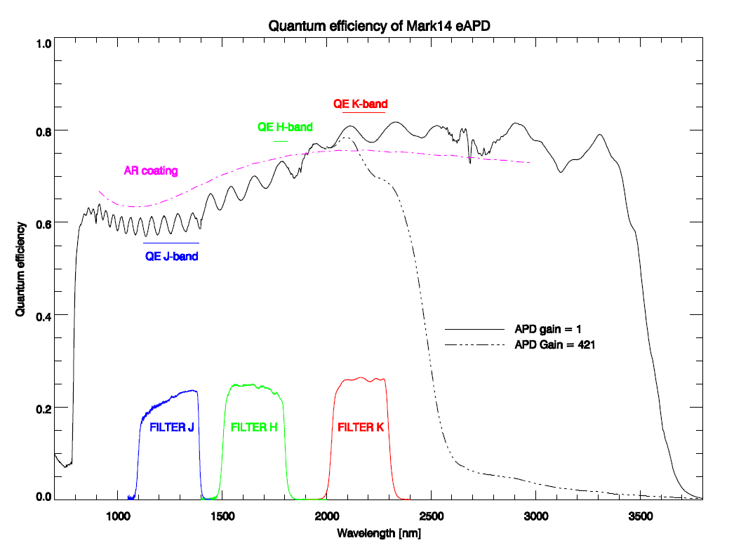
IR WFSing: Sky + thermal background noise
Balanced budget for unresolved targets
Dark < 50 e-/s/pix
Thermal background < 70 e-/s/pix
14e-/s/pix <Sky<140 e-/s/pix vs. plate scale
Notes:
I would like to stress only one technical highlight: the management of sky and thermal background.
Our trade-off is to guide in J+H to maximize the SNR by balancing the incoming flux from the object and the sky background.
It turns out that we will get ~ 150 e-/s of sky at Lambda< 1.75 microns
Then, we are dominated by the black body emissivity above 1.75 microns
The Saphira sensor is sensitive up to more than 4 microns even though it seems to cut after K band with very high (not allowed) APD gains
We will actually work in a regime very close to gain 1 in terms of QE, with an APD gain of ~ 60
So we need an IR blocking filter, that balances the thermal background budget with the sky background budget so that, when combining all noise sources, we remain below 1 e- rms per pixel per frame

Slide 19
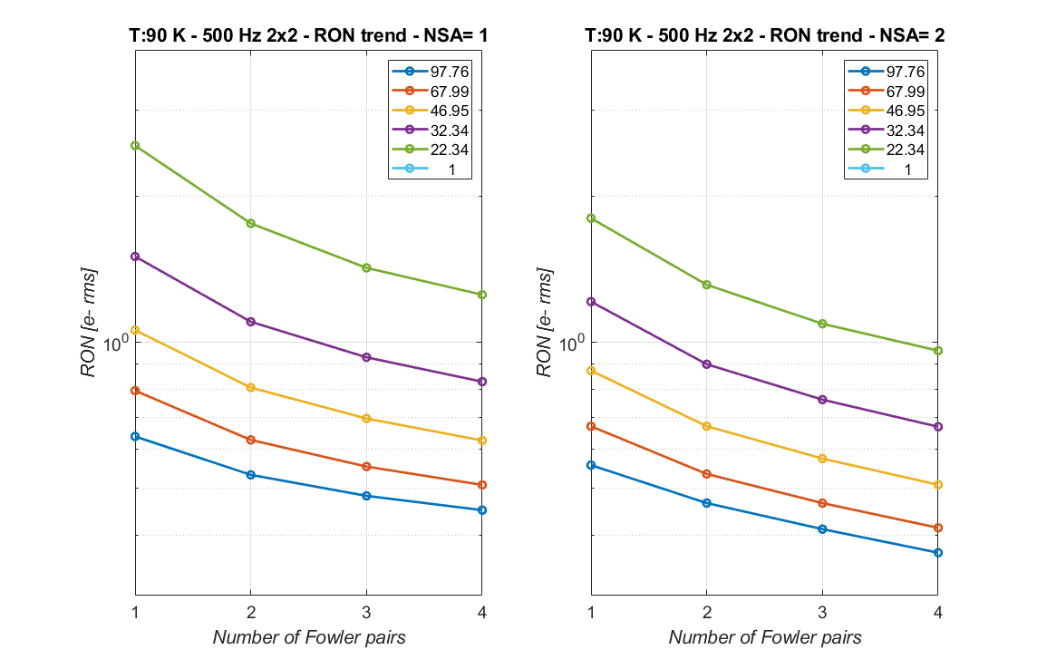
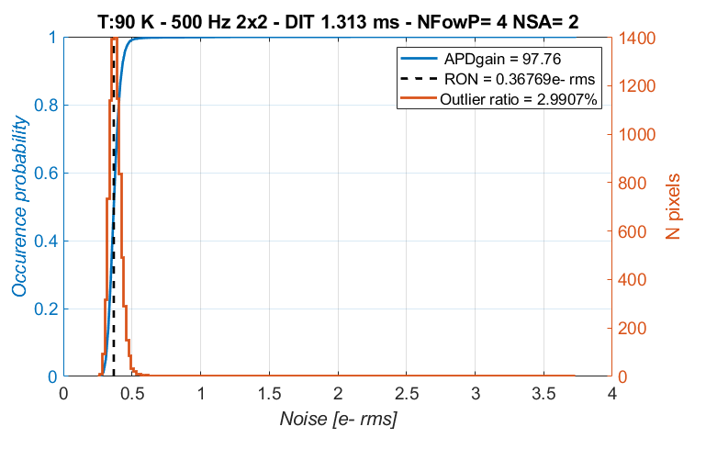
Read-out optimization: low RON !
Notes:
Large parameter space to scan, optimize and baseline for all read-out modes
We can achieve very low subelectronic RON (actually RON here is the sum of RON +Dark + some thermal Backg). We can get as low as 0.3 e- rms with high APD gain and some Fowler pairs.

Slide 20
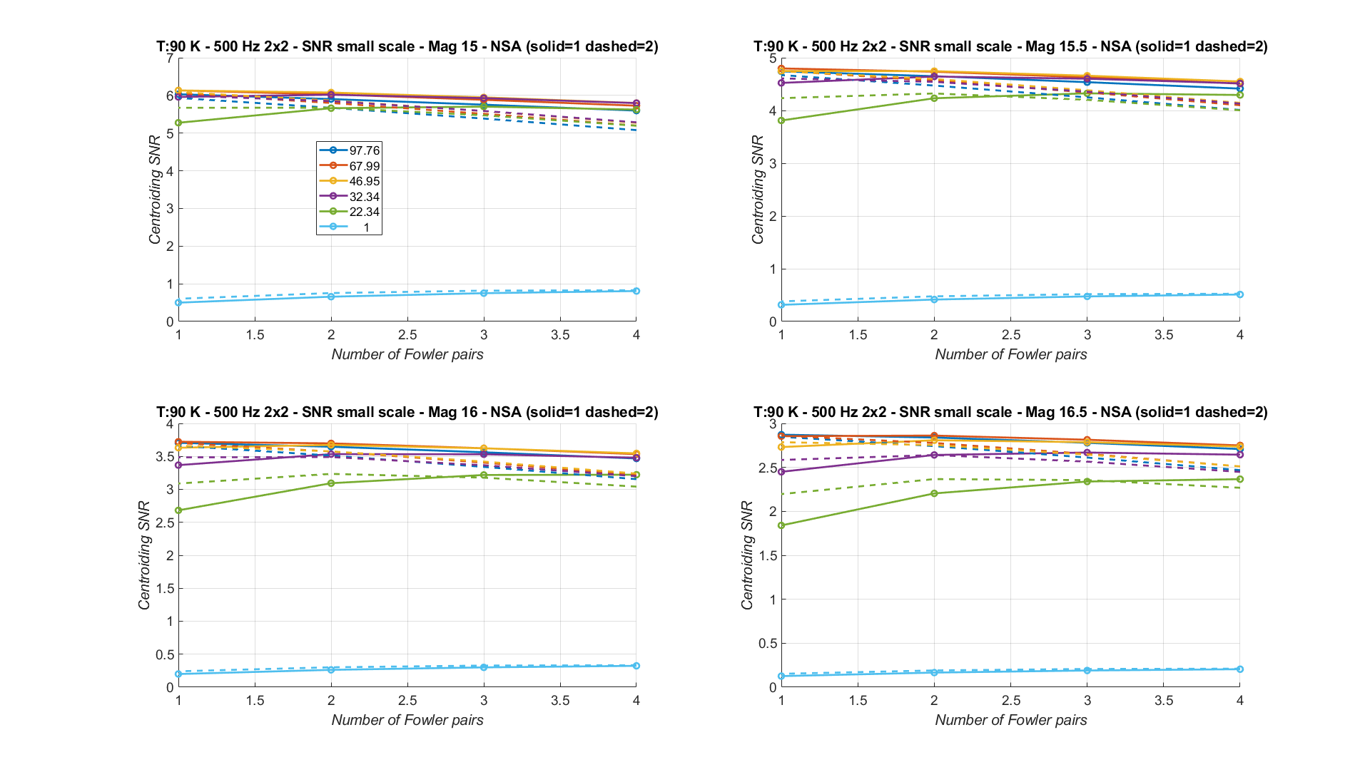
Read-out optimization: SNR matters !
APD gain
SNR including background noise and excess noise factor
Notes:
But minimizing RON is not our purpose, we rather want to maximize SNR. So when taking into account the background and the signal level including effective integration time and excess noise factor, we find an optimum with an APD gain ~ 50 to 70 and 1 to 2 Fowler pairs depending on the mode

Slide 21
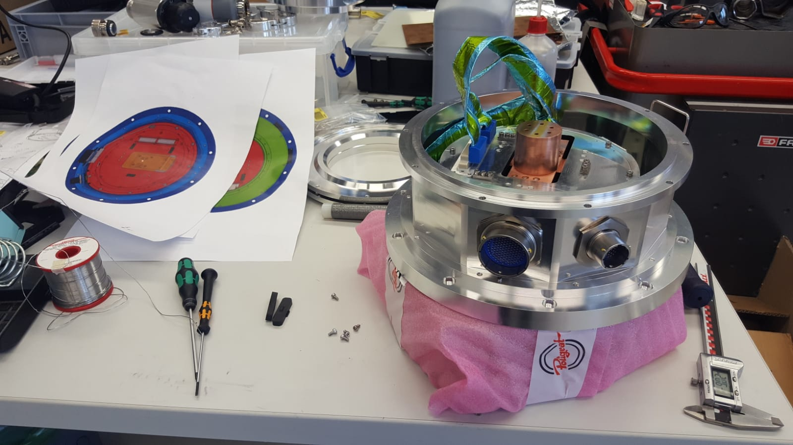
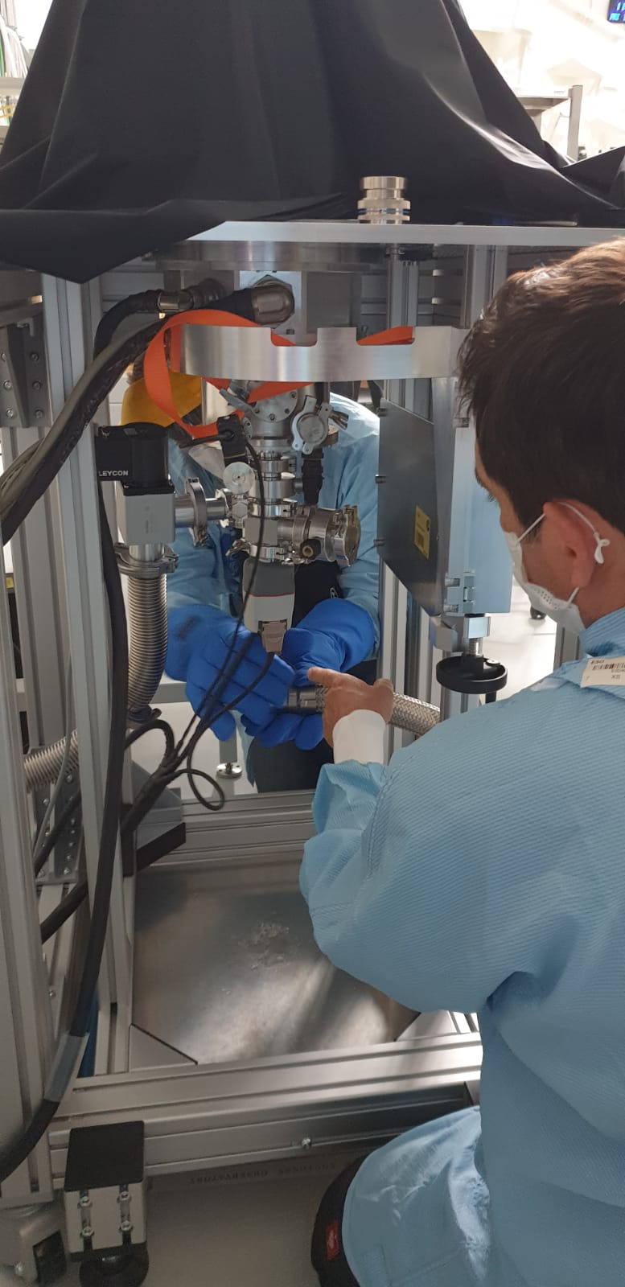
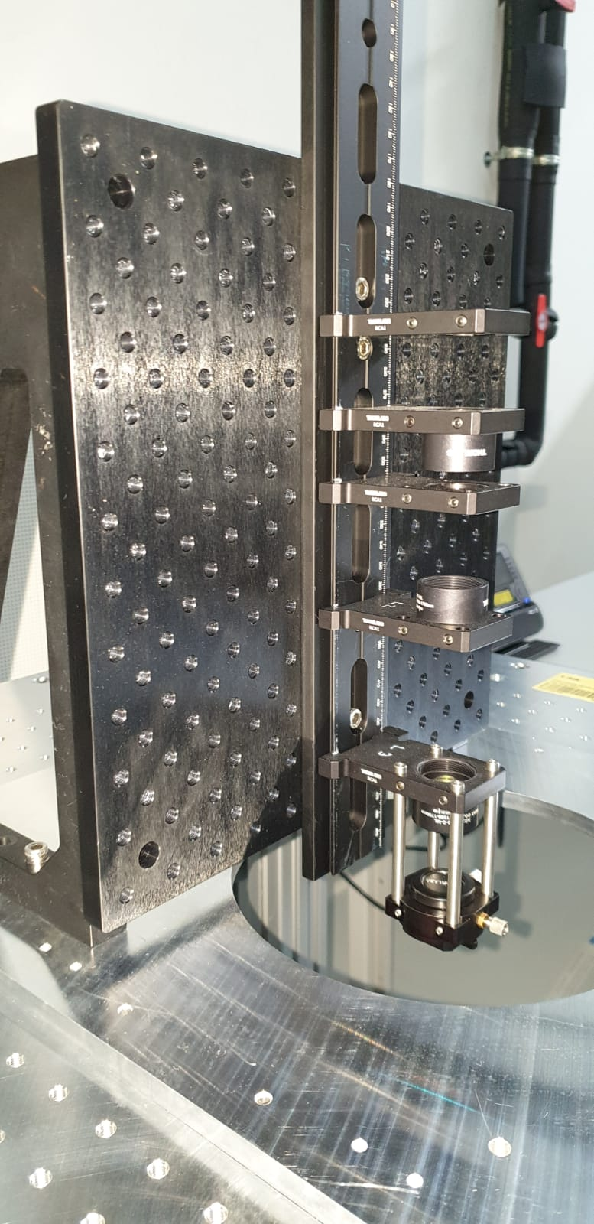
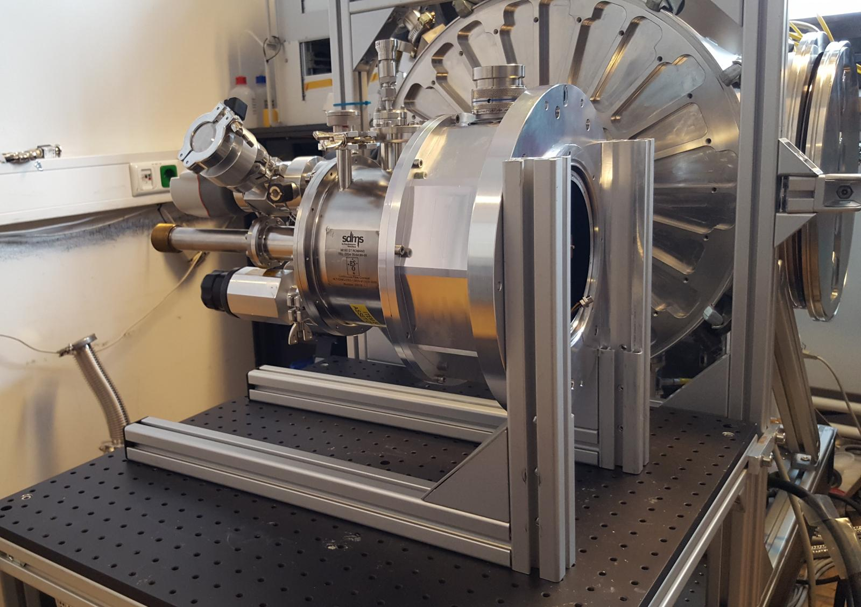
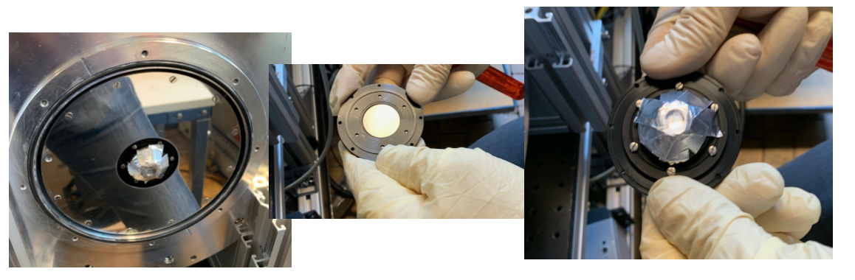
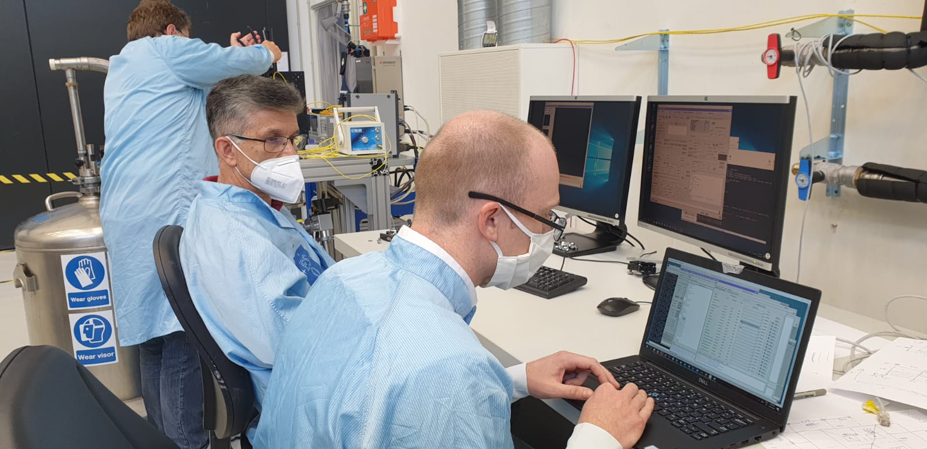
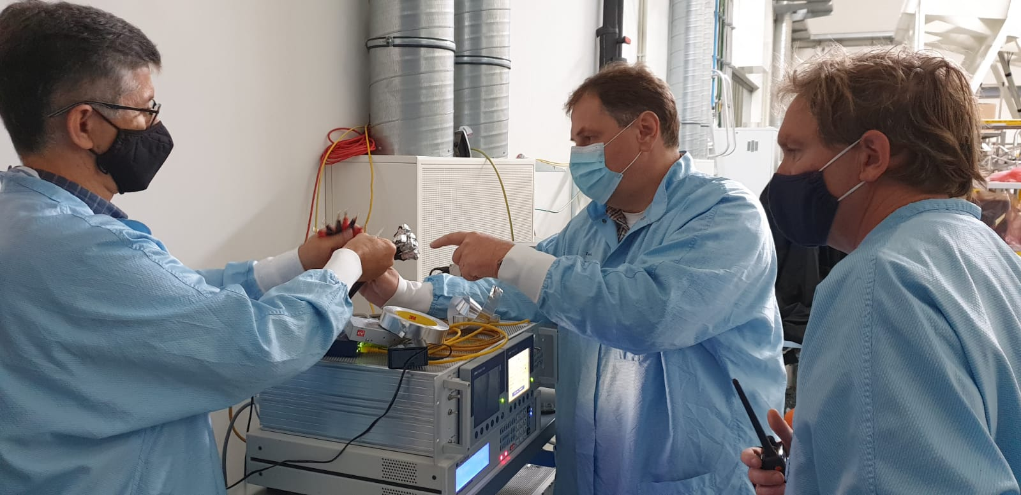
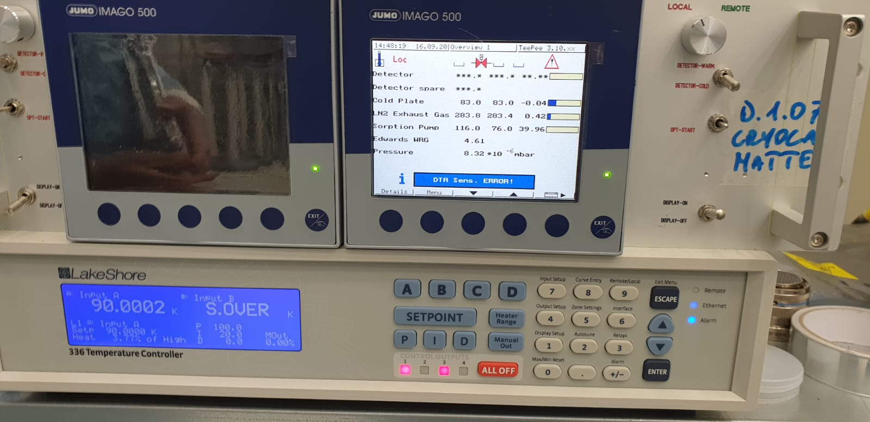
Design phase in 2019 / MAIT in 2020
Notes:
So, after an efficient design phase in 2019, we conducted the MAIT in 2020 under Covid.
It was essentially about integrating a Saphira detector inside a newly designed detector head connected to a CFC cryostat
The, tuning of the NGC read-out parameters
And connection to the Real Time Computer RTC and develop the missing algorithm and auxiliary tasks
We had a small test bench where we could mimic the AIT, verify the WFS performance and the RTC functionnalities

Slide 22
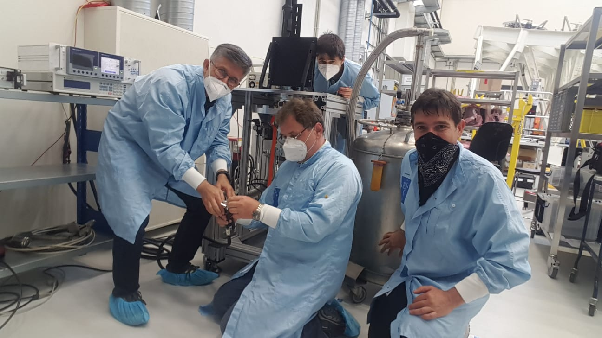
Despite COVID, successful PAE in October 2020
Notes:
Despite remote working, we could complete the system test and successfully pass PAE last fall.

Slide 23
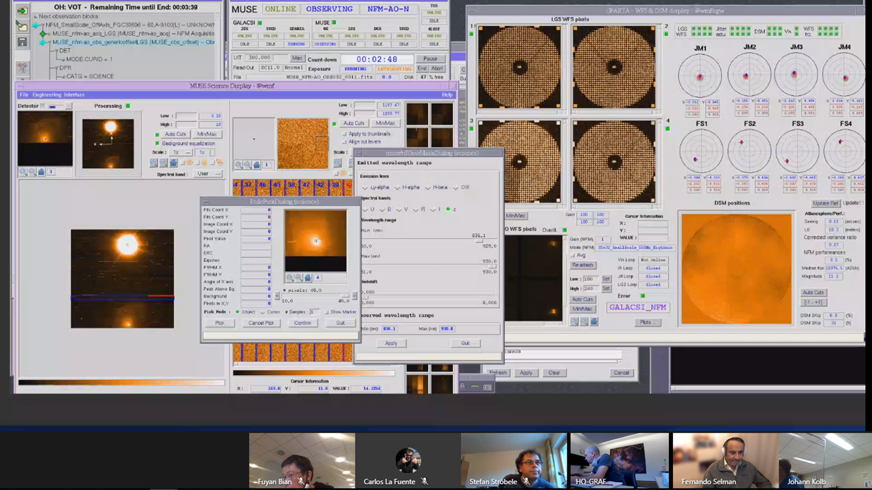
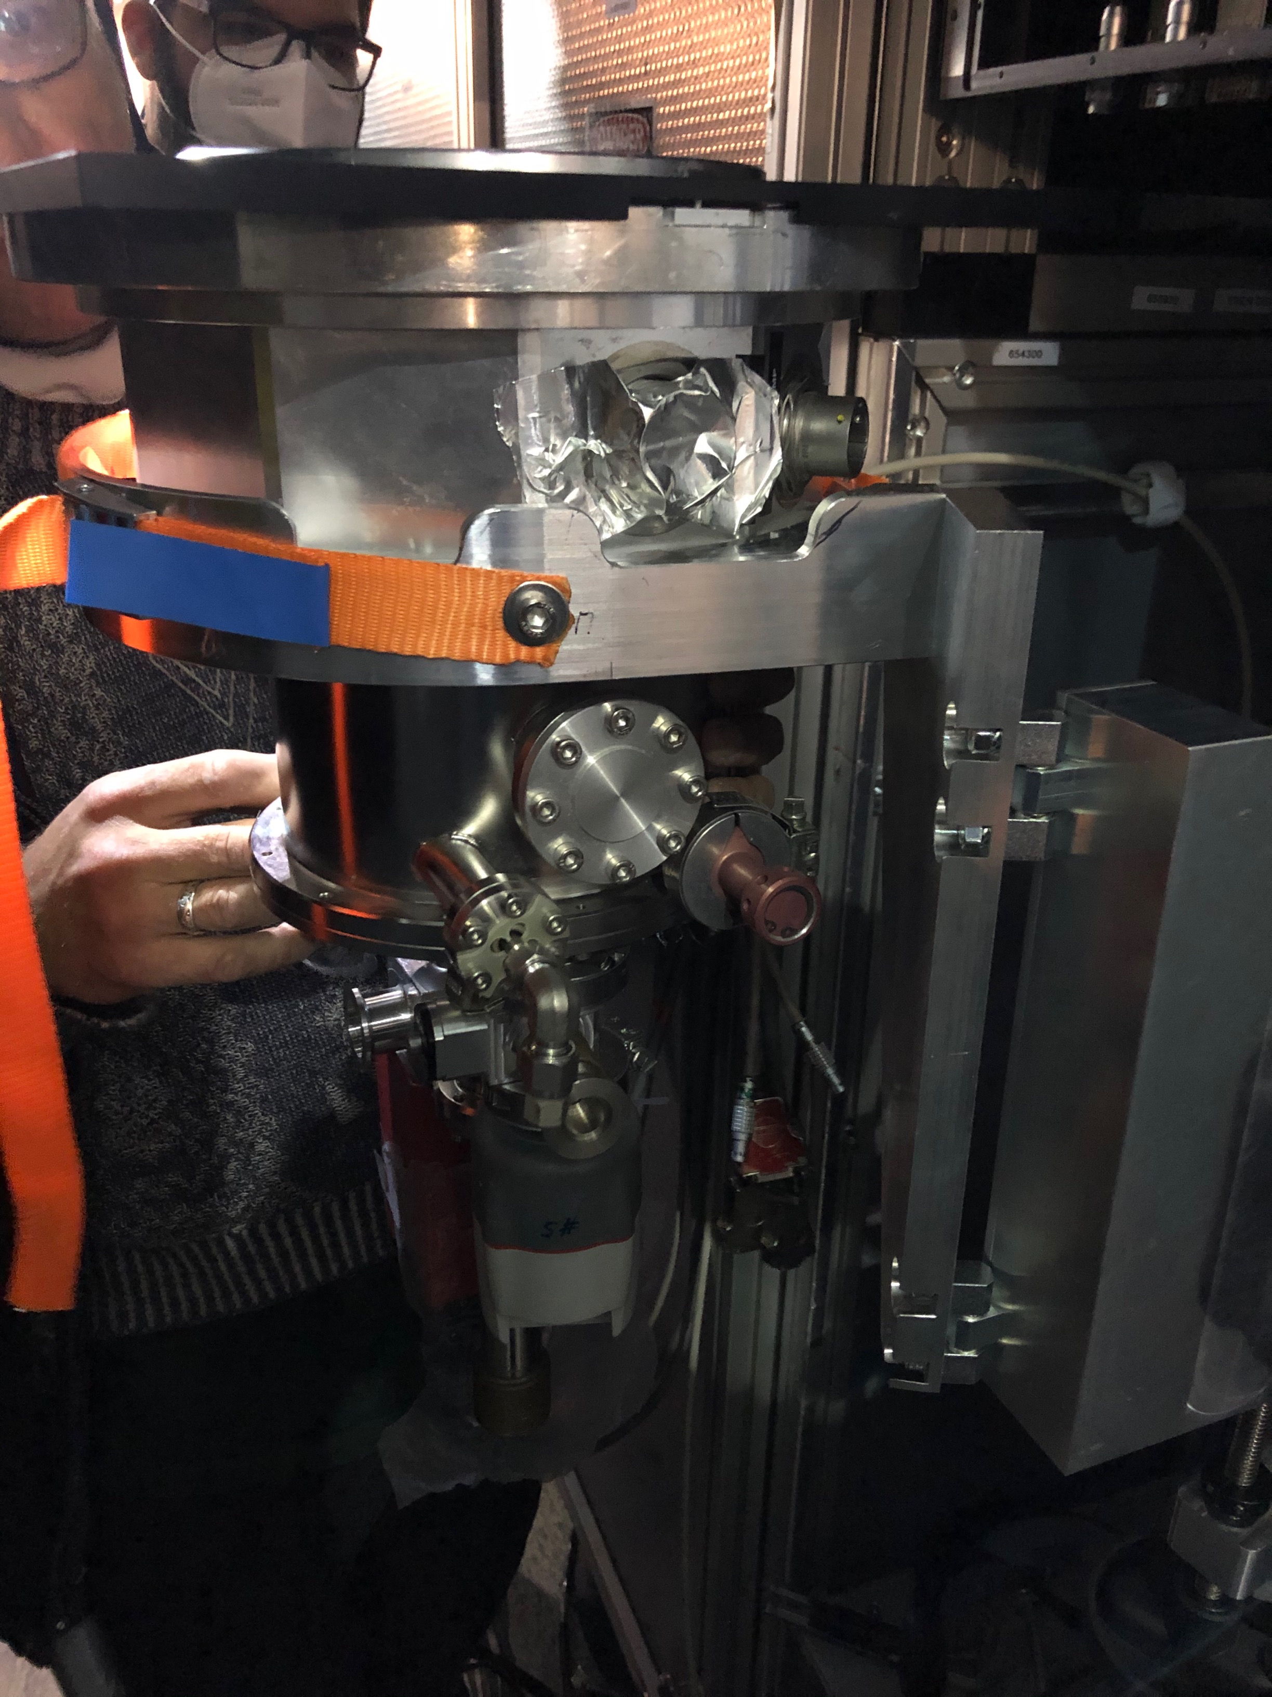
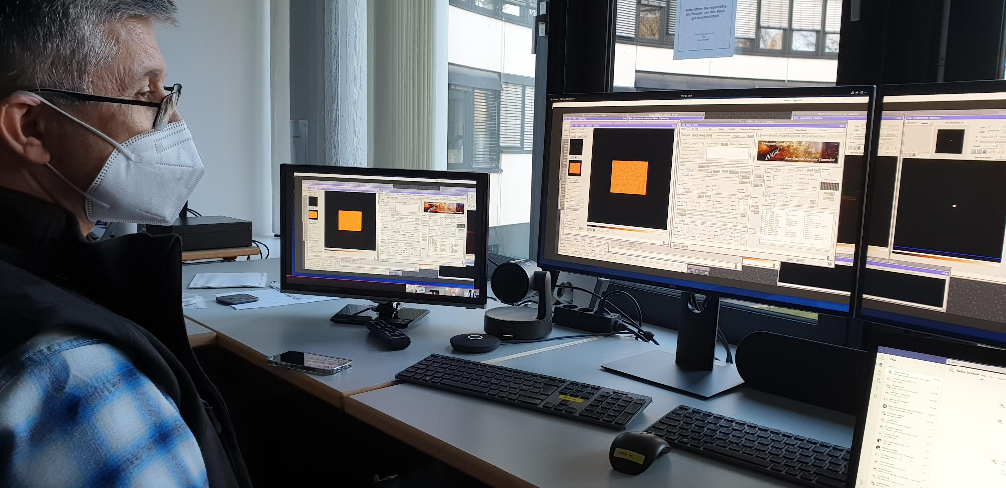
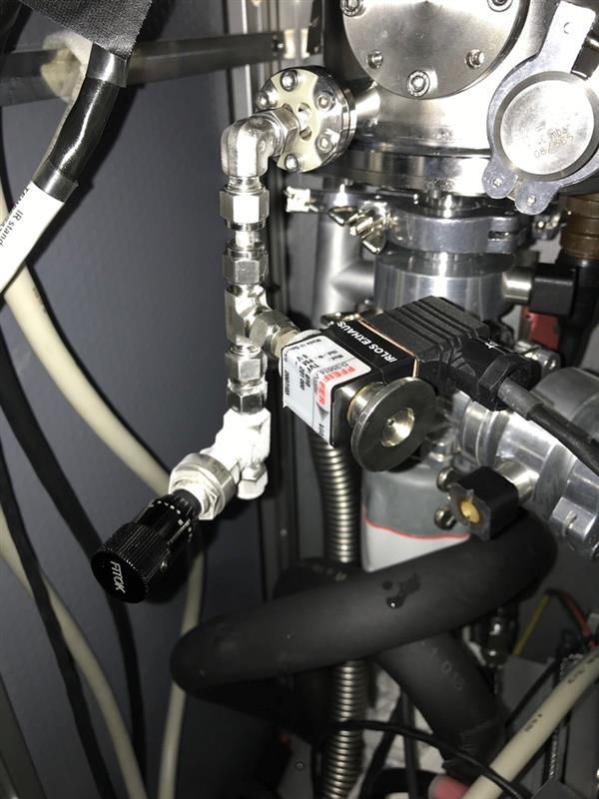
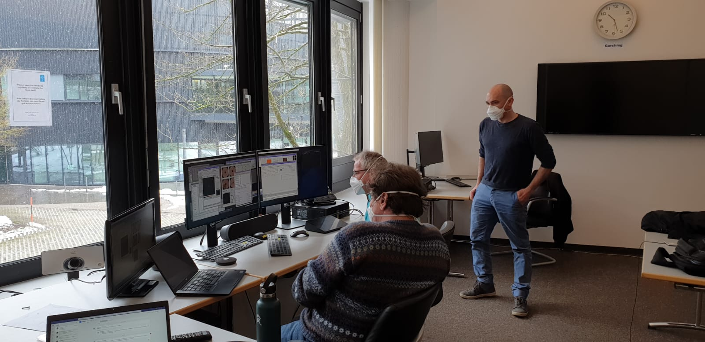
Remote AIV & commissioning 1: March 2021
Notes:
In March, we carried out our AIV & commissioning
The hardware intervention has been taken over by Paranal staff after proper training. The Garching team provided remote support from home and the G-Raf room
Here you can see a part of the Garching team at the end of the first night in the G-RAF room.
Above a screenshot during the 7th commissioning night where you’ve got a TIO and a night astronomer, Fuyan at the UT4 console, Johann in the VLTI control room, Fernando from home in Santiago, Stefan from home in Garching and myself in the G-RAF room

Slide 24
1st commissioning achievements
Robust operation at J magnitude > 17 @ 500 Hz
The project TLRs are fulfilled in terms of limiting magnitude, time to completion and budget
MUSE NFM is back in routine operation with upgraded performance
LTAO performance
SR ~0.75 in H band with a seeing of 1” incl. static aberrations with TT loop @ 200 Hz
Equivalent to 0.18 @ 650 nm
~4 times > specified performance
~twice > goal performance
Notes:
I recall here a quick summary of the AIV and first commissioning back in March 2021 Our main achievements are the following:
In remote AIV and commissioning, we could deploy the 2 workhorse modes
We could achieve robust operation on unresolved targets of magnitude ~ 17
TLRs are already met after Comm1
Cherry on the cake: MUSE NFM is back in operation and delivers science with upgraded performance since the day after the end of the commissioning
The LTAO performance can be verified on the IRLOS full pupil PSF. And we get very good performance of 0.75 SR in H band for a seeing of 1” which is much higher that the specified performance
This is a proof that the LTAO is working very well ! The AO with lasers is nearing the classical NGS SCAO

Slide 25
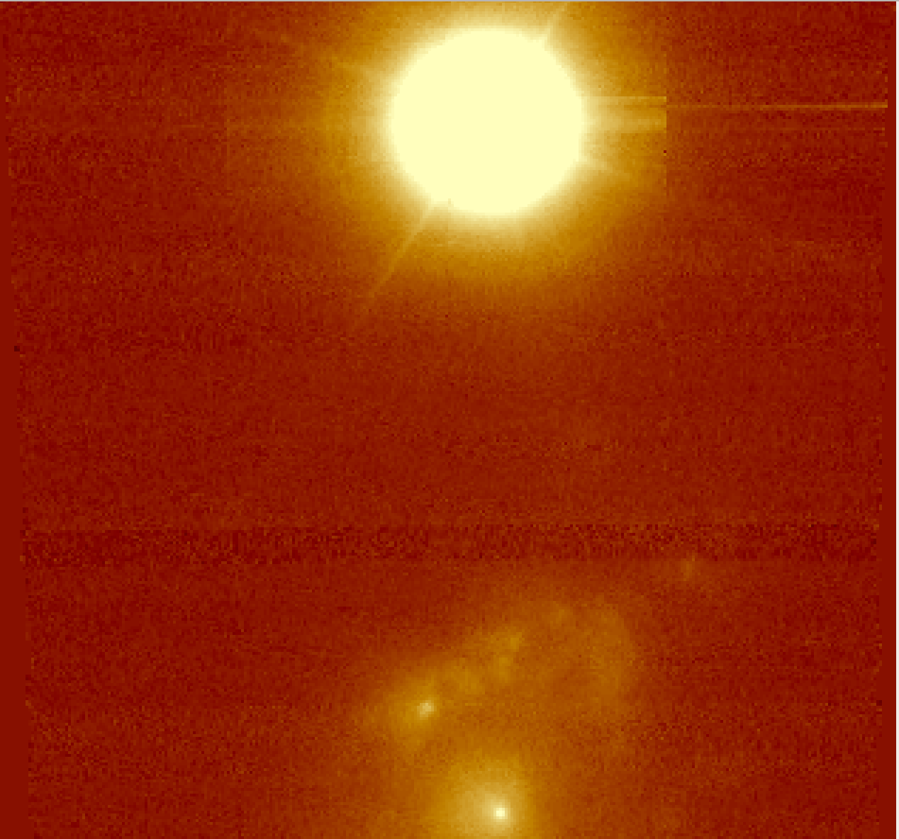
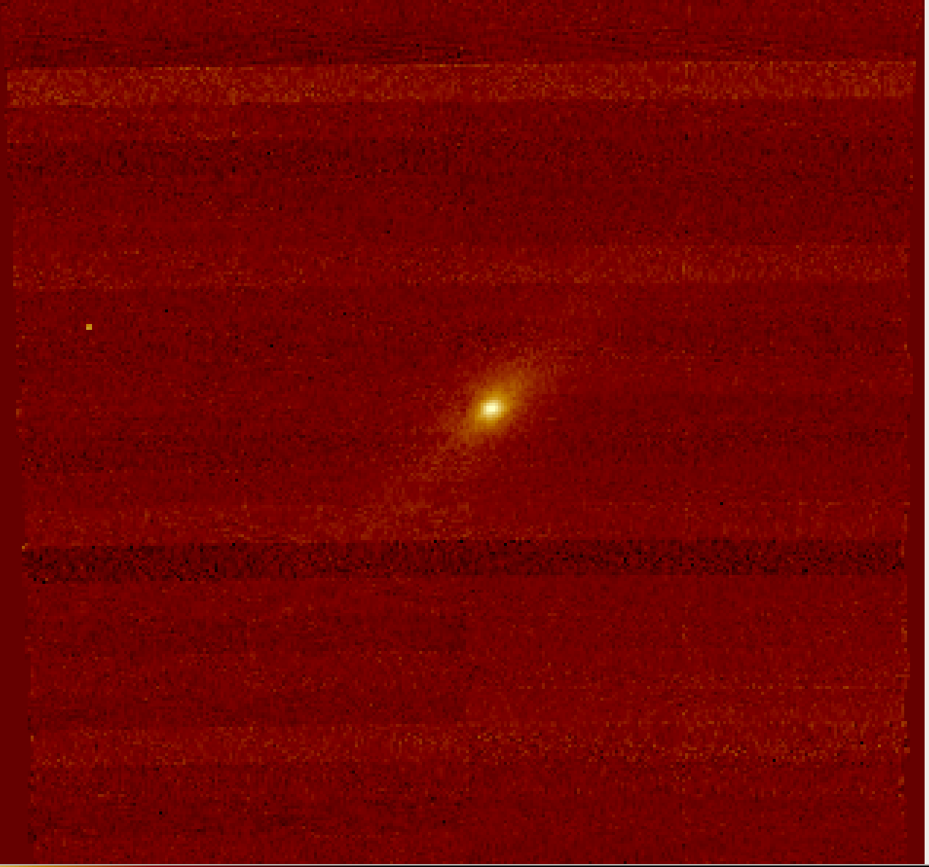
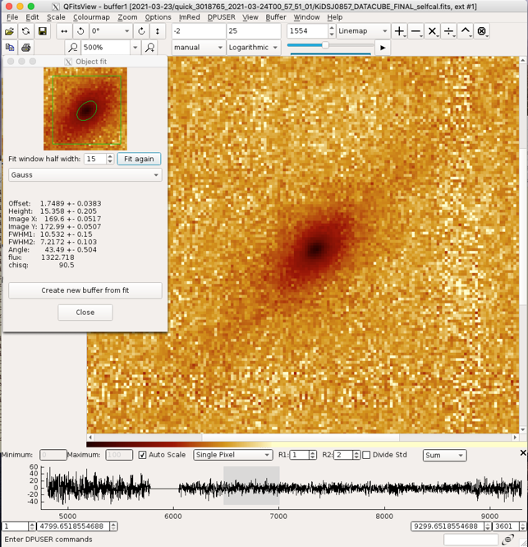
MUSE NFM verification: commissioning OBs
Credit: Fernando Selman and Johanna Hartke
“A pathfinder to observe high redshift galaxies with MUSE”
PGC 33606
SmallScale - 500Hz
J = 10.69
Band: Cousins I
FWHM ~ 68 mas
Airmass: 1.235
Tau0: 4.8 ms
SmallScale - 500Hz
J = 16.4 Re = 0.45” z = 0.1764
Band Cousins I
FWHM ~ 175 mas
Airmass: 1.11 Tau0: 9.2 ms
ExpoTime: 300 s
Notes:
2 remarkable OBs performed while running IRLOS at 500Hz. [Right] An illustration of faint Galaxy core, this time much fainter was considered “a pathfinder” by our night astronomer
[Left] We were guiding alternatively on the extended Galaxy nucleus or on the star, demonstrating off axis guiding capabilities

Slide 26
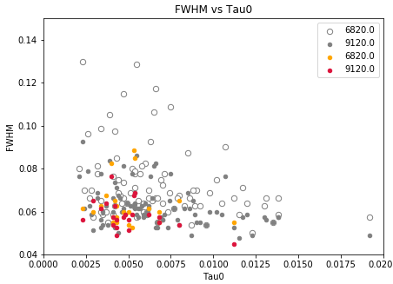
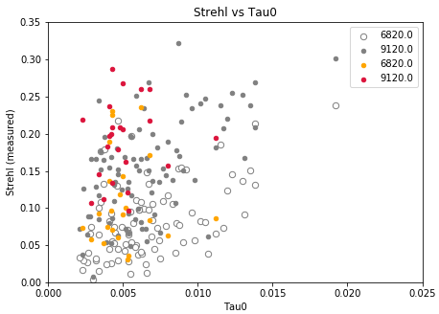
Performance on MUSE vs. Tau0
MUSE NFM regular Quality Control on standard targets. On going accumulation of performance points as a function of observing conditions
As expected, the performance is less impacted by low Tau0 cases (colored vs. gray points)
Notes:
Regular quality control is performed with MUSE by observing standards. These are the data points acquired between the 1st and the 2nd commissioning
We can observe that both in terms of fwhm and SR, the achieved performance is consistent with the best performance levels that could be reached in 2020, after the tomography optimization.
These first data points even seem to indicate that we are less sensitive to coherence time, as expected by running faster
Here I have to say that the performance delivered at the focal plane of the AO system is significantly better. It is degraded by NCPA and spectrometer features, downstream.

Slide 27




Commissioning 2: Faint end mode deployment
Wrap-up of bright modes
Total noise characterization
Centroiding optimization for faint end
Rejection transfer function optimization
Notes:
During the commissioning 2,
We have verified and wrapped up the 2 work horse modes
In particular, we have measured the rejection transfer function and realized that there was a significant latency gain in using less pixels per subaperture. So we went from 32x32 to 20x20.
We have verified robustness and performance when guiding on extended targets, on unresolved targets, on axis and off axis and also on crowded fields
Then, we focused on the deployment of the faint mode, to go beyond our goal performance level
We have tuned the Saphira parameters to reach a balanced noise budget between RON, thermal and sky background. You see on the top right plot a total noise contribution slightly above 1e- rms under thick clouds at 500 Hz. It is lower than 1e- rms under clear sky conditions.
We have implemented a well tuned 2x2 subapertures mode with 200Hz framerate.
Finally, we have pushed the limiting magnitude to a new limit,i.e. Jmag of 19.3 which corresponds to a case with 2 photons per frame/ SA, that is a SNR of 1 at 200Hz. In this case, the star can’t be seen on the AO RTD even when averaging 50 real time images.
So, to make sure that, we were really closing the TT loop we opened it and switched to telescope field stabilization on a bright star off axis. The fwhm went from less than 100 mas to ~200 mas.
Acquisition was straight forward, robust, up to mag 19.5, we did not try fainter.
Jmag=19 → MUSE 5.5x4.0 spaxels , 0.49", 4.7ms, 1.18 airmass
Jmag=19.3 → MUSE 4.2x3.4 spaxels, 0.55", 4.3ms, 1.30 airmass
Ttfree → MUSE 7.3x5.7 spaxels , 0.66", 3.8ms, 1.34

Slide 28


Commissioning 2: Faint end mode deployment
Jmag= 19.3 → 2.11 photons / frame / subaperture → SNR =1
Jmag=19
Notes:
During the commissioning 2,
We have verified and wrapped up the 2 work horse modes
In particular, we have measured the rejection transfer function and realized that there was a significant latency gain in using less pixels per subaperture. So we went from 32x32 to 20x20.
We have verified robustness and performance when guiding on extended targets, on unresolved targets, on axis and off axis and also on crowded fields
Then, we focused on the deployment of the faint mode, to go beyond our goal performance level
We have tuned the Saphira parameters to reach a balanced noise budget between RON, thermal and sky background. You see on the top right plot a total noise contribution slightly above 1e- rms under thick clouds at 500 Hz. It is lower than 1e- rms under clear sky conditions.
We have implemented a well tuned 2x2 subapertures mode with 200Hz framerate.
Finally, we have pushed the limiting magnitude to a new limit,i.e. Jmag of 19.3 which corresponds to a case with 2 photons per frame/ SA, that is a SNR of 1 at 200Hz. In this case, the star can’t be seen on the AO RTD even when averaging 50 real time images.
So, to make sure that, we were really closing the TT loop we opened it and switched to telescope field stabilization on a bright star off axis. The fwhm went from less than 100 mas to ~200 mas.
Acquisition was straight forward, robust, up to mag 19.5, we did not try fainter.
Jmag=19 → MUSE 5.5x4.0 spaxels , 0.49", 4.7ms, 1.18 airmass
Jmag=19.3 → MUSE 4.2x3.4 spaxels, 0.55", 4.3ms, 1.30 airmass
Ttfree → MUSE 7.3x5.7 spaxels , 0.66", 3.8ms, 1.34

Slide 29

Commissioning 2: deployed Modes
Notes:
Offered modes
Simple decision tree based on J magnitide and object extension (binary: Yes/No)
Right for extended objects only 2 modes: bright and faint
Left for unresolved targets: 3 modes: faint, bright and very bright.
When the objects get brighter than magnitude 7 we have implemented an automatic spreading of the LGS constellation not to be polluted by the NGS light. We have also added the automatic insertion of narrow band filters to go down to mag 0.5
So before the IRLOS+ project, the automatically usable mag range was 7 to 14.5. Now it is 0.5 to 19

Slide 30




Commissioning 2: MUSE performance
Pre
Post
Credit: Fernando Selman and Johanna Hartke
Notes:
Commissioning performance data on MUSE
Large dot → comm2 IRLOS+
Small dot: before
Left plot: FWHM as a function of airmass
It’s interesting to witness that performance is good despite quite bad weather conditions as you can see from the Tau0 values. Actually, the grey zone in the Tau0 colorbar is normally not allowed for observing with MUSE NFM
This combined to the fact that we tested quite often very faint targets
Nevertheless, the achieved performance is in line with what we got in the past, actually better performance at all wavelength according to the MUSE IOT

Slide 31
Show case: Einstein cross
https://www.eso.org/sci/publications/announcements/sciann17429.html
DIMM seeing = 1.03
Airmass=1.14
Tau0=3.6 ms
600s total integration time
Cloudy sky (thin)
Such lensed quasar was not observable with the previous IRLOS
It’s now straight forward, in the bright regime of IRLOS+
Visible correction radius consistent with the correction of 850 modes
Despite conditions, probably the highest spatial resolution image of this object
Notes:
Finally, the show case presented in the science announcement that came out in August
Interesting target that was part of the science verification of MUSE NFM
But NFM was failing miserably on such target as the project scientist puts it
0.4’’ correction radius at 900 nm

Slide 32

Next: PSF Reconstruction
Credit: Fernando Selman and Johanna Hartke
PhD of Arseniy Kuznetsov on self-learning AO: stay tuned …
Notes:
This is a PSF fitting on MUS NFM AO corrected images
Next is going to be the PhD of Arseniy Kuznetsov starting this Friday on Self learning AO.
His first work will be the PSF reconstruction of MUSE NFM in collaboration with LAM and MAVIS through Olivier Beltramo Martin

Slide 33
Status and next steps
The only LTAO system in operation delivers high performance and robust science
GALACSI NFM now goes 4 magnitude fainter (Goal was 2)
Before the upgrade 7<Jmag<15 → After the upgrade 0.5<Jmag<19
Off axis guiding has been pushed to 5’’ radius
NFM performance is now less sensitive to Tau0 and seeing, also better and more robust performance on extended targets
Next steps:
Commissioning report and PAC
Dissemination of the results
Further improvement of the LTAO: technical time in November 2021
PSF reconstruction and improvement of MUSE NFM optical quality

Slide 34

The IRLOS+ team
Notes:
I finish by a picture of the team that worked with dedication, quality and sometimes even fun despite the COVIS stituation

