Slide 1
MAORY design trade-off study: tomography dimensioning
Sylvain Oberti, Miska Le Louarn – ESO Garching
Emiliano Diolaiti, Carmelo Arcidiacono, Laura Schreiber, Matteo Lombini – INAF Bologna
and the rest of the MAORY consortium
AO4ELT5 – Tenerife – 30-06-2017
Notes:
I am Sylvain Oberti, working for ESO but contributing to the MAORY consortium
I am sorry to bother you during the digestion process.
Sorry for the misleading title.

Slide 2
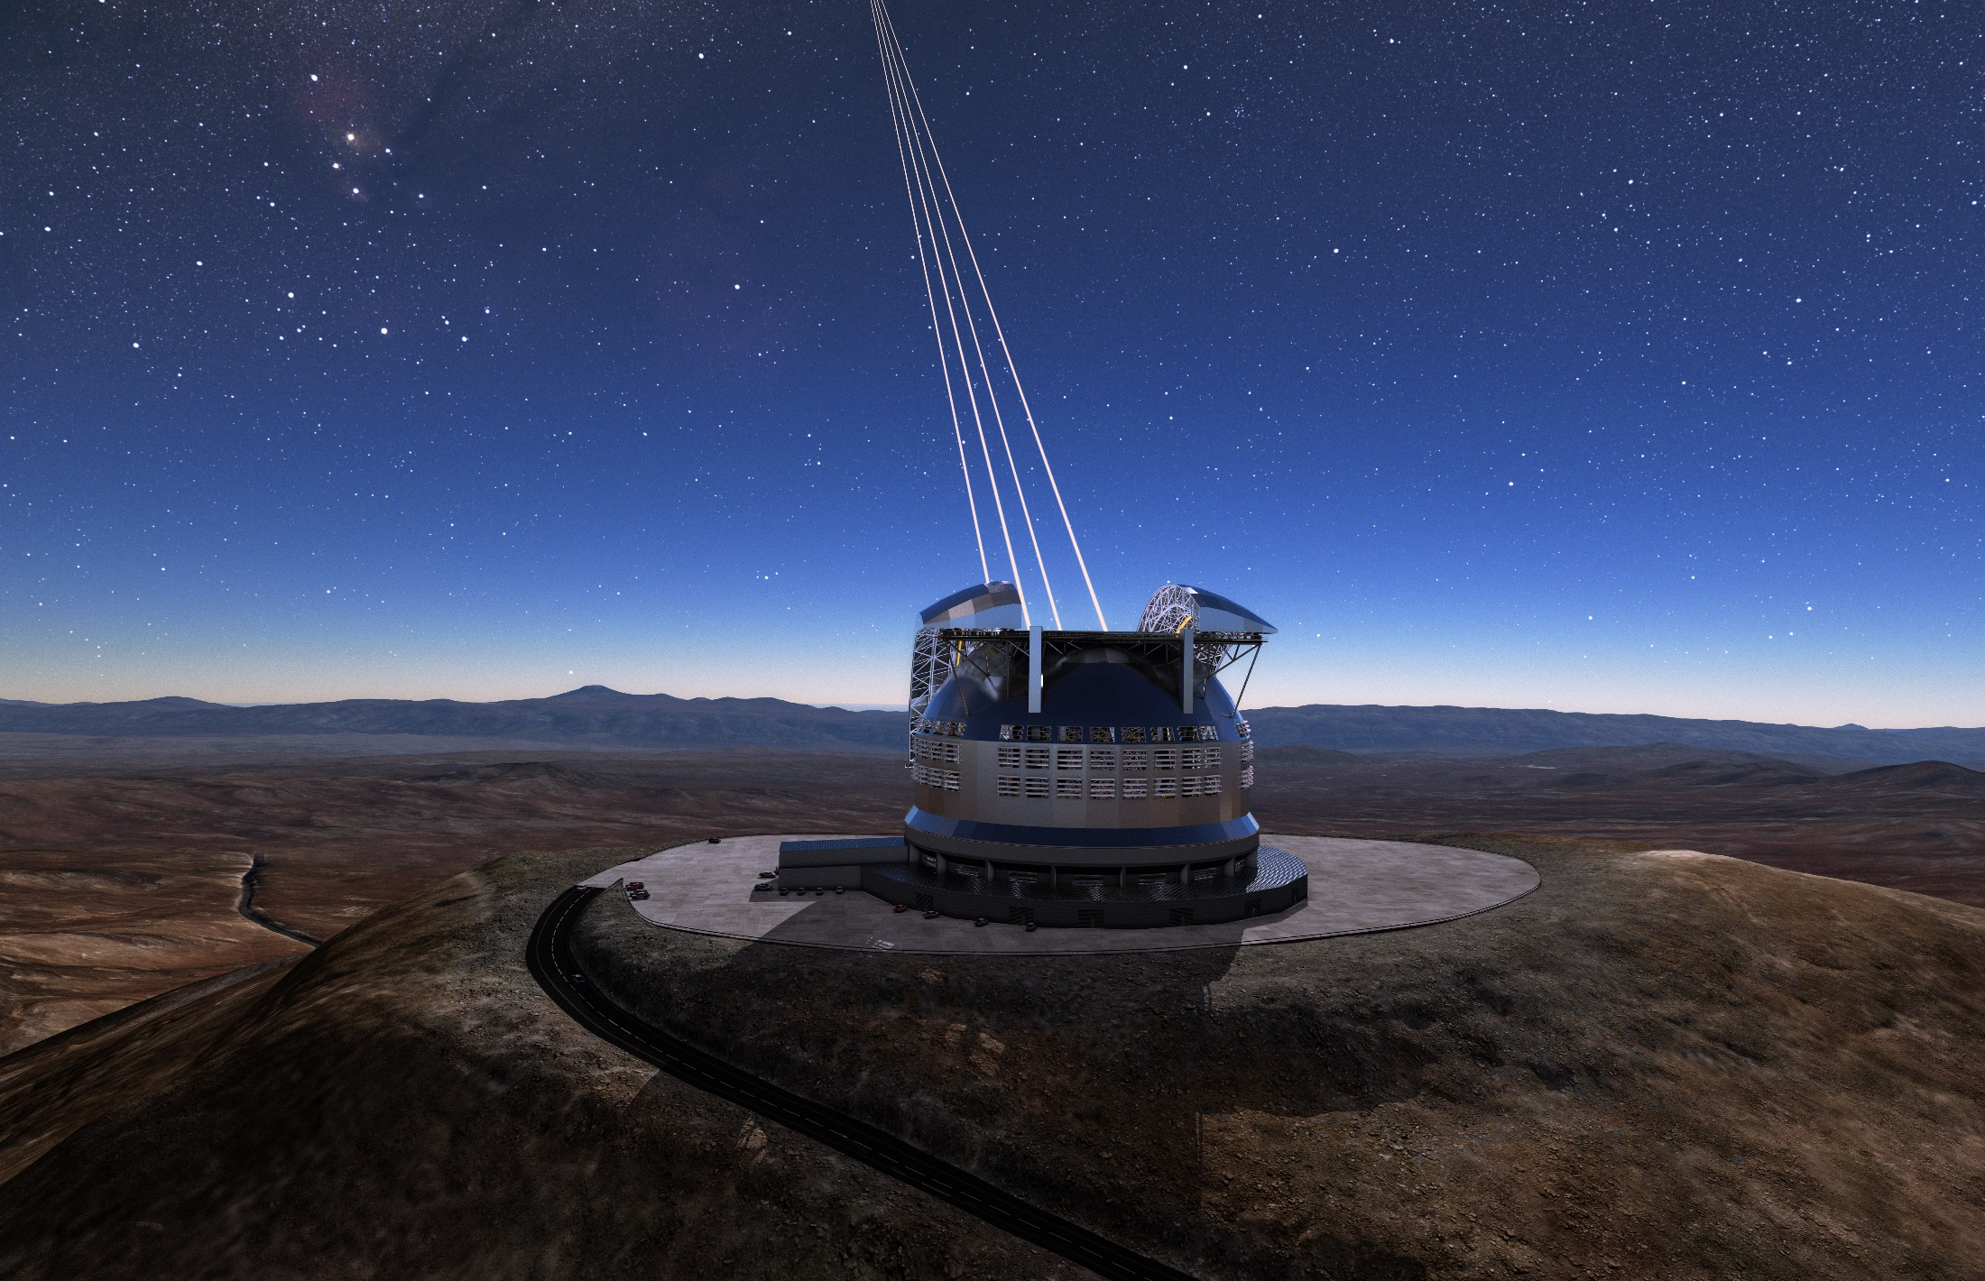
Multi-conjugate Adaptive Optics RelaY for the E-ELT
MAORY serves MICADO
+ future second port INS (TBD)
Notes:
MAORY stands for Multi-conjugate Adaptive Optics Relay for the E-ELT.
It serves the instrument MICADO, a 1’ imager + spectrometer
+ future 2nd port TBD

Slide 3
Outline: phase B design trade-off
1- Analysis of dimensioning parameters constrained by tomographic and generalized fitting error
Number of post-focal DMs conjugated in altitude
DM pitch
DM altitudes
LGS asterism angle
Number of LGS
LGS and NGS asterism geometry - not shown in this talk
under some constraints
Seeing
Cn2 profile
Zenith distance
Telescope phase 1 / phase 2
Number of LGSs: 4/6
M1 central obstruction: 28%/57%
2- LGS WFS design: new concept of super-resolution wavefront sampling, a way to improve multi WFS AO and get rid of spot truncation
Notes:
Revisit phase A design !
Main purpose of this recent study is to address high level trade-off related to tomography and fitting error, essentially DMs TLRs and LGS number and asterism angle. This is done under constraint of external parameters: seeing, Cn2, phase 1/phase 2
I will show some analyses, compare baseline to other options and open discussion

Slide 4
Driver: MAORY main specifications
Performance in best conditions
Q1 seeing (0.234 m) and wind, as close to zenith as possible
Over 20” FoV
SR > 50% @ 2.2 microns (goal 60%)
Sky coverage requirement not applicable
Performance in median conditions
median seeing (0.157 m) and wind, as close to zenith as possible
Over 1’ FoV
SR > 30% @ 2.2 microns (goal 50% @ 2 microns)
Performance in sub optimal conditions
Q3 seeing (0.139 m) and wind, zenith distance 30 degrees
Over 2’ FoV
SR > 15% @ 2.2 microns (goal 30%)
SR uniformity < 10% absolute PTV across FoV of interest
Sky coverage > 50%
Notes:
Error budget MAORY 231 nm, telescope 145 nm rms → 37% SR en K
Main spec: Focus on median and sub optimal conditions which are the design drivers

Slide 5



OCTOPUS® end-to-end simulation
Simulated MCAO WFE terms
Generalized fitting
Spatial aliasing
Temporal error
LGS WFS noise
NGS WFS noise
Tomographic error
Command computation:
Tomographic reconstruction to estimate the multi layer turbulent phase: FRIM3D/POLC with perfect priors on Cn² profile
Projection of the estimated 3D phase onto the DMs space. The projection is optimized on a specific FoV
No other error budget term
high flux and no spot elongation
high flux
cone effect and anisoplanatism but optimal reconstruction of 35 layers
Notes:
For this reason, we are working without LGS spot elongation and with high flux for LGS and NGS. The reconstruction prior are perfectly known.
Star map to measure Sr across a FoV of 2’ square: 29 stars with a denser mapping around the center
6 LGS @ 1 ‘ off axis unless otherwise specified
3 NGS @ 70” off axis to split the technical field in two equivalent areas
4 tomography optimization field, actually acting on the projection of the reconstructed layers:
Full field
FoV1 for MICADO small field
FoV2 for MICADO large field
FoV3 for 2’ field
3 turbulence profiles:
Spec
Jet stream @ 13.5 km
Worst case with intermediate layer @ 8.5 km
2 seeing and zenith angle cases: mentionned in blue in the following slides

Slide 6
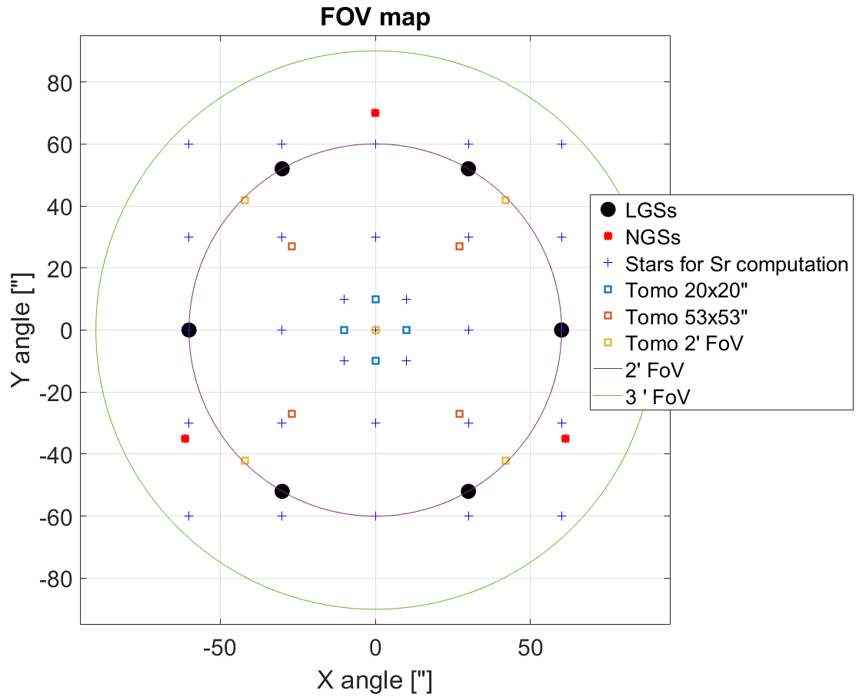
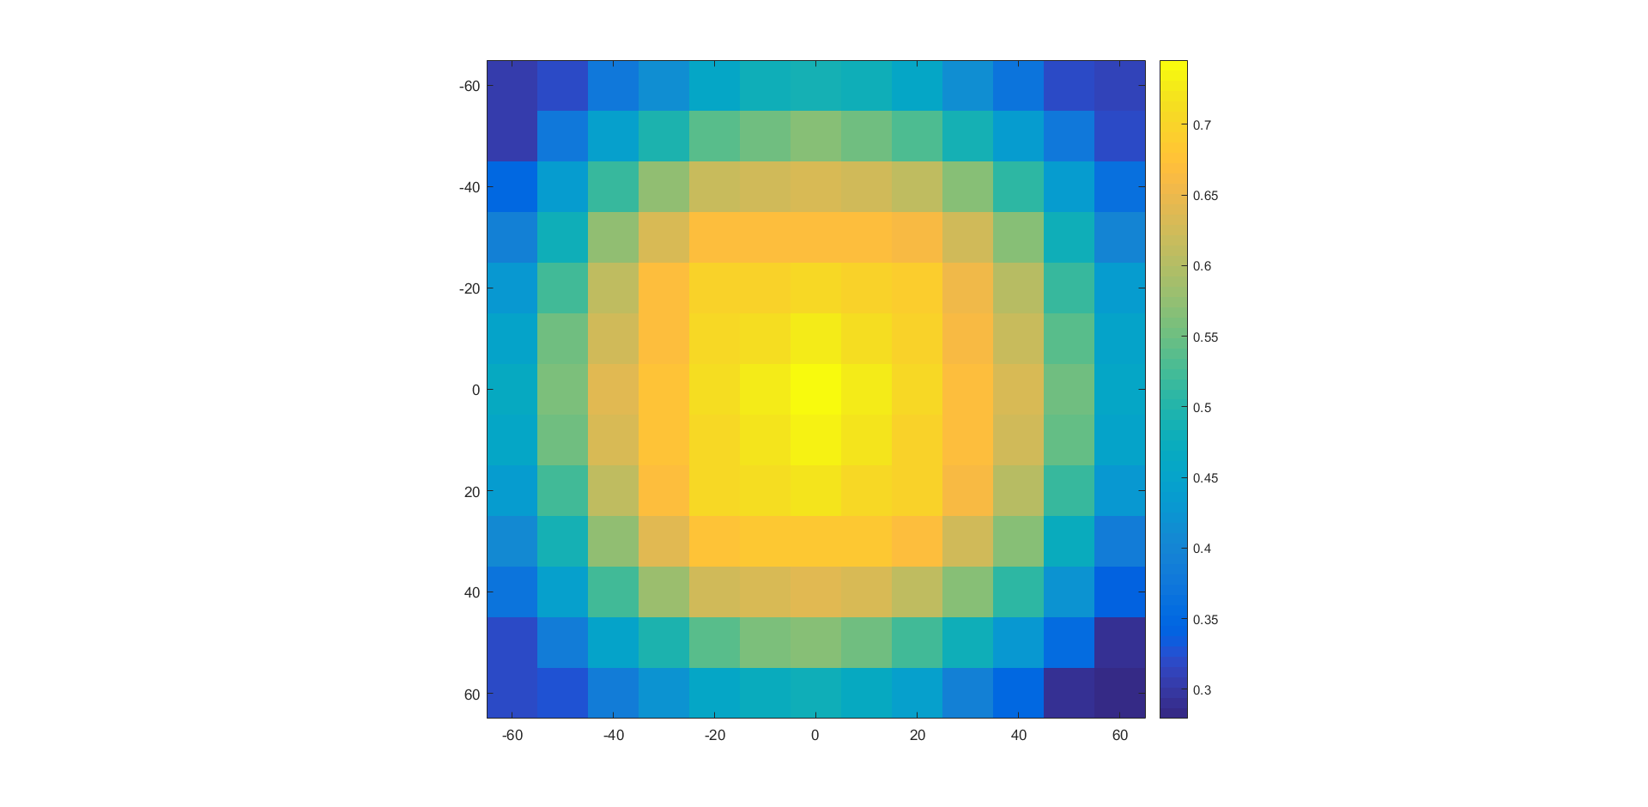
Typical simulated FoV
MICADO small field 20”x20”
MICADO large field 53”x53”
Notes:
For this reason, we are working without LGS spot elongation and with high flux for LGS and NGS. The reconstruction prior are perfectly known.
Star map to measure Sr across a FoV of 2’ square: 29 stars with a denser mapping around the center
6 LGS @ 1 ‘ off axis unless otherwise specified
3 NGS @ 70” off axis to split the technical field in two equivalent areas
4 tomography optimization field, actually acting on the projection of the reconstructed layers:
Full field
FoV1 for MICADO small field
FoV2 for MICADO large field
FoV3 for 2’ field
3 turbulence profiles:
Spec
Jet stream @ 13.5 km
Worst case with intermediate layer @ 8.5 km
2 seeing and zenith angle cases: mentionned in blue in the following slides

Slide 7
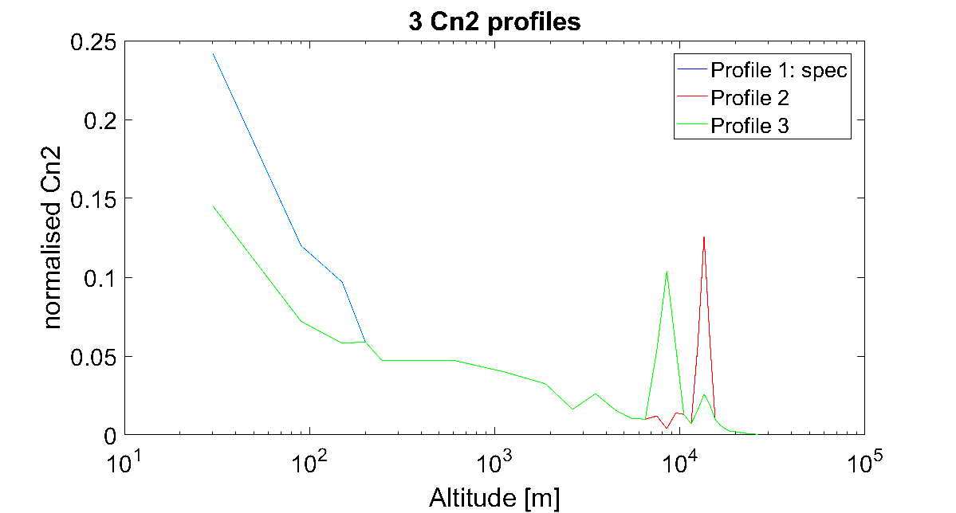
Cn² profiles
+ other profiles measured by stereo scidar
Notes:
3 turbulence profiles:
Spec
Jet stream @ 13.5 km
Worst case with intermediate layer @ 8.5 km

Slide 8
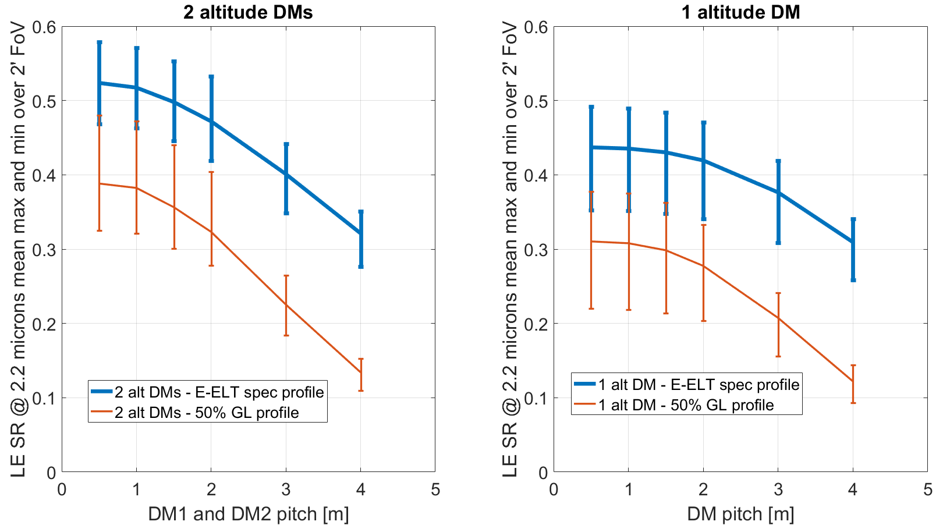
Gen. fitting: N DMs and pitch
r₀=0.129 m, Z=30º
2 post-focal DMs: performance flat for pitch < 1.5 m
1 post-focal DM: performance flat for pitch < 2 m
Strong impact from Cn2 profile
Notes:
0.8” seeing Zenith=30
Plot shows min, max and averaged performance across 2 ‘ field vs. projected DM pitch in m on sky for:
1 post-focal DM (Right) vs. 2 post-focal DMs (Left)
Profile1 vs. Profile2
Conclusions:
- Pitch smaller than 1 m does not make sense for 2 post-focal DMs
- Pitch smaller than 1.5 m does not make sense for 1 post-focal DM
Strong impact of turbulence profile : dominates over the trade-off number of DMs and pitch → realistic Cn2 sensitivity analysis to be performed
In this case, with a layer @ 13.5 km, 1 DM case is not more sensitive than 2 DMs

Slide 9
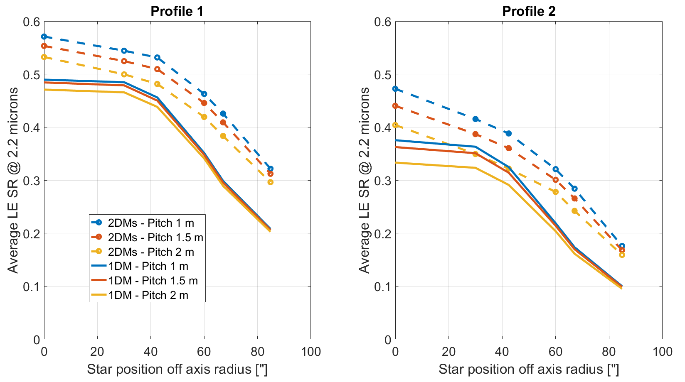
Benefit 2 vs. 1 post-focal DM(s)
K band: 2.2 µm
r₀=0.129 m, Z=30º
2 post-focal DMs provide performance improvement of up to 25% in the science field and 100% in the technical field in K band, 250% in J band
2 post-focal DMs desirable to increase sky coverage
Notes:
Gain in Sr 2 post-focal DMs vs. 1 in the following cases:
Top: Median seeing Z=30: Profile 1 vs. Profile 2 – optimization full field – different pitch
Bottom : Good seeing, Z=0, Profile 1 vs. Profile 3 – 3 fields for optimization of the projection – 2 pitches
MICADO large field diagonal is the red line
Conclusions:
2 post focal DMs provide performance improvement of up to 25% in the science field
Strong advantage in the technical field: up to factor 2 in K, 3.5 in J band
The message here is that 2 post-focal DMs are desirable in order to increase sky coverage
It could also be attractive for a future instrument: 2nd port

Slide 10
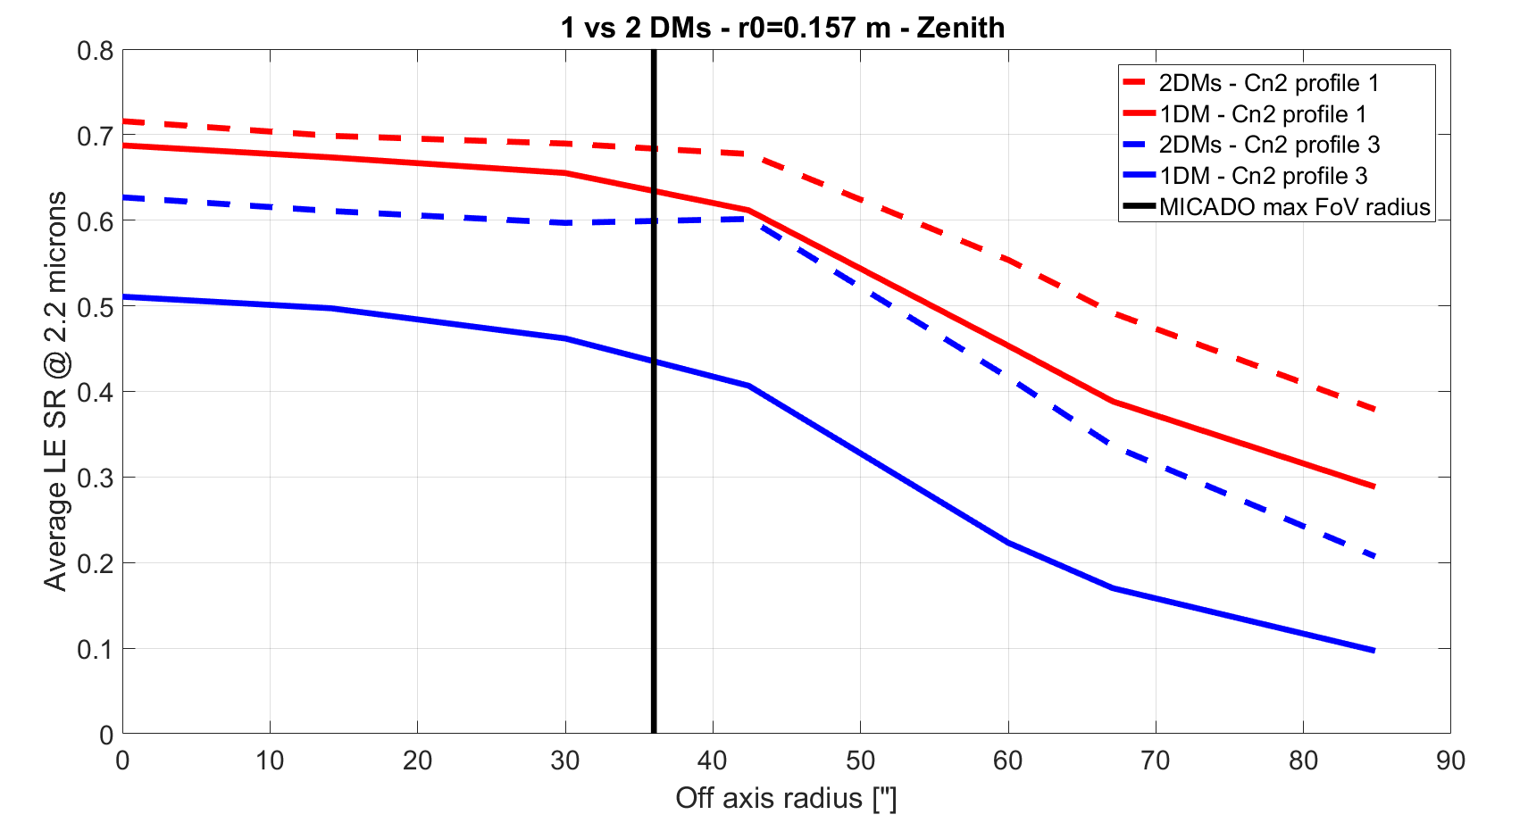
Benefit 2 vs. 1 post-focal DM(s)
2 post-focal DMs improve tolerance to Cn2 profile variation
Notes:
Now, if we a look at a kind of worst case altitude turbulence layer w.r.t. to the ESO median profile, clearly 2 post-focal DMs are more robust to Cn2 change.

Slide 11
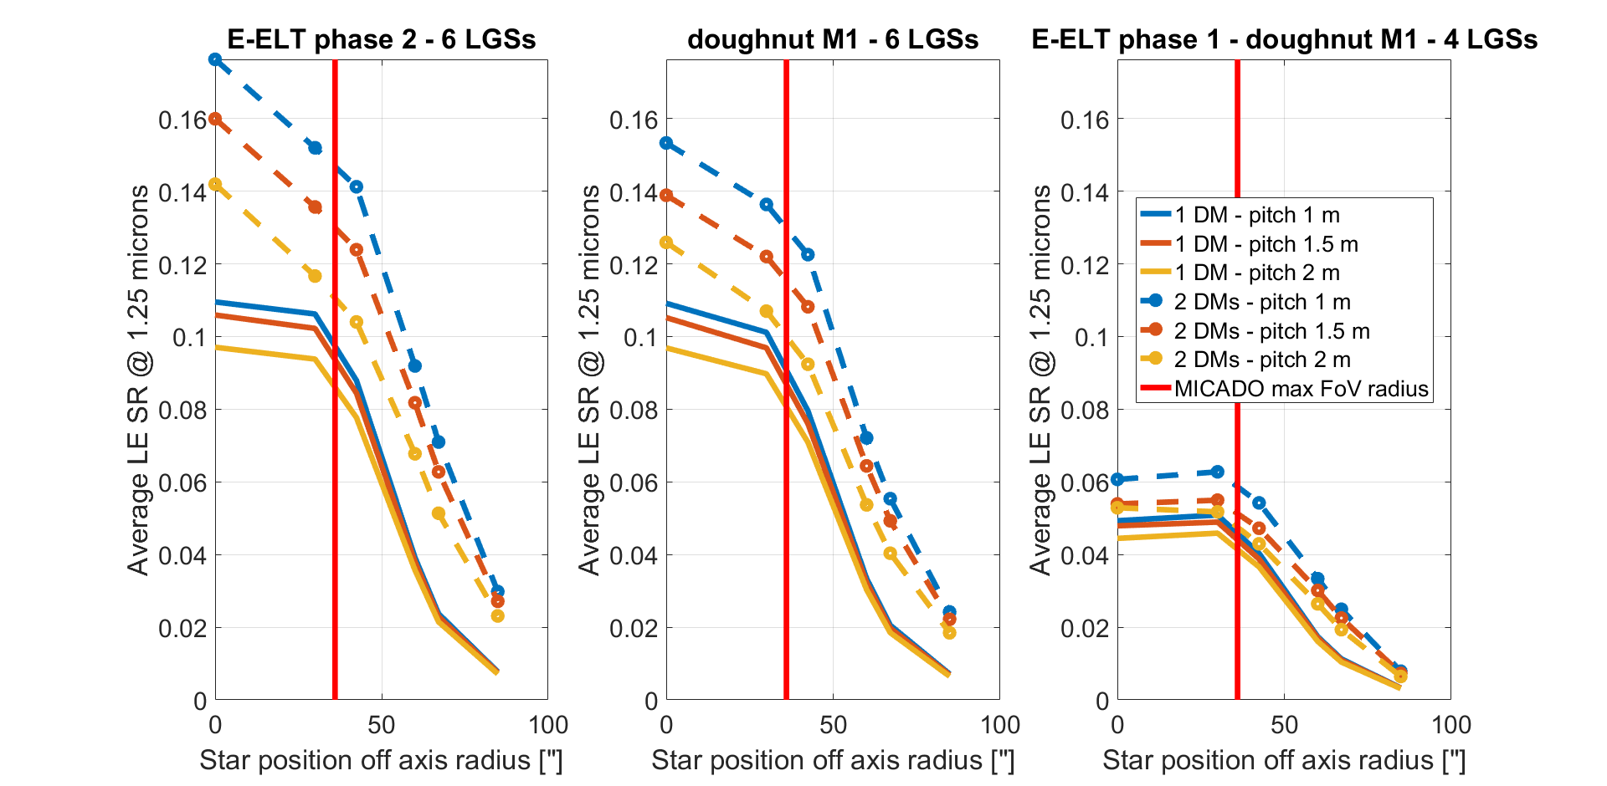
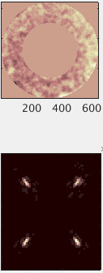
E-ELT phase 1 / phase 2 – J band
M1 doughnut impact on Sr is not significant. How about NGS sky coverage ?
Dramatic impact 6 LGSs → 4 LGSs
Lower wavelength performance pushes for:
6 LGSs
2 post-focal DMs
finer DM pitch
K band: 2.2 µm
r₀=0.129 m, Z=30º
C_{n}²: Profile 1
Photon noise σ²
x3.8 long axis
Notes:
Study of E-ELT phase 1 / phase 2 impact on J band LE Sr averaged across the 2’ FoV
J band matters both for NGS sensing and science
3 cases:
- Left: E-ELT phase 2 with 6 LGSs and 28% central obstruction
Right: E-ELT phase 1 with 4 LGSs and 57% central obstruction
Middle: Hybrid case with 57% central obstruction and 6 LGSs
Conclusions:
Limited impact of doughnut on Sr but on sky coverage: To be analysed
Strong impact of number of LGS
Benefit from having 2 post-focal DMs: limited in phase 1, yes with 6 LGSs
6 LGSs is a must have !

Slide 12
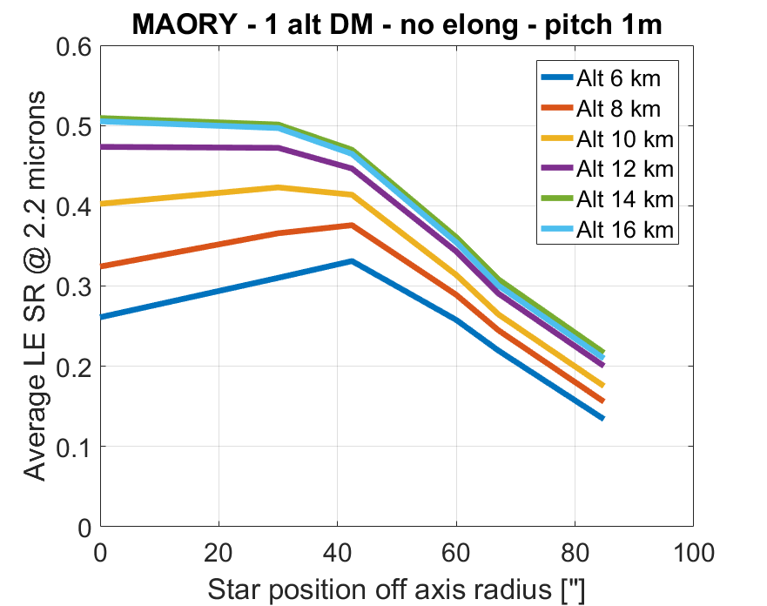
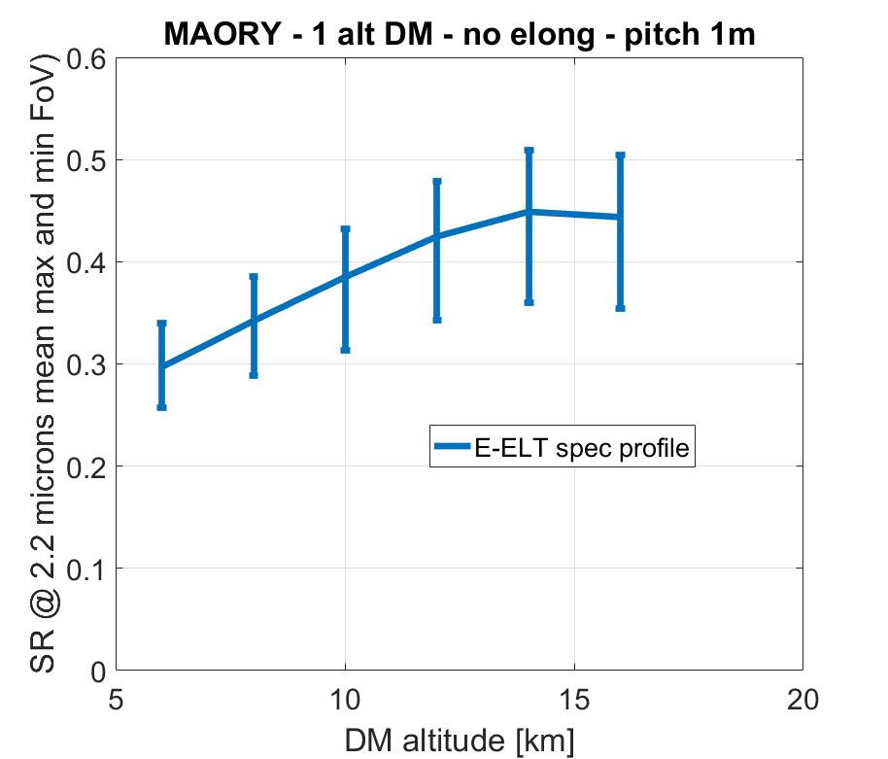
Post-focal DM altitude: single DM
K band: 2.2 µm
r₀=0.129 m, Z=30º
C_{n}²: Profile 1
1 post-focal DM: conjugation altitude matters and should be > 14 km
The conjugation altitude should be higher to cope with larger airmass cases
Notes:
0.8” seeing Zenith=30
Plot shows orthodadial averaged Sr vs star radial position in the field
Conclusion:
With 2 DMs, performance is not sensitive to lower DM altitude
With 1 DM, altitude should be higher than 12 km
Altitude of higher altitude DM not analyzed in the 2 DM case, Action ?
Baseline is, since phase A, to have the DMs @ 4 km and 12.7 km
To be robust to higher airmass, I propose to put the DMs at higher altitude (maybe 6 and 15 km ?). The turbulent layer are shifted upwards linearly with airmass, so factor of 2 at Z=60
Of course, this needs to be confirmed by a cn2 sensitivity study

Slide 13
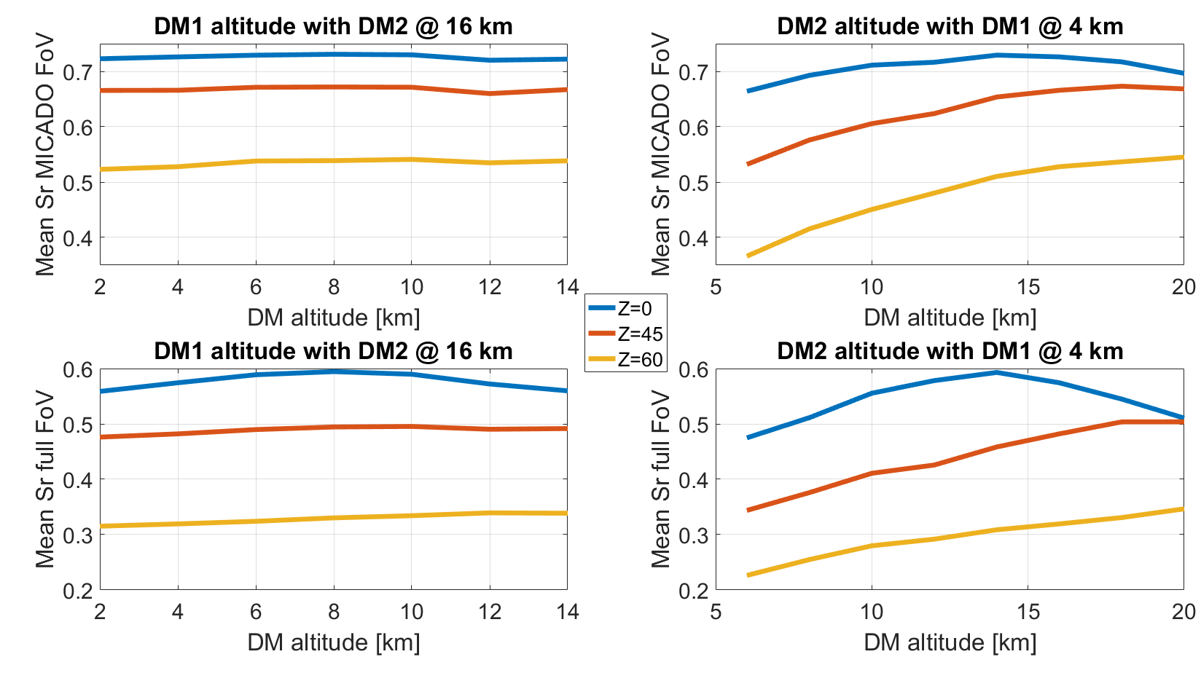
Post-focal DM altitude: 2 DMs case
Results confirmed by Cn² sensitivity study
Performance insensitive to DM1 altitude
DM2 optimal altitude naturally increases with airmass
16 km conjugation is a good trade-off
16 km is also close to optimal for a single post-focal DM → Upgradability
Notes:
Performance shown in the MICADO large field and full field, with 2 DMs pitch 1.5m, playing with DM1 and DM 2 altitudes
16 km is a good choice valid for both cases where we use a single or two post-focal DMs
Cn2 sensitivity studies confirm these altitudes: not very sensitive

Slide 14
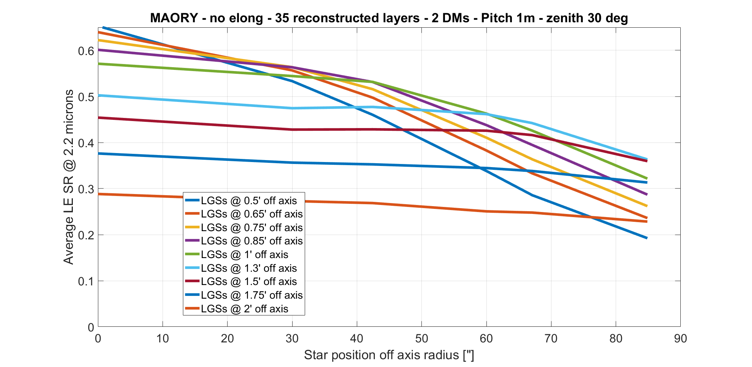
LGS asterism angle – full field optim
K band: 2.2 µm
r₀=0.129 m, Z=30º
C_{n}²: Profile 1
1’ radius
45”radius
Tomography reconstruction maximizes performance in full field here
Closer LGSs improve Sr on axis, decrease uniformity across the MICADO field and decrease the Sr in the technical field
Trade-off between 45” and 1’ radii → other FoV optimization to check
Notes:
This is performance against field position for different LGS radius
LGS asterism with full field optimisation of the projection
Important to say that tomography is optimized in full field
Closer LGSs improve the Sr on axis but decrease uniformity and Sr in technical field
Trade-off between 45” and 1’ radii
We can combine LGS asterism angle tuning and SW reconstruction tuning

Slide 15
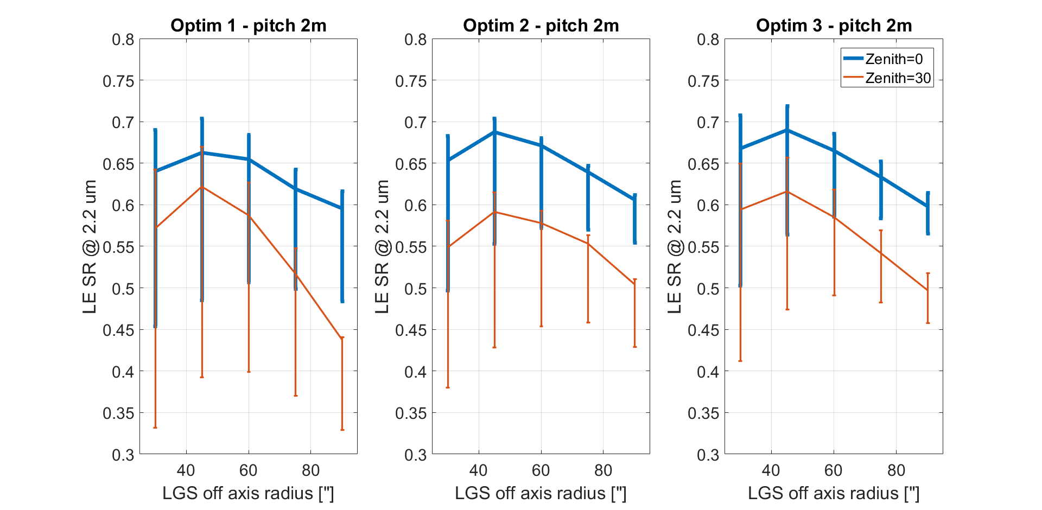
LGS angle – projection optimization
K band: 2.2 µm, r₀=0.157 m, C_{n}²: Profile1
Tomography reconstruction maximizes performance in 3 different FoVs with NGS @ 70” off axis
Maximum and average Sr in MICADO field highest for LGS @ 45” off axis
Average performance in 2’ FoV highest for LGS @ 1’ off axis
Baseline: 45” radius
Notes:
Same analysis as performed before but for spec seeing (0.6”) pitch of 2m and different optimal fields for 2 zenith angles
For LTAO optimal angle ranges between 45” at zenith and 20” @ Z=60
The larger the zenith angle the closer the LGSs should be.

Slide 16
Ultimate performance in 20” square
Best performance on axis (LTAO with on axis NGS) is achieved with 20” radius @ Z=60
NGS cannot be closer than 30” radius without vignetting the science FoV
Confirmation that a fixed 45” radius is almost optimal for MICADO at any airmass for both small field and wide field: one single asterism configuration → less complexity
Notes:
@ large airmass the NGS correction was too poor when optimizing on axis and forced to enlarge the FoV on=f the NGS WFS → too long computation.
Here noi NGS, all mods corrected by the LGS, this helps even more the perf on axis.
At Z=60 one can see the performance
- on axis
- in MICADO small FoV
in MICADO large field
On axis, as in LTAO, optimal radius is 20”
In MICADO small FoV, going down to 30” radius provides a significant performance improvement
In any case, 45” is the best case for any zenith distance when it comes to performance in the large MICADO FoV.
45” is a hard limit with pick-off mirrors, could be decreased with prisms
Shall we try to decrease the hard limit of asterism angle ? Is it a significant performance improvement for MICADO @ Z=60? We should ask Rick probably

Slide 17
Conclusions on design trade-off
2 post-focal DMs (baseline: 1) are desirable in order to enhance:
Performance in the technical field → sky coverage and robustness (acquisition)
Performance in the blue for NGS sky coverage and MICADO performance
Robustness to Cn2 profile variation and zenith distance
DM pitch between 2m and 1.5m → better for worse seeing and with 2 DMs
Post-focal DMs altitude: 4-6 and 16 km to be robust to larger airmass and accommodate 2 post-focal DMs later
LGS asterism angle: fixed @ 45” radius + optimization of tomography projection depending on FoV of interest
E-ELT phase 1 / phase 2:
M1 doughnut main impact on sky coverage and PSF shape: TBC
6 LGSs are highly desirable
Notes:
Main choices:
2 post-focal DMs should be pushed but baseline is 1
Pitch 1.5 m preferred
DM altitude 16 km for highest and flexible for lowest
6 LGSs are a must

Slide 18
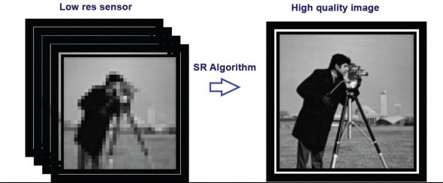
WF sampling super-resolution
Notes:
New idea based on the concept of super-resolution:
- A frozen scene can be super resolved by stacking undersampled frames shifted by a fraction of sampling element

Slide 19
WF Super-resolution: rationale
Current MAORY design is based on 6 LGS WFS with 80x80 subapertures and 10x10 pixels of 1” to 1.5” per subaperture
Spot truncation occurs as spot elongation can get as large as 25”: why not reducing the number of subapertures and increase the number of pixels per subaperture ?
Why we could live with less subapertures ?
We have a redundant multi WFS system
Altitude turbulence is weak
The spatial sampling in altitude can be coarser
MAORY altitude DMs baselined with pitch of 1.5 to 2m: can be easily controlled with subapertures of pitch > 0.5 m
Problem: How to sample the ground layer properly to be able to control 5000 degrees of freedom provided by M4 ?
Break the symmetries by not aligning the WFS with the pupil
Go for super-resolution wavefront sampling thanks to sub-sample shift
The ground layer and possibly the DM is seen the same way by all WFS

Slide 20
Basic monodimension description
Let S be the function describing the 1st derivative of the wavefront along one axis (a line across the pupil). The concept can be generalized by considering S to be the phase or its second derivative or an intensity pattern in the focal planem or elsewhere, etc …
amplitude
S(x)
x
T
T
T/2
Sampling with a grid of sampling period T and subaperture (or sampling element) size T across which the signal is averaged out
Sampling with same resolution but grid shifted by half a sampling element
Combining the 2 sampling patterns (blue and red), we effectively get a twice smaller sampling period T/2 but keeping a subaperture size of T
Notes:
Basic monodimensional description

Slide 21
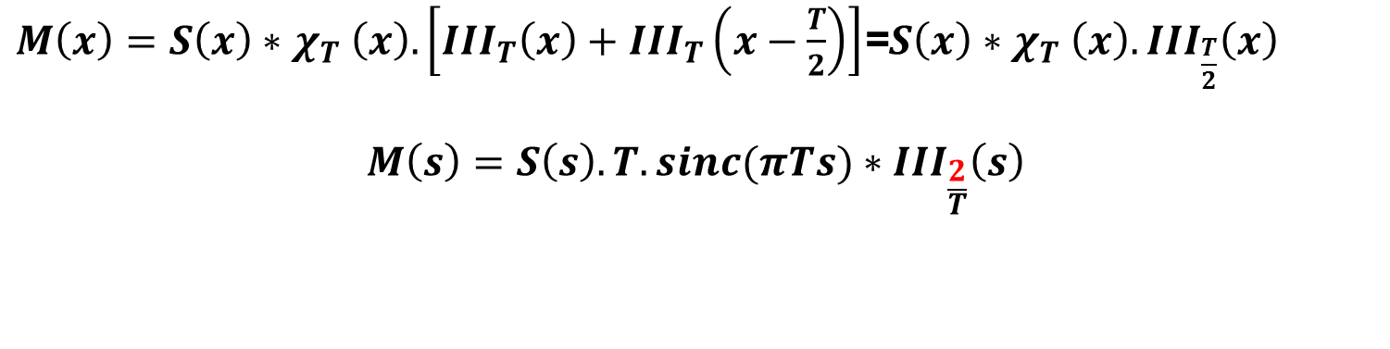
Combining sampled measurements
By concatenating the sampled measurements in the direct space from blue and red cases, we get:
A sampling period T/2 → the same spatial resolution but a twice wider first null point of the sinc function hence better sensitivity
$M\left(x\right)=S\left(x\right){∗χ}_{T}\left(x\right).\left[{III}_{T}\left(x\right)+{III}_{T}\left(x−\frac{T}{2}\right)\right]$=$S\left(x\right){∗χ}_{T}\left(x\right).{III}_{\frac{T}{2}}\left(x\right)$
$$M\left(s\right)=S\left(s\right).T.sinc(πTs)∗{III}_{\frac{2}{T}}\left(s\right)$$
FT
Sensitivity function remains the same
Only related to subaperture size
The sampling period is twice larger.
The distance between the diracs is wider in frequency domain
aliasing is reduced
Notes:
Combining sampled measurements consists of:
Convolution of the spatial function by a top hat
Multiplication by a sum of 2 shifted dirac comb, which provide another dirac comb with a twice smaller period
In Fourier space:
Sensitivity function that depends only on subaperture size and shape
Convolved to a Dirac comb with twice better spatial resolution and a reduced aliasing

Slide 22
First numerical simulations
VLT case – 8 m – AOF dimension
1364 KL modes in the pupil plane
Modal interaction matrices:
1 40x40 SH
5 co-aligned 20x20 SH
5 20x20 SHs with pupil shift of +/- 50% SA in X and Y
5 20x20 SHs with pupil rotation of 0, 11, 22, 33 and 44 degrees
Analysis of spatial frequency contained in the signal by singular value decomposition
Noise propagation
Wavefront reconstruction
Tomography case with 4 LGS WFS @ 10” off axis (LTAO)
Notes:
Some simulation:
Modal IM
Minimum variance open loop reconstruction error
Tomographic case

Slide 23
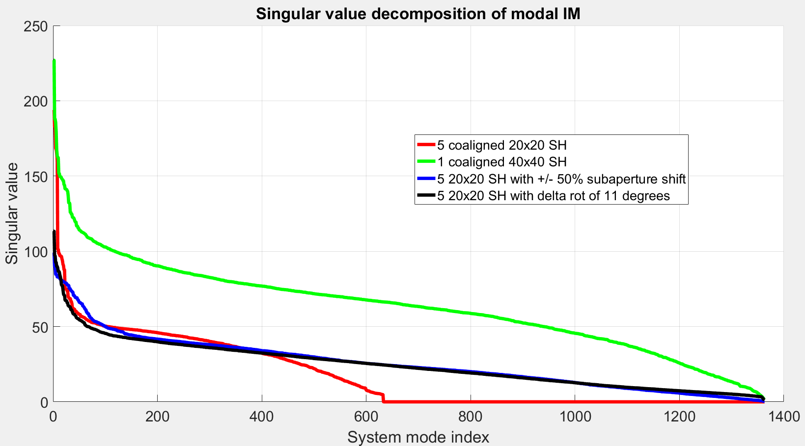
Singular value decomposition
Information at all spatial frequencies retrieved by shifted and rotated SHs

Slide 24
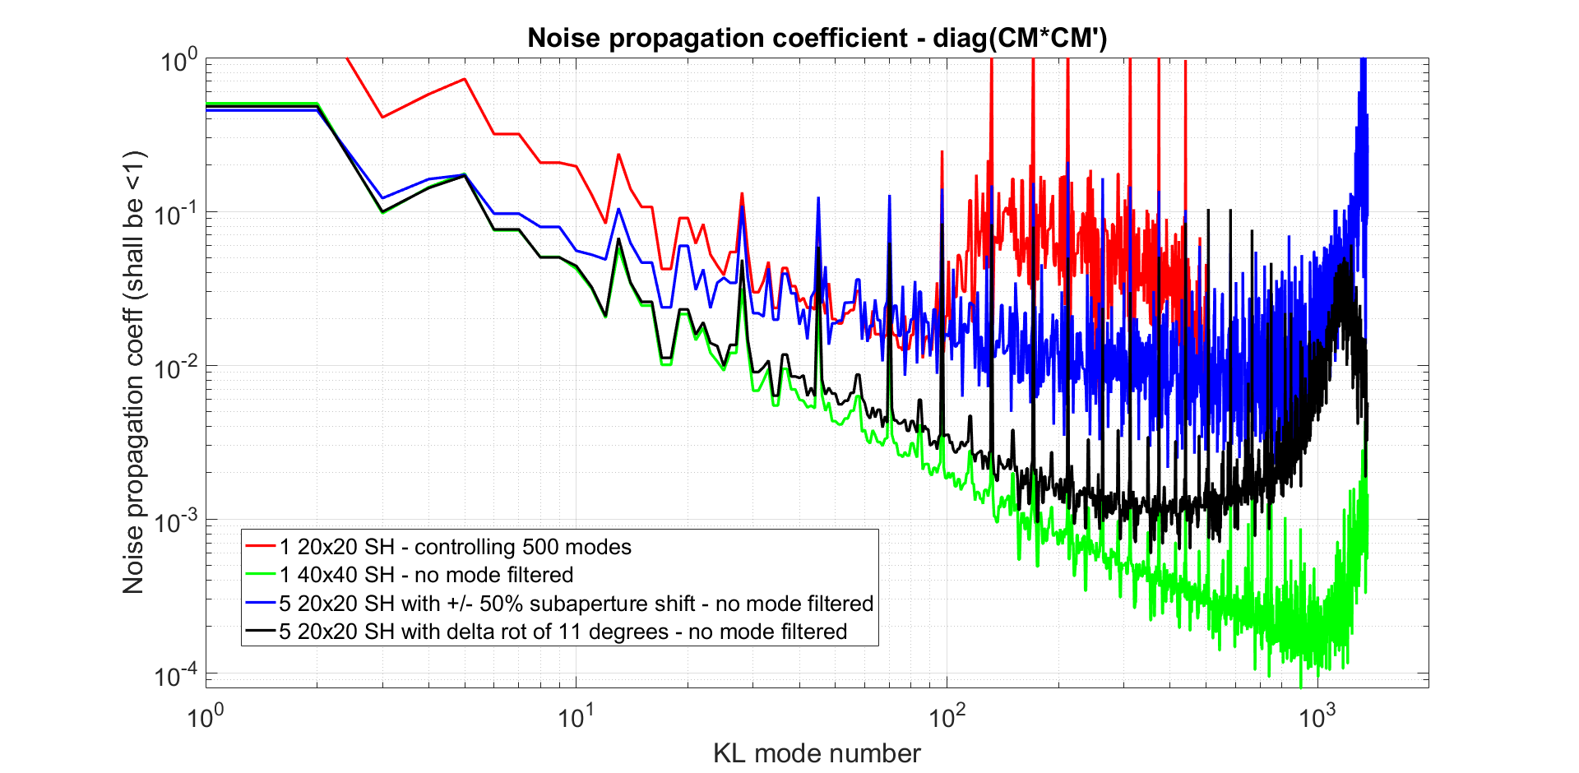
Noise propagation
High noise propagation with shifted SH because of bad management of edge effects, while rotated SHs propagate more noise than 40x40 along the high order modes due to sensitivity penalty

Slide 25
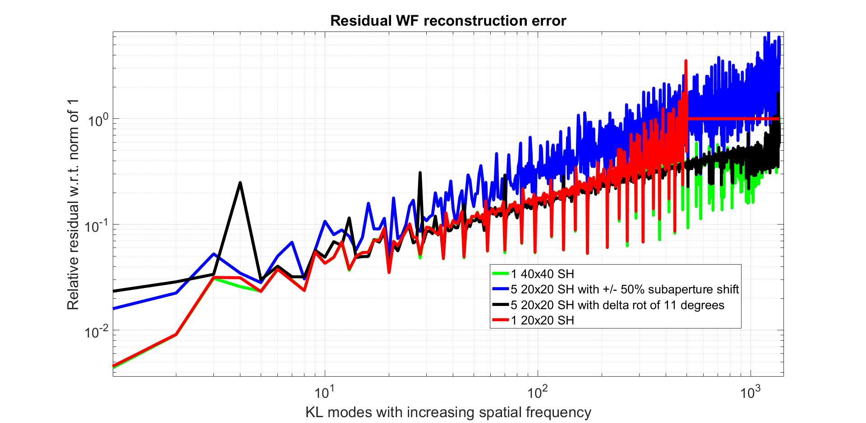
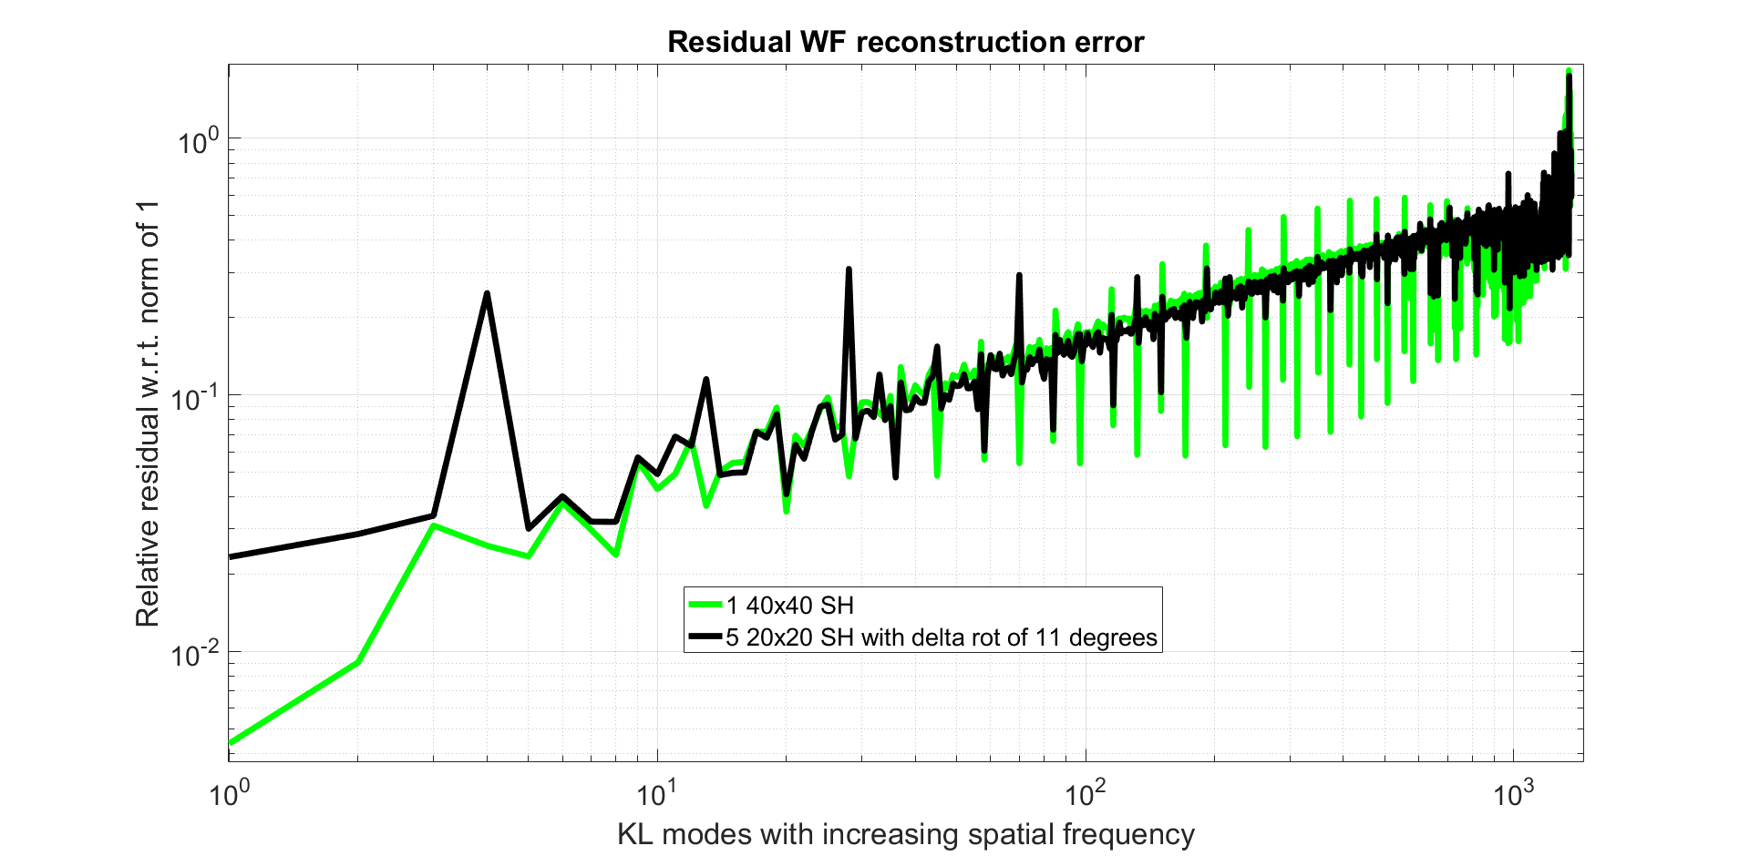
WF reconstruction with unknown DM model shift (4cm in M1 space)
The rotated 20x20 case behaves like the 40x40 case
In both cases, we can reconstruct ~ 1300 modes, where the WFE becomes as large as the input WF

Slide 26
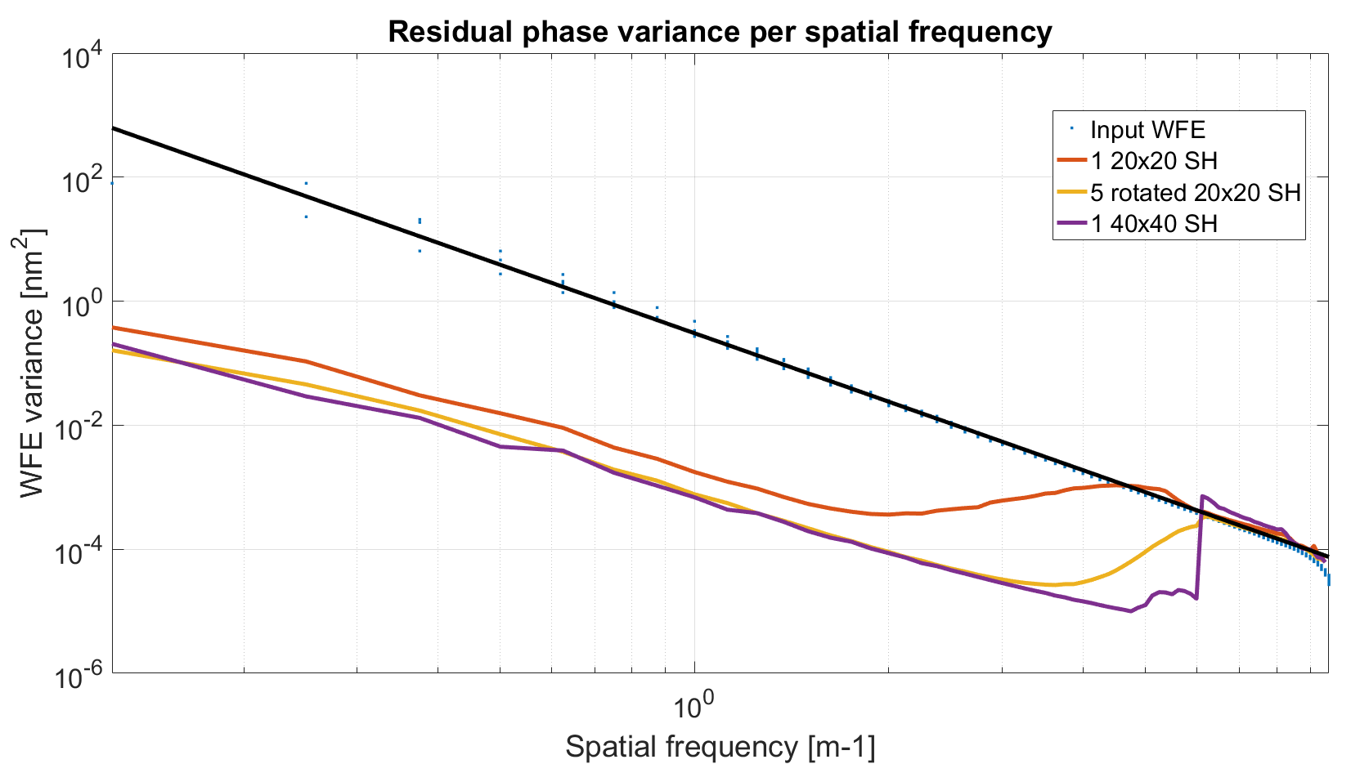
Monolayer reconstruction with MV

Slide 27
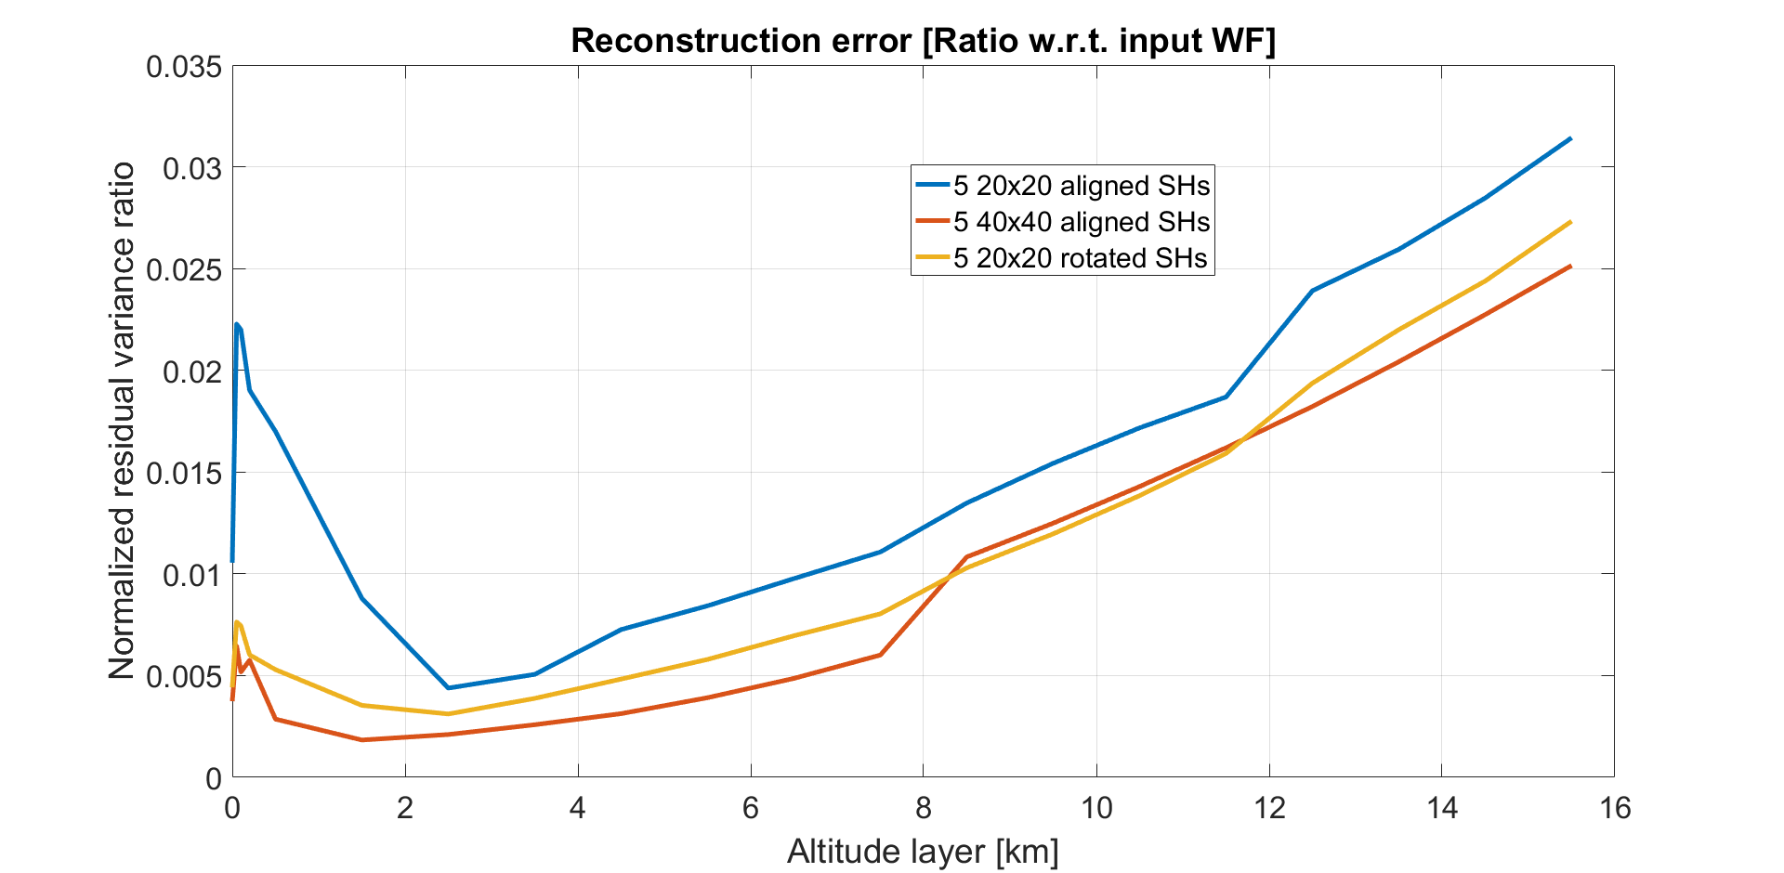
LGS tomographic reconstruction open loop minimum variance
The shifted 20x20 case performs well across the first 2 km altitude
Then, superresolution is built in for all cases which behave similarly

Slide 28

WF sampling by a grid
Classically, SH WFS are designed with a square grid of subapertures with the following assumptions:
Regular spacing of the subaperture (dirac comb sampling)
Sampling period equal to subaperture size (top hat)
The SH measurement operator in Fourier space is:
$$M\left(s\right)=s.sinc(πds)∗{III}_{\frac{1}{T}}\left(s\right)$$
Combining geometrically 4 SHs shifted by half a subaperture in X and Y can be considered as a meta SH WFS with:
Regular spacing of the subaperture (dirac comb)
Sampling period twice shorter → less aliasing
Same subaperture shape and size → same sensitivity
This way, we can decouple the subaperture size from the sampling period in our designs
Sampling function
Sensitivity function
Subaperture size
Sampling period
T=d/N

Slide 29
Benefit and next steps
For MAORY, going to 40x40 subapertures would bring the following obvious benefits:
20x20 pixels per subaperture → no truncation and better linearity
Flux per subaperture x 4
RTC MVM complexity ~ /4
Super-resolution seems well suited for wide field AO, e.g. 7’ NGS GLAO mode with few subapertures (20x20 ?)
Multi WFS AO systems may not want to correct misregistrations but just measure them accurately
Next steps:
Aliasing reduction: analytical evaluation
End-to-end model for MAORY and trade-off on subaperture number
Try to find why it does not work …

Slide 30
Thank you for your attention !

