Slide 1
Quasar Death
Martin Elvis
Charles L. Steinhardt¹, Heng Hao², Monica Young³,
Guido Risaliti⁴, Francesca Civano
Harvard-Smithsonian Center for Astrophysics
and 1. IPMU, Univ. Tokyo; 2. SISSA, 3. Penn State Univ.; 4. INAF, Arcetri, Italy

Slide 2
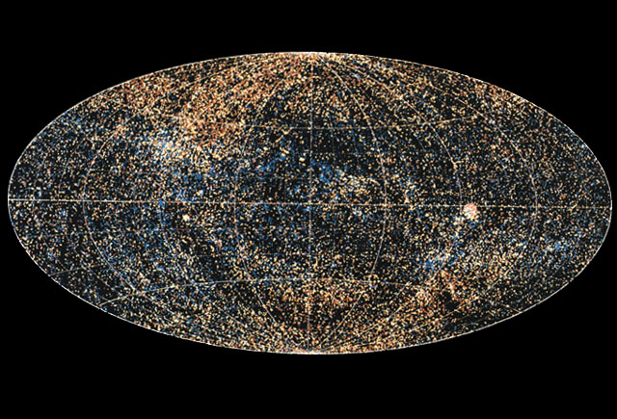
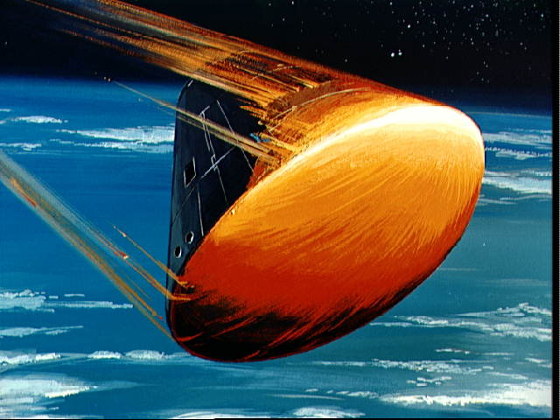
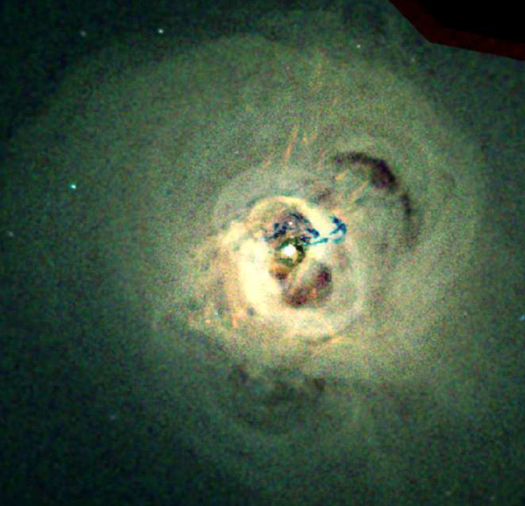
Why Study Quasars?
Astronomy:
100,000 quasars
in the ROSAT
X-ray sky
Astrophysics:
Gravity powered
Not fusion.
Cosmology:
Co-evolution of galaxies and supermassive black holes
Physics:
Relativistic jets
Reynolds C.
Light bending near the
Event horizon

Slide 3
The 7 Ages of Supermassive Black Holes
Birth
Rapid growth – by z=7
Merger growth
Quasar growth – Soltan
Radio Mode
Quasar Death - turn-off
Quiescence
Ignorant
No data
Know a little
Think we know quite a bit
Know a little
Ignorant
Know a little
Notes:
Pop III, Direct (quasistars), primordial 2. Super Edd to get 2e9 in 450Myr [TBR]

Slide 4
The Quasar Standard Model

Slide 5
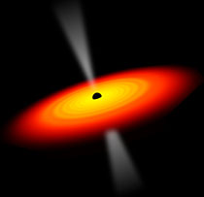
The Quasar Standard Model
massive black hole
Lynden-Bell 1969
accretion disk
Lynden-Bell 1969, Pringle & Rees 1972,
Shakura & Sunyaev 1972
relativistic jet
Rees 1967 [PhD],
Blandford & Rees 1974

Slide 6
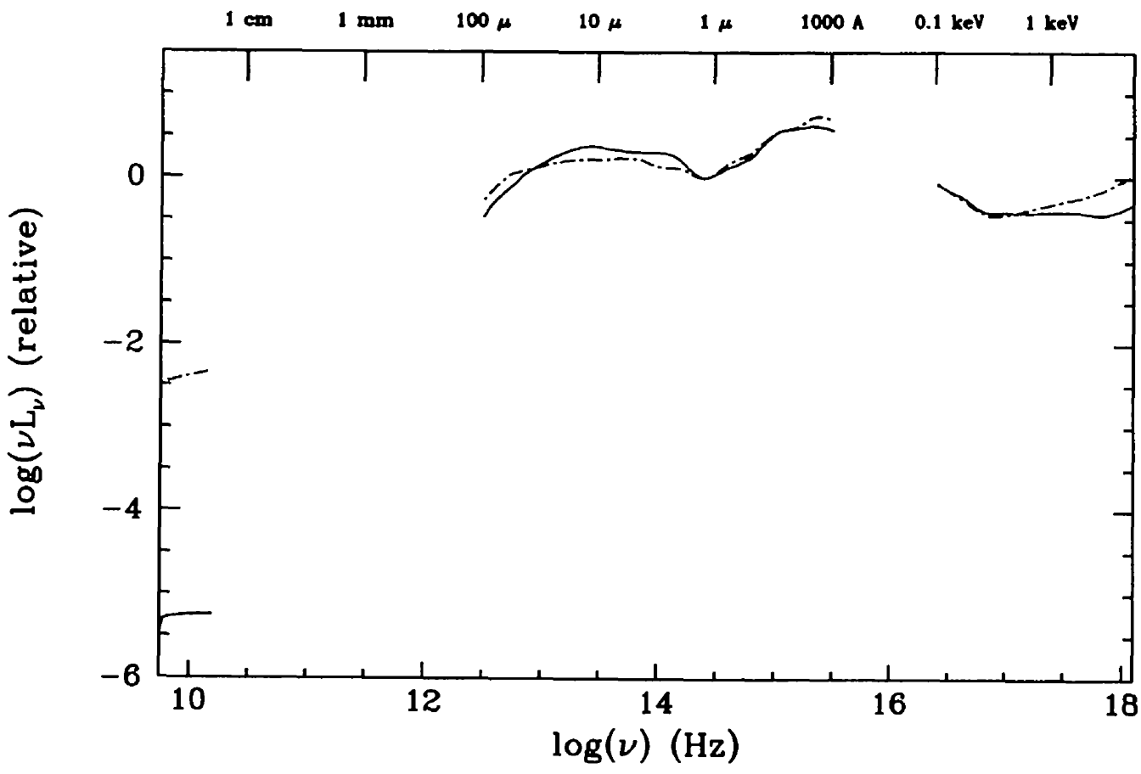
The quasar Spectral Energy Distribution (SED)
Elvis et al. 1994 ApJS, 95., 1 ( 1001 citations on 10 Dec 2010 )
Temperature: accretion disk
Radio
IR
Opt/UV
EUV
X-ray
1 dex
Luminosity: Massive Black Hole
α_{ox}
Elvis et al. 1994 mean SED works in 90% of Quasars
(Hao et al. 2011, Harvard PhD 2011)
Quasar Growth physics is invariant with z, L, L/L_{Edd}
Relativisitic Jet: synchrotron
19
Notes:
6

Slide 7
The quasar Standard Model
No prediction of:
Atomic Features
Maximally Hot dust
X-rays
Evolution
massive black hole
Lynden-Bell 1969
accretion disk
Lynden-Bell 1969, Pringle & Rees 1972,
Shakura & Sunyaev 1972
relativistic jet
Rees 1967 [PhD],
Blandford & Rees 1974

Slide 8
Age 4: Quasar Growth

Slide 9
Luminosity Function Evolution
Traditional approach
SDSS Richards et al. (2006)

Slide 10
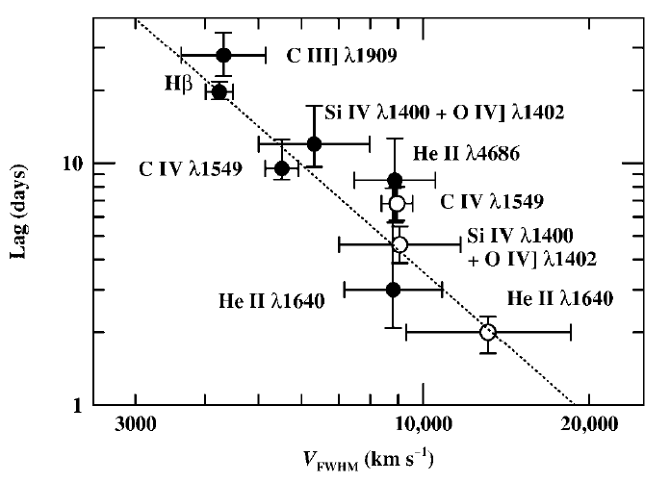
Quasar Black Hole Masses
v²r=const
Keplerian
v²r= GM
Keplerian
R=L^{1/2}
1
v2r
Black
Hole
Mass
R (cm)
1
2
MASS
From a single spectrum
Vestergaard, 2002 ApJ 571,733
Lag (days)
R( r_{g} )
2
FWHM
Peterson & Wandel 1999
Peterson et al. 1993, PASP, 105, 247;
2006MmSAI..77..581P
Notes:
>50,000 M_{BH} from SDSS

Slide 11
Black Hole Mass Function vs. Redshift
z=2.8
Age=2.3Gyr
Downsizing
z=1.25 Age=4.9Gyr
○
○
○
○
○
◆
◆
◆
○
◆
High Mass
Black Holes
Turn off
◆
○
Vestergaard et al. (2008)

Slide 12
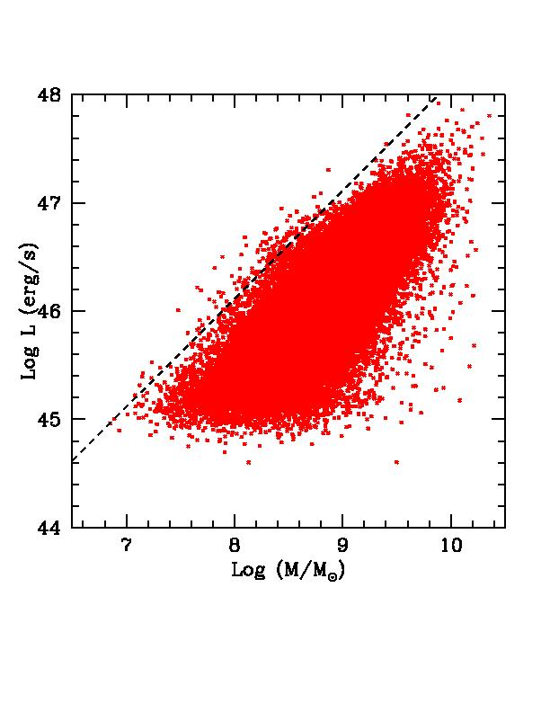
The Quasar Mass-Luminosity Plane
Charles Steinhardt, Harvard PhD Thesis 2010
L=L_{Edd}
Luminosity
SDSS DR5, all z‏
Mass
Kollmeier et al. 2006
Steinhardt & Elvis 2010

Slide 13
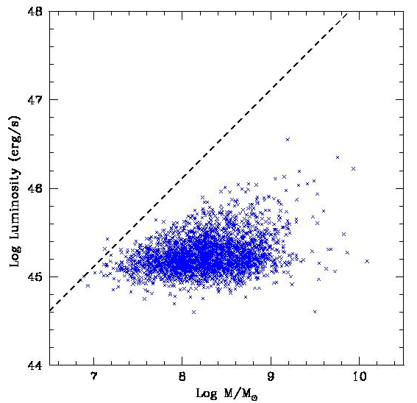
One M-L slice in redshift
L=L_{Edd}
0.2 < z < 0.4, H‏
SDSS Saturation
Luminosity
Detection Limit
Steinhardt & Elvis 2010
MNRAS, 402, 2637
Mass

Slide 14
More physics than just L_{edd}
Longer BH growth times
Harder ‘Rapid Growth’ problem
One long ‘on-phase’ allowed?
Not episodic outbursts?
L=L_{Edd}
0.2 < z < 0.4, Hβ‏
~0.5dex
Luminosity
Sub-Edd Boundary
Detection Limit
Steinhardt & Elvis 2010
MNRAS, 402, 2637
Mass

Slide 15
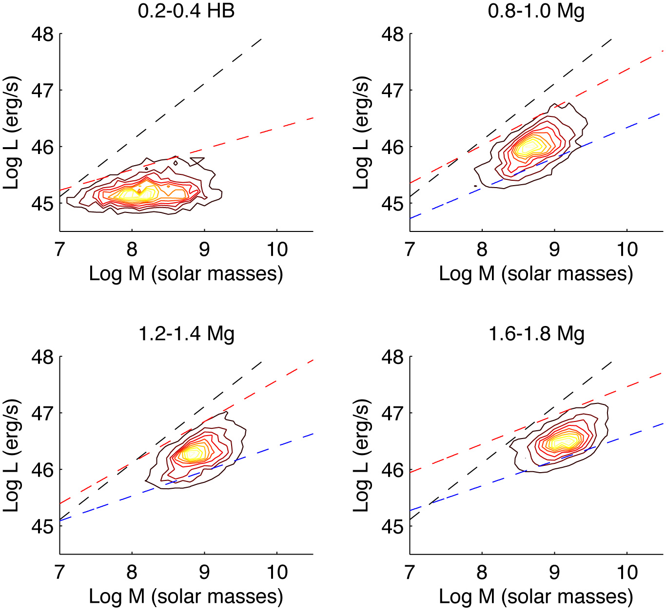
Supermassive Black Holes Know about Cosmic Time
Boundary moves to higher mass at higher redshift
Not just accretion disk physics
Low z
Steinhardt & Elvis 2010
MNRAS, 402, 2637
High z

Slide 16
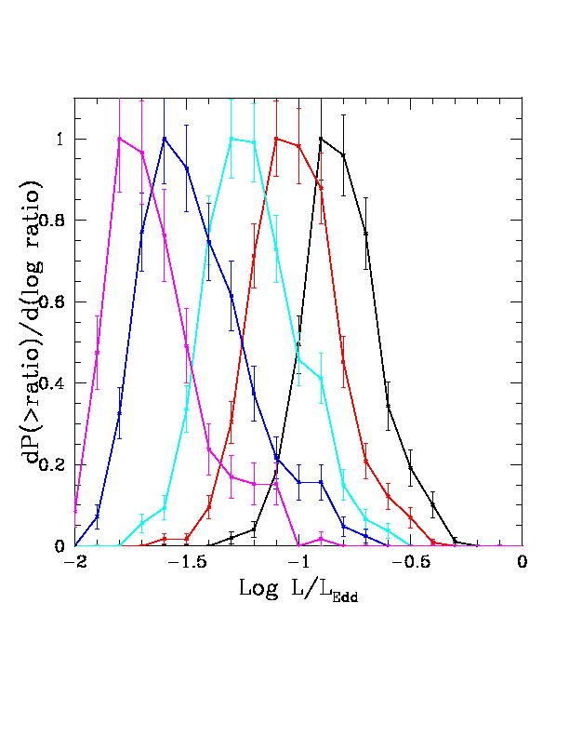
Whole Population affected
L/L_{Edd} distribution vs. Mass
Vertical cuts in M-L plane
High
mass
Low
mass
Left side of each curve is incomplete
Normalized to peak
0.2<z<0.4
Notes:
What was expected?

Slide 17
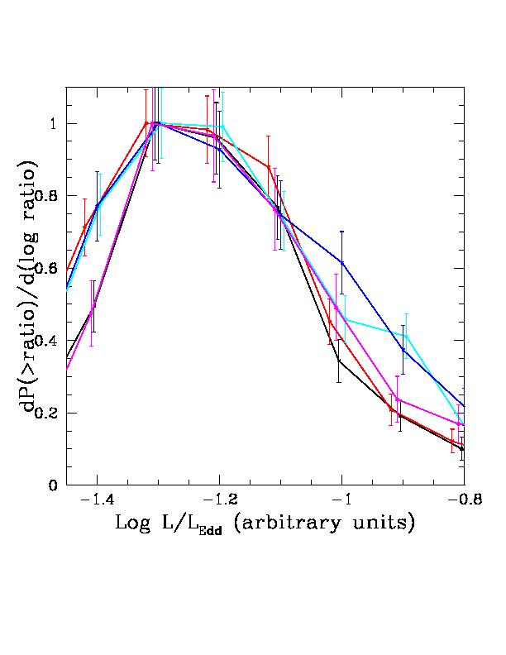
Narrow L/L_{edd} Distribution at fixed redshift, Mass
Common form
Narrow L/L_{Edd} range
Comparable to variability
Intrinsic range is small
= Characteristic L//l_{Edd} at each (M,z)
Are Quasars “Standard candles” after all?
Normalized to peak
~0.3 dex
Incomplete
Notes:
What was expected?

Slide 18
More Complex Quasar Growth phase
Not all quasars can radiate at the Eddington limit
Highest mass quasars at each z are sub-Eddington
SMBH knows about cosmic time
Boundaries move with z
Quasars may not be episodic
Could have a single long on-phase
At each (z,M) there is a characteristic L/L_{Edd}
“Standard Candles”?

Slide 19
Age 6: Quasar Death

Slide 20
Quasar Death: High mass SMBH don’t come back
L=L_{Edd}
Quasar Death line
Luminosity
Sub-Edd Boundary
Detection Limit
0.2 < z < 0.4, Hβ‏
Mass

Slide 21
L=L_{Edd}
Upper Mass Limit
Luminosity
Sub-Edd Boundary
SDSS detection Limit
Mass

Slide 22
Death line moves to higher mass with redshift
In each redshift bin, the highest mass quasars “die” by the next Δz=0.2 bin
Co-ordinated demise: Quasars know about cosmic time
Quasar Death line
1 Gyr

Slide 23
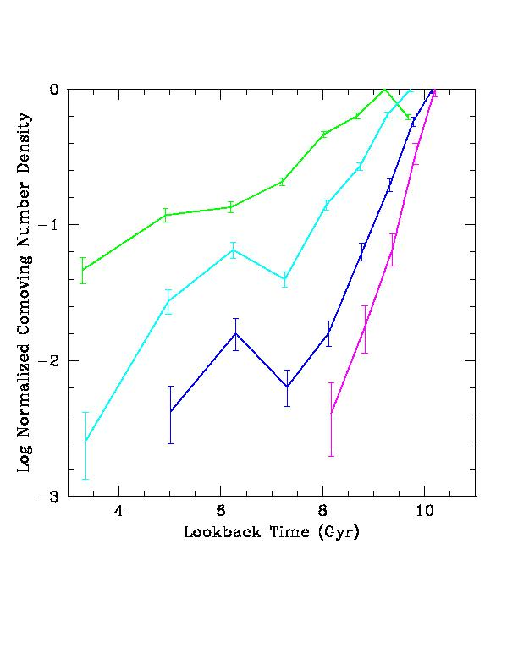
decline rate of number density depends on mass
Log M (solar)
9.75-10.0
Low Mass
low M
9.50-9.75
9.25-9.50
9.00-9.25
High Mass
high M
Steinhardt & Elvis, 2011MNRAS.410..201S

Slide 24
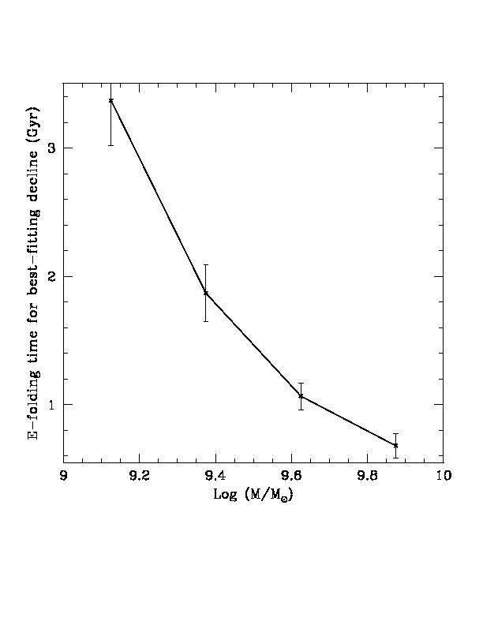
A rapid demise
Coordinated to <0.7Gyr @ highest Masses
Set up at z>~10? (Age < 0.5 Gyr)
Declines faster than galaxy mergers?
N(t) = N₀e^{-t/τ(M)}
τ Gyr
1 Gyr
9.0
10
log M/Msol
Steinhardt & Elvis, 2011MNRAS.410..201S

Slide 25
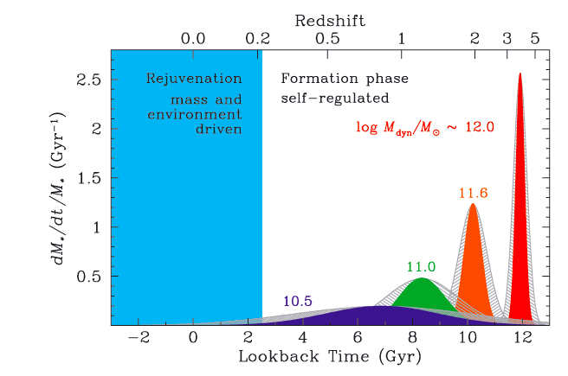
Brief High z Star Formation In Massive Galaxies
FWHM~100Myr
Thomas et al., 2010, MNRAS, 404, 1775

Slide 26
The Quasar ‘Dying Zone’
L=L_{Edd}
Quasar Death line
Luminosity
Sub-Edd Boundary
Detection Limit
0.2 < z < 0.4, Hβ‏
Mass

Slide 27
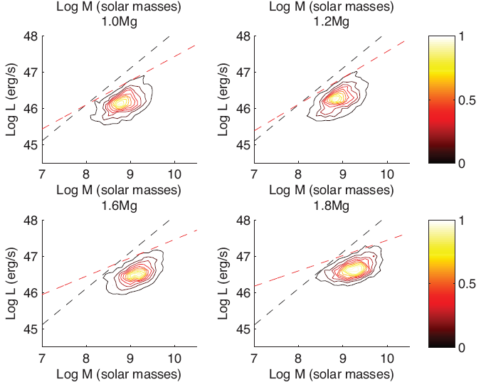
Intrinsically red quasars lie in dying zone
Monica Young, Boston University PhD Thesis 2010
z = 1-1.2
z = 1.2-1.4
5/7 Red Quasars lie in “turn-off” region
z = 1.8-2.0
Young, Steinhardt et al. 2011, in prep.
Notes:
3rd contour corresponds to 20% of number density

Slide 28
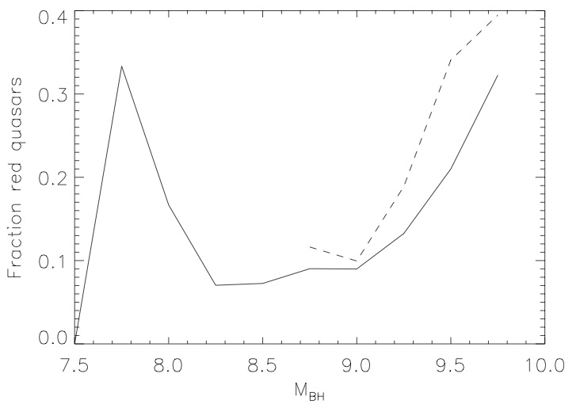
Dying (red) Quasars common at highest masses
1.5 < z < 1.7‏
35%
δ(g - i) > 0.3
L<0.1L_{Edd}
25%
Red Quasar Fraction
Mass
Young, Steinhardt et al. 2010, in prep.

Slide 29
Quasars die first in UV
Strong CIV
z = 1-1.2
Weak CIV
z = 1.2-1.4
Larger MgII/CIV at high masses
Weaker/softer ionizing continuum?
logM
8.0
9.0
9.5
z~2
Steinhardt & Elvis,
2011MNRAS.410..201S

Slide 30
Low accretion rates in the dying zone
Monica Young, Boston University PhD Thesis 2010
Model NOT fit (only normalized)
Low mdot → low disk temperature
T α (M_{BH}.mdot) ^{-1/4}
How are emission lines powered?
Typical quasar
(Elvis+94)
Toy model
Young, Risaliti & Elvis 2008, ApJ, 688, 128
+ Young, et al., in prep.
Notes:
30
JHK, corrected for Halpha and host galaxy
optical spectrum + photometry
UV points corrected for Lyalpha

Slide 31
First Clues to Quasar Death
Highest mass quasars at each z fail to reach Eddington limit
Quasars die off rapidly above a critical mass at each z
Death line moves down in mass toward present
Starving the accretion disk may fit ‘dying quasars’

Slide 32
Age 2: Early Rapid Growth

Slide 33
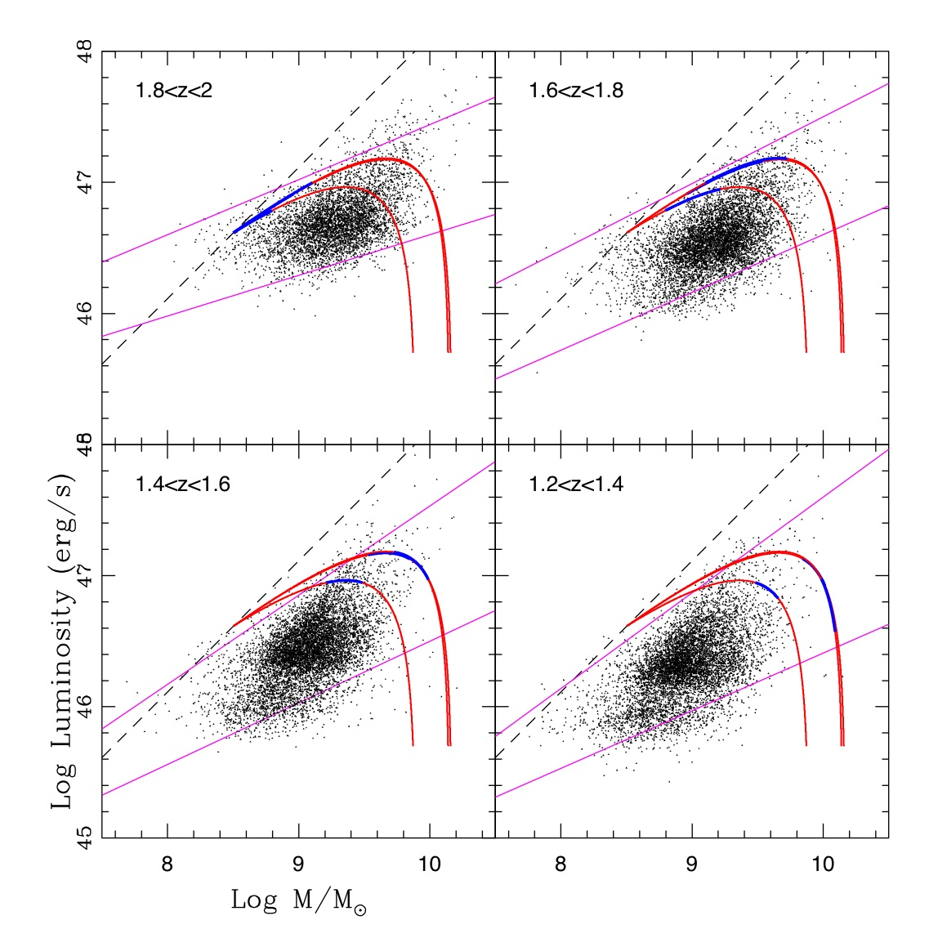
Evolutionary Tracks for Individual Quasars
Initial
Mass
1,3Gyr
Steinhardt, Elvis & Amarie, 2011 MNRAS in press, astro-ph/1103.4608

Slide 34
Tightly Constrained tracks
Δ 20%
Δ 20%
t₀
Mass
Luminosity
M₀
0.5 dex
κ
α
Mass
Time
κ = L/mdot = ε/lifetime
Steinhardt, Elvis & Amarie, 2011 MNRAS in press, astro-ph/1103.4608

Slide 35
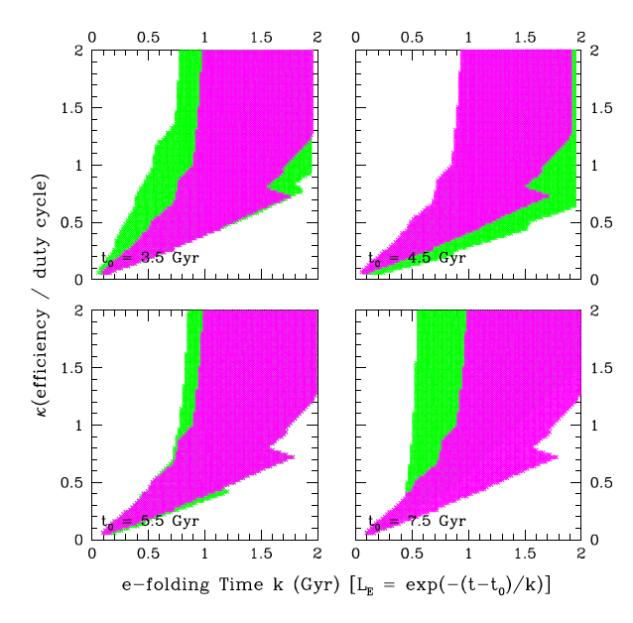
A Single Track for all SMBH?
κ small: non-luminous growth dominates, but anti-Soltan
κ large: slow growth, smaller turn-off masses
κ = L/mdot = ε/lifetime
Steinhardt, Elvis & Amarie, 2011 MNRAS in press, astro-ph/1103.4608

Slide 36
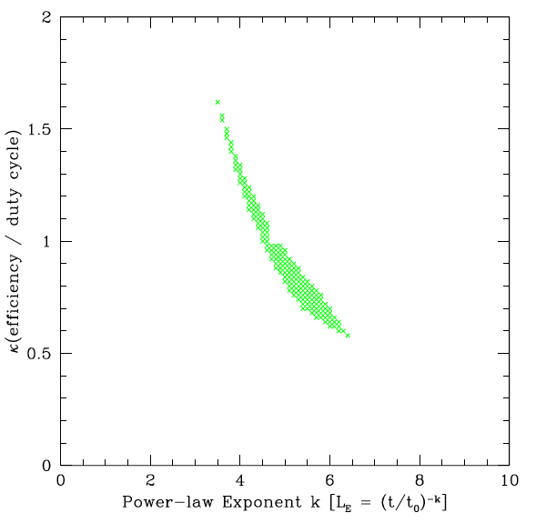
A single track for ALL Quasars ?
MgII masses only
z>0.8, t₀ < 6 Gyr
Invert to give SMBH Initial Mass Function?
: >0.2dex from boundary
Interpolation issues
No exponential solutions
Steinhardt, Elvis & Amarie, 2010 MNRAS in press, astro-ph/1103.4608

Slide 37
First Clues to Quasar Initial growth
Quasars must stay within M,L locus
Simple evolutionary tracks can achieve this
A single evolutionary track for all quasars is allowed
Invert to get SMBH IMF?

Slide 38
The 7 Ages of Supermassive Black Holes: What have we learned?
Birth
Rapid growth
Merger growth
Quasar growth
Radio Mode
Quasar Death
Quiescence
Ignorant
Initial Mass Function?
No data
Know a little
L ≠ L_{edd}; knows z; standard candle?
Think we know quite a bit
Know a little
Rapid, coordinated; starvation?
Ignorant
Know a little
Quasar Mass-Luminosity Plane is a valuable tool
Notes:
Pop III, Direct (quasistars), primordial 2. Super Edd to get 2e9 in 450Myr [TBR]

Slide 39
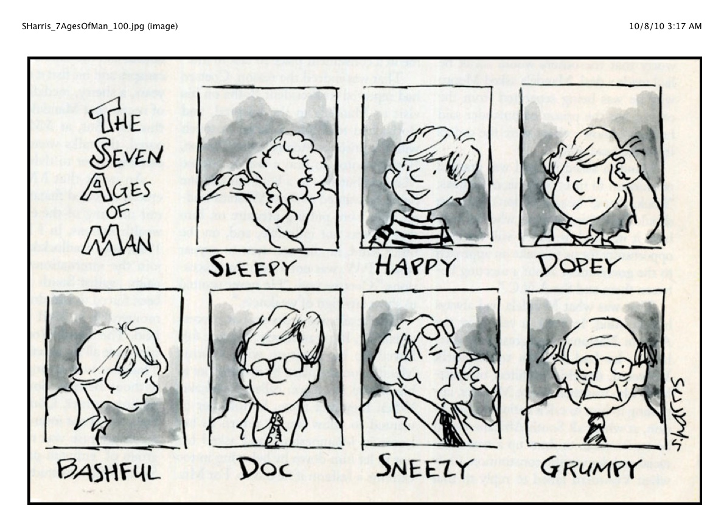
The Seven ages of man
All the world's a stage, And all the men and women merely players; They have their exits and their entrances; And one man in his time plays many parts, His acts being seven ages. At first the infant, Mewling and puking in the nurse's arms; And then the whining school-boy, with his satchel And shining morning face, creeping like snail Unwillingly to school. And then the lover, Sighing like furnace, with a woeful ballad Made to his mistress' eyebrow. Then a soldier, Full of strange oaths, and bearded like the pard, Jealous in honour, sudden and quick in quarrel, Seeking the bubble reputation Even in the cannon's mouth. And then the justice, In fair round belly with good capon lin'd, With eyes severe and beard of formal cut, Full of wise saws and modern instances; And so he plays his part. The sixth age shifts Into the lean and slipper'd pantaloon, With spectacles on nose and pouch on side; His youthful hose, well sav'd, a world too wide For his shrunk shank; and his big manly voice, Turning again toward childish treble, pipes And whistles in his sound. Last scene of all, That ends this strange eventful history, Is second childishness and mere oblivion; Sans teeth, sans eyes, sans taste, sans everything.
Jaques;
As You Like It,
Act II, Scene VII, lines 139-166’
William Shakespeare
S. Harris

Slide 40
Postscript: Accretion Disk Winds

Slide 41
Atomic Features in Quasar Spectra
None are predicted by the Quasar Standard Model
High ionization BELs
e.g. CIV, OVI
Low ionization BELs
e.g. MgII, Hβ.

Slide 42
Radiation Driving Determines Quasar Structure
Elvis 2000ApJ...545...63E; Risaliti & Elvis, 2010, A&A 516, A 89
High
Ionization
Absorber
Warm
Absorber/
High ionization
BLR
Cold
Eclipsers/
Low
ionization
BLR
Slow
Cold
Eclipsers
NLR
Bicones
Broad Absorption Lines
(failed)
electron-
scattering
wind
Line-Driven
wind
Failed
wind
Dust-Driven
Wind

Slide 43
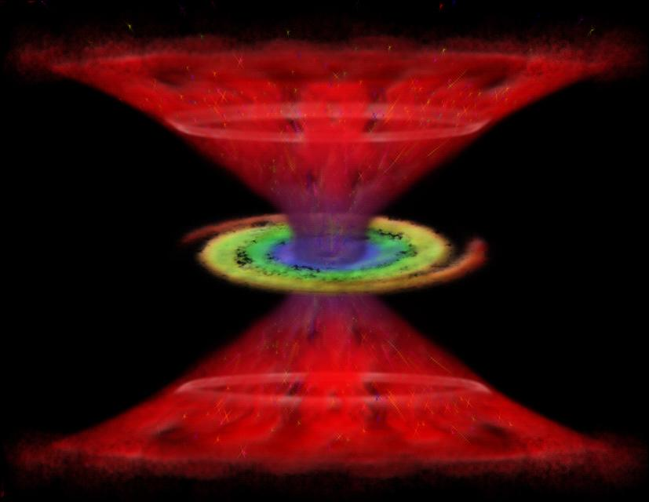
Accretion Disk Winds: the 4th Element
Explains ALL Emission & Absorption Lines
Explains: Broad, Narrow Absorption Lines, High Ionization Emission Lines, hot dust
Still no prediction of:
X-rays
Evolution: The 7 Ages of BH
massive black hole
Lynden-Bell 1969
accretion disk
Lynden-Bell 1969, Pringle & Rees 1972,
Shakura & Sunyaev 1972
relativistic jet
Rees 1967 [PhD],
Blandford & Rees 1974
disk winds
Murray et al., 1995
Elvis 2000
Nenkova et al., 2008

Slide 44
PS2: Merger Growth

Slide 45
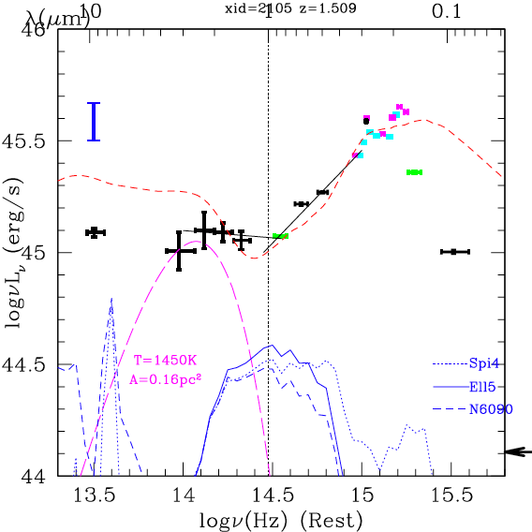
Merger Growth: Hot-Dust Poor QUASARS
Heng Hao, Harvard PhD Thesis 2011
Hao et al. 2010 ApJ
Low Covering Factor (0.06-0.3)
Missing inner ‘torus’
z<1.5
4.9%±0.8%
1.5<z<3
15.9%±3%
Timing suggests merger-related cause:
Disrupted ‘torus’?
Outburst destroyed inner dust?
Merger ejected SMBH+disk+BLR, not ‘torus’? (Komossa & Merritt 2006; Guedes et al., 2010)
E94
0.3-0.6 dex

Slide 46
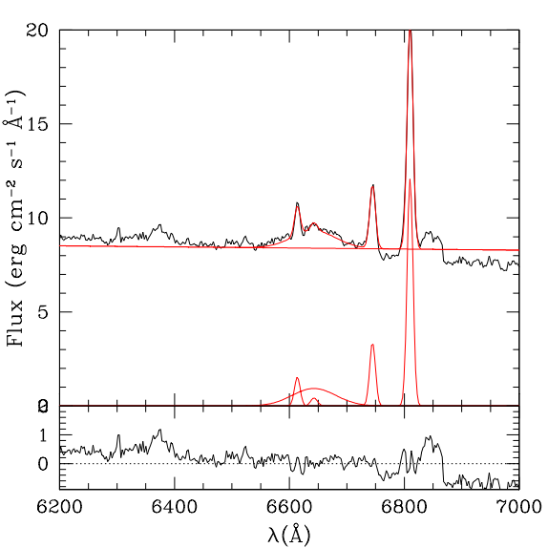
Merger Growth in action: a Recoiling Black Hole
Civano et al. 2010 ApJ
Chandra COSMOS source CID-42
[OΙΙΙ]
N
Hβ
z=0.359
E
Hβ
Off-nuclear source
Is the “AGN”
Δv=1180km/s
2.5kpc
by Eli Bressert
15”

